Slide 1
Corporate Valuation Workshop

Slide 2
Valuation Methods
Method 1: Using the current stock price
TECHNICAL METHODS (Methods 2 & 3):
Intrinsic value
Dividend Discount Model
FUNDAMENTAL METHODS (Methods 4 – 7)
Comparable method using Trading EBITDA Multiples
Comparable method using Acquisition EBITDA Multiples
Discount Cash Flow Method
Leveraged Buyout Private Equity Expectation Model
OTHER – SPECIAL CIRMUSTANCES (Method 8)
Using Black-Scholes Option Pricing Model to price the Enterprise Value post-bankruptcy (Fundamental)

Slide 3
Fundamental Method 4 – Trading EBITDA Multiples

Slide 4
Fundamental Method 5 – Acquisition EBITDA Multiples

Slide 5
Fundamental Method 6 – DCF Analysis

Slide 6
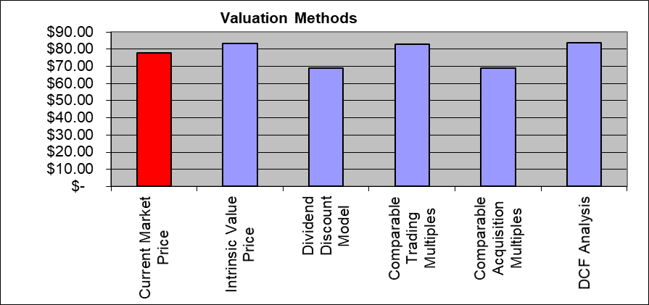
Comparative Analysis on methods 1-6

Slide 7
Method #7: Using the LBO Model – based on Investor Expectation
Case Study Workshop:
The Case:
Celerity Tech Inc. has been in the tech services businesses for a little more than 3 years growing at relatively fast pace though customer acquisition. The founders and current owners of Celerity Tech are looking at various options for expansion including bringing a new a private equity investor that has the expertise and network of customers. The valuations using typical conventional methods values the company $5.3 million or 12x last year’s $443,000 EBITDA.

Slide 8
Method #7: Using the LBO Model – based on Investor Expectation

Slide 9
Method #7: Using the LBO Model – based on Investor Expectation

Slide 10
Method #7: Using the LBO Model – based on Investor Expectation

