Slide 1
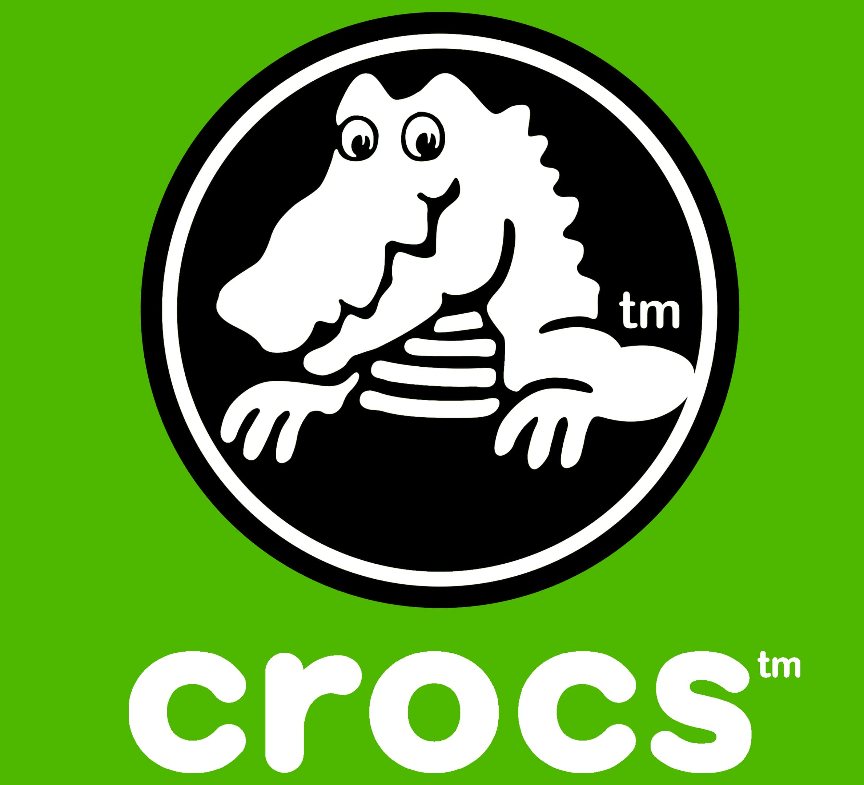
PROPOSED LBO OF CROCS, INC. (“CROX”)
Seton Hall University
February 21, 2026

Slide 2
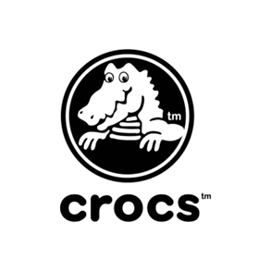
Executive Summary
Target Overview
  Crocs is globally recognized footwear brand with strong customer loyalty
  Consistent free cash flow generation, high margins, and low capital intensity
Entry Valuation & Leverage
  Attractive entry at ~8.0x EBITDA
  Starting a moderate leverage of ~4.6x, supporting rapid deleveraging
  Discounted valuation relative to peers
  Conservative operating assumptions (Base, Upside and Downside cases) generate compelling risk-adjusted returns
Recommended Offer
  $120 per share, representing:
    ~30% premium to 1-year average price
    ~20% premium to current trading price (post-earnings increase)

Slide 3
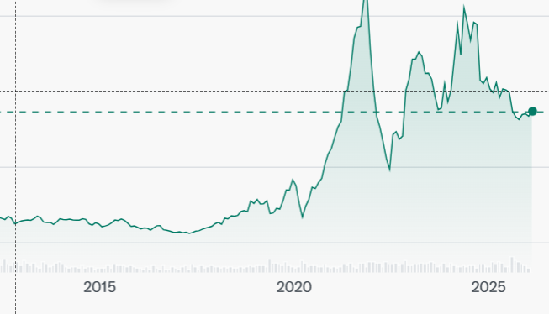
The Story
Historically volatile, fad-driven footwear brand
Massive 2020–2022 resurgence
Post-peak normalization -temporary fad
HEYDUDE acquisition
Business is structurally stronger today: high-margin, asset-light model with durable free cash flow
Brand momentum returning via scalable partnerships instead of one-off celebrity hype

Slide 4
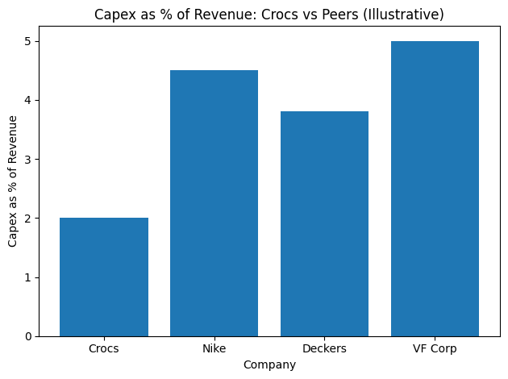
Investment Thesis
Strong and steady cash flow supported by a global brand and repeat customers
High margins
Capital-light, outsourced manufacturing model
Low capex
Multiple exit options
Plan to diversify the product
International expansion
-19% gain after earnings

Slide 5
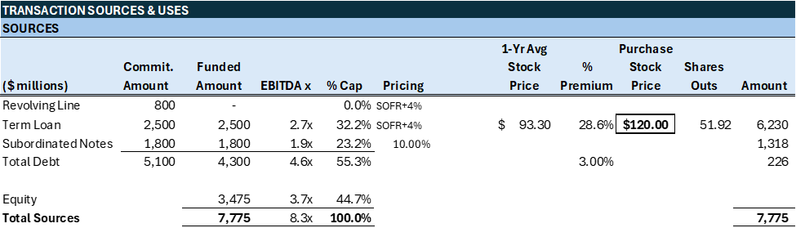
Transaction Sources & Uses & Proforma Capital Structure
Notes:
The stock avrgage last year traded around 93 paying 30% premumum 6 bil to buy all shares pluse debt and fees 3 b term loan and 800 m revoloving fro spending and 1.8 b total leverage 4.4 times = debt to ebidta

Slide 6
Debt Structure & Key Terms
 | REVOLVING CREDIT | TERM LOAN B | SUBORDINATED NOTES
Amount | 800,000,000 | 2,500,000,000 | 1,800,000,000
Rate | SOFR + 4.0% Commitment Fee: 0.5% | SOFR + 4.0% | 10% Fixed
Term | 5 Years - Renewable | 7 Years | 10 Years
Scheduled Amortization | No Amortization | 1.0% Yrs1-6, 94.0% yr 7 | 0.0% Yrs 0-9, 100% yr 10
Purpose | Working Capital | Fund the LBO | Fund the LBO
Financial Covenants | Max Leverage Ratio Min Interest Coverage | Max Leverage Ratio Min Interest Coverage | No Financial Covenants
Negative Covenants | No Dividends Debt Incurrence Limitation Change in Control |  | Change in Control
Affirmative Covenants | Quarterly & Annual Financial Statements, Compliance
Expected Rate | B+/B1 | B+/B1 | B/B2

Slide 7
Business Overview
Crocs, Inc. (NASDAQ: CROX) is a global casual footwear company built around comfort, lightweight materials, and strong brand engagement.
Founded in 2002; headquartered in Broomfield, Colorado
Publicly traded on NASDAQ (CROX)
Operates a two-brand portfolio:
  Crocs (core brand)
  HEYDUDE (acquired 2022)
Sells in 85+ countries through wholesale, owned retail, and e-commerce
Asset-light model with outsourced manufacturing.
Crocs has evolved from a niche clog brand into a scaled, global casual footwear platform with strong digital and international reach.
Notes:
Change this around

Slide 8
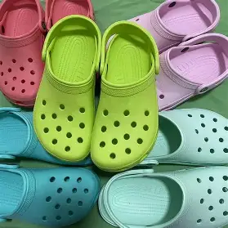
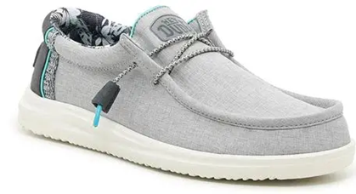
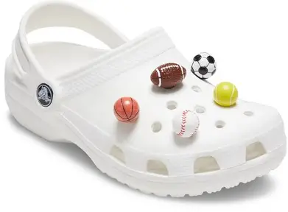
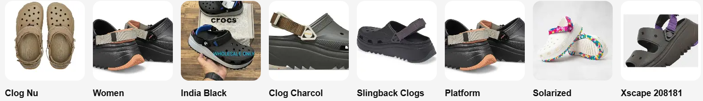
Product Portfolio
The Crocs brand drives scale and margin, while HEYDUDE broadens consumer occasions through lightweight casual footwear. Crocs owns the functional comfort of the wet and messy world, while HEYDUDE provides the lifestyle comfort of the dry and social world.
HEYDUDE Brand:
$715M | 17.7% total revenue
Crocs Brand: Core Growth Engine
$3.33B | 82.3% total revenue
Jibbitz™ charms

Slide 9
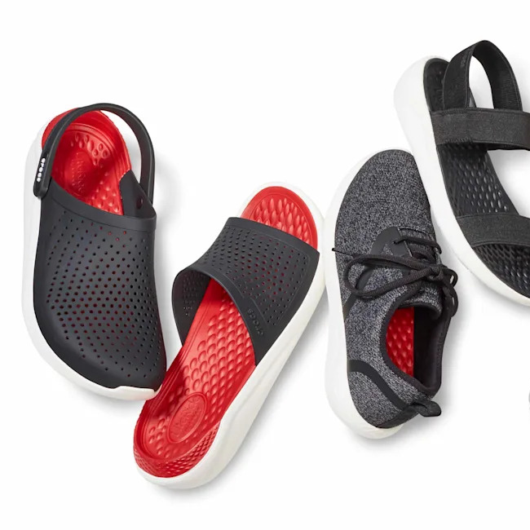
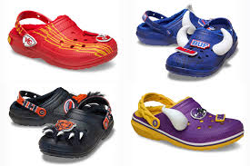
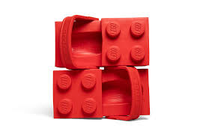
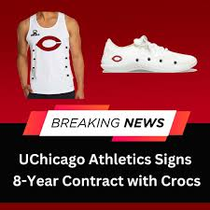
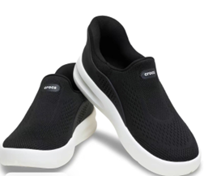
Incoming Products
Expanding into sneakers, boots, sandals and comfort shoes
NFL partnership driving licensed fan footwear
NCAA deals expanding collegiate-themed shoe lines
Lightweight walking shoe
Notes:
Change this around

Slide 10
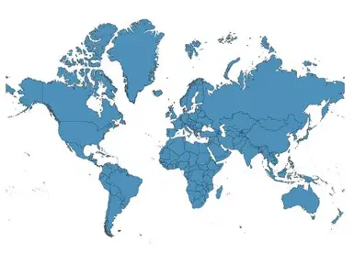
Revenue Mix: Geography
Sells in 85+ countries through wholesale, owned retail, and e-commerce
While North America anchors revenue today, international markets particularly Asia represent meaningful upside.
North America, FY25, Croc's brand revenues decreased 6.8% to $1,710 million
International (Asia, EMEA, LATAM), FY25, Crocs brand revenues increased 11.9% to $1,616 million.
International Contribution: By 2025, international sales grew to represent 48.6% of total Crocs brand revenue ($1,616M out of $3,326M), as domestic North American sales began to soften in 2025.
China saw triple-digit growth in early 2024 and finished the year with over a 70% increase, outperforming all other major regions, and continued to increase into 2025.
Notes:
Change speaking notes to 2025 ( not 2024 )
In North America, Crocs brand revenue declined 6.8% in FY25 to $1.71 billion, reflecting softer domestic demand.
• In contrast, international markets — including Asia, EMEA, and Latin America — grew 11.9% to $1.62 billion, showing strong momentum outside the U.S.
• By 2025, international sales made up 48.6% of total Crocs brand revenue, nearly half of the business.
• This shift highlights two things: first, domestic sales are moderating, and second, international markets are becoming a key growth driver.
• From an LBO perspective, this geographic diversification supports the upside case and reduces reliance on a single consumer market.
China alone grew 64% in 2024, outperforming all other regions.

Slide 11
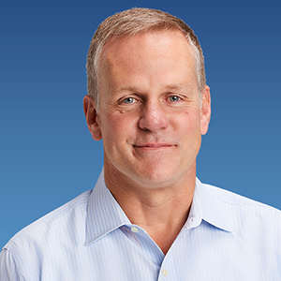

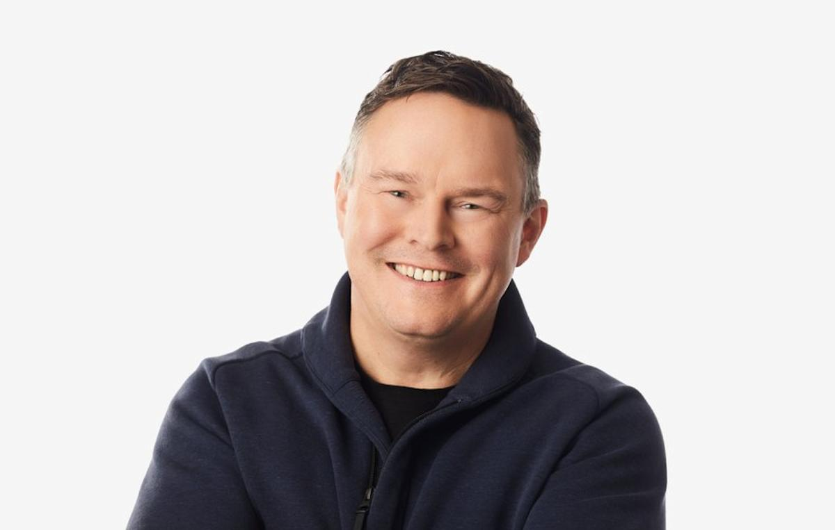
Management Overview
Experienced, Shareholder-Oriented Leadership Team Driving Scalable Growth
Andrew Rees Chief Executive Officer​
CEO since 2017; previously President.
Led brand transformation from niche clog brand to global lifestyle platform.
Oversaw international expansion and DTC acceleration.
Successfully executed and integrated the HEYDUDE acquisition (2022).
Terrence Reilly, Chief Brand Officer
Joined Crocs in 2013 as Chief Marketing Officer and successfully repositioned the brand, transforming its foam clogs into a culturally relevant and “cool” product.
Departed in 2020 to Stanley, where he turned an oversized water bottle into a must-have consumer item through sharp brand positioning and demand creation.
Patraic Reagan Chief Financial Officer
Appointed September 2025
Served as Chief Financial Officer of SharkNinja, Inc., a global product design and technology company, and previously held senior finance leadership roles at Nike, Inc., bringing extensive global consumer brand experience.
Notes:
Change speaking notes to 2025 ( not 2024 )
In North America, Crocs brand revenue declined 6.8% in FY25 to $1.71 billion, reflecting softer domestic demand.
• In contrast, international markets — including Asia, EMEA, and Latin America — grew 11.9% to $1.62 billion, showing strong momentum outside the U.S.
• By 2025, international sales made up 48.6% of total Crocs brand revenue, nearly half of the business.
• This shift highlights two things: first, domestic sales are moderating, and second, international markets are becoming a key growth driver.
• From an LBO perspective, this geographic diversification supports the upside case and reduces reliance on a single consumer market.
China alone grew 64% in 2024, outperforming all other regions.

Slide 12
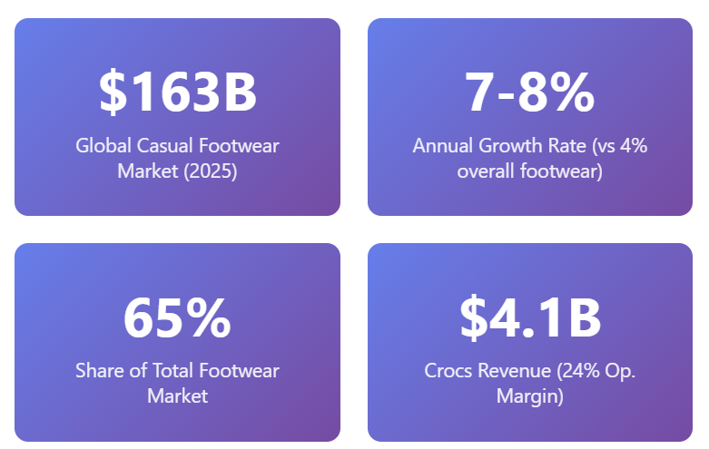
Industry Overview
Growing Market
Comfort is trending
High Barrier to Entry
Strong Profitability

Slide 13
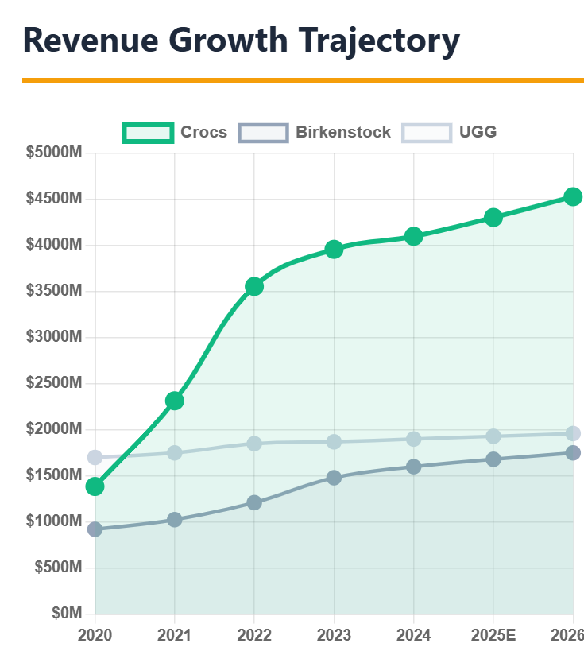
Competitive Landscape
Staple in The Comfort Market
Larger Revenue Base
Rapidly Outgrowing Competition

Slide 14
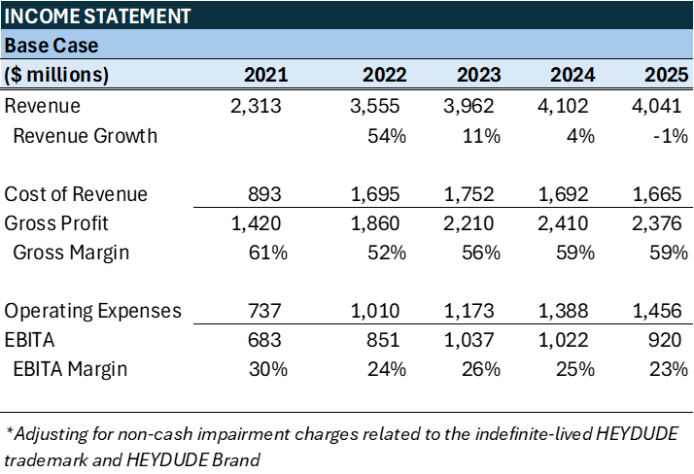
Historical Financial Performance
Revenue CAGR ~4%; 2022 revenue +54% driven by HeyDude acquisition. 2025 growth moderated following post-acquisition normalization
Gross margin dipped to 51% (2022) post-acquisition; recovered to ~59% (2024–2025)
EBITDA margin stable at ~25% average, demonstrating strong operating discipline
Notes:
Add Bullet points, get rid of amortization
In 2022, Crocs experienced a 54% revenue increase, largely attributable to the HEYDUDE acquisition, which significantly expanded the company’s scale and product portfolio.
• Growth then slowed and normalized, with revenue stabilizing around $4 billion in 2024–2025 — much higher than pre-2022 levels.
• Gross margins dipped in 2022 due to higher costs, but have recovered to a strong 59%, showing pricing power and cost control.
• While operating expenses increased, EBITA margins remain healthy at 23%, indicating strong profitability.
• Overall, Crocs has shifted from rapid growth to a stable, consistent cash-flow business, which is ideal for an LBO.

Slide 15
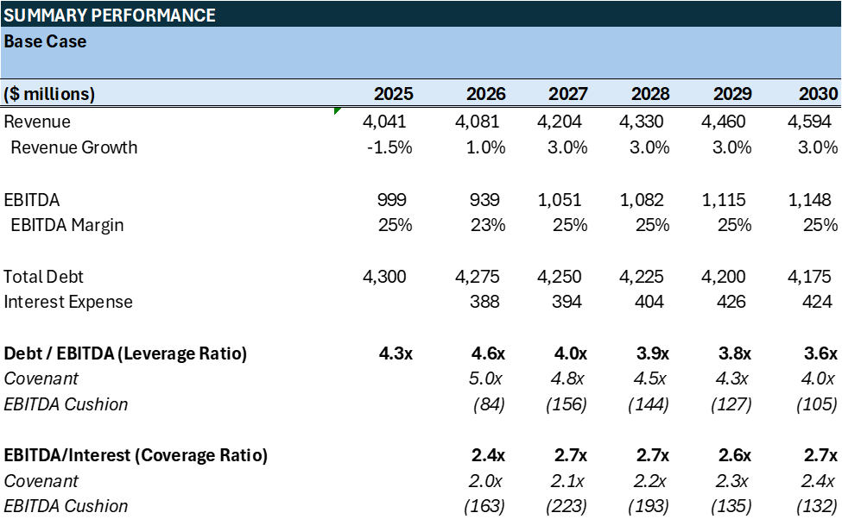
Projections - Base Case
2026 revenue growth at 1.0%, in line with latest company guidance
2027–2030 growth at 3.0% annually, slightly below historical average
EBITDA margin dips in 2027 due to new product launch costs and higher marketing spend, then normalizes thereafter
Base case reflects strong free cash flow generation, enabling accelerated deleveraging and comfortable headroom across all covenant tests.
Notes:
3-5 % growth from historical avergages in 2026 we increased the cost of revenue for more marketing will dip in 2026 due to expenditures more normalized average
The management recently announced a 1% revenue gain for 1% then we have a modest gain of 3% for our base case
We have a decline in gross margin due to new shoe expenses and Ebita for marketing expenses

Slide 16
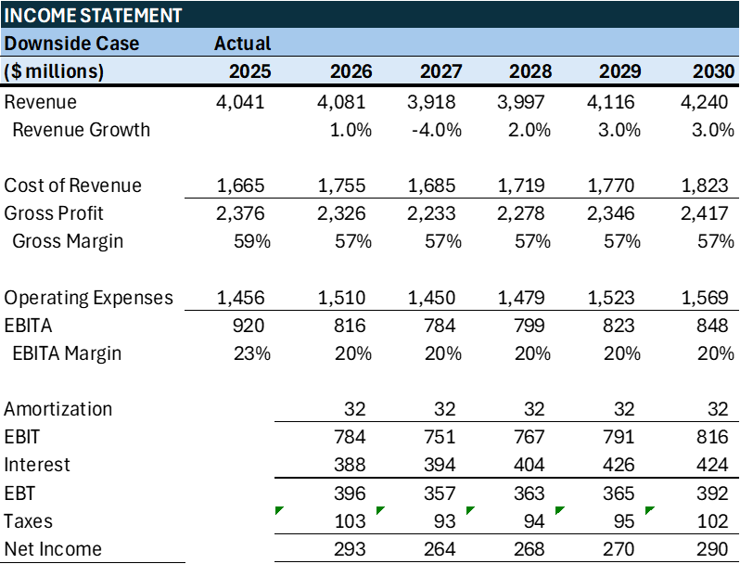

Projections - Downside & Upside Case
Notes:
In downside we will 6% decline due to tariffs and more economic conditions in upside we have new offering new products and high growth from new direction
We ran two diff case downside case embedded reflection of 4% decline due to embed recension and then back to normal revenue growth

Slide 17
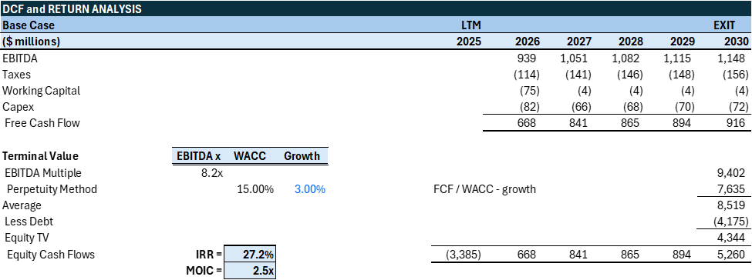
LBO Returns Summary
Notes:
Our base case prodjcetions project fcf using terminal value methons EBITDA and perp termnical value of 9 B subtracted debt get terminal value of 5 688 + 841+ 865+894+5260

Slide 18
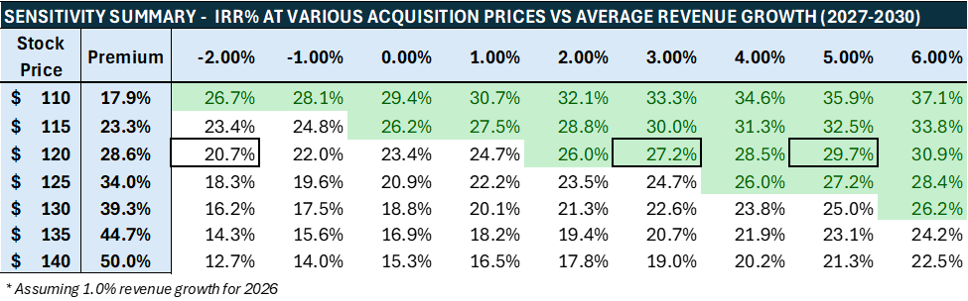
Sensitivity Analysis
This sensitivity chart shows that even with low growth expectations and acceptable paid premium for the stock the returns are very attractive

Slide 19
Risks & Mitigants
KEY RISKS | MITIGANTS
Fashion cyclicality Consumer preferences can shift quickly, leading to demand volatility and inventory risk. | Diversification Strong product innovation pipeline and expansion beyond core clogs into sandals, sneakers, and collaborations reduce reliance on a single trend cycle.
Brand concentration Heavy reliance on a flagship product or brand identity could expose earnings to saturation risk. | DTC economics Strong gross margins, owned digital ecosystem, and omni-channel integration enhance pricing power and customer lifetime value.
High Tariffs Exposure to trade policy changes and import duties could increase landed product costs, particularly in U.S. markets. | International Expansion Increasing international revenue mix and reduced dependence on U.S. domestic sales, along with diversified global sourcing, lowers concentration risk and limits tariff impact.
Notes:
Fashion cyclicality: Trends can shift quickly, creating demand volatility and inventory risk.
→ Crocs mitigates this through product diversification beyond clogs into sandals, sneakers, and collaborations.
• Brand concentration: Heavy reliance on a flagship product could create saturation risk.
→ Their strong direct-to-consumer model boosts margins, pricing power, and customer lifetime value.
• High tariffs: Trade policy changes could increase product costs, especially in the U.S.
→ International expansion and diversified sourcing reduce geographic concentration and help manage tariff exposure.
• Overall, while the risks are real, the business has clear structural mitigants that support stability and long-term value creation.

Slide 20
Exit Strategy & Recommendation
Target exit horizon: 3–5 years
  Exit Alternatives:
    IPO
    Strategic sale
    Secondary buyout
Exit Assumption:
  Multiple normalization toward peer median (8.0x EBITDA)
Investment Committee Recommendation:
  Proceed with acquisition
  Returns Profile:
    ~27% IRR and 2.5x MOIC in base case under conservative assumptions
    Downside supported by strong free cash flow generation
    Upside driven by operational improvement and modest multiple re-rating

Slide 21
Appendix
Transaction Sources & Uses
Base Case
Upside Case
Downside Case
Sensitivity Table

