Slide 1

Peloton Interactive, Inc.
History & Evolution
https://www.youtube.com/watch?v=-toUdF5wWq4&t=62s

Slide 2
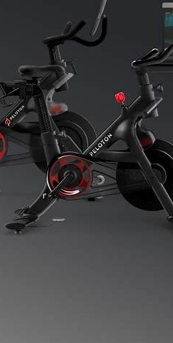
Founding & Early Years (2012–2014)
Founded in 2012 by John Foley & team (Cortese, Stanton, Kushi, Feng).
Vision: Bring boutique fitness studio experience to the home.
2013 Kickstarter: Raised $300,000+.
2014: First Peloton Bike launched (~$2,000) + subscription classes.

Slide 3

Rapid Growth & Expansion (2015–2019)
Built strong community-driven model (leaderboards, instructors).
2018: Launched Peloton Tread.
2019 IPO: Raised $1.1B, valued at $8B.
Positioned as a leader in connected fitness.

Slide 4

Pandemic Boom (2020–2021)
COVID-19: Gyms closed → Surge in at-home fitness.
Sales more than doubled in 2020.
5M+ members by 2021.
Market cap peaked $50B+ (2021).
Beyoncé content partnership boosted brand visibility.

Slide 5

Challenges & Decline (2021–2023)
Demand slowed as gyms reopened.
Supply chain issues + delivery delays.
2021 Recall: Tread+ treadmill accidents.
Stock collapsed from peak.
Leadership change: John Foley → Barry McCarthy (2022).
Mass layoffs as part of restructuring.

Slide 6

Turnaround Attempts (2023–2025)
Shift toward platform-first strategy.
Peloton content available on TVs, tablets, non-Peloton devices.
Partnerships: Amazon, Hilton Hotels.
Focus on subscription revenue > equipment sales.
Still a strong brand, but far below pandemic peak.

Slide 7
Key Takeaways
Innovation: Hardware + software + community.
Boom: Pandemic turned Peloton into fitness leader.
Bust: Supply, safety, and post-pandemic demand decline.
Future: Competing with Apple Fitness+, Tonal, gyms—pivoting to platform model.

Slide 8
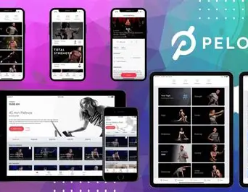
PELOTON Update:
PELOTON DIGITAL:
https://www.youtube.com/watch?v=ubzo0qBii3A
https://www.youtube.com/watch?v=aHBxuc9vpjs

