Slide 1


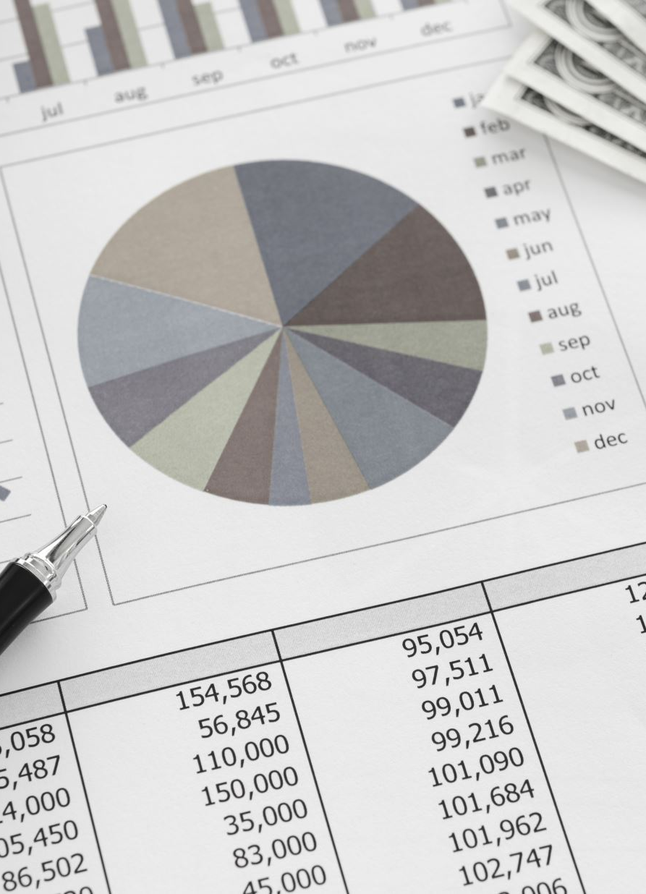


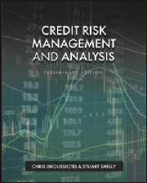

Credit Risk Portfolio Management IV: Derivative Hedging
LECTURE #6
Chapter 7
“Credit Risk Management & Analysis”

Slide 2
Lecture Title & Objectives
Learning Objectives
Analyze credit derivatives used to hedge and transfer risk
Apply concepts through real-world cases: The Big Short and Archegos Capital

Slide 3

Swaps

Slide 4
SWAPS -
Interest Rate Swaps
Cross Currency Swaps
Total Return Swaps (TRS)
Credit Default Swaps (CDS)
Credit Spread Options (CSO)

Slide 5
SWAPS - Interest Rates Swaps
Interest rate swaps are contracts between two parties via a financial intermediary who agree to exchange (swap) one set of cash flows for another
There are three different types of interest rate swaps: fixed to floating, floating to fixed, and float to float.
Fixed to floating: For example, let’s assume a company issued bonds at a fixed interest rate. The company's management feels that it can reduce the payments by entering into a swap agreement that swaps its fixed rate with a net floating rate supporting its view that rates will stay low for a while. In this case, the issuer of bonds can enter into a swap with a counterparty bank in which the company receives a fixed rate to offset its bond coupon payment and pay a floating rate. The swap is structured to match the maturity and cash flow of the fixed-rate bond and these two fixed-rate payments are netted.
Floating to fixed: A company that is currently a borrower of a Secured Overnight Financing Rate (SOFR) floating rate loan and needs access to a fixed-rate loan because of concern that the rates will go up can enter a swap to achieve a fixed rate.
Float to float: Companies sometimes enter into a swap to address different maturities that have different floating rates, known as a basis swap. A company can swap from 1e-month SOFR to 3-month SOFR because the rate is more attractive, or it matches other payment flows.

Slide 6
SWAPS - Example 1: Interest Rates Swaps

Slide 7
SWAPS - Example 1: Interest Rates Swaps
Figure 14.5 shows an example of two parties with two different views on interest rates who seek advice from their investment advisor on how to use the swap market to get a better-priced loan. This is a case where two parties (A&B) have approached a bank to borrow a $100 million loan. The bank gives them a choice of fixed rate or floating rate, shown in figure 14.
In this case,
Party A was given a choice to borrow either 5% fixed or SOFR + 0.30%. Separately,
Party B was given a choice to borrow either 6.20% fixed rate or SOFR + 1.0%.
Party A’s view is that rates will stay low, so it intends to choose the floating rate while Party B’s view is that the rates will go up so it’s natural that it should lock in the fixed rate.
The investment advisor is recommending that both parties choose the opposite option and enter into a swap agreement to not only achieve their view but also to save on cash flow.

Slide 8
SWAPS – Example 1: Interest Rates Swaps
Figure 14.5 shows that despite their view, Party A chose the fixed-rate option and Party B chose the floating-rate option.
Party A will pay the 5% fixed rate to the bank it is borrowing from, receive a swap rate of 4.95% from the swap dealer, and pay SOFR to the swap dealer, so Party A’s net pay is SOFR + 5 bps derived from 5.0% + SOFR – 4.95%.
Party B will pay the floating rate SOFR + 1% to the bank that it is borrowing from and receive SOFR from the swap dealer as well as pay a swap rate of 4.95%.
Party A’s net pay comes to be the 5.95% fixed payment derived from SOFR + 1% - SOFR + 4.95% (SOFR offsets to derive a fixed rate of 5.95%).
Both parties benefited from the swap agreement by 25 basis points.
Without the swap agreement and going with its view, Party A would have chosen SOFR + 0.30% instead of paying SOFR + .05% and Party B would have chosen a fixed rate of 6.20%, which is higher than the swap agreement at a net fixed rate of 5.95%.

Slide 9
SWAPS – Example 2: Cross-Currency Swaps
Cross-currency swaps, or simply, currency swaps, are exchange contracts of interest across different currencies. Interest payments are exchanged at specific set dates through the life of the contract. Companies that have their businesses abroad often use currency swaps to hedge their currency exposure and get more favorable interest rates by borrowing in local markets and using them to swap their payment exposure to the home currency.
Example: A U.S. company that obtains a loan in Europe to build a manufacturing plant. However, since it will be servicing a Euro-based loan to start the construction and it is abroad, it will have to convert its debt payments from U.S. dollar to euros. Not knowing the exchange rate in the future, the company has two choices:
Enter a Futures contract going LONG on the Euro-to-US Dollar exchange rate for all three future debt payments (see Fig 14.6 for forward rates)
Enter into a Cross-Currency Swap Agreement

Slide 10
SWAPS – Example 2: Cross-Currency Swaps
Figure 14.6 shows that despite the higher fixed interest rate charged (from 6% to 7%), by swapping from euro to U.S. dollar today, the U.S. company expects to yield a benefit of an estimated $2.37 million, of course, assuming that the euro-versus-dollar ratio will increase, showing levels from 1.15x to 1.21x in 3 years
Like interest rate swaps, currency swaps have three variations on the exchange of interest rates: fixed-to-fixed rate; floating-to-floating rate; or fixed-to-floating rate. The cross-currency swap opportunity offered to an investor weighs the difference between taking higher or lower interest rate today to hedge the higher or lower movement in the currency exchange

Slide 11
CREDIT DERIVATIVES (TRS, CDS, CSO, CDO)
A credit derivative is an instrument designed to separate market risk from credit risk and to allow the separate trading of the latter
Banks use credit derivatives as both buyers and sellers. Bank that want to eliminate the amount of exposure to a particular borrower, geography or industry.
Banks are in the business of providing loans but can sell the credit risk using credit derivatives such as Total Return Swaps (TRS), Credit Default Swaps (CDS) or Credit Spread Options (CSO).
Credit Derivatives transactions involves three parties:

Slide 12
Total Return Swaps (TRS)
A total return swap is a swap agreement in which one party makes payments based on a set rate, either fixed or variable, while the other party makes payments based on the return of an underlying asset, which includes both the income it generates and any capital gains.
In total return swaps, the underlying asset, referred to as the reference asset, is usually an equity index, a basket of loans, or bonds.
In a total return swap, one party makes payments according to a set rate, while another party makes payments based on the rate of an underlying or reference asset.

Slide 13
Total Return Swaps (TRS)
Example 3:
View: Party A that manages a portfolio of $10 million believes that the portfolio will suffer for the next year. Instead selling their entire position they transfer 9Swap) the risk to Party B. Party B is willing to take the portfolio risk and pay a pre-determine agreed fixed/floating return.
Assume that two parties enter a one-year Total Return Swap in which one party receives the SOFR in addition to a fixed margin of 2% (Spread). The other party takes market risk and gets the total return (TRS) of the Equity Portfolio on a principal amount of $10 million.
Scenario 1: After one year, if SOFR is 3.5% and the Equity Portfolio appreciated by 15%
Scenario 2: Equity Portfolio falls by 15%.

Slide 14
Case Study: Archegos Capital (TRS)
What Happened
Archegos used TRS to build massive leveraged equity exposure
Prime brokers did not see full consolidated exposure
Key Risks Exposed
Hidden leverage
Counterparty concentration risk
Poor margin and collateral management
Why This Is a Credit Risk Case
Losses were borne by banks, not Archegos
Failure was due to exposure aggregation failure
Teaching Insight
Transparency matters more than credit scores.

Slide 15


Credit Default Swaps, CDOs
https://youtu.be/xbiDrzTd8fE

Slide 16
Credit Default Swaps (CDS)
A credit-default swap (CDS) is a contract that allows the investor to swap the investor’s credit risk with another investor.
If an investor who holds bonds is concerned that the bonds will be defaulted, the investor will buy CDS to offset or swap the risk when the bonds do default.
The investor who agrees to sell the CDS and receives a premium is obliged to reimburse the investor if the bonds default; this is structured similar to a life insurance policy where the insured pays a monthly payment or premium to the insurance company who does not expect that the insured will die anytime soon. In this case, the event is the death of the insured before the payment is made. In a CDS, the event is the default of the bonds.
A credit-default swap is the most common form of credit derivative for most bonds, including municipal bonds, sovereign bonds, corporate loans and bonds, or mortgage-backed securities—a popular asset class written for the 2008–2009 crisis in the book written by Michael Lewis (2010) The Big Short.
Depending on the contract, most CDS contracts are designed so that the buyer of a credit-default swap is entitled to receive the par value of the bonds, along with any unpaid interest, if the issuer defaults on the bond payments. CDSs are priced very close to their probability of default.
Some investors use CDS to price equivalent bonds.

Slide 17
SWAPS – Example 4: Credit Default Swaps (CDS)
Figure 14.7 shows an example where a lender or an investor in corporate loans that holds $100 million in floating rate loans is receiving a rate of SOFR + 3%.
The investor in this loan has a few concerns that the loan could potentially be in default and thus enters into a CDS contract to hedge the risk. The CDS rates offered escalate from 2–4% as the maturity increases from 1 to 5 years, calculated based on a duration (not shown here).
In this case, the borrower initially receives L + 3% and pays out 2% on a notional amount of the $100 million that matches the direct exposure of the loan.
Despite a negative cash flow that the borrower is scheduled to receive in years 3, 4, and 5, the preservation of capital is more important.
In this case, the borrower expects a refinancing at par soon or the worst-case scenario of a bankruptcy will give the borrower the right to receive par (100%) of $100 million from the swap contract.
Please note that the actual SOFR that the borrower receives is not included in the cash flow, assuming that the borrower’s cost of capital is SOFR offsetting that income.

Slide 18
Collateralized Debt Obligation (CDO)

