Slide 1





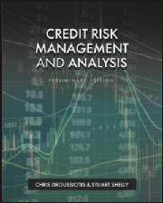

Credit Risk Portfolio Management III: Market Risk, Primary (Syndications) and Secondary Loan Markets
LECTURE #5
Chapter 7
“Credit Risk Management & Analysis”

Slide 2
Lecture Title & Objectives
Learning Objectives
Understand market risk in loan portfolios
Explain primary market syndication as exposure reduction
Understand how ratings create liquidity
Explain the role of the secondary loan market
Introduce portfolio monitoring (AMMR)

Slide 3
Market Risk in Credit Portfolios
Market Risk
Risk from concertation, interest rates, spreads, and liquidity
Can reduce loan value even if borrower pays on time
Key Drivers
SOFR / yield curve shifts
Credit spread widening
Market liquidity stress

Slide 4
Corporate Loans
Corporate Loan Types
Revolvers (incl. ABL)
Term Loans (TL-A, TL-B)
Second-lien & Mezzanine
Unitranche
Bridge / Swing / DIP
Project Finance

Slide 5
Primary Loan Market: Underwriting & Syndication
Primary Loan Market
Loans are originated and underwritten by banks
Bank initially bears full market risk
Why Banks Syndicate
Reduce single-name exposure
Reduce market risk
Meet regulatory and internal limits
Retain relationship + fees

Slide 6
Rating Agencies as Liquidity Creators
Role of Rating Agencies (Primary Market)
S&P and Moody’s rate:
Borrowers
Loan facilities
Key rating inputs:
Industry risk
Business risk
Financial leverage & coverage
Cash-flow durability
Why Ratings Matter
Enable institutional participation
Allow loans to trade
Create price transparency
Make syndication scalable
Without ratings, there is no liquid loan market

Slide 7
Types of Loan Syndication
Syndication Structures
Fully Underwritten
Arranger absorbs market risk
Higher fees
Best Efforts
Risk shared with market
Repricing possible
Club Deal
Relationship-driven
Smaller transaction

Slide 8
The Loan Syndication Process
Merge the two “Loan Syndication Process” slides into one clean process slide:
Mandate awarded
Information Memo (IM) prepared
Bank meeting & lender due diligence
Commitments submitted
Internal ratings assigned
Allocations finalized
Legal documentation
Funding & closing

Slide 9
Exposure Management Through Syndication
Exposure Reduction Techniques
Selling down loan positions
Retaining servicing and fee income
Transferring risk without losing client relationship
Credit Risk Benefit
Lower loss severity in default
Reduced capital allocation per borrower
Teaching Insight
Syndication is a credit risk management tool, not just a funding tool.
Syndication converts underwriting risk into manageable portfolio exposure.

Slide 10
The Secondary Loan Market
Secondary Loan Market – Purpose
Allows lenders to:
Further reduce exposure
Adjust portfolio risk
React to credit deterioration
Historical Context
Emerged late 1990s / early 2000s
Driven by:
Institutional Term Loan B market
Growth of CLOs
Expansion of loan ratings

Slide 11
Term Loan A vs Term Loan B
Term Loan A
Bank-funded
Relationship-driven
Less liquid
Term Loan B
Institutional investors
Actively traded
Designed for secondary liquidity

Slide 12
Secondary Market Participants
Investment Grade (IG)
Mostly bank-to-bank trading
Relationship-driven
Price less critical
Leveraged Loan (LevFin)
CLOs, loan funds, BDCs, hedge funds
Price-driven
Credit-sensitive

Slide 13
Why Secondary Prices Move
Loan Prices Decline Due To
Credit deterioration
Spread widening
Liquidity stress
Weak underwriting
Markets price risk before defaults occur

Slide 14
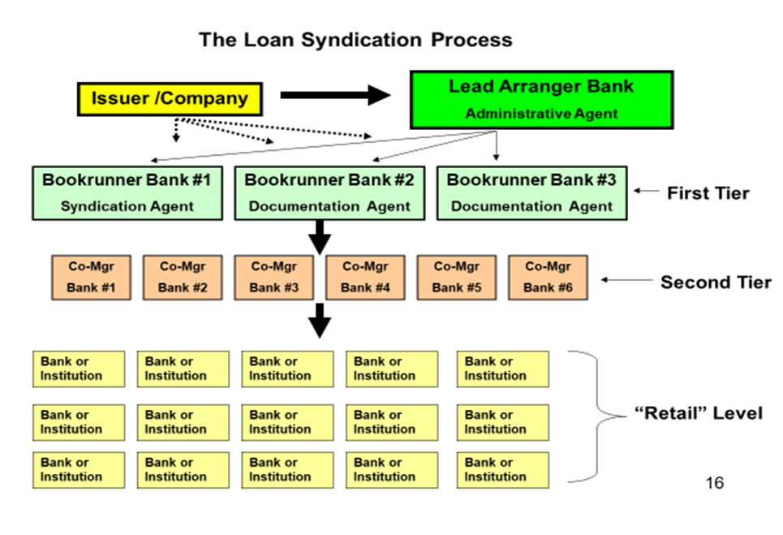
The Loan Syndication Process

Slide 15
The Case of Loans
The leveraged loan asset class has been relatively attractive for many portfolio managers due to the following investment characteristics.
Insulation from interest rate risk: Both the revenues and cost of the CLO is based on floating rate interest (SOFR based) that is reset at least every 90 days, so even if the interest rate rises for the CLO’s loan obligations, the rates will also rise at the same level for the individual portfolio of companies, enabling natural arbitrage for the CLO manager.
Low price volatility: In general, leverage loans experience reduced volatility resulting from a low correlation and covariance with other assets. The floating rate nature of leveraged loans contributes to its low correlation with other security types. Only short-term treasury bills (considered risk free) consistently exhibit lower volatility.
Defensive strategy: Senior loan funds have historically provided consistent, higher risk–adjusted returns compared to other asset classes, which may make them attractive to investors during volatile markets.

Slide 16
CORPORATE LOANS
There are many types of corporate loans depending on the company’s purpose in raising such loans. The figure lays out the facilities that are typically found on an LBO transaction and ranks the facilities in a “waterfall” priority of payment in case there is a liquidation, even such as a bankruptcy.

Slide 17
Rating Agency Methodology
Industry Risk
Company-Specific Business Risks
Management Factor
Financial Risk Analysis
Loan-to-value or debt capitalization ratio
Leverage ratio of debt to EBITDA
Coverage ratios, including EBITDA/interest and cash flow to debt service
Cash Flow Forecasting and Modeling

Slide 18
The Secondary Loan Market
Why the Secondary Market Matters
Enables active trading and portfolio rebalancing
Provides transparency on credit quality deterioration
Serves as an early warning system for credit risk

Slide 19
Secondary Loan Terms - Concepts
Loan participation: A loan participation, sometimes called “silent participation,” is an agreement between two or more lenders in which a primary lender sells specific rights in a loan to other lenders (participants)
Loan assignments: Defined in the credit agreement, assignments are the sale or transfer of all or portion of the loan from one bank (assignor) to another bank (assignee). With the purchase, the assignee has the same rights and obligations as all the other banks listed in the agreement as a lender of record
Most-favored Nation: Most agreements for leverage loans include “most-favored nation” (MFN) pricing protection.
Sunset provision: A sunset provision is a clause in the loan agreement that would allow the MFN protection to expire after a set period, typically 90–180 days.

Slide 20
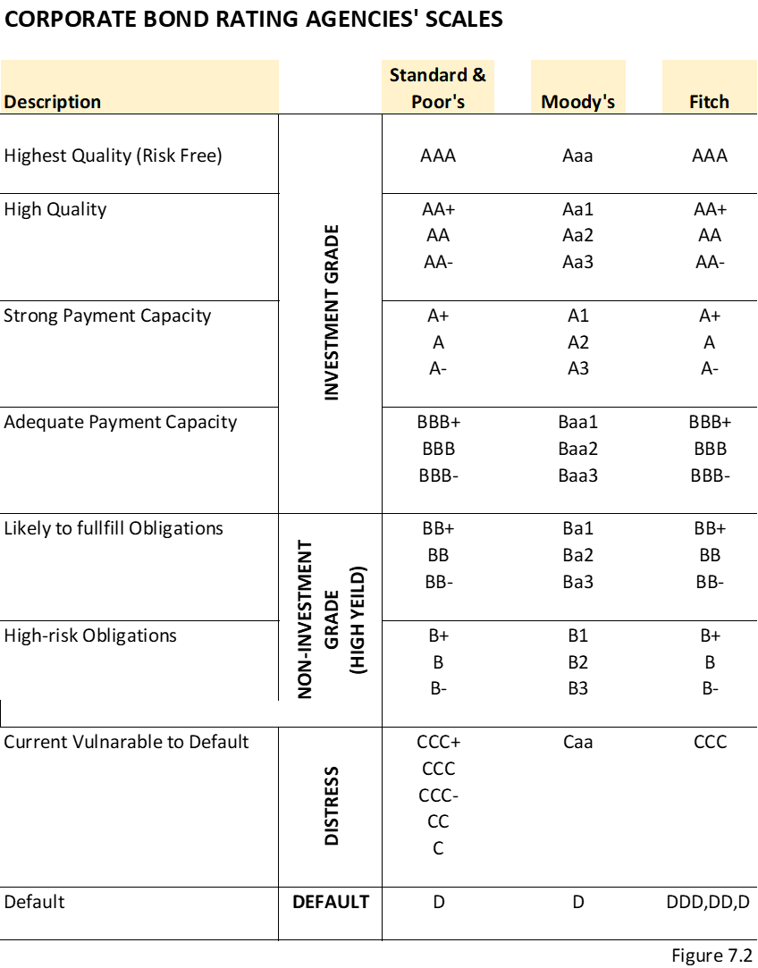

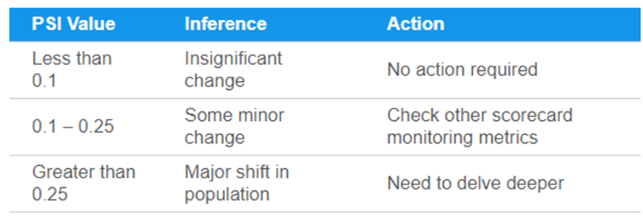
Bonds, Loans and CLOs Ratings

Slide 21

Pricing and Loan Yields
Then the pricing is set based on an initial spread over a base rate (usually SOFR) at set original issuance discount (OID), which represents the additional “fee” the investor receives. The loan yield formula is as follows:
$$Annual loan yield=SOFR+spread+\frac{\left(\frac{100−OID}{4 years}\right)}{100}$$
Please note that this conventional formula is based on 4 years’ average life of the loan.
A typical press announcement from the lead arranger bank will be as follows:
“The term loan B price is set at SOFR + 4.5% at 99.0 OID and is now free to trade.”
Based on this example and assuming the starting SOFR is 2.50%, the initial loan yield is then calculated as follows:
$Annual loan yield=2.5\%+4.5\%+\frac{\left(\frac{100−99}{4 years}\right)}{100}$ = 2.5% + 4.5% + 0.25% = 7.25%

Slide 22
Pricing and Loan Yields
The Loan Syndication and Trading Association (LSTA) was established in the mid 1990s to develop liquidity and transparency in the secondary market for bank loans.
LSTA provides dealer-secondary quotes based on market-to-market and other relevant information including the most volatile loans, the list of the biggest price movers, and the listing of the newest deals.
The LSTA, in conjunction with Standard & Poor’s Leveraged Commentary & Data (LCD), has developed a LevFin index as a benchmark representing a weighted average of the 100 largest loan facilities.
The index, S&P/LSTA Index is a total return index of the leverage loans. Loan portfolio managers use this as a benchmark to compare the portfolio performance and other asset class to the market.
A list of loan secondary trading level examples is shown in figure 12.1.

Slide 23
Portfolio Monitoring: Why It Matters
Credit Risk Does Not End at Origination
Risk evolves throughout the loan life
Portfolio Monitoring Objectives
Detect early signs of deterioration
Ensure covenant compliance
Protect lender position before default

Slide 24
Asset Management Monitoring & Reporting (AMMR)
What Is AMMR?
Ongoing loan-level and portfolio-level monitoring framework
Core AMMR Components
Financial reporting (monthly, quarterly, audited)
Covenant testing (DSCR, leverage)
Borrowing base certificates
Compliance and regulatory reporting
Instructor Line
AMMR is about "inspect what you expect."

Slide 25
AMMR as Risk Mitigation
How AMMR Reduces Losses
Identifies issues before payment default
Enables proactive restructuring
Improves recovery outcomes
Connection to CAMELS
Directly supports Asset Quality (A) and Management (M)

