Slide 1
Entrepreneurial Finance and Venture Capital
On-Line
July 20– Aug 1: 8:00am-11:00am
Professor Droussiotis
LECTURE 4 – Fundraising Rounds Explained
Chapter 5

Slide 2
Fundraising Rounds Explained - Introduction
Fundraising rounds reflect a startup's evolution from idea to scalable business—not just financing milestones.
Each funding stage corresponds to reduced risk, increased validation, and greater operational maturity.
Every round has different investor expectations, requiring specific milestones, traction, and evidence of progress.
Choosing the right financing instrument matters, including SAFEs, convertible notes, and priced equity rounds.

Slide 3
Fundraising Rounds Explained - Introduction
Timing is critical—raising too early, too late, or using the wrong financing structure can negatively impact valuation, dilution, and future fundraising.
Capital should be aligned with milestone achievement, enabling the company to reach the next stage of growth and increase enterprise value.
Understand the long-term impact of dilution and structure fundraising to preserve founder ownership while attracting quality investors.
Successful fundraising is about raising the right capital, at the right time, from the right investors.

Slide 4
Fundraising Rounds Explained - Introduction
Case Study Examples
Promed Bioscience – Raised growth capital tied directly to manufacturing expansion and commercial demand.
Threedium – Progressed through fundraising by achieving clear commercial milestones and attracting strategic lead investors.
EMBIO Diagnostics – Used customer validation and regulatory progress to reduce risk before raising institutional capital.
Darefore – Built its fundraising story around a differentiated technology and a clearly defined market opportunity.
Ascanio – Matched financing strategy to product development and enterprise customer milestones, demonstrating disciplined capital planning.
Key Takeaway: Every fundraising round should have a clear purpose: reduce risk, achieve measurable milestones, increase company value, and position the startup for the next stage of growth.

Slide 5
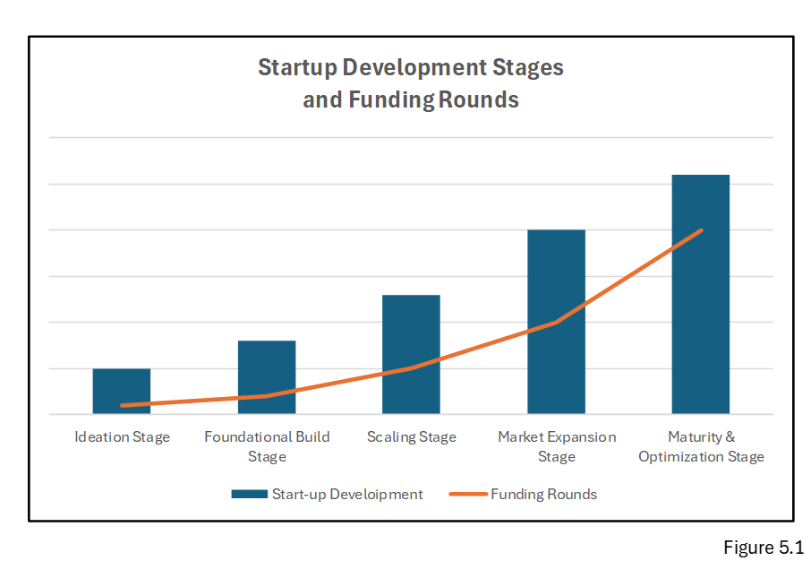
Understanding Fundraising Stages

Slide 6
The Pre-Seed Stage: Turning Insight into Experiments
Purpose: Transform an idea into a prototype, proof of concept, or minimum viable product (MVP). Primary objective: Validate the problem, technology, and founding team's vision. Investors focus on: Founder quality and commitment.
Market insight and problem definition.
Technical feasibility.
Size of the market opportunity.
Early product validation.

Slide 7
The Pre-Seed Stage: Turning Insight into Experiments
Limited or no revenue is expected—the investment is primarily based on the team's vision and execution potential. Capital is typically used for: Product development.
Building the MVP.
Customer discovery.
Initial hiring.
Early market validation.
Common financing instruments: SAFE (Simple Agreement for Future Equity) or Convertible Note. SAFEs are popular because they are fast, inexpensive, and allow founders to focus on building the business rather than negotiating complex legal agreements.

Slide 8
The Pre-Seed Stage: Turning Insight into Experiments
Case Study – Darefore
Identified an overlooked problem in sports performance:
  Coaches relied primarily on subjective observation.
  No technology accurately measured posture and movement in real time.
Developed proprietary sensor technology that created a new biomechanical data layer.
Raised pre-seed funding through a SAFE before significant commercial traction.
Investors backed:
  A compelling market insight.
  Strong technical feasibility.
  An experienced founding team.
Investor takeaway: At the pre-seed stage, investors invest in exceptional founders with a differentiated vision and a credible path to building a transformative solution—not in revenue.

Slide 9
Seed Funding
Purpose: Transition from prototype to a validated business with early customer adoption. Primary objective: Demonstrate product-market fit and validate commercial demand. Investors focus on: Customer validation.
Pilot programs and early users.
Product-market fit.
Initial revenue or commercial traction.
Repeat customer engagement.
Execution capability of the founding team.

Slide 10
Seed Funding
Capital is typically used for: Product refinement.
Expanding the team.
Customer acquisition.
Building sales and marketing capabilities.
Preparing for scalable growth.
Common financing: SAFE, Convertible Notes, or the company's first priced equity round. The investment story shifts from proving the idea to proving customers value and are willing to pay for the solution.

Slide 11
Seed Funding
Case Study – EMBIO Diagnostics
Demonstrated strong customer validation through:
  Successful pilot projects.
  Early commercial partnerships.
  Real-world product testing.
Showed measurable improvements in rapid pathogen detection compared with traditional laboratory methods.
Generated investor confidence through:
  Customer interest.
  Operational validation.
  A clear commercialization pathway.
Investor takeaway: At the seed stage, investors fund companies that have moved beyond a promising idea and can demonstrate real market validation, growing customer demand, and a credible path toward scalable revenue.

Slide 12
Series A: From Proof to Repeatability
Purpose: Prove the business model is repeatable, scalable, and commercially viable.
Primary objective: Transition from product-market fit to predictable growth.
Investors look for: Consistent revenue growth.
  Repeatable customer acquisition.
  Strong customer retention and expansion.
  Proven unit economics.
  Scalable sales and operating processes.
.

Slide 13
Series A: From Proof to Repeatability
Capital is used to:
  Scale sales and marketing.
  Expand product capabilities Build operational infrastructure.
  Hire senior leadership and commercial teams.
  Support international or market expansion.
Focus shifts from proving the product to scaling the business.
Priced equity rounds become standard, establishing:
  Formal company valuation.
  Preferred shares.
  Board governance.
  Investor protections.
  Institutional ownership structure.

Slide 14
Series A: From Proof to Repeatability
Case Study – Threedium
Successfully transitioned from pilot projects to repeatable enterprise deployments.
Demonstrated:
  Multiple global brands adopting the platform.
  High customer retention and expansion.
  Predictable enterprise sales.
Series A capital was used to:
  Expand real-time 3D rendering capabilities.
  Build enterprise integrations.
  Grow global sales and customer success teams.
Investor takeaway: Investors no longer questioned whether the technology worked—they invested because Threedium had demonstrated a repeatable, scalable commercial model capable of becoming a global leader.

Slide 15
Growth Rounds (Series B, C & Beyond):
From Scale to Market Leadership
Purpose: Accelerate growth, expand market leadership, and build a sustainable, industry-leading company.
Primary objective: Scale proven business models across larger markets while improving profitability and operational efficiency.
Investors look for: Strong and predictable revenue growth.
  Market leadership and competitive differentiation.
  Scalable unit economics.
  Experienced management team.
  Robust governance and operational excellence.
  Clear path to profitability.

Slide 16
Growth Rounds (Series B, C & Beyond):
From Scale to Market Leadership
Capital is used to: Expand into new geographic markets.
Launch new products and services.
Make strategic acquisitions.
Scale operations and infrastructure.
Strengthen technology and leadership teams.
Growth-stage investors focus on execution at scale, not product validation. Priced equity rounds dominate, typically including: Board representation.
Preferred shares.
Liquidation preferences.
Anti-dilution protections.
Information and governance rights.

Slide 17
Growth Rounds (Series B, C & Beyond):
From Scale to Market Leadership
Case Study – Heroes Made
Successfully expanded from individual schools to district-wide adoption.
Demonstrated:
  High customer retention across multiple academic years. contracts with school districts.
  Recurring subscription revenue.
  Expansion through additional educational content and services.
Growth capital funded:
  Geographic expansion.
  Development of new curriculum content.
  Scaling sales, customer success, and operations.
Attracted both:
  Mission-driven impact investors.
  Traditional venture capital firms.
Investor takeaway: Heroes Made had evolved from proving its educational platform to establishing itself as a scalable market leader with predictable recurring revenue and long-term growth potential.

Slide 18
Understanding Financing Instruments
SAFEs: Speed and Simplicity
SAFEs allow founders to raise early capital without negotiating valuation, governance rights, or board seats. Investors provide capital today for the right to receive future equity at terms tied to valuation caps or discounts. Their purpose is to eliminate friction during the earliest phases, giving founders the flexibility to iterate before committing to formal valuation.
  SAFEs work best when:
    the company is pre-traction,
    angels or micro funds are leading,
    speed matters more than structure, and
    founders want to avoid legal overhead.
They become risky only when stacked excessively with inconsistent caps, which can distort conversion outcomes later.

Slide 19
Understanding Financing Instruments
Convertible Notes: Flexible Structure with Discipline
Convertible notes behave like debt that turns into equity. The interest, maturity date, and conversion mechanics give investors protection while maintaining the agility of early-stage financing. Notes are particularly useful when:
  investors want defined conversion timelines,
  the company faces regulatory or technical risk, or
  the round requires a bridge between early and institutional investors.

Slide 20
Understanding Financing Instruments
Case Study: FDA-Regulated Device Company
A medical device startup used a convertible note strategically when preparing for FDA submission.
Rather than waiting for full clearance, they hired a regulatory consultant who initiated early conversations with compliance officers, restructured documentation, and mapped the approval process.
This allowed them to raise a note with milestone-based conversion, demonstrating that complex regulatory landscapes can be navigated with foresight and structure.

Slide 21
Understanding Financing Instruments
Priced Equity Rounds: Formal Valuation and Governance
Priced rounds assign a valuation and issue preferred shares. They define how control, governance, and economic rights are allocated among investors and founders. This structure becomes essential as companies scale and institutional money enters. Priced rounds formalize:
  the valuation of the company,
  investor rights,
  governance roles, and
  the long-term framework for dilution.
Series A and beyond typically follow this structure.

Slide 22
Dilution, Ownership, and Cap-Table Design
Every fundraising round creates dilution, but well-managed dilution accelerates growth and increases long-term company value.
The objective is not to avoid dilution—it is to raise capital efficiently while preserving meaningful founder ownership.
Founders should understand:
  The cumulative impact of dilution across multiple funding rounds.
  Employee Stock Option Pools (ESOPs).
  SAFE and Convertible Note conversions.
  Ownership implications of future financing.

Slide 23
Dilution, Ownership, and Cap-Table Design
Differentiate between:
  Protective dilution – capital that creates significant value and supports growth.
  Corrosive dilution – unnecessary dilution resulting from poor planning, weak negotiations, or raising capital too early.
Maintain a clean cap table with transparent ownership, clear governance, and simple equity structures.
Plan fundraising strategically to avoid excessive dilution while maintaining flexibility for future rounds and key hires.
A well-designed cap table signals operational maturity, investor readiness, and strong corporate governance.

Slide 24
Dilution, Ownership, and Cap-Table Design
Case Study – Ascanio
Initially struggled to raise capital because its go-to-market strategy lacked sufficient detail.
Improved fundraising readiness by:
  Mapping customer procurement cycles.
  Identifying budget decision-makers.
  Understanding enterprise sales timelines.
  Developing a repeatable commercial strategy.
Raised capital incrementally at higher valuations as execution milestones were achieved.
Result: Preserved founder ownership while avoiding unnecessary early-stage dilution.
Investor Perspective: A clean cap table and disciplined approach to dilution demonstrate that founders understand not only how to build a company—but also how to finance one responsibly over the long term.

Slide 25
Precision Capital Planning: When Capital Has Logic
Nothing convinces investors more than founders who can articulate exactly how capital translates into capability. The strongest fundraising rounds demonstrate that each euro or dollar has purpose by expanding production, increasing throughput, accelerating sales cycles, or resolving a bottleneck inhibiting scale.
Case Study: Colgen Bioscience
Colgen Bioscience, a producer of collagen for skin care, when raising €1.25 million, they did not give vague hiring plans or high-level projections. They specified the exact equipment purchases, the resulting expansion in collagen production capacity, and how those increases matched the annual demand committed by Korean skincare manufacturers. Their capital plan was so clear that investors could almost feel the machinery turning. It is difficult to say no when the raise feels like the natural fulfillment of an existing market pull. Return on Investment (ROI) is easier to calculate when the machine’s cost is known, the collagen production capacity is clearly defined, and there are contractual commitments specifying who will purchase the output and in what quantities. As illustrated on table 5.1 below the ROI is estimated annual profit from the production divided by the investment:

Slide 26
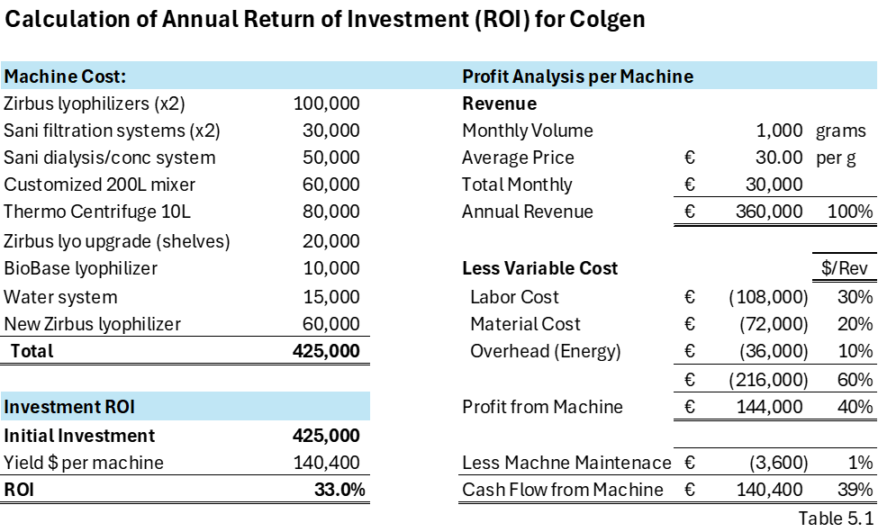
Precision Capital Planning: When Capital Has Logic

Slide 27
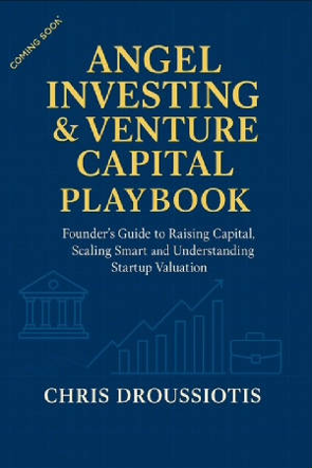
Excerpt from my new book
Over the years, I’ve learned that successful fundraising rarely depends on charisma or pitch-deck polish. Success depends on sequencing. The strongest founders understand that each round is a chapter, and each chapter requires a different kind of narrative, evidence, and operational maturity.
I remember advising Embio Diagnostics during their earliest days. Their ambition was bold—reduce the detection time for foodborne pathogens from hours to minutes. But before their seed round, the story wasn’t ready. Validation was still theoretical. Everything changed when a major dairy company agreed to test their device in an active production environment. The moment Embio proved that their three-minute detection workflow could replace legacy methods taking several hours, investors no longer saw a risky scientific idea—they saw a future category leader. It reminded me how often a single moment of validation separates a speculative raise from a compelling one.
What impressed me most was how Embio used each successive fundraising round to expand their strategic horizons. With early capital, they focused tightly on food diagnostics—an urgent and regulated sector where speed, accuracy, and operational efficiency mattered. But as the company matured, they began to see that their underlying electrochemical sensing technology was far more versatile than any single application. By the time they approached their next round, Embio had identified an even larger and more financially attractive market: air-quality detection. The needs were global, urgent, and increasingly tied to public health, workplace safety, and environmental monitoring.
.

Slide 28
Excerpt from my new book
Their transition from food diagnostics to air-quality intelligence was not a pivot born out of desperation; it was the natural evolution of a platform technology growing into its full potential. Investors understood this immediately. The company’s earlier validation in food safety created credibility, but the expansion into air-quality made the business truly scalable. Instead of selling a device for a niche segment of food testing, Embio was now addressing industrial facilities, transportation hubs, schools, hospitals, and municipalities—markets measured not in tens of millions but in billions.
This shift reshaped the narrative in their most recent raise. The story was no longer about a faster listeria test; it was about building a universal sensing platform capable of monitoring airborne contaminants, pollutants, and pathogens in real time. With each round, Embio was not simply raising more money—they were raising money with a broader purpose. The capital from one phase opened the door to a larger market in the next, fueling a progression from a specialized diagnostics company into a multi-market technology engine with global relevance.
That experience reinforced a lesson I’ve witnessed in many successful startups: the best founders use each round of capital to widen their strategic aperture. They enter through a narrow, winnable niche, prove their technology where stakes are high, and then leverage that credibility to expand into markets that demand more capital but offer dramatically larger upside. Embio’s journey is a perfect illustration of how a company grows not only through innovation, but through thoughtful fundraising that unlocks increasingly ambitious opportunities.

Slide 29
CASE STUDIES

Slide 30
Case Study 1:
How a Series A Round Reshaped the Cap Table
When Sofia and Marco founded LuminaTech, a predictive maintenance software company for industrial machinery, they split ownership based on contribution and early sweat equity.
Sofia, the technical founder, retained 50%, while Marco, the commercial lead, held 30%. Early angels received 5%, and a 15% employee option pool was created to hire the first engineers and data scientists.
Before their Series A, the company had outstanding 10 million shares and strong early traction but needed substantial capital to expand into new markets.

Slide 31
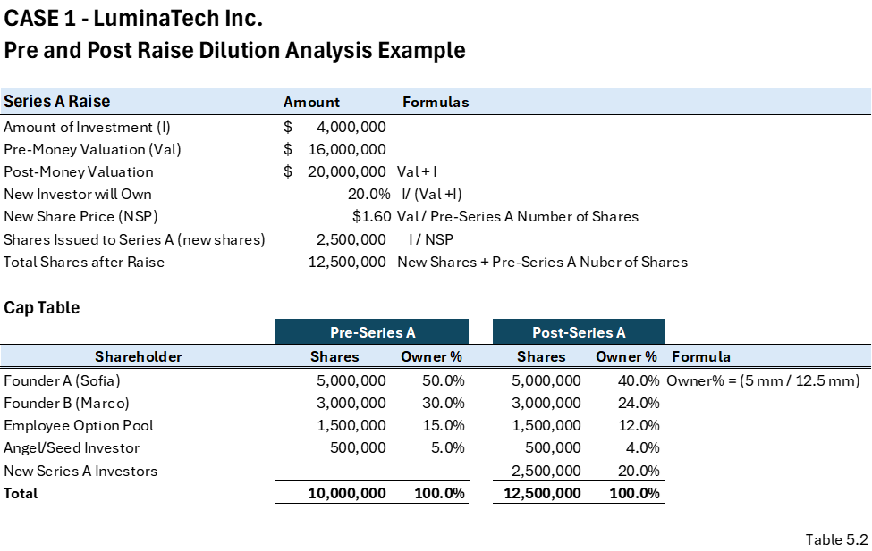
Case Study 1:
How a Series A Round Reshaped the Cap Table
As shown on table 5.2 below, by the time LuminaTech prepared to raise a $4 million Series A, investors valued the business at a $16 million pre-money valuation.
This meant that after the investment, the company would have a $20 million post-money valuation, and the Series A investors would own 20% of the company.
To deliver that ownership, LuminaTech had to issue 2.5 million new shares at $1.60 per share, increasing total shares outstanding from 10 million to 12.5 million.

Slide 32
Case Study 1:
Understanding Dilution: The LuminaTech Series A Example
Dilution does not mean losing shares—it means owning a smaller percentage of a significantly larger company.
Following the Series A investment:
  Sofia's ownership declined from 50% → 40%.
  Marco's ownership declined from 30% → 24%.
  Angel investors declined from 5% → 4%.
  Employee Stock Option Pool declined from 15% → 12%.
  New Series A investors acquired a 20% ownership stake through their $4 million investment.
Dilution was proportional—all existing shareholders experienced the same 20% reduction in ownership.
This is a fundamental principle of priced equity financing unless special provisions (e.g., anti-dilution rights or option pool adjustments) alter ownership percentages.

Slide 33
Case Study 1:
Understanding Dilution: The LuminaTech Series A Example
The new capital created significant value by enabling:
  Expansion of the engineering team.
  Faster product development.
  International expansion into Germany, the Netherlands, and Italy.
  Greater credibility with customers and future investors.
Although ownership percentages declined, the overall value of each founder's remaining equity increased substantially.
Key lesson: Successful fundraising is not about avoiding dilution—it is about ensuring that the value created by the new capital grows faster than the ownership percentage decreases.
Founder Perspective: The goal isn't to own 100% of a small company. The goal is to own a meaningful percentage of a much larger, more valuable company.

Slide 34
Case Study 2:
The SAFE Conversion Chaos That Nearly Killed a Seed Round
When Clara launched Biostream Labs, a biosensor startup specializing in real-time hydration tracking for athletes, she relied on SAFE notes to get the company off the ground. It was fast, simple, and—at the time—seemed like the easiest way to raise capital while she refined the technology. Over two years, Biostream raised $650,000 from multiple angels using SAFE agreements.
But like many first-time founders, Clara didn’t realize that the details buried in each SAFE including valuation caps, discounts, and side letters could dramatically affect ownership once the notes converted.

Slide 35
Case Study 2:
The SAFE Conversion Chaos That Nearly Killed a Seed Round
At the time of negotiation, the differences seemed small. One angel insisted on a $3 million valuation cap. A second investor pushed for a 20% discount with no cap. A third demanded a most-favored-nation (MFN) clause. Clara was eager to close each check and assumed that the conversion math would “take care of itself later.”
It didn’t.
When Biostream Labs prepared its $4 million priced seed round at a $10 million pre-money valuation, the SAFE investors expected automatic conversion. But because every SAFE had different terms, the conversion created a cap-table nightmare.

Slide 36
Case Study 2:
The SAFE Conversion Chaos That Nearly Killed a Seed Round
The Hidden Bomb: Different Caps Meant Different Share Prices
The first investor, holding the €3M cap SAFE, converted at the lowest effective price, giving them an unexpectedly large percentage of the company. The second investor, holding the 20% discount, converted at a higher price. The MFN investor triggered their clause and demanded to match the best terms negotiated by anyone else.
The founders and new seed investors quickly realized that the SAFE holders were collectively claiming far more equity than originally anticipated - nearly 30% of the company, instead of the 15–18% Clara assumed.

Slide 37
Case Study 2:
The SAFE Conversion Chaos That Nearly Killed a Seed Round
The Investor Rebellion
When the lead seed investor reviewed the cap table, he paused the entire round. He made his point bluntly: “I’m not investing in a company where the early instruments dilute the founders before we even start.”
The issue was not the SAFEs themselves - it was the inconsistency across them. Each one pulled the cap table in a different direction. The most generous SAFE terms ballooned the equity owed, and because of MFN clauses, the worst SAFE retroactively upgraded all the others.

Slide 38
Case Study 2:
The SAFE Conversion Chaos That Nearly Killed a Seed Round
The Costly Fix
To save the round, Clara had to hire a corporate attorney and a cap-table specialist to:
  Model all conversions under multiple scenarios
  Renegotiate terms with two SAFE holders
  Buy out a portion of one SAFE at a discount
  Increase the pre-money option pool by 5% (diluting everyone)
  Amend side letters to remove MFN language
It took six weeks, thousands of euros in legal fees, and countless phone calls with frustrated early investors. Only after the SAFE conversions were harmonized and the resulting cap table was stable did the new lead investor agree to proceed with the seed round.

Slide 39
Case Study 2:
The SAFE Conversion Chaos That Nearly Killed a Seed Round
The Aftermath
Clara ended up with 12% less ownership than she expected. At the SAFE conversion she was reduced by 9% and after the Series A raise she was reduced by 23%. The advice to founders is that “SAFE notes are fast, but not free. The cost comes later, during conversion. If you don’t control the terms early, the terms will control you when it matters most.”
Why This Case Matters
This case reveals a common but often hidden truth in early-stage financing. SAFEs simplify cash in, but complicated cap tables later. Without consistent caps, aligned discounts, and explicit modeling, founders risk creating structural problems that only surface during priced rounds—problems severe enough to delay or destroy an otherwise fundable raise.

Slide 40
Case Study 2:
The SAFE Conversion Chaos That Nearly Killed a Seed Round
Cap Table Adjustments:
When Clara founded Biostream Labs, the company had a simple ownership structure:
10,000,000 founder shares, owned entirely by Clara and her technical co-founder Mateo. In the earliest months, they raised money quickly through SAFEs. It felt easy at the time - sign a short agreement, collect funds, and return to building the product.

Slide 41
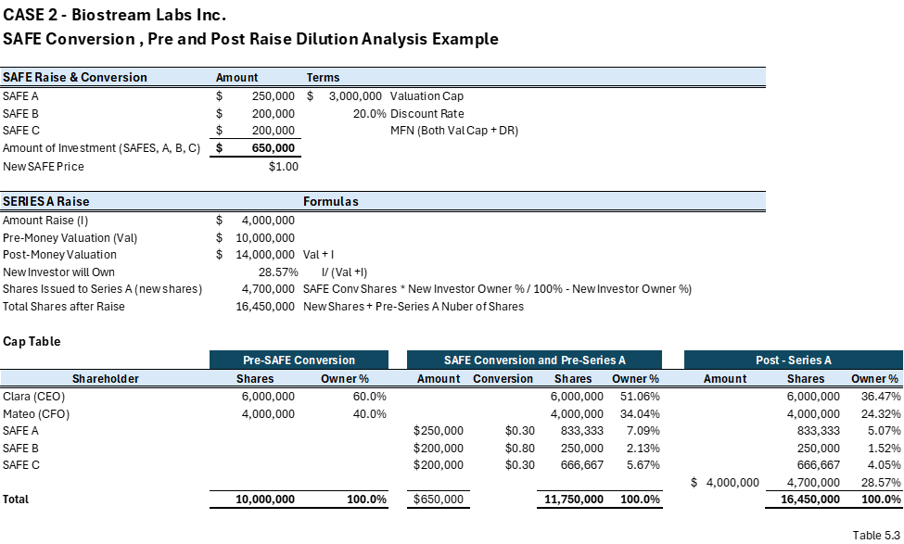
Case Study 2:
The SAFE Conversion Chaos That Nearly Killed a Seed Round
But, as demonstrated in Table %.2, each SAFE carried different economic terms.
One investor insisted on a €3M valuation cap, another took a 20% discount, and a third negotiated both a €3M cap AND an MFN clause - meaning they could demand to match any better terms granted to someone else.

Slide 42
Case Study 2:
The SAFE Conversion Chaos That Nearly Killed a Seed Round
Clara didn’t model what these differences meant.
She assumed the SAFEs would convert into something reasonable “later.”
But later they arrived with their €4M Seed Round at a €10M pre-money valuation, and the conversion math turned the cap table into a disorderly spiral moving her ownership from 60% to 36.47%.

Slide 43
Case Study 3:
The Option Pool Expansion Shock at NovaAI Robotics
When Daniel and Priya founded NovaAI Robotics, their vision was clear: developing autonomous robotic systems capable of performing hazardous industrial inspections. The company raised a small pre-seed round and secured two early design partners. By the time they prepared for a €6 million Series A, NovaAI had a working prototype and early revenue from pilot contracts.
Internally, the founders felt confident about the round. They believed the traction justified their target valuation of €18 million pre-money. What they didn’t anticipate was the negotiation around something many first-time founders underestimate: the option pool expansion.

Slide 44
Case Study 3:
The Option Pool Expansion Shock at NovaAI Robotics
The company had an existing 5% option, mostly allocated. They needed more hires, particularly in engineering and business development, but pushed those decisions off until after the raise. The Series A lead investor had no intention of leaving the option pool that small. The Investor’s Position: “Your Hiring Plan Requires More Equity”. When reviewing NovaAI’s hiring plan, the Series A lead argued that to hit growth targets—expanding engineering, sales, QA, and robotics technicians—the company needed a 15% unallocated pool, not 5%.
This is where the negotiation turned. The investor insisted the option pool expansion be done pre-money, meaning dilution comes from founders and early investors, not the Series A investor. This is completely standard practice. And it shocked Daniel and Priya.

Slide 45

Case Study 3:
The Option Pool Expansion Shock at NovaAI Robotics
Option Pool Expansion Math (Pre-Money)
The founders needed to create an additional 10% pool before the round. The goal is to Increase the option pool to 15% of the post-expansion, pre-money capitalization. Here is the math to calculate how many new shares they need to issue:
Let the new total share count (after expansion) be X.
  We need: $0.15X=\text{Option} \text{Pool} \text{Shares}$
  Currently, the pool is: $0.05×10,000,000=500,000 \text{shares}$
  Let new option pool be P, and total shares be X: $P=0.15X$
  But P must equal: $500,000+\text{new} \text{shares}$
  We solve: $500,000+\text{new} \text{shares}=0.15X$ then $X=10,000,000+\text{new} \text{shares}$
  Solving yields: New shares needed for the pool expansion: 1,764,706 shares
  This brings total shares pre-money to: $10,000,000+1,764,706=11,764,706 \text{shares}$
The founders were diluted before a single dollar of investment entered.

Slide 46
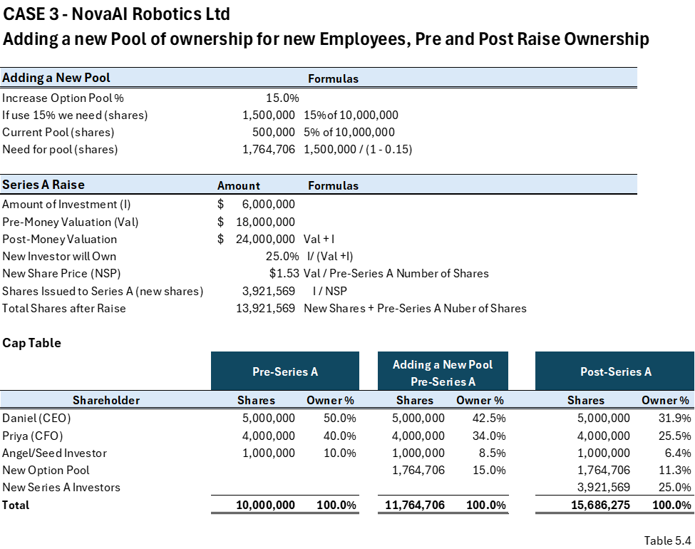
Case Study 3:
The Option Pool Expansion Shock at NovaAI Robotics
Table 5.4 illustrates the pre-pool conversion, pre-series and post-series A ownership %

