Slide 1

Mergers & Acquisitions
Professor Chris Droussiotis
Lecture 3: CORPORATE TAKEOVER MARKET
Case study 2: Facebook acquisition of WhatsApp

Slide 2
Understanding Takeover Tactics
Friendly Takeovers
Hostile Takeovers
Reverse Takeovers
Backflip Takeover

Slide 3
Understanding Takeover Tactics

Slide 4


Friendly Takeover
Target company agrees to the acquisition offer in a peaceful manner subject to approvals by:
  Shareholders
  Regulators (check if the deal complies with the antitrust laws)
Both the acquirer and target company takes part in designing the structure of the deal to their mutual satisfaction.
Better price per share is another advantage of a friendly takeover.

Slide 5
Friendly Takeover
Facebook acquiring WhatsApp
$19 Billion
Facebook purchased WhatsApp in February 2014 for an approximate total of $16 billion, broken down into:
$4 billion in cash and about $12 billion in Facebook shares.
As part of the deal, WhatsApp's founders and employees with an additional $3 billion in restricted stock units.
The acquisition price was staggering for an app that made little money and was largely popular outside the United States.

Slide 6
Friendly Takeover
Facebook acquiring WhatsApp
BENEFITS FOR FACEBOOK SHAREHOLDERS | BENEFITS FOR WHATSAPP SHAREHOLDERS
BUYING THE TREND AND MARKET PENETRATION: WhatsApp was heavily outpacing Facebook Messenger on mobile in certain areas | PREMIUM PRICE: $19 Billion represent 950 x 2013 Revenue ($20 million) Sequa Cap invested: $58mm – taking a 3.5billion (60x) Founder: Takes $3 billion Tax Free
DEFENSIVE ACQUISITION: WhatsApp’s rise came at a crucial moment — just as Facebook was fully realizing its ambitions as a mobile-first company and making messaging a core service. WhatsApp was quickly demonstrating that it could compete with Facebook on its most important battleground | GROWTH OPPORTUNITY: WhatsApp — which lacked the market reach of Facebook — was drawing from the same pool of limited attention. And with the rise of other messaging apps like WeChat, Kik, Line, and Viber, which all showed promising signs of growth (especially in markets like Asia), Facebook saw both vulnerability and opportunity in WhatsApp.

Slide 7


Facebook Acquiring WhatsApp

Slide 8
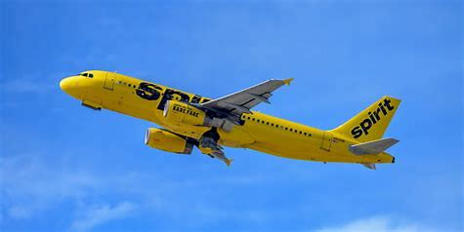
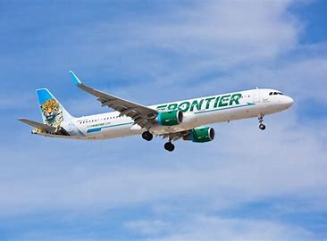
Friendly Takeover – Case Study
Feb 7, 2022 | Frontier Airlines offered to buy Spirit for $2.9 billion or $25.83 per share
Feb 10 | Spirit Board Agreed to the Merger. The two companies are closely linked and had been discussing a combination for years. Subject to shareholder vote, Spirit entered into a merger agreement with Frontier. Under which Spirit and Frontier would combine in a stock and cash transaction. Under the terms of the merger agreement, Spirit equity holders would receive 1.9126 shares of Frontier plus $2.13 in cash for each existing Spirit share they own. Later, shareholders did not approve the merger – instead, they went with the JetBlue Hostile takeover

Slide 9


Friendly Takeover
Merger of Frontier & Spirit
BENEFITS FOR FRONTIER SHAREHOLDERS | BENEFITS FOR SPIRIT SHAREHOLDERS
BUYING MARKET PENETRATION: 5th largest Airline | PREMIUM PRICE: All in $25 per share acquisition – relatively low multiple / cash and stock
ACQUISITION BENEFITS: Scale, depth, relevance and capabilities required to compete more effectively, expand investment in improved technology products and services and create the ability to better respond to the competitive challenges and cyclical business conditions of the airline industry; | SYNERGIES / JOBS: $500 million in net annual synergies 10,000 direct jobs and thousands of additional jobs at the companies’ business partners by 2026. the delivery of $1 billion in annual consumer savings,

Slide 10
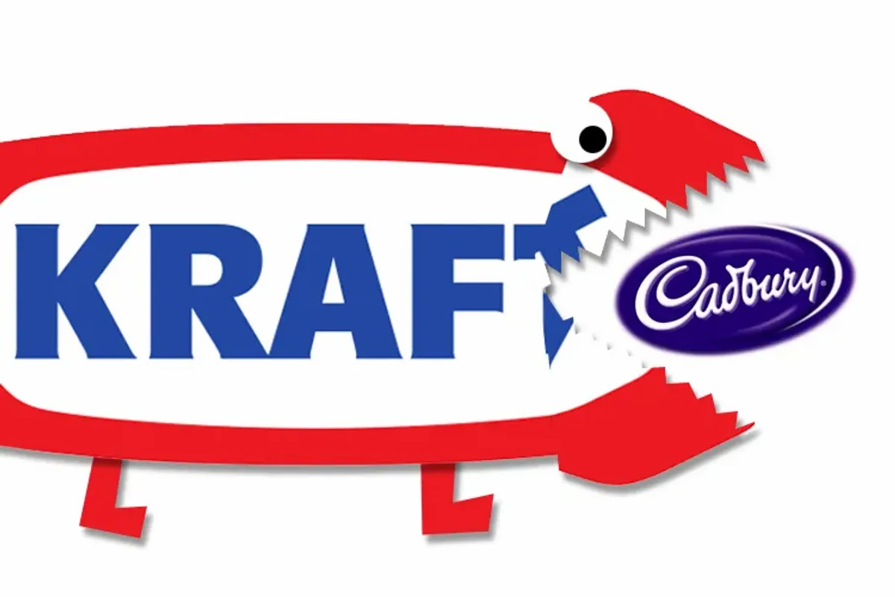
Hostile Takeover
The target company doesn’t want the acquirer to acquire it
The takeover is without the consent of the board of directors of the target company.
The acquirer will directly go to the shareholders of the company to acquire the shares of the target company without letting the management of the target company know about such actions.
The target company can use several mechanisms to defend itself against a hostile takeover including:
  Poison Pill
  The crown jewel defense
  Pac Man defense

Slide 11

Hostile Takeover
Kraft acquisition of Cadbury
2010 saw the most controversial takeover of British Cadbury by the American giant Kraft Foods.
Kraft hopes to acquire Cadbury to expand its global influence, especially in the snack category from emerging markets such as India.
Cadbury did not sell, posing a major challenge to Kraft’s search for Cadbury.
UK’s takeover code, leading the UK to modify takeover rules on how foreign companies acquire British companies.
Many people in the M&A field believe that it has become too easy for foreign companies to acquire British competitors, and the process has become a bit sketchy.
The acquisition and merger team responsible for overseeing this area reviewed the law and revised the Takeover Code in September 2011 – the law was called “Cadbury Law”

Slide 12

Hostile Takeover
Kraft acquisition of Cadbury
$19.5 Billion
BENEFITS FOR KRAFT SHAREHOLDERS | NOT BENEFITIAL FOR CADBURY SHAREHOLDERS
TIMING AND PRICE: After recession, low price | DISCOUNT PRICE: Cadbury rejected the offer on the basis of undervalued Cadbury which was now of a lesser value. It was in fact even lower than the current Cadbury share price – £7.13 Net Value per share is lower than the 5-year average trading
GLOBAL MARKET SHARE: the biggest cross-border acquisition this year. Such a deal clearly pushed Kraft as number 1 dealer in confectionary. A merger allowed Kraft to gain a footing in the fast-growing chewing gum category. | JOB LOSSES: The unions are worried that the jobs of hundreds would be at stake (estimated 9000plus) as Kraft would try to reduce costs to operate efficiently and pay back its debts. The company has also not given any formal assurance that it would protect 4500 UK jobs. Also it is a known fact that when a company needs to cut costs, jobs and job conditions suffer.

Slide 13
Hostile Takeover
Kraft acquisition of Cadbury
$19.5 Billion
BENEFITS FOR KRAFT SHAREHOLDERS | BENEFITS FOR CADBURY SHAREHOLDERS
COST SAVINGS: A combination of Kraft products like Toblerone, Oreos and Ritz crackers with Trident gum and Dairy Milk chocolates from Cadbury would result in $625 million annual pretax cost savings on annual company costs of research and development, advertising, branding and procurement. | GLOBAL REACH: Cadbury would profit from Kraft’s extensive distribution network around the globe. Cadbury had been vulnerable to a takeover ever since it demerged its US soft drinks business. This high takeover bid was an attractive opportunity to do away with such a fear. A combined Kraft and Cadbury would significantly expand the global reach of both businesses and create synergies worth in the region of $625m. Since a stand-alone Cadbury “had limited opportunities for value creation,” agreement to the contract for takeover seemed like a wise decision.
REVENUE SYNERGIES: There would also be a significant level of revenue synergy ($50 billion annually) that would subsequently result in higher earnings per shar

Slide 14
Hostile Takeover
JetBlue acquisition of Spirit
BENEFITS FOR JETBLUE SHAREHOLDERS | NOT BENEFITIAL FOR SPIRIT SHAREHOLDERS
5th largest Airline in the US:shareholders would benefit From B6’s financial stability, revenue growth, and profitability; “Expected to Deliver Run-Rate Operational Synergies of $600-700 Million and to be Accretive to EPS in Year One.” Spirit Airlines N919NK Airbus A320-271neo. | UNILIKELY DEAL: completion risk to Spirit stockholders
GLOBAL MARKET SHARE: the biggest cross-border acquisition this year. Such a deal clearly pushed Kraft as number 1 dealer in confectionary. A merger allowed Kraft to gain a footing in the fast-growing chewing gum category. | BUSINESS MODEL: significantly diminished capacity on former Spirit routes, also resulting in higher prices for consumers.

Slide 15
Hostile Takeover JetBlue acquisition of Spirit
BENEFITS FOR JETBLUE SHAREHOLDERS | BENEFITIAL FOR SPIRIT SHAREHOLDERS
Stability, Growth and Synergies: shareholders would benefit financial stability, revenue growth, and profitability; 150 destinations | PRICE: A superior all-cash price of at least $33.50 per Spirit share, a premium of 51% to the implied value of the Frontier transaction as of June 28, 2022; Accretive to EPS in Year One – after operational synergies of $600-700
MARKET SHARE: The combination of the two airlines would position it as “the most compelling national low-fare challenger to the four large dominant US carriers by accelerating the reach of its “JetBlue Effect” – combination of low fares and quality. The combined airline will create the fifth-largest airline in the United States. | FREE MONEY: Shareholders will receive $2.50 per share owned right away (13% more than Frontier’s prepaymen), and then beginning in January of 2023, another $.10/share every month the deal does not close up to $34.15/share if not closed by July of 2024. Spirit shareholders would receive more cash in the unlikely event a JetBlue deal is terminated ($4.30 per share assuming the ticking fee is paid in full) than they would receive if the Frontier transaction is consummated ($4.13 per share).

Slide 16
Hostile Takeover JetBlue acquisition of Spirit
BENEFITS FOR JETBLUE SHAREHOLDERS | BENEFITIAL FOR SPIRIT SHAREHOLDERS
 | IF THE DEAL DOES NOT GO THROUGH: If the deal is not approved, Spirit is in a position to try another merger. Depending on the market position of competitors at that point in the future, Spirit may find itself as the lead in that deal as Frontier was in the proposed merger. Spirit was already one of the fastest growing airlines in the US with more than a hundred new A320s on order, it could continue to grow, strengthen and improve its stand-alone position without any adverse effect on travelers.
 | BUSINESS MODEL: significantly diminished capacity on former Spirit routes, also resulting in higher prices for consumers.

Slide 17
Hostile Takeover
An acquirer may proceed with the hostile takeover using any of the following strategies:
  Tender Offer: In a tender offer, the acquirer company makes a public offer to purchase shares from the shareholders of the target company at a price more than the current market price.
  Proxy Fight: In proxy fights, the acquirer company makes the shareholders of the target company agreed to use their proxy votes in a way that is in favor of the acquirer company so that they could make the desired changes in the target company or in its management.

Slide 18
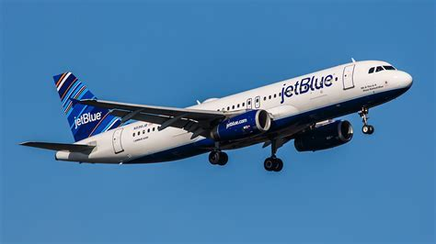
Hostile Takeover – Case Study
April 5 | JetBlue officially made an unsolicited offer of $33 per share in cash earlier this week, beating a near $25 per share cash-and-stock bid from Frontier made in February (ULCC.O).
Apr 29 | JetBlue CEO in a letter to Spirit Chairman H. McIntyre Gardner and CEO Christie: “While we would unquestionably prefer to negotiate a transaction with you, if you continue to refuse to constructively engage with us so that we can deliver this value to your stockholders, we are actively considering all other options available to us,”
May 2 | Spirit Board rejects JetBlue deal: “Frontier deal had a better chance of passing muster with regulators and would be better for investors in the long run”. Also, the Justice Department is suing JetBlue and American Airlines, seeking to unwind a partnership between those two airlines. A trial is scheduled to begin this fall. CEO of Spirit sends a letter to JetBlue’s CEO. JetBlue had accused Spirit’s board of not looking out for shareholders’ best interests in spurning JetBlue’s offer, while Spirit and Frontier suggested that JetBlue was merely trying to spoil their deal and fend off a potential new rival.

Slide 19
Hostile Takeover – Case Study
The May 2 Letter to JetBlue
May 2, 2022
Robin Hayes
Chief Executive Officer
JetBlue Airways Corporation
27-01 Queens Plaza North
Long Island City, NY 11101
Dear Mr. Hayes:
We have reviewed JetBlue's updated proposal dated April 29, 2022, with Spirit's Board of Directors and its legal and financial advisors. Our Board has unanimously determined that JetBlue's proposal does not constitute a "Superior Proposal" under Spirit's existing merger agreement with Frontier.
..............................................

Slide 20
JETBLUE
Letter to SPIRIT shareholder
Multiple Spirit directors have significant ties to Frontier’s controlling shareholder, Bill Franke, resulting in a conflicted Spirit Board more focused on securing an inferior transaction with Frontier than maximizing value for its own shareholders.
While negotiating for eight months with Frontier, Spirit’s Board never seriously considered any alternatives, resulting in an original merger agreement with Frontier that was clearly suboptimal, with a low premium, no reverse break-up fee, and no divestiture commitment. Frontier has improved its offer twice only because we launched our “vote no” campaign.
The Spirit Board consistently ignored or refused to engage with JetBlue until faced with certain defeat on the original shareholder meeting date and then, in an attempt to avoid the widespread perception of its poor corporate governance, pretended to engage with JetBlue.
The Spirit Board continues to forgo any engagement or good faith negotiation with JetBlue, publicly rejecting our latest proposal in less than a day without ever discussing the amended terms.
Don’t let the Spirit Board’s allegiances to Frontier’s controlling shareholder keep you from the most value creating opportunity. This is the time to make your voice heard and deliver a clear message to the entrenched Spirit Board that you want the superior JetBlue transaction.
Vote AGAINST the Frontier transaction today.

Slide 21
Hostile Takeover – Case Study
May 9 | Uncertainty of any deal
May 16 | JetBlue made an official tender offer (Filed an SEC TO) valued at $3.2 billion and said it was willing to pay more if Spirit cooperated with an acquisition. Note: Sundown Acquisition Corp. (SPV) JetBlue said Monday that it was taking its offer to acquire Spirit Airlines directly to that carrier’s shareholders, after Spirit’s board rejected a takeover proposal and decided to stick with its plan to merge with Frontier Airlines. In a statement, JetBlue said it was offering $30 a share to buy all of Spirit’s outstanding stock, a move known as a tender offer. That share price, setting the total purchase price at more than $3.2 billion, was slightly less than it originally offered to Spirit. After JetBlue announced its tender offer, Spirit said its board would review the proposal and share its position with shareholders within 10 business days. The airline encouraged shareholders to take no action on JetBlue’s tender offer until that review is concluded. JetBlue said it had filed a “vote no” proxy statement calling for Spirit shareholders to reject the Frontier merger. JetBlue said that its all-cash offer was currently worth 60 percent more than Frontier’s cash-and-stock proposal. Frontier’s share price has fallen by about a third since it announced its merger with Spirit, reducing the value of its bid

Slide 22
Hostile Takeover – Case Study
June 28 | Spirit Airlines, Inc. ("Spirit" or the "Company") (NYSE: SAVE) today reaffirmed its commitment to its merger agreement with Frontier Group Holdings Inc. (“Frontier”) (NASDAQ: ULCC), parent company of Frontier Airlines, Inc., and commented on the most recent revised offer from JetBlue Airways Corporation ("JetBlue") (NASDAQ: JBLU) received on June 27, 2022. Spirit has scheduled the Special Meeting of Stockholders (the “Special Meeting”) to approve the proposed merger with Frontier for Thursday, June 30, 2022, at 9:00 a.m., Eastern Time. All stockholders of record as of the close of business on May 6, 2022, are entitled to vote at the Special Meeting. The Spirit Board of Directors strongly recommends you vote FOR the merger on the WHITE proxy card today. If you have already voted, remember that a proxy vote can be changed. For more information on how to vote for the merger, please call the Company’s proxy solicitor, Okapi Partners.

Slide 23
Reverse Takeover
A reverse takeover (RTO) is a process whereby private companies can become publicly traded companies without going through an initial public offering (IPO).
A private company buys enough shares to control a publicly-traded company.
An RTO is also sometimes referred to as a reverse merger or a reverse IPO.
A reverse merger is an attractive strategic option for managers of private companies to gain public company status.
It is a less time-consuming and less costly alternative to the conventional initial public offerings (IPOs).

Slide 24
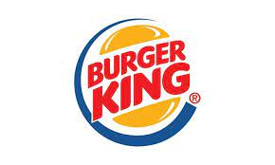
Reverse Takeover
Burger King
June 2012: The Miami-based company’s return to the stock market comes less than two years after it was taken private in a $3.26 billion sale to Brazilian investment fund 3G Capital Management LLC and at a time when restaurants are struggling to make gains against fast-food leader McDonald’s Corp.
Burger King debuted at $14.50
Burger King were taken private just 18 months before they decided to go public to initiate growth. They merged with Justice Holdings, an investment company based in London.

Slide 25
Backflip Merger
BA backflip takeover is a type of takeover that occurs when an acquirer becomes a subsidiary of the company it purchased.
Upon completion of the deal, the two entities join forces and retain the name of the company that was bought.
A backflip takeover is usually pursued by companies that want to expand and simultaneously revamp their image.
The acquired company usually benefits from the vast financial resources of the acquiring company, helping it grow.

Slide 26
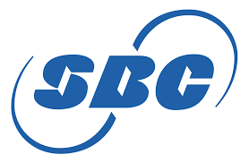
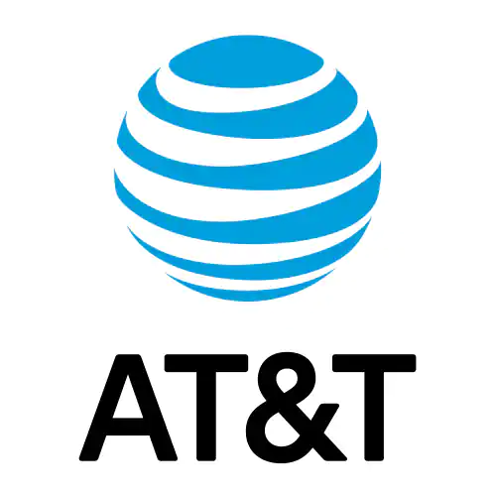
Backflip Merger
SBC Communications acquisition of AT&T
In 2005, SBC Communications purchased AT&T for $16 billion and retained the AT&T name, while the SBC name was absorbed into the overall company. SBC did this because AT&T was and is one of the most popular brand names in the world and has one of the longest histories of a telephone company.
SBC bought AT&T because the merger allowed SBC to grow significantly, accessing AT&T's large network and customer base, allowing other subsidiaries of SBC to expand beyond their regional areas of the business to become a truly national player.
With this merger, SBC became the largest provider of data and phone services to corporate entities in America, and AT&T lived on through the merger in a business that it was otherwise struggling in.

Slide 27
Antitakeover Defenses –
Poison Pills and Shark Repellent Concepts
Shareholders’ Rights Plans – Give existing shareholders the opportunity to buy additional stock at a discounted price – making the takeover more expensive (from increased shares) – Papa John’s (PZZA) – MBO by ousted founder John Schnatter.
Voting Rights Plans – a clause that the board of directors adds to its charter to regulate the voting rights of shareholders who own a predetermined percentage of the company's stock (i.e., 20%, or supermajority vote) – Avon Products
Staggered Board if Directors and Proxy Fights– time consuming tactic to vote out the entire board of directors making the proxy fight a challenge for the prospective raider (staggered – directors elected at different times)
White-Knight – A strategy that enables a company's management to thwart a hostile bidder by selling the company to a bidder they find more friendly. Walt Disney defended hostile bid by Saul Steinberg by Sid Bass and JPM and Bear Stearns
Pac-Man Defense – Acquiring the Acquirer – Porsche / Volkswagen (Porsche accumulation of VW backfired)

