Slide 1





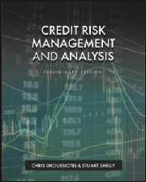

US Banking System, Credit Markets, Financial Crisis and Macroeconomics
LECTURE #2
Chapter 2
“Credit Risk Management & Analysis”

Slide 2
Agenda
The U.S. Banking System:
Investment Banking
Commercial Banking
Credit Markets & Macroeconomics
The Role of the Fed
Regulatory Framework
(Financial Crisis, Bank, Dott Frank, BASL I, II, IIII, Guidelines)

Slide 3
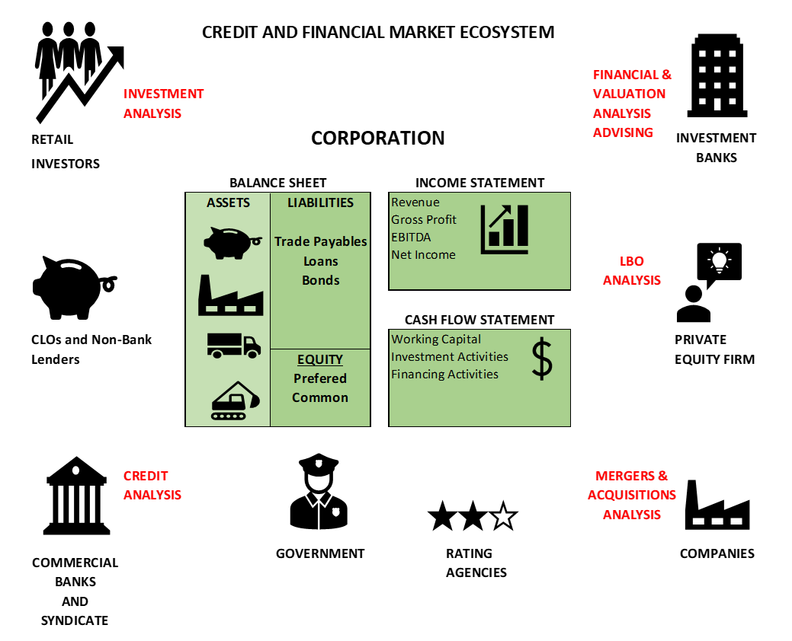
Credit Markets & Macroeconomics Overview

Slide 4
Investment Banking
Primary Function
Facilitates capital formation and market liquidity
Acts as an intermediary between issuers (corporations, governments) and investors

Slide 5
Investment Banking
Core Activities
Capital Markets
Equity issuance (IPOs, follow-ons)
Debt issuance (investment-grade, high-yield bonds)
Mergers & Acquisitions (M&A)
Advisory on acquisitions, LBOs, divestitures, restructurings
Sales & Trading
Market-making in equities, fixed income, derivatives
Structured Finance
Securitization, leveraged finance, CLO structuring

Slide 6
Investment Banking
Risk Profile
Market risk (rates, spreads, equity prices)
Counterparty credit risk
Liquidity and operational risk
Role in Credit Markets
Underwrites and distributes credit risk to investors
Prices risk via spreads, covenants, and structure

Slide 7
Commercial Banking
Primary Function
Provides credit intermediation and payment services
Core engine of credit creation in the economy

Slide 8
Commercial Banking
Key Activities
Deposit-taking (retail and corporate)
Lending:
Consumer loans (mortgages, auto, credit cards)
Commercial & industrial (C&I) loans
Commercial real estate (CRE)
Treasury services and cash management

Slide 9
Commercial Banking
Credit Risk Focus
Borrower cash flow and repayment capacity
Collateral and recovery values
Loan structuring and covenant protection
Balance Sheet Model
Maturity transformation: short-term deposits → long-term loans
Interest rate risk management critical
Why It Matters
Commercial banks are systemically important
Failures directly impact households and businesses

Slide 10
Credit Markets & Macroeconomics
Credit Markets
Public markets: corporate bonds, asset-backed securities
Private markets: bank loans, private credit, direct lending
Structured credit: CLOs, MBS, ABS

Slide 11
Credit Markets & Macroeconomics
Macroeconomic Linkages
Interest rates determine borrowing costs
Economic growth drives credit demand
Inflation affects real returns and default risk
Labor markets influence consumer credit performance

Slide 12
Credit Markets & Macroeconomics
Credit Cycle
Expansion → easy credit, tight spreads
Peak → aggressive underwriting
Contraction → rising defaults, widening spreads
Recovery → deleveraging and repricing of risk
Key Insight
Credit risk is cyclical, not static

Slide 13
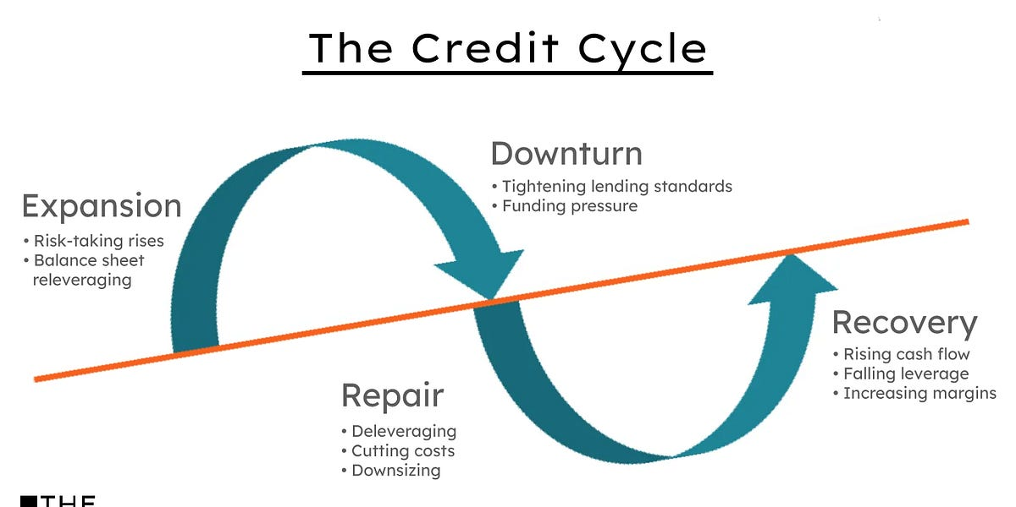
The Credit Cycle – Phases of Cycle
1. Expansion
Economic growth accelerates
Credit availability increases
Lending standards loosen
Credit spreads tighten
2. Peak
Aggressive underwriting
High leverage and covenant-lite loans
Asset prices inflated
Risk is underpriced

Slide 14
The Credit Cycle – Phases of Cycle
3. Contraction
Economic slowdown or shock
Defaults rise
Credit spreads widen
Banks tighten lending standards
4. Recovery
Deleveraging
Balance sheet repair
Risk repricing
Conservative underwriting returns

Slide 15
The Role of the Federal Reserve
Mandate
Price stability
Maximum employment
Financial system stability

Slide 16
The Role of the Federal Reserve
Core Tools
Monetary Policy
Federal Funds Rate
Open market operations
Balance Sheet Tools
Quantitative easing (QE)
Quantitative tightening (QT)
Supervisory Role
Stress testing (CCAR)
Bank examinations

Slide 17
The Role of the Federal Reserve
Crisis Role
Lender of last resort
Liquidity backstop for the financial system
Why It Matters for Credit
Interest rates affect:
Loan demand
Credit spreads
Asset valuations
Liquidity conditions influence default risk

Slide 18
The Role of the Government and Government Agencies
The Role of the US Federal Reserve (Fed)
To promote a Stable and Healthy US Economy by Implement the U.S. Monitory Policy
Money Supply
Set Interest Rates
Provides Financial Service to Banks
The Role of the Federal Deposit Insurance Corporation (FDIC)
Insure bank Deposits up to $250,000
The Role of the Office of the Comptroller of the Currency (OCC)
Regulates and supervises National Banks

Slide 19
Central Banks and Monetary Policy
Countries use a “Central Bank” to implement and administer their monetary policy – controlling interest rates and money supply
The US uses its Federal Reserve Banking System (the Fed) in conjunction with the US Treasury
Money Supply refers to the amount of a country’s currency that is available for the payment of goods and services as well as for the repayment of debt.
Most of the Money Supply is not actually in the form of physical notes but rather is recorded in the form of mortgages, US Treasuries, and Deposits and Loans.
Monetary Policy, which refers to the governance of interest rates
Money Supply, impacts liquidity (available funds), the flow of money, and the cost of borrowing, all of which has implications for inflation.
Decreases Money Supply by issuing debt (Bills <=1 year, Notes between >1, <10 years, Bonds longer than 10 years, the most popular are 10 and 30) and Increases Money Supply by Buying Treasuries, which also lowers rates
Inverse relationship between Price and Rate

Slide 20
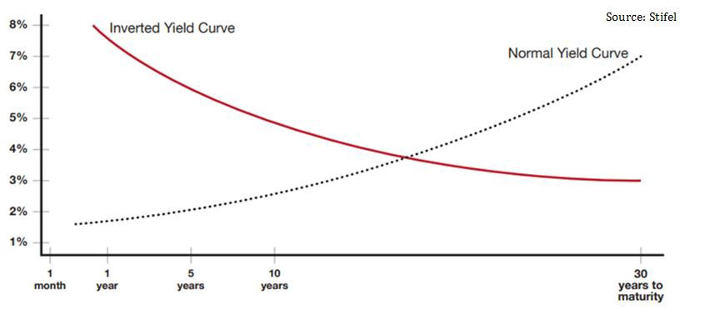
Normal vs Inverted Yield

Slide 21


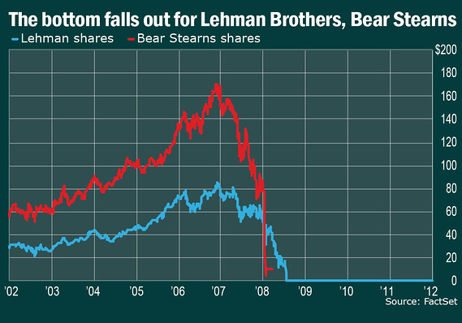
Regulatory Framework
Financial Crisis (2008) – The Turning Point
Excess leverage, weak underwriting, opaque structured products
Systemic risk materialized through interconnected institutions

Slide 22
COVID19
Federal Government passed two stimulus spending packages (2020 & 2021):
$1.9 T - Coronavirus Aid, relief and economic security CARES Act
$2.3T – Consolidated Appropriations Act (CAA)
Banks flush with deposits at low cost of borrowings, generated huge profits

Slide 23
SVB’s Business Model (Not a Typical Retail Bank)
Silicon Valley Bank specialized in:
Venture capital firms
Startups and tech companies
Life sciences and VC-backed enterprises
Key concentration risks
Depositors were:
Corporate, not retail
Highly correlated (VC ecosystem)
Mostly uninsured (> $250k FDIC limit)
Deposits were large, mobile, and confidence-sensitive
📌 This made SVB structurally vulnerable to a rapid run.

Slide 24
SVB’s Business Model (Not a Typical Retail Bank)
The Balance Sheet Mismatch (Core Problem)
Assets
Large portfolio of long-duration fixed-income securities
U.S. Treasuries
Agency MBS
Purchased when interest rates were near zero
Liabilities
Short-term deposits
Mostly demand deposits from startups and funds
📌 Classic maturity and duration mismatch

Slide 25
Regulatory Framework
Dodd-Frank Act
Strengthened oversight of systemically important banks
Introduced:
Enhanced capital and liquidity requirements
Stress testing and resolution planning (“living wills”)
Restricted proprietary trading (Volcker Rule)

Slide 26
Regulatory Framework – Basel Framework (I, II, III)
Basel I
Minimum capital requirements
Risk-weighted assets (simple framework
Basel III
Higher quality capital (Common Equity Tier 1)
Liquidity requirements:
LCR (Liquidity Coverage Ratio)
NSFR (Net Stable Funding Ratio)
Countercyclical buffers
Basel II
Three pillars:
Minimum capital requirements
Supervisory review
Market discipline
Greater reliance on internal risk models

Slide 27
Regulatory Framework
Why Regulation Matters
Limits excessive risk-taking
Protects depositors and financial stability
Shapes how banks:
Price credit
Allocate capital
Manage balance sheets

Slide 28
Regulatory Framework
Big Picture Takeaway
The U.S. banking system connects capital markets, credit creation, and economic growth
Investment banks price and distribute risk
Commercial banks originate and manage credit
The Fed controls liquidity and systemic stability
Regulation constrains risk—but also reshapes incentives

Slide 29
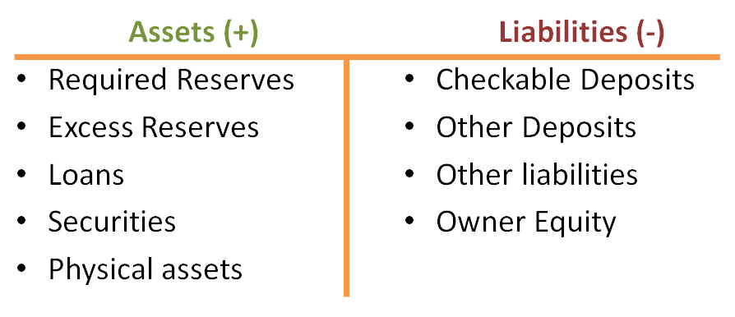
Bank Balance Sheet (How Banks Actually Take Risk)

Slide 30
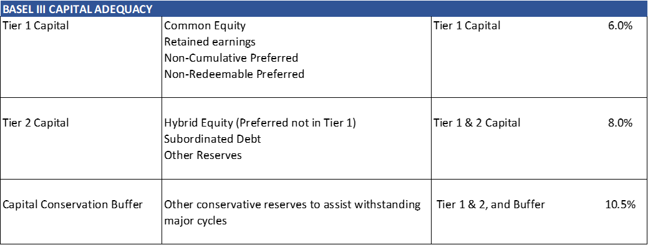
Role of Regulators, Bank Equity, and Capital Adequacy
Regulators ensure the Safety and Soundness of US banking institutions, primarily for the protection of the depositors
OCC – Office of the Comptroller of the Currency): primary regulator
FDIC – Federal Depository Insurance Corporation: Insures bank deposits up to $250,000 per account (not necessarily owner of account)
Bank Charters:
OCC – Federal (Savings Associations) and National (National Banks)
State Charter – State Comptrollers
The Capital Adequacy Ratio (CAR) of Risk Based Capital (Tier 1 Capital and Tier 2 Capital) to Risk Weighted Assets (RWA):

Slide 31
Role of Regulators, Bank Equity, and Capital Adequacy
Regulators ensure the Safety and Soundness of US banking institutions, primarily for the protection of the depositors
OCC – Office of the Comptroller of the Currency): primary regulator
FDIC – Federal Depository Insurance Corporation: Insures bank deposits up to $250,000 per account (not necessarily owner of account)
Bank Charters:
OCC – Federal (Savings Associations) and National (National Banks)
State Charter – State Comptrollers
The Capital Adequacy Ratio (CAR) of Risk Based Capital (Tier 1 Capital and Tier 2 Capital) to Risk Weighted Assets (RWA):

Slide 32
Corporate Banking: CAMELS Bank Ratings
The OCC regulates banks and performs regular reviews of banks, with the largest banks under constant regulatory review, due mainly to their massive size and risk in the event of a negative outcome. Bank regulators have developed a rating scale from 1 to 5, where 1 is the highest and 5 being the lowest, wherein the regulators measure banks against various operational, qualitative, and quantitative attributes. The rating systems is an acronym called CAMELS, which stands for:
Capital Adequacy – discussed previously.
Asset Quality – discussed above – see ACL.
Management
Earnings
Liquidity – interest rate sensitivity and ability to convert assets to cash.
Sensitivity – to certain risk exposures
The regulators of banks provide lists of banks and their respective CAMELS ratings, however, will oddly not provide any insight into the basis for the ratings nor details behind how each bank ranked on each attribute.
Any bank with a rating below 2 is considered troubled

Slide 33
Corporate Banking Loan Money Terms
Amount:
The amount of money borrowed, which is typically the “Face” amount of the loan, note, or bond
Interest Rate:
The annual rate paid (accrued) each year to compensate for the time value of money and risk
Repayment Schedule: (Amortization Schedule)
Date certain, schedule of payments of interest and principal over the life of the loan
Maturity:
Date of final repayment in full of the loan plus accrued interest and penalties and any other fees
Collateral:
The security for the loan (house, car, equipment, intangible assets, etc.)

Slide 34
Corporate Banking: TVM concepts can be used to calculate Loans as well
LOAN
Principal (Loan Amount) plus Risk-Free Interest for each period the Principal is outstanding until its return equals the Future Value of the initial principal Amount
P = Principal
i_{r} = risk-free interest rate per annum
n = number of periods
FV = Future Value of original Principal Amount
FV = P * (1 + i_{r})^{n} (1.1)
We then add a Risk Premium (i_{rp}), to compensate for the assessed credit risk: risk (probability) of default, and loss given the event of default – including all costs and net of recoveries
FV = P * (1 + (i_{r} + i_{rp})) ^{n} (1.2)
Most Bonds have semi-annual interest payments, having a payment frequency (f) of 2 per annum
FV = P * (1 + (i_{r} + i_{rp})/f) ^{n*f} (1.3)

Slide 35
Corporate Banking: Repayment (Amortization) Schedule
Fixed Constant Principal Payments: Straight Line
Each repayment of principal reflects a given equal amount per period
P = A / (Term * f): [P = Principal Payment Amount]
Fixed Sculpted, Balanced or Uneven Principal Payments:
The payments of principal are fixed and known, yet are different from period to period, presumably to accommodate for varying cash flows of the borrower
Balloon Payments:
A large fixed payment to be made some period in the future, after a grace period or a term of reduced payments. The Balloon payment may be the final maturity payment.
Fixed P&I (Principal & Interest):
Mortgage – payments in arrears, no payment at time zero
P&I = A / ((1- (1 / (1+i)^{n})) / i) (1.4)
Lease Schedule – payments in advance – first payment made at time zero
P&I = A / (((1- (1 / (1+i) ^{(n-1)})) / i) +1) (1.5)

Slide 36
Corporate Banking: Typical Corporate Loan and Bond Debt Schedule

Slide 37
Corporate Banking: Typical Mortgage Type Payment Schedule

Slide 38
Corporate Banking: Reserves - Allowance for Credit Losses
Risk Weighted Assets (RWA - refers to the value of a bank’s assets as adjusted for reserves.
“Reserves” refers to the concept of the bank making a reserve for potential future credit losses.
Allowance for Credit Losses (ACL) was developed after the Global Financial Crisis (GFC) of 2008.
ACL is an accounting concept, providing for a “contra asset” account (credit balance), which reduces the gross value of balance sheet assets by a credit loss provision in much the same way accumulated depreciation estimates the declining value of property plant and equipment by creating a contra asset reducing the net carrying value of the fixed assets of an enterprise.
ACL was developed to replace the old notion of Allowance for Loan and Lease Losses (ALLL)
Current Estimate of Credit Losses (CECL) - current period accruals
Developed from “bottoms up analysis at loan level” – NAAH, not really, but almost!

Slide 39
Corporate Banking: Bank Asset Rating Categories
All commercial banks, credit agencies, and institutions that lend money to corporations, focus on the following five areas of analysis when rating the Borrower and the loan based on the probability of default.
Loan-to-value (LTV) or debt capitalization ratio: This ratio, expressed as a percentage, compares the enterprise debt to its’ total capital, or total value of the asset or business. It is important to look at each tier of credit in the capital structure to examine priorities and collateral interests.
Leverage ratio of debt to EBITDA or EBIT: This leverage ratio, or debt to cash flow ratio, is one of the most popular ratios to used analyze the solvency and credit quality of a company.
Coverage ratios describing the Borrower’s ability to service either Interest alone or the combination of Interest and Principal, include EBITDA / interest and cash flow (EBITDA) to debt service (Principal and Interest):
Cash flow forecasts, typically using a 30% haircut to base projections:
Customized operating ratios based on the company’s business that which can be cyclical or seasonal or depend on commodity pricing

Slide 40
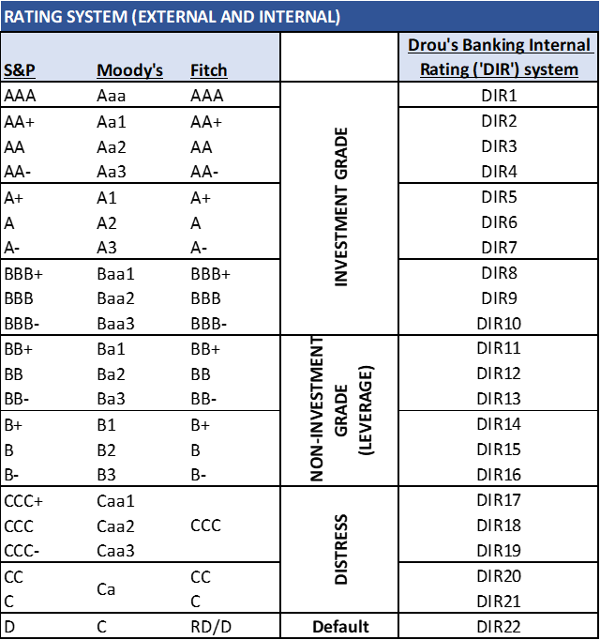
Bank Asset Rating Categories
Based on how each borrower and loan is assessed against the ratios and measures, most banks use a rating scale for their internal portfolio risk management. An example of which is below:

Slide 41
Corporate Banking: Basic Bank Loan Products
Bank commercial lending products may be categorized in one of two types primarily constructed around the nature of the assets they are collateralized with:
Short-term working capital revolving credit facilities
Equipment, real estate, or corporate term loans (based on enterprise values)
Working Capital Facilities
Revolving credit facilities: because they are self-liquidating, are paid down through cash collections and reborrowed constantly
Often structured with a Lockbox _ account control agreement – requiring collections o be controlled and “swept” agsint the loan outstandings
Orange County Lamborghini example
Secured by Inventory and Receivables
ABL – Business Credit Structures
Rigorous asset level monitoring and auditing, and strict controls over cash, lockbox and sweeps
Receivables Factoring: discussed in Chapter 15
Merchant Cash Advances: discussed in Chapter 15

Slide 42
Corporate Banking: Basic Bank Loan Products
Wholesale Banking and Syndicated Credit Facilities:
Larger borrowers or those where an ABL structure isn’t required or suitable – see Tyson Foods Case Study
Term Credit Facilities: typical bank duration is 3-7 years, other than certain mortgages secured by generic real estate (office buildings, etc, not factories)
Equipment Term Loans:
Specialized equipment lending against fungible equipment assets such as medical equipment or trucks (often in the case of sole proprietorships using SBA (Small Business Administration) loans
Mortgage Term Loans:
Term loans secured by real property, unless fungible such as office buildings, will likely be shorter term loans -5-7 years, and lower advance LTVs
Corporate Term Loans:
Most corporate term loans fall into this category, low LTV secured by all fixed assets and often all assets in a single collateral pool along with the working capital revolving credit facility (revolver)

Slide 43
Basic Bank Loan Products
Stretch Senior term loan:
Secured by all assets, LTVs possibly higher than typical, requiring extra risk premium
Term Loan A, B, C:
The differentiation of tranches of senior term loans may simply designate the maturity spectrum each tranche covers but may also represent different loan agreements and different types of holders or lenders.
Second Lien Term Loan:
A second lien loan is one that may or may not have a primary perfected lien on assets uniquely to that loan, but rather has a second lien security interest in collateral which other lenders may have a primary security interest.
Subordinated Term Loan:
While a second lien or springing lien term loan has a subordinated interest and claim against collateral ahead of trade creditors and other constituents such as employees or customers, a Subordinated Lender has specifically relegated themselves by their credit agreements to a subordinated position, which may be secured, but most often is not, to ensure the trade creditor positions are not impaired. Subordinated debt may be a structural requirement of the borrowers’ trade creditors and have nothing to do with the leverage or other indebtedness of the company.

Slide 44
Corporate Banking: Commercial Finance – Equipment Finance
Appropriate for Asset Intensive Borrowers – Initial loans against Original equipment Costs (OEC), High LTV, 3-7 years
Equipment loans are often provided by the Commercial Finance or Leasing units within banks or non-bank Commercial Finance companies such as Stonebriar Commercial Finance or Encina Commercial Finance. Leasing as a product is discussed in Chapter 13 later in this book.
Rigorous monitoring and establishment of procedures to ensure the equipment is adequately maintained by the borrower to protect the value of the collateral. In many cases equipment lenders will install remote tracking devices on equipment and may also install controlled “shut-off” switches to enable the lender to control a borrower’s use and access to equipment.
Commercial equipment finance requires specialized monitoring and unique asset valuation skills, and the lenders often have substantial secondary sales marketing activities supporting the end-of-life monetization of equipment as collateral.
End-of-life (EOL) analysis is important to lending against equipment assets, and constantly reviewing the collateral condition and value against current market replacement costs and the decay curve of the collateral – the declining value of a new piece of equipment over its useful life.
Commercial Finance lenders are concerned about replacement cost of equipment as a protection of their collateral value – decay curve of its depreciating market value is important
Best performing asset class in the global financial crisis (GFC)

Slide 45
Corporate Banking: Parties to a Credit Agreement
Two primary parties to a credit agreement: (1) Borrower, and (2) Lender. There may be others such as documentation agent, collateral agent, trustee (in securitizations and syndications) and asset audit firm (in ABL and Commercial Finance).
Borrower: The Borrower is the commercial business or enterprise which is seeking to borrow debt capital to fund their operations, acquire a building, facilities, equipment, inventory, or another business, or simply to support their growth. The attributes of the Borrower are essential to the structure and nature of the credit Facility developed and underpin the rate the bank will charge for the risk they are taking.
Borrower Risk:
i) Collateral
ii) Creditworthiness of Borrower
Investment grade v. non-investment grade
Historical financial performance
Revenues
EBITDA – Earnings Before Interest Depreciation and Amortization
DSCR – Debt Service Coverage ratio
iii) Management
iv) Competition
v) Customers

Slide 46
Corporate Banking: Parties to a Credit Agreement
Lender: Banks private lenders and non-bank lenders, such as Commercial Finance companies or Business Credit providers
skills in an industry or with managing and monitoring an asset class, such as rail cars or truck trailers, beer kegs or marine containers.
Banks, as discussed previously are constrained by their regulatory construct

Slide 47
Corporate Banking: Banking Units
Origination and Relationship Management
Industry Groups
Geographic Groups
Wholesale Banking
Middle Market Banking
Product Specialists: LBO, Leasing, ABL, Project Finance, Venture Credit, Commercial Paper, etc.
Credit & Underwriting – approves the loans and manages the potfolio, including CECL and ACL
Operations - Asset Management, Monitoring, and Reporting (AMMR) – manages the book of loans
Finance & Treasury – funds the banks balance sheet
Audit & Review
Syndications and Asset Sales
Capital Markets
Investment Banking
Wealth Management

Slide 48
Corporate Banking: Credit Underwriting and Structuring
Complete various internal documentation of a credit review process
Initial Client Evaluation Questionnaire – background on client
Management Capability and Moral Standing Review: Client Acceptance Memo – CAM template – foundational critical gating preqialifcation of potential borrower, size, industry, location, business (years in business and business model), assets as collateral, and character of borrower
Historical Financial Performance Review: Business Plan Evaluation and Assessment Memo – BEAM template – historical financial analysis and financial forecast with pro-forma financial statements and debt capital as contemplated
Collateral Review: - BEAM
Business Plan Review: - BEAM
Credit Underwriting and Structuring Review: - BEAM
Investment Screening Memo – ISM template – which ultimately becomes the Investment Committee Memo, when it is taken to committee for approval

Slide 49
Corporate Banking: Credit Underwriting and Structuring
Debt Capacity Analysis
Revolving Credit Capacity:
Inventory aging analysis by type – Raw Materials, WIP and finished Goods.
Inventory Turns (COGS / Inventory)
Seasonality – a review of the seasonality of sales demand cycles will enable the lender to establish the inventory variability throughout the year and the needs for having more inventory in one period than another to ensure adequate supplies to fulfil customer orders and the manufacture of finished goods to fulfill customer orders.
Manufacturing cycle
Raw materials commodity risk and exposure, and substitution availability and marketability (including access to remote locations)
Freight into manufacturing or distribution warehouses
Accounts Receivable
Quality
Aging – collectability
Revenue and collections cycle
Maximum Debt Capacity Analysis: Establish the predictable recurring EBITDA levels to refine the determination of the maximum available indebtedness of the enterprise. The capacity may be dependent on the type of credit instruments and structure contemplated – see Tyson foods case study
Term Debt Capacity Analysis: Derived from the Maximum debt Capacity less the revolver – Note: the Revolver is both “self-liquidating” (best lenders assets) and does not require amortization – so maximize this first!

Slide 50
Corporate Banking: Loan Covenants
To establish early warning signs
To ensure cash flow performance and repayments are made according to the borrower and lender agreed undertakings.
Typical Performance Covenants include the following:
Minimum EBITDA
Minimum Equity
Minimum EBITDA to Interest of
Minimum EBITDA to Principal and Interest (“Debt Service”) – called a Debt Service Coverage Ratio (DSCR)
Various reporting and governance covenants as well as maxmimum indebtedness and minimum cash and equity are also common
Investment Grade loans often have no collateral and no covenants
Global Crossing
Enron
LBO Structures

