Slide 1

Mergers & Acquisitions
Professor Chris Droussiotis
Lecture 2: REGULATORY ENVIRONMENT

Slide 2
Understanding Federal Securities Laws
Securities Act of 1933 - governing Primary Market
  Protection of Investors (disclosure, registration)
Securities Act of 1934 - governing Secondary Market
  Protection of Investors (trading practices, manipulation, Insider Trading)
  On-going reporting (10k, 10q, 8k)
  Proxy Solicitations

Slide 3
Regulation of Mergers & Acquisitions
M&A regulation seeks to balance corporate growth with market fairness and investor protection.
Anti-Trust Regulations – focusing on Consumers/Competitors:
  Sherman Act (1890)
  Clayton Act (1914)
  Hart-Scott-Rodino Act (1976)
  Williams Act (1968)
  Protection Rights Regulation – focusing on Shareholders:
  SEC Regulations 13D, 13G, 14D
  Sarbanes-Oxley Act (2002)
  Fair Disclosure (FD)

Slide 4
Understanding Antitrust Legislation
The Sherman Act (1890)
    Prohibits new business combination resulting in monopolies (Primary Market)
  Existing firms growing to a dominance position
    Standard Oil breakup (1911).
    AT&T breakup (1982).

Slide 5

Case Study: The Sherman Act (1890)
Standard Oil (1911): The Supreme Court found Standard Oil engaged in monopolistic practices (price-fixing, predatory pricing) and ordered it broken into 34 independent companies (e.g., Exxon, Chevron).
Key “Baby Standards” (Modern Successors)
Standard Oil of New Jersey (Esso) → became Exxon, later merged with Mobil to form ExxonMobil (1999).
Standard Oil of New York (Socony) → became Mobil, merged with Exxon.
Standard Oil of California (Socal) → became Chevron.
Standard Oil of Indiana → became Amoco, merged with BP in 1998.
Standard Oil of Ohio (Sohio) → became part of BP.
The Ohio Oil Company → later known as Marathon Oil; pipeline unit became Marathon Petroleum.
Continental Oil (Conoco) → merged with Phillips Petroleum to form ConocoPhillips.

Slide 6

Case Study: The Sherman Act (1890)
AT&T (1982): DOJ ruled AT&T a monopoly in telecom. Settlement broke it into seven “Baby Bells” to restore competition in phone services. (Ameritech, Bell Atlantic, BellSouth, NYNEX, Pacific Telesis, SBC Communications).
In 2000, Bell Atlantic merged with NYNEX = Verizon,
The others also merged back and took the name AT&T.

Slide 7
Understanding Antitrust Legislation
The Clayton Act (1914)
Expanded antitrust protections.
  Price discrimination
  Tying of Contracts
  Prohibits one company from buying the stock of another company if their combination results to reduced competition.
  Examples:
  Staples & Office Depot merger blocked (1997, 2016).
  DuPont divestiture of GM stake (1957).

Slide 8


Case Study: Clayton Act (1914)
DuPont & GM (1957): DuPont owned a large stake in General Motors, giving it influence over a competitor’s supply decisions. Court ruled this violated Clayton Act’s prohibition on anti-competitive ownership and forced DuPont to divest.
In 1917, DuPont (a chemical company) began buying large blocks of General Motors (GM) stock.
By the 1920s, DuPont owned about 23% of GM, becoming its largest shareholder. DuPont executives also sat on GM’s board, which gave them influence over GM’s purchasing decisions.
This raised concerns because DuPont was a major supplier of paints, finishes, and other materials to GM, meaning it could steer GM’s procurement toward DuPont products and away from competitors.

Slide 9


Case Study: Clayton Act (1914)
Staples & Office Depot (1997, 2016): FTC blocked the mergers, arguing combined firms would dominate office supply retailing and raise prices for consumers.
Staples and Office Depot were two of the three main players (Staples, Office Depot, OfficeMax) dominating this niche.
The merger was blocked under the Clayton Act because it would have eliminated head-to-head competition between Staples and Office Depot, substantially lessening competition and likely leading to higher prices and less choice in the defined market of office supply superstores.

Slide 10
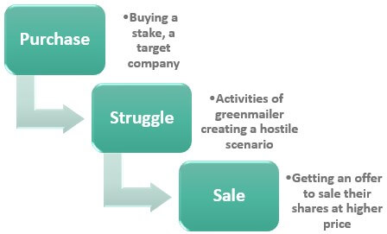
Shareholder Protection Regulation
The Williams Act: Regulation of Tender Offers (1968) – Regulation TO
  Regulation 13(D) and 13(G)
  Regulation 14 (D) – Acquisition and tender offer rules
GREEN MAIL

Slide 11
Shareholder Protection Regulation
Williams Act (1968)
  Regulation of Tender Offers – SEC Regulation TO
    Protects shareholders during tender offers and hostile takeovers.
  Requires full disclosure of intent, source of funds, and plans for the company (Regulation 13D & 13G)
  Allows shareholders time to evaluate tender offers.

Slide 12
Shareholder Protection Regulation
  SEC Regulation 13D
    Requires disclosure when an investor acquires more than 5% of a company’s shares with intent to influence control.
    Filing must be made within 10 days of crossing threshold.
  Example:
  T. Boone Pickens’ takeover bids (1980s) – hostile attempts at Gulf Oil & Unocal triggered Williams Act defenses.

Slide 13
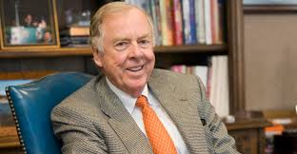
Case Study: Williams Act (1968)
T. Boone Pickens (1980s): Oilman used hostile tender offers (e.g., Gulf Oil, Unocal) to pressure management. The Williams Act required him to disclose funding sources and intentions, giving shareholders more time to decide.
In 1983, oilman T. Boone Pickens, through his company Mesa Petroleum, began quietly acquiring shares of Cities Service (later targeted Gulf Oil in 1984).
He used “wolf pack” tactics: teaming with other investors to quickly accumulate large stakes.
Under the Williams Act, once Pickens crossed the 5% ownership threshold, he had to file a Schedule 13D, disclosing:
The size of his stake.
Source of financing.
His intentions (control or merger).

Slide 14
Shareholder Protection Regulation
  SEC Regulation 13G
    Purpose: Alternative to 13D for passive investors (e.g., index funds, mutual funds).
    Must also disclose ownership >5%, but certify no intent to influence control.
  Example:
  Vanguard or BlackRock filing 13G forms for large passive stakes in public companies.

Slide 15
Shareholder Protection Regulation
  SEC Regulation 14D
    Governs the process of tender offers.
    Ensures equal treatment of all shareholders.
    20 business Days offer period
    Requires disclosures, minimum offer periods, and withdrawal rights.
  SEC Regulation 14D-9
    The target company’s board must respond within 10 days, recommending whether shareholders should accept, reject, remain neutral, or express no opinion.
  Example:
  JetBlue buying Spirit Air

Slide 16
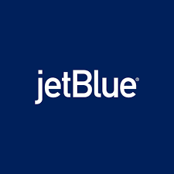

Case Study: SEC 14D and 14D-9
In February 2022, Spirit Airlines announced a merger agreement with Frontier Airlines.
Shortly after, JetBlue made a higher competing offer to acquire Spirit.
Tender Offer
In May 2022, after Spirit’s board rejected its proposal, JetBlue launched a hostile tender offer directly to Spirit shareholders for $30 per share in cash.
JetBlue filed Schedule TO (Tender Offer Statement) under Regulation 14D, detailing:
  Financing sources.
  Conditions of the offer.
  Its strategic rationale (creating the 5th-largest U.S. airline).

Slide 17
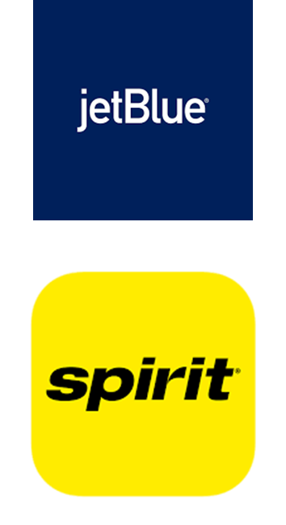
Case Study: SEC 14D and 14D-9
Spirit Board’s Response – Schedule 14D-9
Spirit’s board filed a Schedule 14D-9 with the SEC recommending shareholders reject JetBlue’s offer.
Rationale:
  Spirit argued JetBlue’s bid faced a high risk of antitrust rejection by DOJ.
  Spirit preferred the Frontier merger, which it said offered more regulatory certainty, even if the cash price was lower.
Over several months, Spirit amended its 14D-9 filings as negotiations evolved.

Slide 18

Case Study: SEC 14D and 14D-9
Outcome
Spirit shareholders initially sided with the board, voting to delay JetBlue’s hostile bid.
Eventually, in July 2022, Spirit terminated its Frontier merger agreement after shareholder pushback and entered into a merger agreement with JetBlue for $3.8 billion.
The JetBlue–Spirit case shows how Regulation 14D protects shareholders by requiring full disclosure and a formal board response, ensuring investors can make informed decisions in contested takeovers.

Slide 19
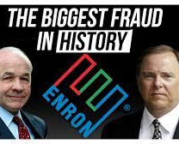
Shareholder Protection Regulation
  The Sarbanes-Oxley Act of 2002 (“SOX”)
  Improves financial transparency, Financial Disclosure, auditing practices, corporate governance, Responsibility
  Impact on M&A:
    Enhanced due diligence requirements.
    Increased compliance costs.
  ENRON & WorldCom CASE:
  Enron scandal, series of events that resulted in the bankruptcy of the U.S. energy, commodities, and services company Enron
  Mark-to-Market accounting
  Transfer troubled assets to Special purpose entities

Slide 20

Shareholder Protection Regulation
  Fair Disclosure (Regulation FD)
  Manipulation
  Ensures all investors have equal access to material information.
  Prevents selective disclosure to analysts, institutional investors, or insiders.
  Applies to public companies communicating earnings, forecasts, or deal information
  ELON MUSK/TESLA CASE:
  Social Media announcement
  Taking Tesla private at $420 per share

Slide 21
Understanding Antitrust Legislation
Hart-Scott-Rodino Act (1976)
Pre-merger notification system with Federal Trade Commission (FTC) & Department of Justice (DOJ.
Allows antitrust review before closing deals.
  Example
  Facebook–Instagram acquisition (2012).

Slide 22


Case Study: Facebook Acquiring Instagram
The Deal
In April 2012, Facebook announced it would acquire Instagram, a then-tiny photo-sharing app with about 30 million users but no revenue.
Purchase price: $1 billion (cash + stock).
Because the transaction exceeded HSR thresholds, Facebook had to file pre-merger notification with the FTC and DOJ.
🔹

Slide 23
Case Study: Facebook Acquiring Instagram
HSR Pre-Merger Review
Under the HSR Act (1976):
  Both buyer (Facebook) and seller (Instagram) filed HSR forms.
  FTC had a 30-day window to review and decide whether to challenge, extend, or clear the deal.
FTC Review (2012):
  Examined whether the acquisition would substantially lessen competition in the social networking or photo-sharing markets.
  FTC voted 5–0 to approve the deal in August 2012, just before Facebook’s IPO.
🔹

Slide 24
Case Study: Facebook Acquiring Instagram
Why Approved at the Time
Instagram was small, unprofitable, and not seen as a standalone competitive threat to Facebook.
Regulators argued users had many alternatives (Flickr, Twitter photo-sharing, Picasa, etc.).
The acquisition was framed as Facebook buying Instagram’s talent and technology rather than eliminating a competitor.
🔹

Slide 25
Case Study: Facebook Acquiring Instagram
Aftermath & Re-Evaluation
Post-acquisition, Instagram’s user base exploded under Facebook’s resources:
  By 2018, Instagram had over 1 billion active users.
  Became Facebook’s primary growth engine and key to mobile/social advertising dominance.
By the late 2010s, critics argued the FTC underestimated Instagram’s competitive potential and missed a chance to block a deal that cemented Facebook’s market power.
In 2020, the FTC (joined by 48 state attorneys general) filed an antitrust lawsuit against Facebook, citing its acquisitions of Instagram and WhatsApp as “illegal monopolization strategies.”
While courts initially dismissed parts of the case, litigation continues as a test of whether regulators can retroactively challenge previously approved mergers.

Slide 26
Case Study: Facebook Acquiring Instagram
Significance for HSR
Shows limits of HSR review: regulators can only judge based on information available at the time.
Sparked a broader debate about “nascent competition” — whether acquisitions of small but fast-growing startups (like Instagram, WhatsApp, or AI companies today) should be blocked to prevent “killer acquisitions.”
It remains one of the most controversial approvals in modern antitrust history.
The Facebook–Instagram case illustrates both the mechanics of HSR pre-merger review and the challenges regulators face in predicting long-term competitive effects, especially in fast-moving tech markets
🔹

Slide 27
Understanding Antitrust Legislation
The Hart-Scott-Rodino Act (1976)
  Acquisitions involving companies of specific size cannot be completed until certain information is supplied to federal government and specified waiting period has elapsed.
    Based on Size of transaction (Assets)
    Based on Size of parties’ test (Sales)
    Based on Size of the acquisition
    Waiting Period (30 days and 15 days for cash tender)

Slide 28
Understanding Antitrust Legislation
HORIZONTAL MERGERS
  Market Share
  Testing HH Index Formula
  i.e. – 5 firms:
  30%, 25%, 20%, 15%, 10%
  (30^2 + 25^2 +…. ) = 2250
  75%, 10%, 5%@ remaining 3 firms
  (75^2 + 10^2 + …) = 5800
  Based on 10,000 (100%)
VERTICAL MERGERS
  Supply Chain Control

