Slide 1


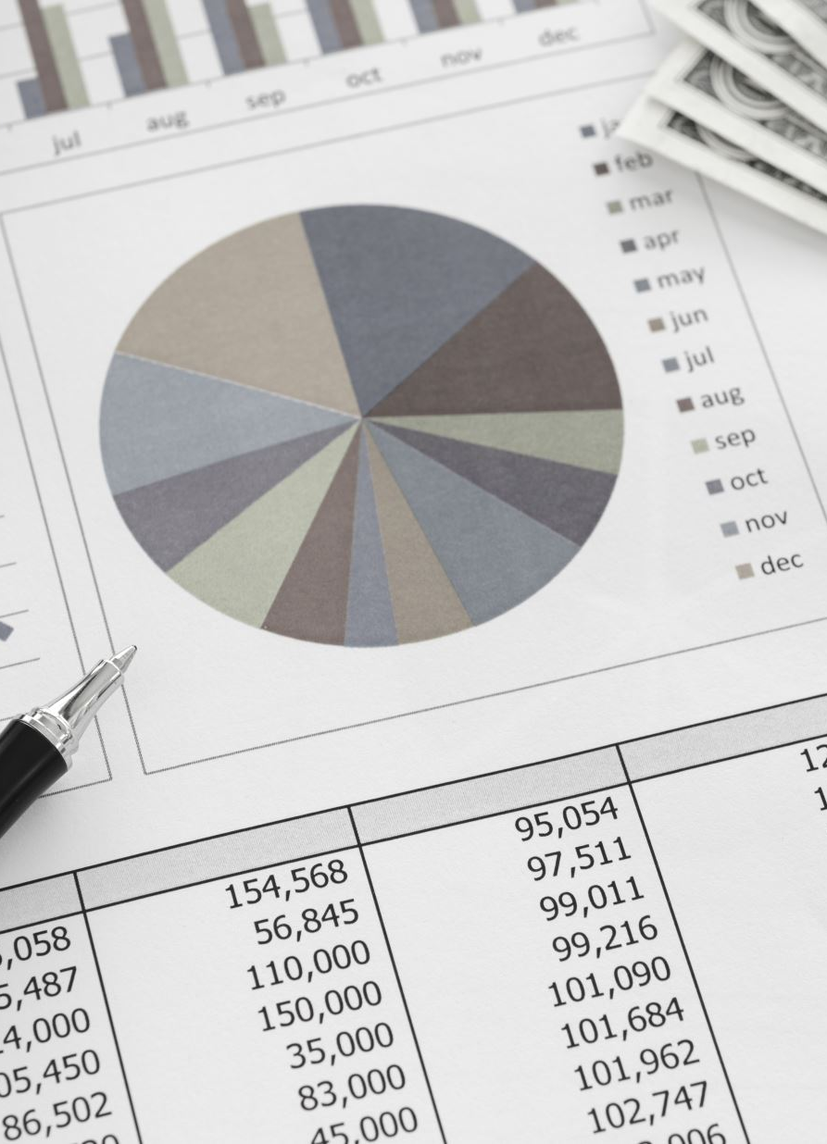


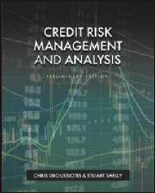

Introducing Credit Basics,
LECTURE #1
Time Value of Money and Risk & Return

Slide 2
Credit Basics
What’s This?

Slide 3
Credit Basics
Top Line, bottom line and Cash Flow Expectation

Slide 4
Credit Basics
Top Line, bottom line and Cash Flow Expectation
New Debt Service
Debt Service

Slide 5
Credit Basics
Top Line, bottom line and Cash Flow Expectation
New Debt Service
Debt Service

Slide 6
Credit vs Investment
CREDIT
Credit Expectation (Lender Mindset)
Core question: Will I get my money back, on time, with interest?
Credit expectation is about capital preservation first, return second.
INVESTMENT
Investment Expectation (Equity / VC / PE Mindset)
Core question: How big can this get, and what multiple can I earn?
Investment expectation is about value creation and upside, accepting risk of loss.

Slide 7
Credit vs Investment
CREDIT
What creditors expect
Defined return: Interest + principal
Asymmetric payoff:
Upside is capped (coupon + fees)
Downside is severe (default, restructuring)
Priority in capital structure: Senior to equity
Predictability over growth
INVESTMENT
What investors expect
Undefined return: Depends on exit
Asymmetric payoff (opposite of credit):
Downside capped at invested capital
Upside theoretically unlimited
Last in the capital structure
Growth, scale, optionality

Slide 8
Credit vs Investment
CREDIT
Key metrics lenders focus on
Cash flow coverage (DSCR, Interest Coverage)
Leverage ratios
Asset collateral / security
Covenants and downside protection
Probability of default (PD) and loss given default (LGD)
📌 Success = no surprises
INVESTMENT
Key metrics investors focus on
Revenue growth and TAM
Margins and operating leverage
Competitive advantage / moat
Exit multiples and timing
IRR and MOIC (multiple on invested capital)
📌 Success = outsized wins that cover losses

Slide 9
Risks that are pushing the Value Line down
FIELDS OF FINACE
Finance & Investment
Credit Risk Management Analysis
EXIT
Risk (Volatility)
Expected Value Line Growth (Return)
Finance Strategies to Keep the Value Line Up
Initial
Investment
ENTRY
3 FACTORS BEFORE YOU INVEST
Measure Expected Return
Quantify Risk
Set Time (Exit)

Slide 10
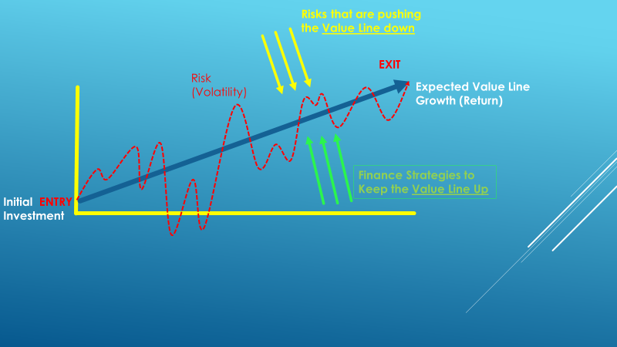
From the Prospective of Mgmt/Equity/Borrower
INVESTMENT
Risks that are pushing the Value Line Down:
Economy
Competition
Government
Disasters
Other Systemic/Firm Specific Risks
Strategies to Keep the Value Line Up
Operating Strategies
Transactional Strategies
Financing Strategies
Social Responsibility

Slide 11
From the Prospective of Lenders
CREDIT
Risks that is pushing the Value Line Down:
Economy
Government
Other Systemic/Firm and Asset Class Specific Risks
Strategies to Keep the Value Line Up
Loan / Bond Structure
Debt Capacity Analysis
Sound Credit Analysis – CAMEL Approach

Slide 12
Investment Math Basics: Time Value of Money Risk & Return Mortgage Calculation

Slide 13
Time Value of Money Concepts
One-Time Investment
Annuities or Even Annual Cash flows
Uneven Annual Cash Flows

Slide 14
One-Time Investment
Four Variables:
Future Value (The expected money you will get in the future)
Present Value (money you invest today)
Interest Rate
Growth of your money
Discount Rate
Cost of Capital
Opportunity Cost
Holding Period Return (HPR)
Internal Rate of Return (IRR) or Rate of Return (ROR)
Time

Slide 15
Calculating Future Value
What is the future value of $1,000 after 3 years if the interest rate is 5% compounded annually?

Slide 16
FV: Formula Method
After 1 year:
FV₁ = PV(1 + r) = $1,000(1.05) = $1,050.00
After 2 years:
FV₂ = $1,050.00(1.05) = $1,102.50 or
FV₂= PV(1 + r)² = $1,000(1.05)² = $1,102.50
After 3 years:
FV₃ = 1,102.50(1.05) = $1,157.63 or
FV₃ = PV(1 + r)³ = $1,000(1.05)³ = $1,157.63
After t years (general case):
FV_{t} = PV(1 + r)^{t}

Slide 17
Future Values: General Formula
FV = PV(1 + r)^{t}
FV = future value
PV = present value
r = period interest rate, expressed as a decimal
t = number of periods (time)
Interest factor = (1 + r)^{t}
To find future values

Slide 18
FV: Using Excel’s Financial Technology
Type the formula
Use a dialogue box
Click on Formulas > Financial > FV.
Fill in the Rate, number of periods (Nper), periodic payments (Pmt), and present value (Pv). Click OK.
Type the function
=FV(rate, nper, pmt, pv, type)

Slide 19
Compound Interest
What is the future value of $1,000 after 3 years if the interest rate is 5% compounded annually?

Slide 20
FV: Formula Methods
After 1 year:
FV₁ = PV(1 + r) = $1,000(1.05) = $1,050.00
After 2 years:
FV₂ = $1,050.00(1.05) = $1,102.50 or
FV₂= PV(1 + r)² = $1,000(1.05)² = $1,102.50
After 3 years:
FV₃ = 1,102.50(1.05) = $1,157.63 or
FV₃ = PV(1 + r)³ = $1,000(1.05)³ = $1,157.63
After t years (general case):
FV_{t} = PV(1 + r)^{t}

Slide 21
FV: Three Methods

Slide 22
Future Value – Example 3
Suppose a relative of yours deposited $10 at 5% interest into a savings account 200 years ago. How much would the investment be worth today with simple interest? With compound interest? What is the difference?
Simple 10 + 10 (0.05) (200) = 110
Compound FV = 10 (1+1.05) ^ 200 = 172,925.81

Slide 23
Calculate Present Value
We can use the future value formula to find the present value.
FV = PV(1 + r)^{t}
Rearrange to solve for PV = FV / (1 + r)^{t}
To find present values

Slide 24
Present Values – Example 2
Suppose when you were born, your parents wanted to begin saving for your college education and they estimated that after 17 years you would need $150,000. If they felt confident that they could earn 8% per year, how much did they need to invest when you were born?
150,000 , 17 years 8.0% = 150,000 / (1.08)^17 = 40,540.34

Slide 25
PV: Using Excel
Type the formula
Use a dialogue box
Click on Formulas > Financial > PV.
Fill in the Rate, number of periods (Nper), periodic payments (Pmt), and future value (Fv). Click OK.
Type the function
=PV (rate, nper, pmt, fv, type)

Slide 26
Calculating the Interest Rate
You are looking at an investment that will pay $1,200 in 5 years if you invest $1,000 today. How much interest does this investment earn?
Starting with FV = PV (1+i)^t
1,200 = 1,000 (1+i)^5
1,200/1,000 = (1+i)^5
[(1,200/1,000)^1/5] – 1= i
[(1.2)^0.20] – 1 = 1.0371 – 1 = 0.0371
i = 3.71%

Slide 27
Interest Rate using Excel
Type the formula
Use a dialogue box
Click on Formulas > Financial > RATE.
Fill in the, number of periods (Nper), periodic payments (Pmt), present value (pv), and future value (Fv). Click OK.
Type the function
= RATE(nper, pmt, pv, fv, type, guess)

Slide 28
Interest Rate – Example 2
Suppose you have a 1-year old son and you want to provide $75,000 in 17 years toward his college education. You currently have $5,000 to invest. What interest rate must you earn to have the $75,000 when you need it?
R = (fv / pv ) ^ 1/t – 1 = 17.27%

Slide 29
Interest Rate
Suppose you buy a home for $300,000 and sell it 5 years later for $400,000. What yearly interest rate did you earn?
PV = 300k, FV = 400k t = 5 I = (400/300) ^ 1/5 – 1 = 5.92%
Excel: Rate(time,pmt, PV,FV)

Slide 30
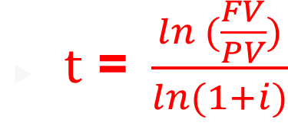
Calculate Time
You want to purchase a new car and you are willing to pay $20,000. If you can invest at 10% per year and you currently have $15,000, how long will it be before you have enough money to pay cash for the car?
FV = $20,000, r = 10%, PV=15,000 t=?
FV = PV (1+i) ^t
20/15 = 1.1^t
ln(20/15) = ln (1.1)^t) ln (20/15)/ ln (1.1) = ln (1.33 )/ ln (1.1) = 0.287/0.095 = 3.02
T = 3.02 years

Slide 31
Calculating Time using Excel
Type the formula
Use a dialogue box
Click on Formulas > Financial > NPER.
Fill in the Rate, periodic payments (Pmt), present value (pv), and future value (Fv). Click OK.
Type the function
=NPER(rate, pmt, pv, fv, type)

Slide 32
Number of periods
You buy a stock for $25 which you expect to grow at a rate of 7% each year. How long will it be before the stock is worth $50?
PV = 25
FV = 50
I = 7.0%
T = ?
T = Ln (FV/PV) / ln (1+i) = ln (50/25) / ln (1.07) = 10.24 years

Slide 33

One-Time Investment
FUTURE VALUE
FV = PV ${\left(1+i\right)}^{t}$
where FV is the future value of the investment, PV is the present value of the investment or the initial investment, i is the expected interest rate or rate of return of the investment, and t is time to realize such investment.
PRESENT VALUE
FV = PV ${\left(1+i\right)}^{t}$, then $PV=\frac{FV}{{\left(1+i\right)}^{t}}$
As an example, assuming the investor targets an investment that is expected to receive $133.10 in 3 years, representing a 10% interest or expected return (sometimes referred to as the discount rate), the investment required today will be calculated as follows:
$PV=\frac{FV}{{\left(1+i\right)}^{t}} = \frac{133.10}{{\left(1+.10\right)}^{3}} = \frac{133.10}{1.331}=100$

Slide 34

One-Time Investment
INTEREST RATES
If the investor knows the amount they are planning to invest today, and targets a specific investment payoff at a set time in the future, then the investor can rearrange the formula to calculate the interest (i) or discount rate that he or she will earn, as follows:
Starting at FV = PV ${\left(1+i\right)}^{t}$, then ${\left(1+i\right)}^{t}=\frac{FV}{PV}$ , and
$i$ = $({\frac{FV}{PV})}^{\frac{1}{t}}$ – 1
As an example, let’s assume the investor invests $100 today and targets an investment that expects to receive $133.10 in 3 years. What will the annual rate of return be on such an investment?
$i$ = $({\frac{FV}{PV})}^{\frac{1}{t}}$ – 1 $=({\frac{133.10}{100})}^{\frac{1}{3}}$ – 1 $=({1.331)}^{\frac{1}{3}}$ – 1 = 1.10 – 1 = 0.10 = 10%

Slide 35

One-Time Investment
TIME
If the investor knows the amount that they are planning to invest today, then sets a target payoff amount in the future and assumes a given rate of return, then he or she can calculate how long it will take to achieve the target. The time (t) to realize the targeted return is calculated by rearranging the formula as follows:
Starting at FV = PV ${\left(1+i\right)}^{t}$, then ${\left(1+i\right)}^{t}=\frac{FV}{PV}$, then adding ln on both sides, you get ${ln \left(1+i\right)}^{t}=ln(\frac{FV}{PV})$ , $t [\ln\left(1+i\right)]=ln(\frac{FV}{PV})$ , and
$t$ = $\frac{ln (\frac{FV}{PV})}{ln⁡(1+i)}$
As an example, assume the investor invests $100 today and wants to find out how long it will take for the investment to reach $133.10 if invested at an annual rate of return of 10%. The time to reach the targeted future value of such investment is calculated as follows:
$t$ = $\frac{ln (\frac{FV}{PV})}{ln⁡(1+i)}= \frac{ln (\frac{133.10}{100})}{ln⁡(1+0.10)}=\frac{ln (\frac{133.10}{100})}{ln⁡(1+0.10)}= \frac{ln (1.331)}{ln⁡(1.100)}= \frac{0.2859}{0.0953}=3 years$

Slide 36
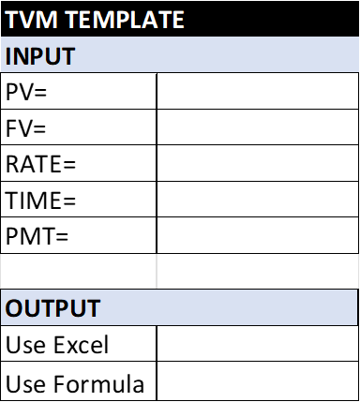
Annuity Investment
In Annuities we are adding the 5th variable (Annual Payment)
Here are the five Variables
Present Value (money you invest today)
Future Value (The expected money you will get in the future)
Interest Rate
Growth of your money
Discount Rate
Holding Period Return (HPR)
Internal Rate of Return (IRR) or Rate of Return (ROR)
Time
Payment (Even Monthly, Even Annual Payment)

Slide 37

Annuities or Even Annual Cash flows
Variable 1: FUTURE VALUE ANUITY (FVA)
FVA = CF + CF (1 + i) + CF (1 + i) (1 + i), or
FVA = CF ( $\frac{{(1+i)}^{t}−1}{i} )$
For example, if an investor invests $100 per year for 3 years and expects a 10% rate of return, then the value of such investment when it is cashed out in 3 years will be calculated as follows:
FVA = CF ( $\frac{{(1+i)}^{t}−1}{i} )=100 \left(\frac{{\left(1+0.10\right)}^{3}−1}{.10} \right)=100 \left(\frac{{\left(1.10\right)}^{3}−1}{.10} \right)= 100 \left(\frac{1.331−1}{.10} \right)= 331.00$

Slide 38

Annuities or Even Annual Cash flows
Variable 2: PRESENT VALUE ANUITY (PVA)
The present value of an annuity (PVA) can be calculated as follows:
PVA = $\frac{CF}{{(1+i)}^{1}}+ \frac{CF}{{(1+i)}^{2}}$ + $\frac{CF}{{(1+i)}^{3}}$ +…..+ $\frac{CF}{{(1+i)}^{n}}$, or
PVA = CF $[\frac{1−\frac{1}{{\left(1+i\right)}^{t}}}{i}]$
For example, if an investor expects to receive $100 per year for 3 years, then what is the present value for an investment if the investor expects to receive a 10% annual rate of return? The calculation of the present value of such an investment is as follows:
PVA = CF $[\frac{1−\frac{1}{{\left(1+i\right)}^{t}}}{i}]=$ 100 $[\frac{1−\frac{1}{{\left(1+.10\right)}^{3}}}{.10}]=100 [\frac{1−\frac{1}{1.331}}{.10}] = 248.69$

Slide 39
Annuity (Real-world) Example
You decide that starting when you are 20 years old you will save $3 a day for retirement. Every day you put $3 in a drawer. At the end of the year, you invest the accumulated savings ($1,095) in a brokerage account with an expected annual return of 12%. If you continue the practice every year until you are 65, how much money will you have?
CF = 10,095 , FV = ? , T= 45 years, PV = 0
FV = CF ((1+r)^t – 1) / r
FV = 1095 ((1+.12)^45 – 1 / .12
$1,487,261.89

Slide 40
Annuity - Cash Flow
If you would like to have $120,000 in your child’s college account in in 18 years and you can earn 6.5% per year, how much must you invest each year?

Slide 41
Who wants to be a millionaire?
How much money do you need to save each year to be a millionaire by the time you are 65 if you can earn an interest rate of 8% and you start saving when you are
20 years old:
30 years old:
40 years old
When you are born

Slide 42
Who wants to be a millionaire?
How much money do you need to save each year to be a millionaire by the time you are 65 if you can earn an interest rate of 8% and you start saving when you are
45? $21,852.21
30? $5,803.26
20? $2,587.28
Born? $541.35
FV=$1 mm
PV = 0
t =65-45 = 20 years
R = 8.0%
=pmt(

Slide 43
Annuity – Interest rate
What interest rate must you earn in order to have $500,000 in a savings account in 20 years in you contribute $2400 per year?

Slide 44
Excel based formulas for one-time and annuity investments:
For calculating all five variables for annuities including the present value, future value, rate of return, time and cash flows or payments (represent set additional payments received during the investment) use the following Excel formulas:
= PV (rate, years, payment, future value) or =pv(rate,nper,pmt,fv)
=FV (rate, years, payment, -present value) or =fv(rate,nper,pmt,pv)
=Rate (years, payment, - present value, future value) or =rate(nper,pmt,pv,fv)
=Nper (rate, payment, - present value, future value) or =nper(rate,pmt,pv,fv)
= Pmt (rate, years, -present value, future value) or =pmt(rate,nper,pv,fv)

Slide 45

Uneven Annual Cash Flows
If the investment expected to produce uneven annual cash flows to the investor, called payments, for a set time, using the same expected rate of return, then the investment is calculated differently. The present value of such cash flows is the sum of all the future cash flows discounted back at a given expected rate of return, as follows:
PV = $\frac{{CF}_{1}}{{(1+i)}^{1}}+ \frac{{CF}_{2}}{{(1+i)}^{2}}+\frac{{CF}_{3}}{{(1+i)}^{3}}+…\frac{{CF}_{t}}{{\left(1+i\right)}^{t}} …. PV= \sum{\frac{{CF}_{t}}{{(1+i)}^{t}}}$
For example, if an investor expects to receive $95 the first year, $92 the second year, and $105 the third year, what is the present value for such an investment if the investor expects a 10% annual rate of return? The calculation of the present value of such investment is as follows:
PV = $\frac{{CF}_{1}}{{(1+i)}^{1}}+ \frac{{CF}_{2}}{{(1+i)}^{2}}+\frac{{CF}_{3}}{{(1+i)}^{3}}= \frac{95}{{(1+0.10)}^{1}}+ \frac{92}{{(1+1.10)}^{2}}+\frac{105}{{(1+1.10)}^{3}}=$
$86.36+76.03+78.89=241.28$

Slide 46

Annuities or Even Annual Cash flows
FUTURE VALUE
FVA = CF + CF (1 + i) + CF (1 + i) (1 + i), or FVA = CF ( $\frac{{(1+i)}^{t}−1}{i} )$
For example, if an investor invests $100 per year for 3 years and expects a 10% rate of return, then the value of such investment when it is cashed out in 3 years will be calculated as follows:
FVA = CF ( $\frac{{(1+i)}^{t}−1}{i} )=100 \left(\frac{{\left(1+0.10\right)}^{3}−1}{.10} \right)=100 \left(\frac{{\left(1.10\right)}^{3}−1}{.10} \right)= 100 \left(\frac{1.331−1}{.10} \right)= 331.00$

Slide 47

Annuities or Even Annual Cash flows
PRESENT VALUE
The present value of an annuity (PVA) can be calculated as follows:
PVA = $\frac{CF}{{(1+i)}^{1}}+ \frac{CF}{{(1+i)}^{2}}$ + $\frac{CF}{{(1+i)}^{3}}$ +…..+ $\frac{CF}{{(1+i)}^{n}}$, or PVA = CF $[\frac{1−\frac{1}{{\left(1+i\right)}^{t}}}{i}]$
For example, if an investor expects to receive $100 per year for 3 years, then what is the present value for an investment if the investor expects to receive a 10% annual rate of return? The calculation of the present value of such an investment is as follows:
PVA = CF $[\frac{1−\frac{1}{{\left(1+i\right)}^{t}}}{i}]=$ 100 $[\frac{1−\frac{1}{{\left(1+.10\right)}^{3}}}{.10}]=100 [\frac{1−\frac{1}{1.331}}{.10}] = 248.69$

Slide 48
Mortgage Calculation

Slide 49

Uneven Annual Cash Flows
If the investment expected to produce uneven annual cash flows to the investor, called payments, for a set time, using the same expected rate of return, then the investment is calculated differently. The present value of such cash flows is the sum of all the future cash flows discounted back at a given expected rate of return, as follows:
PV = $\frac{{CF}_{1}}{{(1+i)}^{1}}+ \frac{{CF}_{2}}{{(1+i)}^{2}}+\frac{{CF}_{3}}{{(1+i)}^{3}}+…\frac{{CF}_{t}}{{\left(1+i\right)}^{t}} …. PV= \sum{\frac{{CF}_{t}}{{(1+i)}^{t}}}$
For example, if an investor expects to receive $95 the first year, $92 the second year, and $105 the third year, what is the present value for such an investment if the investor expects a 10% annual rate of return? The calculation of the present value of such investment is as follows:
PV = $\frac{{CF}_{1}}{{(1+i)}^{1}}+ \frac{{CF}_{2}}{{(1+i)}^{2}}+\frac{{CF}_{3}}{{(1+i)}^{3}}= \frac{95}{{(1+0.10)}^{1}}+ \frac{92}{{(1+1.10)}^{2}}+\frac{105}{{(1+1.10)}^{3}}=$
$86.36+76.03+78.89=241.28$

Slide 50
Excel based formulas:
Excel formulas for calculating all five variables including the present value, future value, rate of return, time and cash flows or payments (represent set additional payments received during the investment):
= PV (rate, years, payment, future value) or =pv(rate,nper,pmt,fv)
=FV (rate, years, payment, -present value) or =fv(rate,nper,pmt,pv)
=Rate (years, payment, - present value, future value) or =rate(nper,pmt,pv,fv)
=Nper (rate, payment, - present value, future value) or =nper(rate,pmt,pv,fv)
= Pmt (rate, years, -present value, future value) or =pmt(rate,nper,pv,fv)

Slide 51

Rates of Return: Holding Period Return (HPR)
HPR = $\frac{CF}{I}$
where CF is the cash flow (inflow and outflow) during the investment period and I is the initial investment.
For example, if an investor buys the stock for $100 and sells it for $120 and during the investment he or she received $2 in dividends, then the cash flow on the numerator is $120 of proceeds for selling the stock plus $2 of cash dividends received (cash inflow) minus the initial investment of $100 (cash outflow), and the net cash flow is $22 = ($120 + $2 - $100). The HPR will be then be calculated by dividing the net cash flow of $22 by the initial investment of $100 resulting in a 22% return:
$$\frac{\left(120−100+2\right)}{100}=\frac{22}{100}=0.22=22\%$$

