Slide 1
Entrepreneurial Finance and Venture Capital
On-Line
July 20– Aug 1: 8:00am-11:00am
Professor Droussiotis
LECTURE 1 – INTRODUCTORY LECTURE

Slide 2
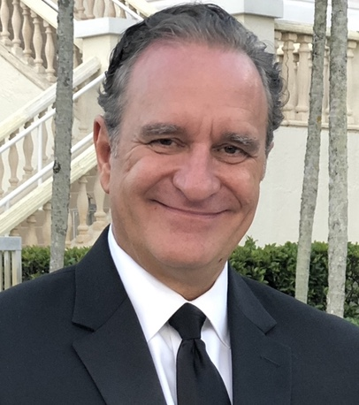
Speaker’s Biography
Chris Droussiotis’ training and expertise is in the area of Investment Banking. Possessing over 30 years of experience by working for numerous corporations in various executive management positions at Bank of America Merill Lynch, CIBC Oppenheimer, Mizuho Financial Group, Bank of Tokyo-Mitsubishi Trust UFJ, Sumitomo Mitsui Banking Corporation
Chris is a former Managing Director, General Manager and the Head of the Leverage Finance, Private Equity Sponsor Group & Structured Finance Department at Sumitomo Mitsui Banking Corporation (SMBC) managing a loan portfolio of over $10 billion of large cap and middle market leveraged loans, as well as investments in SPV funds, CLOs and BDCs that are backed by leveraged loans and high yield bonds.
On April 2018, Chris left SMBC and join Kinisis Ventures Limited (KV), as a Senior Managing Partner. At KV, Chris is responsible with the financial analysis and valuation of start-ups. Recently he obtained a certificate from Columbia University on Blockchain technology which will help KV expand its consulting services to adapt many of the blockchain applications in various industries including fintech, biotech, EdTech and shipping.
Chris is also an adjunct Finance Professor for the last 16 years teaching at various college and universities including at Columbia University, Fordham University, Baruch College and Seton Hall University.
Chris has published three books and one the way
“The Analytical Approach to Finance, Investments and Credit”) 2019
“Credit Risk Management and Analysis” 2022
“Credit Analyst’s Survival Manual” 2024
“Angel Investing & Venture Capital” Coming soon 2026
Chris Droussiotis
Senior Managing Partner
Kinisis Venture Limited

Slide 3
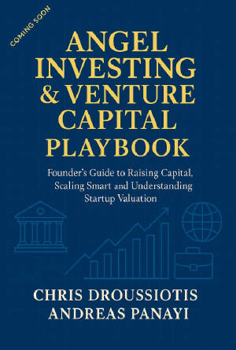





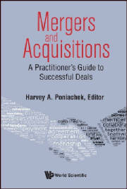


Slide 4
Instructor Name(s): Christakis (Chris) Droussiotis
Instructor Email(s): c.droussiotis@columbia.edu
Instructor’s Website: www.professordrou.com
Office Hours: Monday/Wednesdays 10:30-12:00am
Response Policy: https://calendly.com/professordrou/30min
Facilitator/Teaching Assistant: Office Hours: TBA
Response Policy: Respond to your emails within 24 hours

Slide 5
Course Description
This intensive 2-week course provides students with a comprehensive introduction to entrepreneurial finance and the management of new ventures.
The course explores how to identify business opportunities, validate ideas, design business models, and evaluate financing options.
Students will develop the skills to analyze start-up opportunities, understand the fundraising process, and prepare compelling venture presentations.

Slide 6
Course Objectives
By the end of this module, students will be able to:
Understand the start-up ecosystem and identify viable business opportunities through problem analysis, customer discovery, and basic market validation.
Apply Lean Start-up principles by developing MVP concepts, iterating on feedback, and designing effective business models and value propositions.
Demonstrate foundational entrepreneurial finance skills, including early-stage funding options, basic valuation techniques, and interpretation of key venture metrics (CAC, LTV, churn, burn rate).
Evaluate financing instruments and investor expectations, including angel/VC funding, SAFEs, convertible notes, and term sheet essentials.
Communicate and pitch a venture effectively, integrating business modeling, financial insights, and strategic narrative into a cohesive investor presentation.

Slide 7
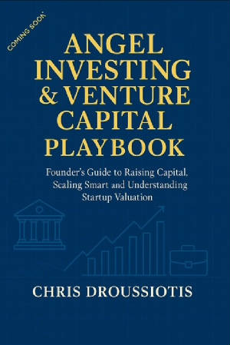
Supplemental Readings
Draft excerpts from the up and coming book “ Angel Investing and Venture Capital Playbook” C. Droussiotis, Cognella Publishing, December 2026
I will post supplementary articles, business cases, and Power Point Lecture Notes on Canvas and on my website www.ProfessorDrou.com on a regular basis.

Slide 8
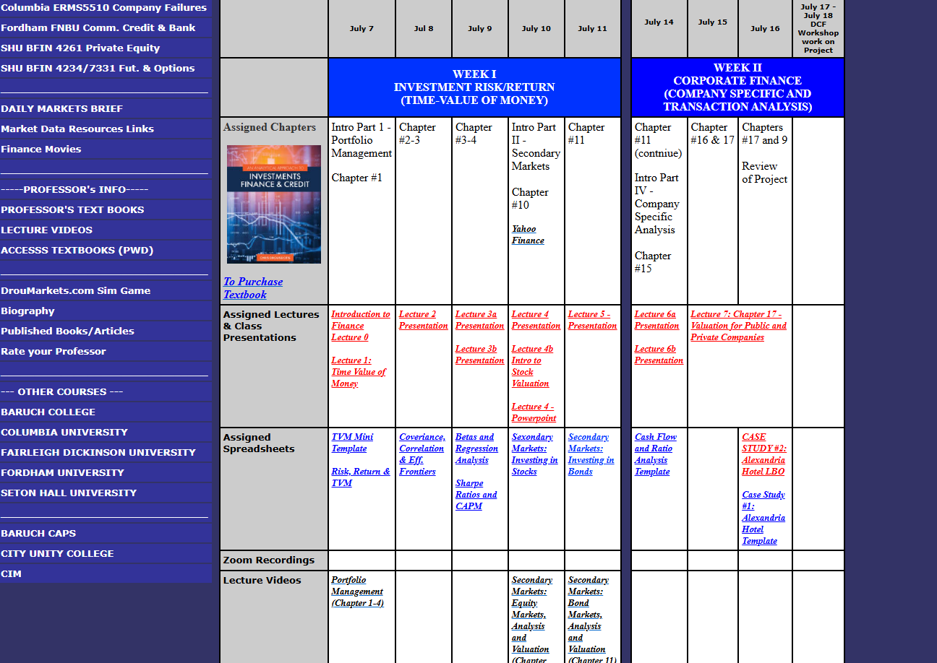
http://www,professordrou.com

Slide 9
Course Roadmap
Day | Objective | Description | Assignments
Week 1: Foundations of Entrepreneurship and Finance
Day 1 | L1 | Introduction to Entrepreneurship & the Start-up Ecosystem - Course overview, start-up lifecycle, venture landscape - Case: Successful vs. failed start-ups
Day 2 | L1 | Opportunity Recognition & Market Validation - Problem identification, customer discovery, TAM analysis - Workshop: Drafting initial opportunity hypotheses | Hmk #1 Due
Day 3 | L2 | Lean Start-up Methodology & MVPs - Building minimum viable products, iteration cycles - Team Exercise: MVP brainstorming for venture project | Hmk #2 Due
Day 4 | L2 | Business Models & Value Propositions - Business Model Canvas, competitive advantage, revenue models - Case study: Platform vs. product-based ventures | Hmk #3 Due
Day 5 | L3 | Entrepreneurial Finance Fundamentals - Early-stage financing needs, bootstrapping, sources of seed capital - Finance Lab: Basic valuation techniques (DCF, comparables, VC method) | Hmk #4 Due

Slide 10
Course Roadmap
Day | Objective | Description | Assignments
Week 2: Financing, Growth, and Venture Management
Day 6 | L4 | Angels, Venture Capital, and Alternative Financing - Funding stages, SAFE agreements, convertible notes, crowdfunding - Workshop: Drafting a mock term sheet | Presentation #1
Day 7 | L4 | Start-up Metrics that Matter - Traction, CAC, LTV, churn, burn rate - Finance Lab: Calculating and interpreting venture KPIs | Hmk #4 Due
Day 8 | L5 | Scaling, Growth, and Founder’s Dilemmas - Managing rapid growth, equity splits, governance challenges - Case study: Scaling pains in unicorn ventures | Hmk #5 Due
Day 9 | L3 | Pitching and Communicating the Venture Story - Investor perspective, storytelling with data, deck design - Team Practice: Mock pitch rehearsals with peer feedback | Preparation of Group Presentation
Day 10 | L5 | Final Team Presentations & Course Wrap-Up - Student venture pitches (simulated investor setting) - Feedback and reflections on entrepreneurial journeys | Final Group Presentation

Slide 11
Ice Breaker
Introductions
  Where are you calling from / High School
  What Grade in High School
  Knowledge of Excel (Scale 1-5)
One startup you admire
One business idea you have if any

Slide 12
Today's Questions
What is a startup?
Why do startups exist?
• Why do 90% fail?
• Why do investors fund companies with no profits?
• Can anyone become an entrepreneur?

Slide 13
What is Entrepreneurship?
Entrepreneurship is
The process of identifying a problem, creating an innovative solution, organizing resources, assuming risk, and building a scalable business that creates value.

Slide 14
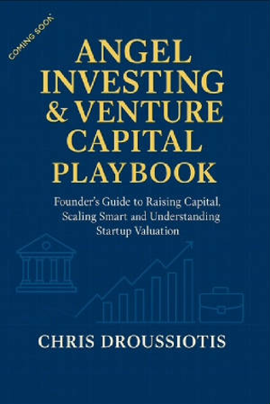
Excerpt from my new book
Like many investors, I have often asked myself the same question Bill Gross posed: Why do some startups succeed while so many others fail? Gross, founder of Idealab, shared one of the most influential studies on startup success. Having examined hundreds of companies, he identified five critical factors that consistently shaped outcomes:
Timing: Launching at the right moment accounts for more than 40% of success. For example, Zoom exploded in adoption during the COVID-19 pandemic as remote work became the global norm, and Airbnb thrived after launching during the 2008 financial crisis, when people were looking for affordable alternatives to hotels and new ways to earn money from spare rooms.
Team & Execution: A strong team with the ability to adapt and execute often outweighs the originality of the idea itself. For instance, Slack successfully pivoted himself from being a failed gaming company into the dominant workplace communication tool.
Idea: A differentiated, and compelling solution still matters. Google’s PageRank algorithm was not the first search engine, but it delivered vastly better results, quickly outpacing competitors like AltaVista and Yahoo Search.
Business Model: The ability to capture value through scalable revenue streams is crucial. Facebook refined its advertising-based model to monetize massive user engagement, creating one of the most profitable business models in tech history.
Funding: While the least important factor, sufficient capital enables execution and scaling. Tesla, for example, survived its early struggles largely because it was able to secure ongoing funding rounds and government incentives until its technology and market caught up.

Slide 15


Why Entrepreneurship Matters
Innovation
Economic Growth
Job Creation
Wealth Creation
Technology Advancement
Social Impact

Slide 16
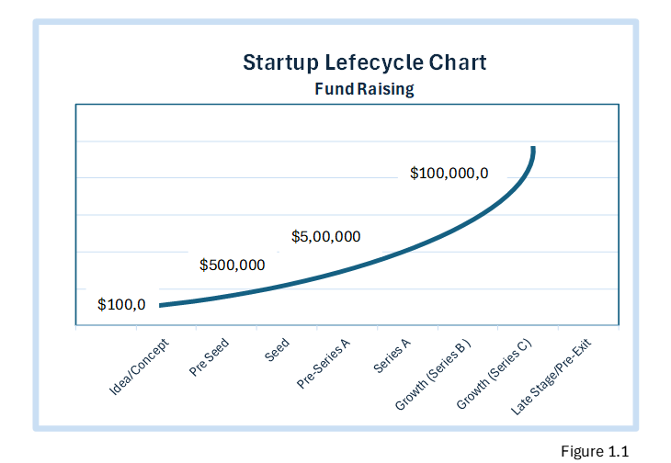
Defining Startup Stages
Idea or Concept Stage
Pre-Seed Stage /Validation
Seed Stage /Pre Commercial
Series A – Commercialization
Growth Stage – Customer Acquisition
Late Stage - Pre-Exit Phase

Slide 17
The Entrepreneurial Mindset
Vision with Flexibility. The most enduring founders hold fast to their mission but are flexible in execution. Netflix started as a DVD-by-mail company but pivoted to streaming before its competitors even grasped the shift. Its vision—to deliver entertainment directly to consumers—never changed, only the medium did.
Speed with Discipline. Moving fast is celebrated in startup culture, but speed without structure is reckless. Nubank, Latin America’s largest digital bank, balanced hypergrowth with rigorous compliance and customer trust, proving that rapid scale and risk control can coexist.
Optimism with Realism. Founders are natural optimists; they must believe in possibilities others overlook. Yet realism grounds ambition. Elon Musk’s grand visions for Tesla and SpaceX are backed by an unflinching confrontation with operational bottlenecks and financial risks. The best entrepreneurs dream big but plan cautiously.

Slide 18
Why Investors Bet on Founders
The phrase “bet on the jockey, not the horse” captures why investors often prioritize the founder team over the product itself. Markets shift, technologies age, and competition evolves, but a resilient, self-aware founder can steer through turbulence.
Investors know that great teams can transform average ideas into billion-dollar outcomes. Conversely, weak teams can waste extraordinary opportunities.
Founders who deeply understand their market problem also inspire confidence
Investors favor founders who turn limited resources into measurable results. Doing more with less signals both discipline and ingenuity
Products evolve; markets shift; but resilient founders rebuild until they find traction

Slide 19
What Investors Really Look For
A startup with modest revenue but rapid improvement in retention can be far more compelling than one with high but stagnant sales.
The narrative also needs to align with the data. When founders claim high engagement, investors will expect churn metrics to confirm it.
In practice, investors interpret startups through two complementary lenses: the quantitative and the qualitative—the numbers and the story. Numbers measure growth, efficiency, and opportunity. The story explains why those numbers matter, revealing the founder’s vision, leadership, and momentum. The most compelling startups integrate both, turning data into conviction and conviction into capital.

Slide 20
The Startup Ecosystem:
Networks, Capital, and Support Systems
Accelerators and incubators
Universities and research institutions
Angel Investors
Corporations – innovation subsidiaries

Slide 21
The Role of Timing and Market Readiness
No matter how strong the idea or team, timing often determines a startup’s fate. Bill Gross’s study found that over 40% of startup success can be attributed to market timing
Startups like Airbnb, Zoom, and Tesla illustrate perfect timing—each entering the market when social, technological, or economic shifts created massive opportunity.
Founders must learn to read the signals
For investors, timing is equally crucial. They seek founders who understand why now—the ability to articulate not just the market size, but the immediacy of the opportunity. Startups that master timing transform foresight into traction.

Slide 22
Angels, VCs, and Alternative Capital Sources
Angel Investors are often the first true believers. They are the earliest Angel Investors, investing their own capital often between $25,000 and $250,000 per deal and taking personal risks where institutions hesitate.
Venture Capital Firms, in contrast, manage institutional money pooled from limited partners (LPs) such as pension funds, university endowments, and family offices.
Alternative Capital Sources have broadened access to early-stage funding. Corporate venture arms like Intel Capital, Google Ventures, and Salesforce Ventures combine capital with strategic benefits

Slide 23
Category | Angel Investors | Venture Capitalists (VCs) | Alternative Capital Sources
Typical Investor Profile | High-net-worth individuals investing personal funds | Institutional investors managing pooled funds (LPs) | Crowdfunding platforms, accelerators, corporate venture arms, family offices, strategic partners, or government grants
Investment Stage | Pre-seed to early-stage (idea to MVP) | Seed to late stage (scaling to exit) | Varies – from pre-seed (crowdfunding, grants) to growth (private equity, corporate venture)
Investment Size | $10,000 – $500,000 (individually or in syndicates) | $1 million – $50 million + (depending on fund size) | Ranges widely: $5,000 (crowdfunding) to $100 million + (corporate or PE)
Funding Structure | Convertible notes, SAFEs, or direct equity | Preferred equity, convertible preferred shares | Convertible instruments, debt, revenue-based financing, or non-dilutive grants
Decision Speed | Fast (weeks); personal and flexible | Slower (months); formal due diligence and committee approval | Depends on type — fast for crowdfunding, slow for corporate or government
Motivation | Personal interest, mentorship, local ecosystem support | Financial returns, portfolio performance, fund mandates | Strategic alignment, diversification, community engagement, or policy objectives
Level of Involvement | Hands-on mentoring, frequent interaction with founders | Governance role via board seat; strategic oversight | Varies — from passive (crowdfunding) to active (accelerators, corporate venture)
Risk Tolerance | High – willing to take early bets | Moderate – prefer proven traction | Mixed – depends on structure (grants = high tolerance, banks = low)
Return Expectation | 5× – 10× over 5 – 7 years | 3× – 5× fund-level return target | Varies widely — may seek financial, strategic, or social returns
Exit Strategy | Acquisition or follow-on VC round | IPO, acquisition, or secondary sale | Depends on source — may not require exit (grants) or expect revenue sharing
Value Beyond Capital | Mentorship, network access, early credibility | Strategic guidance, recruiting help, institutional validation | Platform visibility, customer access, corporate partnerships, or non-dilutive support

Slide 24
The Venture Capital Model: How Funds Work
VC firms act as General Partners (GPs), managing money from Limited Partners (LPs).
A typical fund lasts ten years: the first half for investing, the second half for managing and exiting portfolio companies.
GPs earn management fees (usually 2%) and carried interest which a performance-based profit share, often 20% of fund gains.
Funds operate on the power law principle - a few investments deliver outsized returns that compensate for the majority of losses

Slide 25
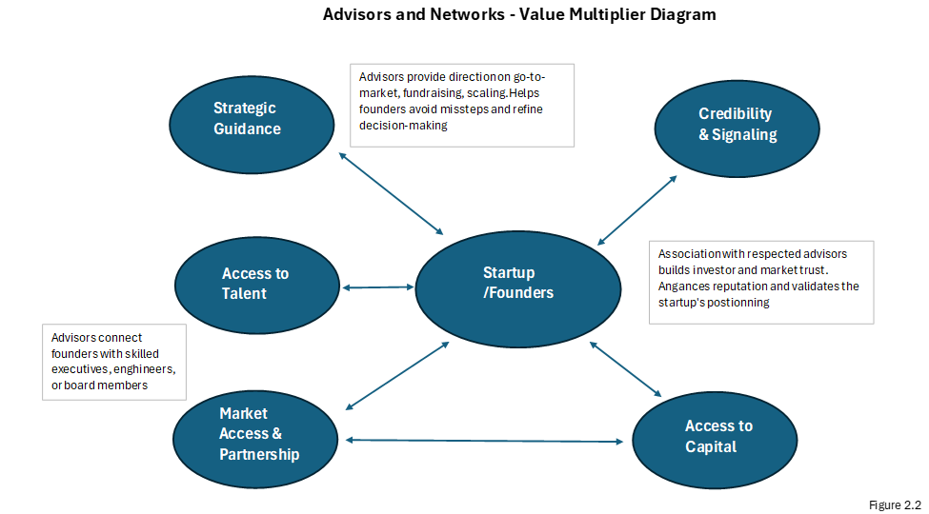
The Role of Advisors and Networks

Slide 26
Market Opportunity Metrics
Total Addressable Market (TAM): The Total Addressable Market represents the total revenue opportunity available if your company captured 100% of the market.
Serviceable Addressable Market (SAM): The Serviceable Addressable Market narrows the focus to the portion of the TAM that your company can actually serve with its product or service, considering factors such as product fit, geography, and distribution.
Serviceable Obtainable Market (SOM): The Serviceable Obtainable Market is the portion of SAM you can realistically capture in the near term—typically within the next 12 to 24 months—given your resources, budget, and go-to-market strategy.
1.5 billion potential users × $30 per year = $45 billion TAM
300 million reachable users × $30 per year = $9 billion SAM.
1 million users × $30 per year = $30 million SOM

Slide 27
Company Specific Metrics – Revenue Metrics
Monthly Recurring Revenue (MRR): MRR is one of the most telling indicators of a startup’s financial momentum. It tracks month-to-month growth trends and customer expansion, providing an immediate view of how effectively the business is scaling.
Annual Recurring Revenue (ARR): ARR reveals the true scale and trajectory of a company’s recurring business model, offering investors and founders a clear picture of predictable income growth.
Activation Rate: Activation Rate measures the percentage of users who complete a key action shortly after signing up—such as creating a profile, uploading content, or completing a first transaction.
Retention Rate: Retention Rate measures how many users continue to use a product over time, indicating long-term engagement and customer stickiness.
Net Promoter Score (NPS): NPS captures how likely customers are to recommend the product to others, serving as a proxy for overall satisfaction and brand advocacy
Daily Active User / Monthly Active User: DAU/MAU ratio measures the proportion of monthly users who engage with the product on a daily basis, providing a snapshot of habitual usage and platform vitality.

Slide 28
Key Performance Indicators (KPI) Measurements
Traction: Traction is the single most persuasive proof point for investors. It can take the form of revenue growth, user adoption, active engagement, partnerships, or even waitlist sign-ups.
Customer Acquisition Cost (CAC): CAC measures how much it costs to acquire each new customer. Investors analyze CAC not in isolation, but relative to revenue and lifetime value.
Lifetime Value (LTV): LTV estimates the total revenue a company can expect from a customer over the course of their relationship.
Churn: Churn measures the percentage of customers who stop using the product or cancel subscriptions.
Burn Rate: Burn rate is the speed at which a startup spends cash each month. When compared against cash reserves, it defines the “runway”

Slide 29
Metric | Definition | Formula | Target Benchmark | Example Value | Investor Insight
Traction | Evidence of user or revenue growth over time | Growth Rate = (Current Users – Previous Users) ÷ Previous Users | 10–20% MoM early-stage | +15% Monthly Active Users | Demonstrates adoption and momentum
Customer Acquisition Cost (CAC) | Average cost to acquire a new customer | CAC = Total Marketing Spend ÷ # of New Customers | $100–$300 (SaaS benchmark) | $220 | High CAC suggests inefficiency; needs LTV balance
Lifetime Value (LTV) | Average revenue expected per customer over their lifetime | LTV = ARPU × Gross Margin × Customer Lifespan | ≥ 3× CAC | $1,200 | LTV/CAC = 5.5× — indicates efficient growth
Churn Rate | % of customers lost during a period | Churn = Lost Customers ÷ Starting Customers | < 5% monthly | 3.8% | Low churn shows strong retention and satisfaction
Burn Rate | Net monthly cash outflow | Burn = Monthly Expenses – Monthly Revenue | < 10% of total cash balance | $60K/mo | 18 months runway at current burn
Metric | Definition | Formula | Target Benchmark | Example Value | Investor Insight

Slide 30
Pipeline Report
While startup metrics such as CAC, LTV, and churn capture important financial ratios, investors often ask a simpler and more direct question: “Where will your next dollar of revenue come from?”. The Pipeline Report is the founder’s most practical answer to that question.
Status | % Probability
Prospecting | 10%
Appointment Scheduled | 20%
Qualified to Buy | 30%
Project Scoping | 60%
Contract Sent | 90%
Closed Won | 100%
Closed Lost | 0%

Slide 31
Pipeline Report
Each sales opportunity moves through these stages as it matures. Assigning probabilities at each step allows founders to apply weighted averages to forecast Expected Revenue, using a simple formula:
Ultimately, the Pipeline Report does more than track potential deals; it shapes investor confidence by showing that management understands its sales process quantitatively.
Customer Name | Expected Close Date | Potential Revenue (€) | Status | % Probability | Expected Revenue (€)
Alpha Retail Ltd. | March 2026 | €100,000 | Project Scoping | 60% | €60,000
BioSense Labs | April 2026 | €250,000 | Contract Sent | 90% | €225,000
Vision AR Inc. | May 2026 | €75,000 | Qualified to Buy | 30% | €22,500
Meditronix SA | June 2026 | €180,000 | Prospecting | 10% | €18,000
TechNova Group | May 2026 | €320,000 | Closed Won | 100% | €320,000
Total Expected Revenue |  |  |  |  | €645,500

