Slide 1



­ERM CPS 5390 Credit Risk Management Tuesdays, 8:10PM – 10:00PM

Slide 2
Instructor and Course Information
Instructor: Christakis (Chris) Droussiotis
c.droussiotis@columbia.edu,
(908) 930-4725 (Voice /Text)
Instructor’s Web: www.ProfessorDrou.com
Office Hours: In Person: 7:00pm-8:00pm (Tuesdays) Lewisohn Hall (2nd floor study room)
Remote: https://calendly.com/professordrou/30min to book a 30-minute zoom call.
Response Policy: I intend to log onto the course and check email daily. You should expect a response from me within 24 hours. If you have an urgent question or concern, please contact me via text message or telephone
Teaching Assistants: Gustav Masch Jimenez
gm3174@columbia.edu
Office Hours: By Appointment (via email)

Slide 3
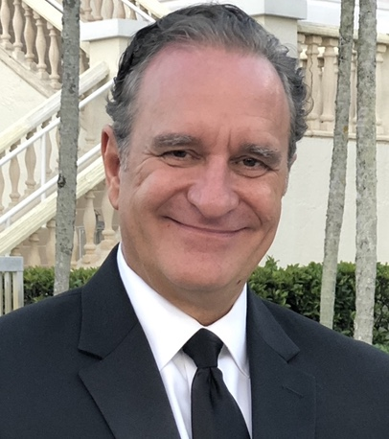
Speaker’s Biography
Chris Droussiotis’ training and expertise is in the area of Investment Banking. Possessing over 30 years of experience by working for numerous corporations in various executive management positions at Bank of America Merill Lynch, CIBC Oppenheimer, Mizuho Financial Group, Bank of Tokyo-Mitsubishi Trust UFJ, Sumitomo Mitsui Banking Corporation.
Chris is a former Managing Director, General Manager and the Head of the Leverage Finance, Private Equity Sponsor Group & Structured Finance Department at Sumitomo Mitsui Banking Corporation (SMBC) managing a loan portfolio of over $10 billion of large cap and middle market leveraged loans, as well as investments in SPV funds, CLOs and BDCs that are backed by leveraged loans and high yield bonds.
On April 2018, Chris left SMBC and join Kinisis Ventures Limited (KV), as a Senior Managing Partner. At KV, Chris is responsible with the financial analysis and valuation of start-ups. Recently he obtained a certificate from Columbia University on Blockchain technology which will help KV expand its consulting services to adapt many of the blockchain applications in various industries including fintech, biotech, EdTech and shipping.
Chris is also an adjunct Finance Professor for the last 20 years teaching at various college and universities including at Columbia University, Fordham University, Baruch College and Seton Hall University.
Chris has published three books (“The Analytical Approach to Finance, Investments and Credit”, “Credit Risk Management and Analysis” and ”Credit Analyst’s Survival Manual”)
Chris Droussiotis
Senior Managing Partner
Kinisis Venture Limited

Slide 4
Gustav Masch Jimenez

Slide 5
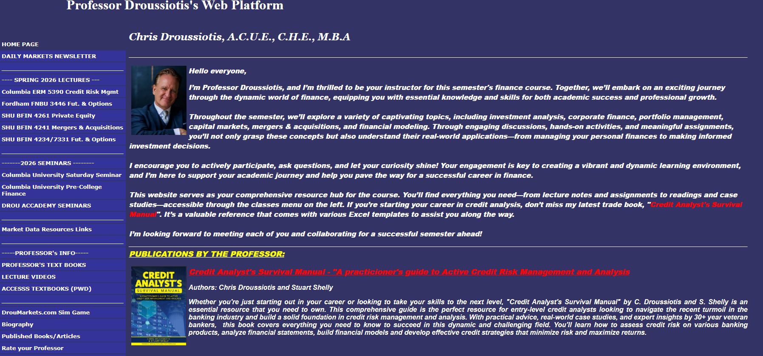
Professor’s Website www.ProfessorDrou.com

Slide 6
Course Overview
Examine how financial institutions assess, price, and manage credit risk across retail, corporate, and institutional markets
Integrates core finance and risk concepts: risk–return tradeoffs, time value of money, expected loss, default rates, LGD, CAPM, and VaR
Cover the U.S. banking and credit system, including commercial and investment banking, credit markets, macroeconomic forces, and regulation (Federal Reserve, Dodd-Frank, Basel)
Explore applied credit portfolio management:
CAMELS, internal credit scoring, underwriting, syndication, loan trading, and private credit
Structured products and derivatives: CLOs, interest rate swaps, CDS
Apply theory through real-world case studies (e.g., JP Morgan, Silicon Valley Bank, Metanext CLO Fund, Spirit Airlines, Hyatt Hotels), developing skills in borrower analysis, financial statement evaluation, debt capacity, recovery, risk, and valuation

Slide 7
Learning Objectives (LO)
Upon successful completion of this course, you will be able to:
Explain the fundamental principles of credit risk, including risk–return dynamics, expected loss modeling, LGD, and default probability.
Interpret how the U.S. banking system, credit markets, macroeconomic conditions, and regulatory frameworks (Dodd-Frank, Basel guidelines) influence credit decision-making.
Analyze the creditworthiness of consumers and corporations using financial statements, ratio analysis, solvency and liquidity metrics, and industry risk assessments.
Evaluate retail credit tools such as FICO scores, mortgage mathematics, consumer credit protections, and real estate lending practices.
Assess corporate loan structures, credit facilities, covenants, collateral, and debt capacity across various industries and borrower types.

Slide 8
Learning Objectives (LO)
Apply portfolio management concepts—such as CAMELS ratings, exposure measurement, syndications, and reserves/ACL—to manage credit risk at the portfolio level.
Model structured finance products including CLOs and multi-tranche credit structures, performing LGD, default, and return analysis.
Examine the role of credit derivatives (e.g., CDS, TRS) in hedging and transferring credit and market risk.
Critically evaluate real-world credit failures and case studies (e.g., SVB, Archegos, structured credit breakdowns) to identify root causes and risk management lessons.
Apply industry-standard credit underwriting, monitoring, and reporting practices relevant to roles in banking, private credit, and enterprise risk management.

Slide 9
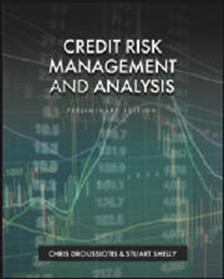
Required Textbook
The following text is based on the professor’s lecture notes– with the textbook you can access Active Learning homework/project and exam platform.
Droussiotis, C. & Shelly S. (2023), Credit Risk Management and Analysis, First Edition. Cognella Publishing. ISBN-13: 978-1793541000 - Link to purchase including Active Learning: : https://store.cognella.com/90758

Slide 10
Course Requirements
Graded Homework Problems (20%):
Graded Homework Problems give you an opportunity to demonstrate your mastery of the topics covered in the course and solidify your knowledge of finance theory through the practical application of the concepts, models, and theories, discussed in class. Students are required to submit a set of Graded Homework Problems. Homework and due dates will be posted on Canvas. The student could wish to submit their homework via Cognella’s ACTIVE LEARNING platform.
Individual Project (15%):
Each student will be assigned a publicly traded company. See Exhibit A for Project’s description.
Attendance (5%):
Attendance (both in class and on-line) will be recorded.

Slide 11
Course Requirements
Midterm Exam (30%):
There will be a Midterm Exam that will be based on the textbook (chapters 1-4 and 10-11 and the spreadsheets taught in class.
Final Exam (30%):
The Final Exam will include some of the concepts from the midterm including equity valuation, Return and TVM. Most of the exam though will focus on textbook chapters 15-17 and partial chapter 9. The students need to study spreadsheets analysis covered in class including the Alexandria Hotel projections and DCF analysis, Hyatt stock valuation, LBO and Capital Markets financial model, and return and bond analytics spreadsheet. The exam will be taken during the Exam Period. It will be opened books taken on-line.
The students need to study the various spreadsheet analysis covered in class including the Celerity Technology Company case study; the Alexandria Hotel WACC analysis and Hyatt Corporation enterprise valuation methods.

Slide 12
Course Requirements (Assignments)

Slide 13
Career in Credit Risk Management

Slide 14




Spectrum of career opportunities in finance
CORPORATE FINANCE
CREDIT ANALYSIS
INVESTMENTS
Corporations
Treasury (Budget & Planning)
Controller / Accounting
Commercial Banking
Credit Analysis (Corporate / Project Finance / Asset Finance)
Advisory (Syndications, Distribution, Sales & Trade)
Portfolio Management
Risk Management (Credit & Market)
Operations – Compliance & KYC
Loan Control/Treasury
Merchant Banking (CLOs, BDCs)
Credit Analysis (Bonds/Loans)
Portfolio Management
Investment Banking
Broker/Dealer - Sales & Trade
Advice (M&A, Capital Markets, Economics)
Research
Portfolio Management
Wealth Management
Other Finance Careers
Rating Agencies for Bonds and Loans
Consulting Services (Capital Markets, M&A)
Specialized Finance Services
Private Equity
Equity Analysis
Portfolio Management (Equity)

Slide 15
CREDIT ANALYSIS
FRONT OFFICE
Customer facing services
Corporate Finance: Underwrite, Lending / Investing (Primary Market)
Sales & Trade – (Secondary Market)
Advisory and Research
MIDDLE OFFICE
Risk Management
Market Risk
Credit Risk
Operating Risk
Liquidity Risk
BACK OFFICE
Operations / IT (Technology) & Compliance

Slide 16
Key Players in Private Credit
Total Global Commercial Banks (Ex China)
Top Global Private Credit Firms
• Ares Management – Direct Lending, Special Situations
• Blackstone Credit – Direct Lending, Mezzanine, Distressed
• Apollo Global – Opportunistic, Structured Credit
• KKR Credit – Direct Lending, CLOs
• Oaktree Capital – Distressed, Special Situations
• Golub Capital – Middle Market Lending
• HPS Investment – Senior Secured, Mezzanine
• Crescent Capital – High-Yield, Mezzanine
• Sixth Street – Opportunistic, Growth Lending
• Blue Owl (Owl Rock) – Direct Lending, NAV Loans
Specialized/Niche Players
• Antares Capital – Sponsor-Backed Lending
• Twin Brook – Lower Middle-Market
• Runway Growth – Venture Debt
• Alcentra – Sub-Investment Grade
• Monroe Capital – Healthcare, Tech Focus
• WhiteHorse (H.I.G.) – Flexible Structures
European Credit Firms
• Ardian – Mid-Cap Lending (France)
• ICG – Subordinated Debt (UK)
• Pemberton – Mid-Market Lending (UK)
• Hayfin – Opportunistic Credit (UK)
• Permira Credit – Growth Financing (UK)
Asset Manager Credit Arms
• Goldman Sachs – Private Credit
• JPMorgan – Strategic Credit
• Morgan Stanley – MSIM Credit Partners
• Bain Capital Credit – Distressed, Opportunistic
• T. Rowe / Oak Hill – High-Yield, Private
• Carlyle – Global Credit Division
Top Global Commercial Banks
• JPMorgan Chase (USA) – $4.1T assets
• Mitsubishi UFJ Financial Group (Japan) – $3.3T
• Bank of America (USA) – $3.2T
• HSBC Holdings (UK) – $3.0T
• BNP Paribas (France) – $2.9T
• Wells Fargo (USA) – $2.0T
• Citigroup (USA) – Global commercial & retail bank
• Santander (Spain) – Leading EU & Latin America bank
• ING Group (Netherlands) – Strong in digital/commercial
• Crédit Agricole (France) – Cooperative commercial giant
Other Major Commercial Banks
• UniCredit (Italy) – Central & Eastern Europe reach
• SMFG (Japan) – Global expansion
• DBS Bank (Singapore) – SE Asia digital/commercial leader
• Royal Bank of Canada (Canada) – North American presence
• TD Bank (Canada) – Major US operations
• Commonwealth Bank (Australia) – Domestic strength
• Westpac (Australia) – Top 4 Aussie bank

