Slide 1
Topic 5: The Risk and Term Structure of Interest Rate
Main Reading (Sources): Chap 5 Mishkin & Eakins, 8th

Slide 2
Chapter Preview
We will examine how the individual risk of a bond affects its required rate. We also explore how the general level of interest rates varies with the maturity of the debt instruments. Topics include:
  Risk Structure of Interest Rates
  Term Structure of Interest Rates

Slide 3
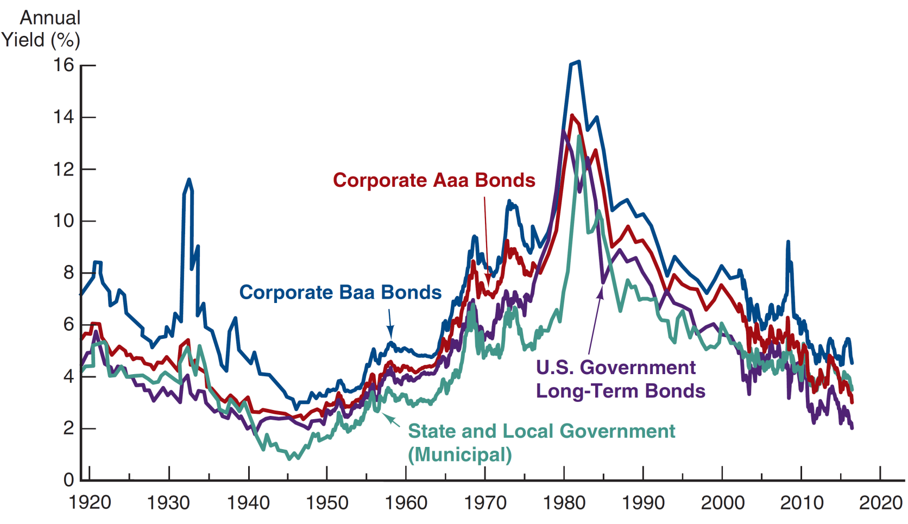
Risk Structure of Interest Rates:
Figure 5.1 Long-Term Bond Yields, 1919–2016
Sources: Board of Governors of the Federal Reserve System, Banking and Monetary Statistics, 1941–1970; Federal Reserve Bank of St. Louis FRED database, https://fred.stlouisfed.org/series/GS10, https://fred.stlouisfed.org/series/AAA, https://fred.stlouisfed.org/series/BAA.

Slide 4
Factors Affecting Risk Structure of Interest Rates
The figure shows two important features of the interest-rate behavior of bonds.
Rates on different bond categories change from one year to the next.
Spreads on different bond categories change from one year to the next.
To further examine these features, we will look at three specific risk factors.
Default Risk
Liquidity
Income Tax Considerations

Slide 5
Default Risk Factor
One attribute of a bond that influences its interest rate is its risk of default, which occurs when the issuer of the bond is unable or unwilling to make interest payments when promised.
U.S. Treasury bonds have usually been considered to have no default risk because the federal government can always increase taxes to pay off its obligations (or just print money). Bonds like these with no default risk are called default-free bonds.
But are these bonds truly default-free bonds?
The spread between the interest rates on bonds with default risk and default-free bonds, called the risk premium, indicates how much additional interest people must earn in order to be willing to hold that risky bond.
A bond with default risk will always have a positive risk premium, and an increase in its default risk will raise the risk premium.

Slide 6
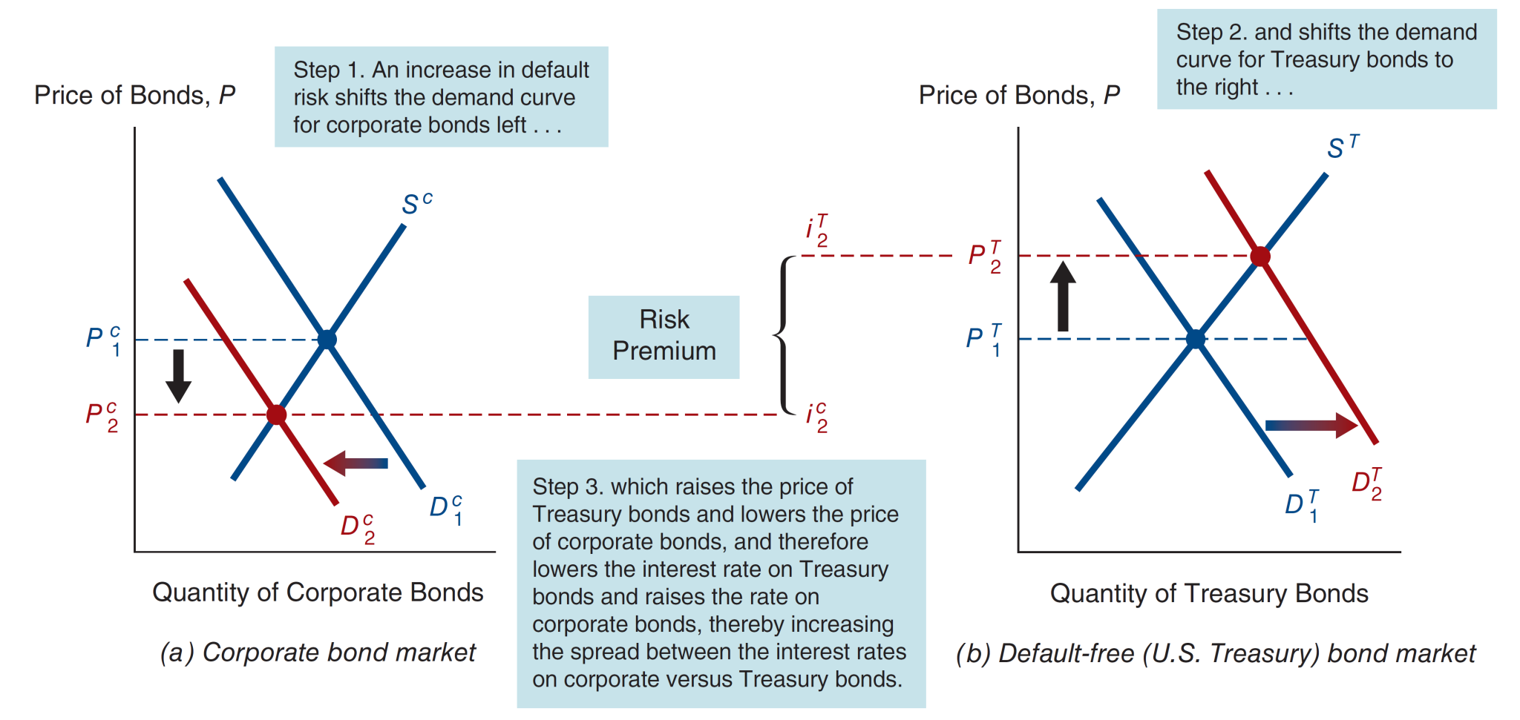
Figure 5.2 Response to an Increase in Default Risk on Corporate Bonds

Slide 7
Analysis of Figure 5.2: Increase in Default on Corporate Bonds
Corporate Bond Market
  1. R^{e} on corporate bonds ↓, D^{c} ↓, D^{c} shifts left
  2. Risk of corporate bonds ↑, D^{c} ↓, D^{c} shifts left
  3. P^{c} ↓, i^{c} ↑
Treasury Bond Market
  Relative R^{e} on Treasury bonds ↑, D^{T} ↑, D^{T} shifts right
  Relative risk of Treasury bonds ↓, D^{T} ↑, D^{T} shifts right P^{T} ↑, i^{T} ↓
Outcome
  Risk premium, i^{c} − i^{T}, rises

Slide 8
Table 5.1 Bond Ratings by Moody’s and Standard and Poor’s
Moody’s Rating | S&P Rating | Description | Examples of Corporations with Bonds Outstanding in 2016
Aaa | AAA | Highest quality (lowest default risk) | Microsoft, J&J
Aa | AA | High quality | Apple, General Electric
A | A | Upper-medium grade | MetLife, Intel, Harley-Davidson
Baa | BBB | Medium grade | McDonalds, BofA, HP, FedEx, Southwest Airlines
Ba | BB | Lower-medium grade | Best Buy, American Airlines, Delta Airlines, United Airlines
B | B | Speculative | Netflix, Rite Aid, J.C. Penney
Caa | CCC,CC | Poor (high default risk) | Sears, Elizabeth Arden
C | D | Highly speculative | Halcon Resources, Seventy-Seven Energy

Slide 9
Case: The Global Financial Crisis and the Baa-Treasury Spread
Starting in 2007, the subprime mortgage market collapsed, leading to large losses for financial institutions.
Because of the questions raised about the quality of Baa bonds, the demand for lower-credit bonds fell, and a “flight- to-quality” followed (demand for T-securities increased.
Result: Baa-Treasury spread increased from 185 bps to 545 bps.

Slide 10
Liquidity Factor (1 of 2)
Another attribute of a bond that influences its interest rate is its liquidity; a liquid asset is one that can be quickly and cheaply converted into cash if the need arises. The more liquid an asset is, the more desirable it is (higher demand), holding everything else constant.
The differences between interest rates on corporate bonds and Treasury bonds (that is, the risk premiums) reflect not only the corporate bond’s default risk but its liquidity too. This is why a risk premium is sometimes called a risk and liquidity premium.

Slide 11
Corporate Bond Becomes Less Liquid
Corporate Bond Market
  1. Liquidity of corporate bonds ↓, D^{c} ↓, D^{c} shifts left
  2. P^{c} ↓, i^{c} ↑
Treasury Bond Market
  1. Relatively more liquid Treasury bonds, D^{T} ↑, D^{T} shifts right
  2. P^{T} ↑, i^{T} ↓
Outcome
  Risk premium, i^{c} − i^{T}, rises
Risk premium reflects not only corporate bonds’ default risk but also lower liquidity

Slide 12
Income Taxes Factor
Municipal bonds tend to have a lower rate the Treasuries (figure 5.1). Why?
Interest payments on municipal bonds are exempt from federal income taxes, a factor that has the same effect on the demand for municipal bonds as an increase in their expected return.
Treasury bonds are exempt from state and local income taxes, while interest payments from corporate bonds are fully taxable.
For example, suppose you are in the 35% tax bracket. From a 10%-coupon Treasury bond, you only net $65 of the coupon payment because of taxes
However, from an 8%-coupon muni, you net the full $80. For the higher return, you are willing to hold a riskier muni (to a point).

Slide 13
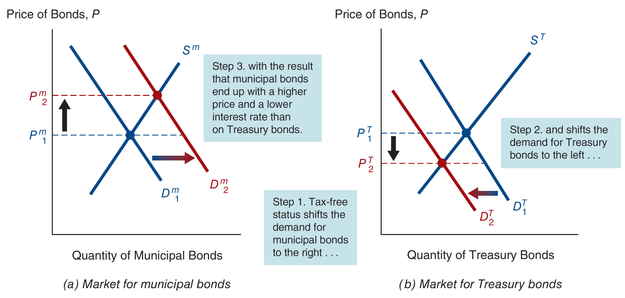
Figure 5.3 Interest Rates on Municipal and Treasury Bonds

Slide 14
Analysis of Figure 5.3: Tax Advantages of Municipal Bonds
Municipal Bond Market
  1. Tax exemption raises relative R^{e} on municipal bonds,
  D^{m} ↑, D^{m} shifts right
  2. P^{m} ↑
Treasury Bond Market
  1. Relative R^{e} on Treasury bonds ↓, D^{T} ↓, D^{T} shifts left
  2. P^{T} ↓
Outcome
  i^{m} < i^{T}

Slide 15
Case: Bush Tax Cut and Obama Repeal on Bond Interest Rates (1 of 2)
The 2001 tax cut called for a reduction in the top tax bracket, from 39% to 35% over a 10-year period.
This reduces the advantage of municipal debt over T-securities since the interest on T-securities is now taxed at a lower rate.
The Bush tax cuts were repealed under President Obama. Our analysis is reversed. The advantage of municipal debt increased relative to T-securities, since the interest on T-securities is taxed at a higher rate.

Slide 16
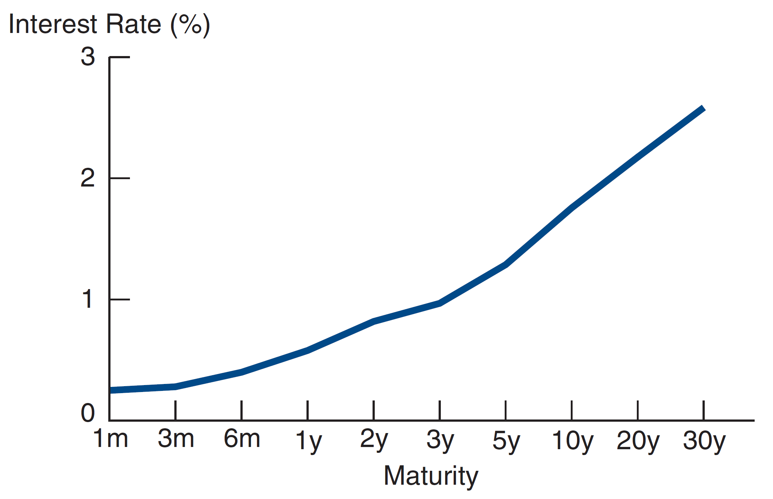
Term Structure of Interest Rates: A Stylized Figure of the Yield Curve

Slide 17
Term Structure of Interest Rates
Bonds with different maturities tend to have different required rates, all else equal.
The term structure of interest rates is the relationship between interest rates or bond yields and different terms or maturities.
Yield curve plots interest rates at different maturities ( a snapshot).
Three main facts on the yield curve:
Interest rates for different maturities move together. We see this on the next slide.
Yield curves tend to have steep upward slope when short rates are low and a downward slope when short rates are high.
Yield curve is typically upward sloping.

Slide 18
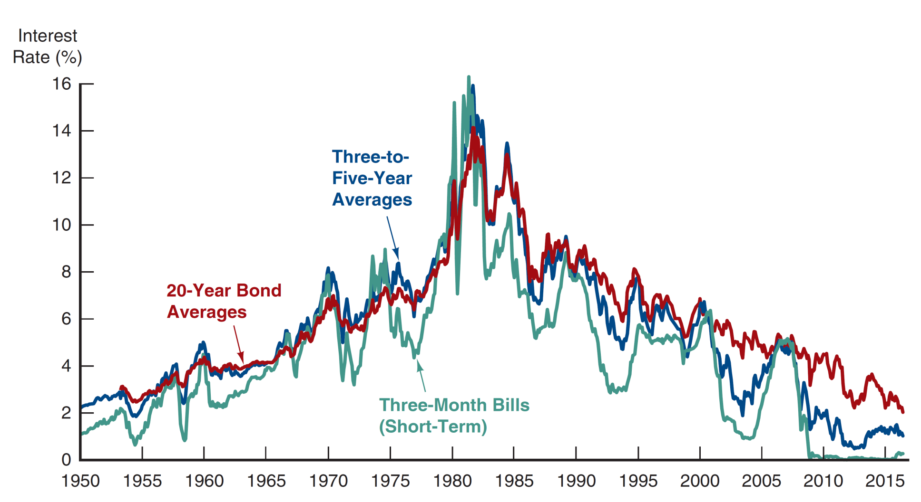
Figure 5.4 Movements over Time of Interest Rates on U.S. Government Bonds with Different Maturities

Slide 19
Three Theories of Term Structure
Expectations Theory
  Pure Expectations Theory explains 1 and 2, but not 3
Market Segmentation Theory
  Market Segmentation Theory explains 3, but not 1 and 2
Liquidity Premium Theory
  Solution: Combine features of both Pure Expectations Theory and Market Segmentation Theory to get Liquidity Premium Theory and explain all facts

Slide 20
Expectations Theory (1 of 2)
Key Assumption: Bonds of different maturities are perfect substitutes
Implication: R^{e} on bonds of different maturities are equal
To illustrate what this means, consider two alternative investment strategies for a two-year time horizon.
  Buy $1 of one-year bond, and when it matures, buy another one-year bond with your money.
  Buy $1 of two-year bond and hold it.
  The important point of this theory is that if the Expectations Theory is correct, your expected wealth is the same (at the start) for both strategies. Of course, your actual wealth may differ, if rates change unexpectedly after a year.

Slide 21
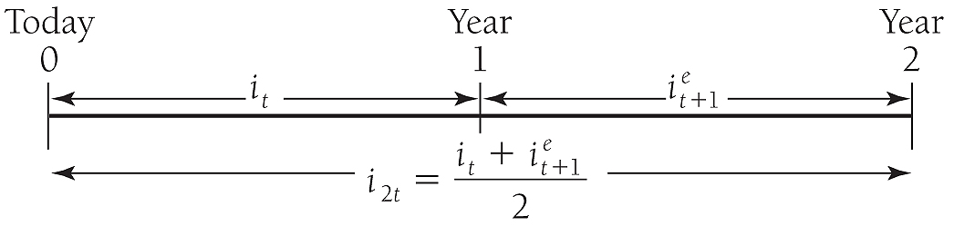
Expectations Theory (2 of 2)
To help see this, here’s a picture that describes the same information:

Slide 22
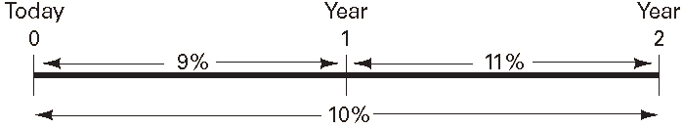
Example 5.2: Expectations Theory
This is an example, with actual #’s:

Slide 23
More generally for n-period bond… (1 of 2)
Don’t let this seem complicated. The equation simply states that the interest rate on a long-term bond equals the average of short rates expected to occur over life of the long-term bond.

Slide 24
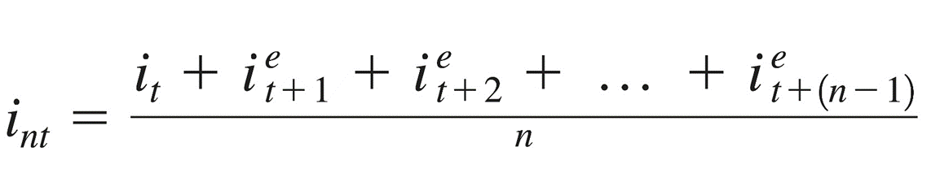
More generally for n-period bond… (1 of 2)
Don’t let this seem complicated. The equation simply states that the interest rate on a long-term bond equals the average of short rates expected to occur over life of the long-term bond.

Slide 25
More generally for n-period bond… (2 of 2)
Numerical example
  One-year interest rate over the next five years
  are expected to be 5%, 6%, 7%, 8%, and 9%
Interest rate on two-year bond today:
(5% + 6%)/2 = 5.5%
Interest rate for five-year bond today:
(5% + 6% + 7% + 8% + 9%)/5 = 7%
Interest rate for one- to five-year bonds today:
5%, 5.5%, 6%, 6.5% and 7%

Slide 26
Expectations Theory and Term Structure Facts (1 of 3)
Explains why yield curve has different slopes
  When short rates are expected to rise in future, average of future short rates = i_{nt} is above today’s short rate; therefore yield curve is upward sloping.
  When short rates expected to stay same in future, average of future short rates same as today’s, and yield curve is flat.
  Only when short rates expected to fall will yield curve be downward sloping.

Slide 27
Expectations Theory and Term Structure Facts (2 of 3)
Pure expectations theory explains fact 1—that short and long rates move together
  Short rate rises are persistent
  If i_{t} ↑ today, i^{e}_{t+1}, i^{e}_{t+2} etc. ↑ ⇒
  average of future rates ↑ ⇒ i_{nt} ↑
  Therefore: i_{t} ↑ ⇒ i_{nt} ↑
  (i.e., short and long rates move together)

Slide 28
Expectations Theory and Term Structure Facts (3 of 3)
Explains fact 2—that yield curves tend to have steep slope when short rates are low and downward slope when short rates are high
  When short rates are low, they are expected to rise to normal level, and long rate = average of future short rates will be well above today’s short rate; yield curve will have steep upward slope.
  When short rates are high, they will be expected to fall in future, and long rate will be below current short rate; yield curve will have downward slope.
Doesn’t explain fact 3—that yield curve usually has upward slope
  Short rates are as likely to fall in future as rise, so average of expected future short rates will not usually be higher than current short rate: therefore, yield curve will not usually slope upward.

Slide 29
Market Segmentation Theory
Key Assumption: Bonds of different maturities are not substitutes at all
Implication: Markets are completely segmented; interest rate at each maturity are determined separately
Explains fact 3—that yield curve is usually upward sloping
  People typically prefer short holding periods and thus have higher demand for short-term bonds, which have higher prices and lower interest rates than long bonds
Does not explain fact 1or fact 2 because its assumes long-term and short-term rates are determined independently.

Slide 30
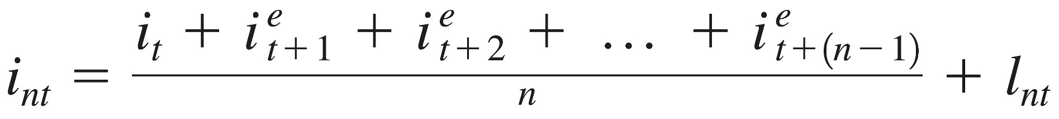
Liquidity Premium Theory (1 of 3)
Key Assumption: Bonds of different maturities are substitutes, but are not perfect substitutes
Implication: Modifies Pure Expectations Theory with features of Market Segmentation Theory
Investors prefer short-term rather than long-term bonds. This implies that investors must be paid positive liquidity premium, l_{nt}, to hold long term bonds.
Results in following modification of Expectations Theory, where l_{nt} is a liquidity premium added to the equation.
We can see this graphically on the next slide.

Slide 31
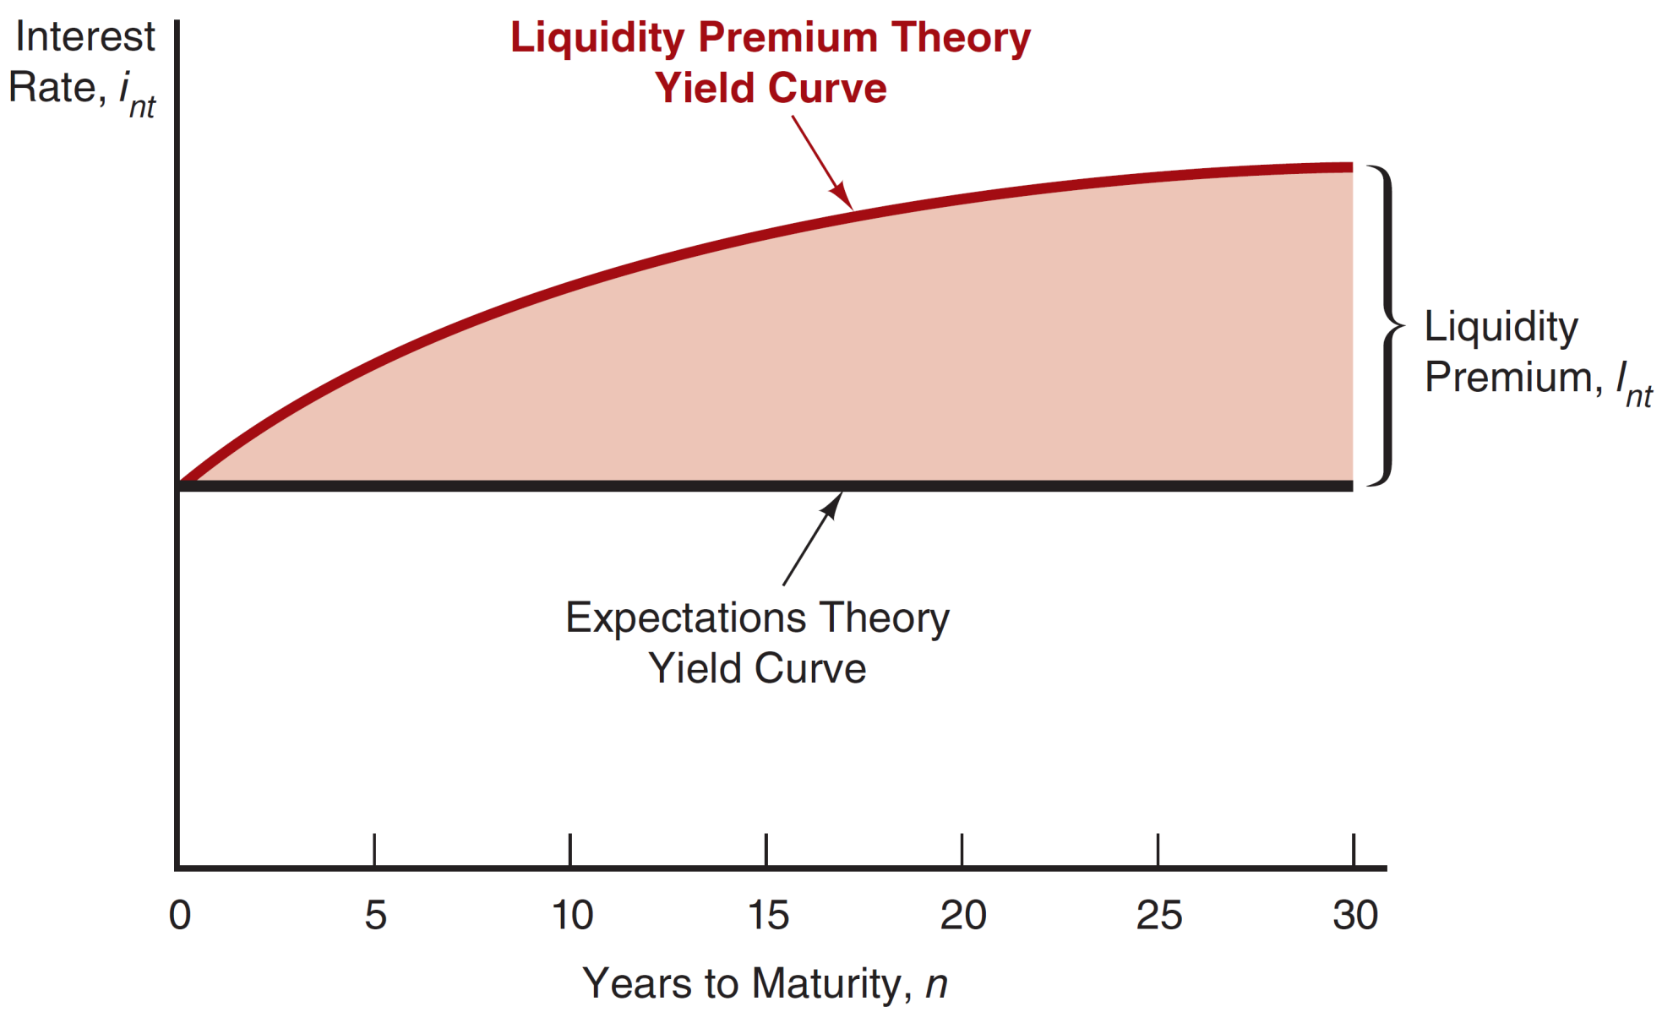
Figure 5.5 The Relationship Between the Liquidity Premium and Expectations Theories

Slide 32
Numerical Example (1 of 2)
One-year interest rate over the next five years: 5%, 6%, 7%, 8%, and 9%
Investors’ preferences for holding short-term bonds so liquidity premium for one- to five-year bonds: 0%, 0.25%, 0.5%, 0.75%, and 1.0%

Slide 33
Numerical Example (2 of 2)
Interest rate on the two-year bond:
0.25% + (5% + 6%)/2 = 5.75%
Interest rate on the five-year bond:
1.0% + (5% + 6% + 7% + 8% + 9%)/5 = 8%
Interest rates on one to five-year bonds:
5%, 5.75%, 6.5%, 7.25%, and 8%
Comparing with those for the pure expectations theory, liquidity premium theory produces yield curves more steeply upward sloped.

Slide 34
Liquidity Premium Theory: Term Structure Facts
Explains All 3 Facts
  Explains fact 3—that usual upward sloped yield curve by liquidity premium for long-term bonds
  Explains fact 1 and fact 2 using same explanations as pure expectations theory because it has average of future short rates as determinant of long rate

Slide 35
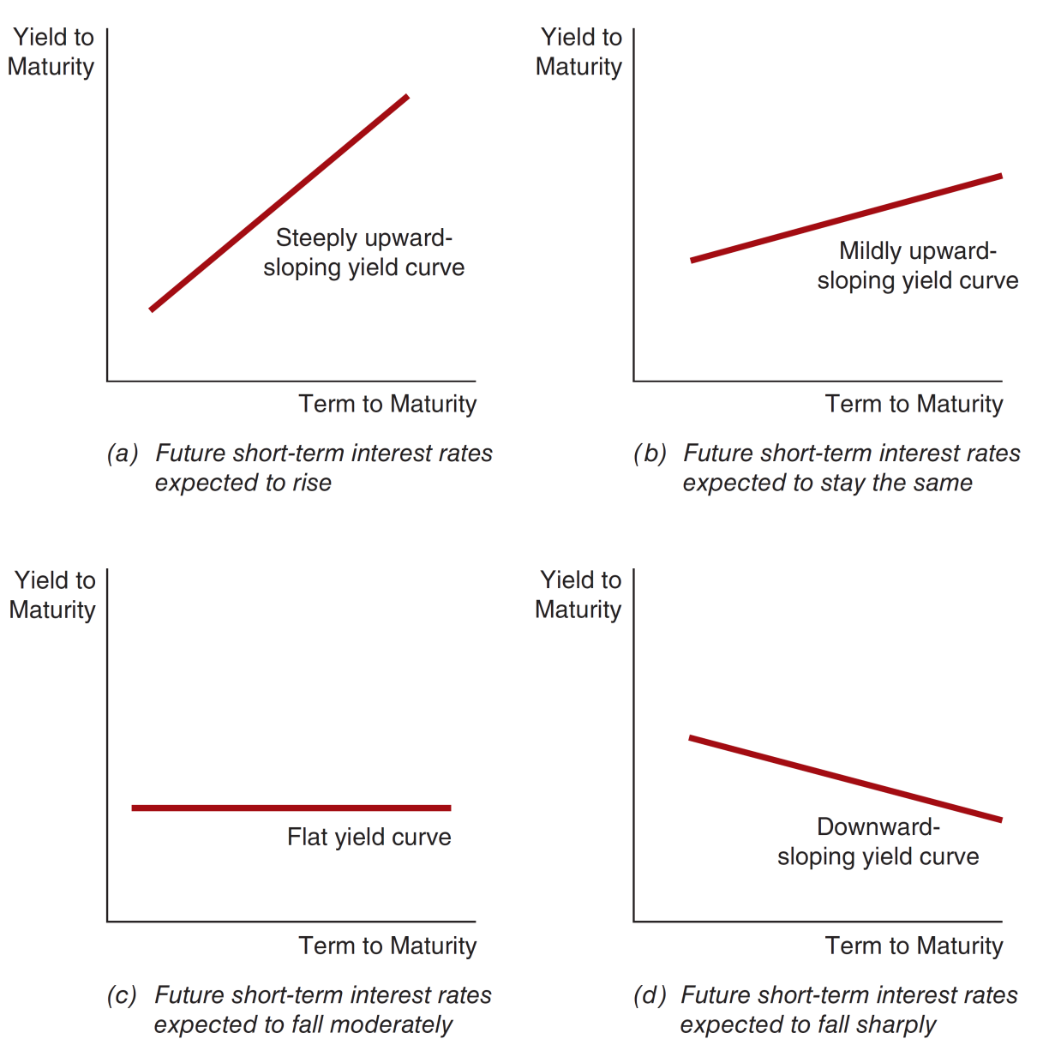
Figure 5.6 Yield Curves and the Market’s Expectations of Future Short-Term Interest Rates According to the Liquidity Premium Theory

Slide 36
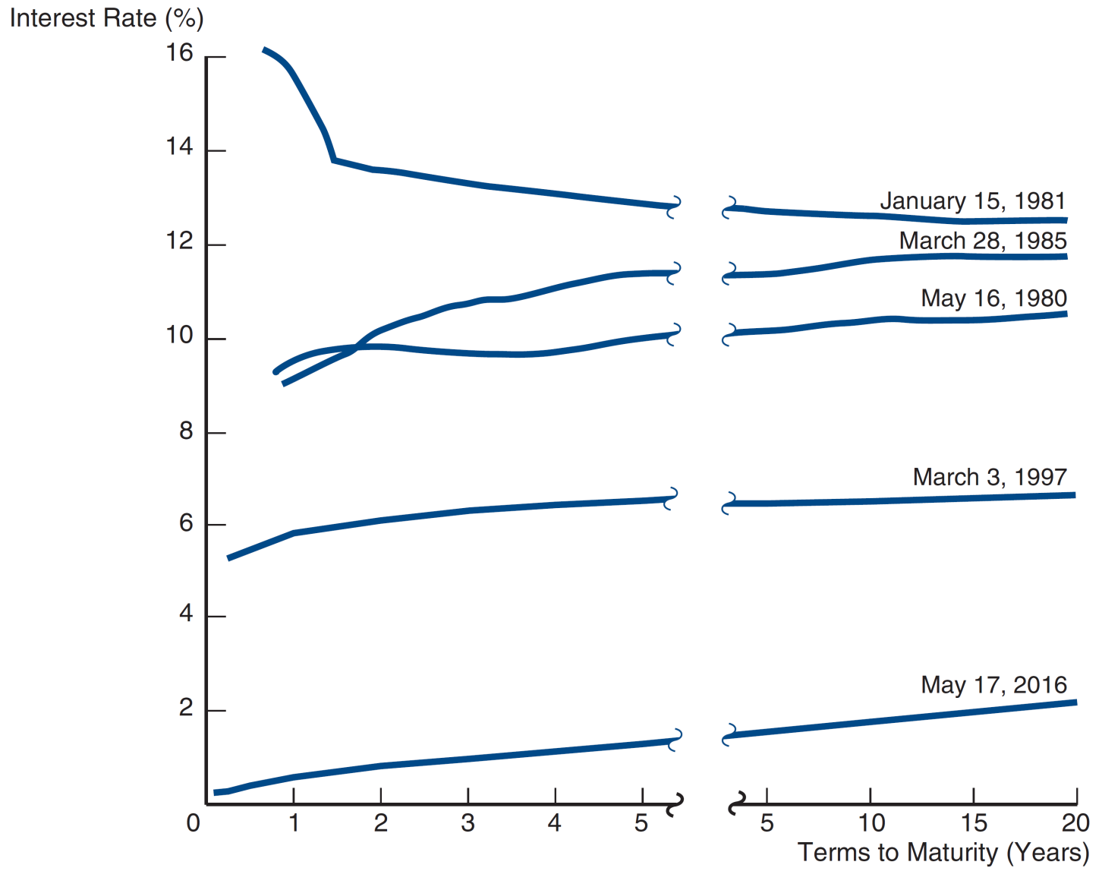
Case: Interpreting Yield Curves
What do they tell us about the public’s expectations of future rates from Figure 5.7 Yield Curves for U.S. Government Bonds?

Slide 37
Case: Interpreting Yield Curves
The steep downward curve in 1981 suggested that short-term rates were expected to decline in the near future. This played-out, with rates dropping by 300 bps in 3 months.
The upward curve in 1985 and 2016 suggested a rate increase in the near future.
The moderately upward slopes in 1980 and 1997 suggest that short term rates were not expected to rise or fall in the near term.
The steep upward slope in 2016 suggests short term rates in the future will rise.

Slide 38
Mini-case: The Term Structure as a Forecasting Tool
The yield curve does have information about future interest rates, and so it should also help forecast inflation and real output production.
  Rising (falling) rates are associated with economic booms (recessions) [chapter 4].
  Rates are composed of both real rates and inflation expectations [chapter 3].

Slide 39
The Practicing Manager: Forecasting Interest Rates with the Term Structure
If a client tells you that she’d like to invest $1000 in one year, what interest rate can you offer in the contract?
From zero coupon bonds, we find that the one-year rate = 5%, the two-year rate = 5.5%
You promise a return of $1000*(1+ i^{e}_{t+1} ), how can you determine the i^{e}_{t+1} such that you will not lose money ? Or how can you help the client to lock i^{e}_{t+1} ?
Borrow the present value of $1000 for one year, invest it for two years. One year later, you receive $1000 from the client and pay off the loan. Two years later, you hand over the total return to the client. $1000*(1+ i^{e}_{t+1} )=$[1000/(1+0.5)]*(1+0.055)^2
So, the implied forward rate is (1.055)² / (1.05) − 1 = 6%

Slide 40
Forecasting Interest Rates with the Term Structure
This can be generalize to the following formula:

Slide 41
Chapter Summary
Risk Structure of Interest Rates: We examine the key components of risk in debt: default, liquidity, and taxes.
Term Structure of Interest Rates: We examined the various shapes the yield curve can take, theories to explain this, and predictions of future interest rates based on the theories.

