Slide 1
Topic 4: Determinants of Interest Rate
Main Reading (Sources): Chap 4 Mishkin & Eakins, 8th

Slide 2
Chapter Preview
In this chapter, we examine the forces the move interest rates and the theories behind those movements. Topics include:
Determining Asset Demand
Supply and Demand in the Bond Market
Changes in Equilibrium Interest Rates

Slide 3
Determinants of Asset Demand (1 of 2)
An asset is a piece of property that is a store of value. Facing the question of whether to buy and hold an asset or whether to buy one asset rather than another, an individual must consider the following factors:
  Wealth, the total resources owned by the individual, including all assets
    Wealth increases = more resources = more purchases
  Expected return (the return expected over the next period) on one asset relative to alternative assets
    Gain for holding an asset (base on interest)
  Risk (the degree of uncertainty associated with the return) on one asset relative to alternative assets
    High Standard Deviation = High Risk
  Liquidity (the ease and speed with which an asset can be turned into cash) relative to alternative assets
    Converting asset to cash

Slide 4
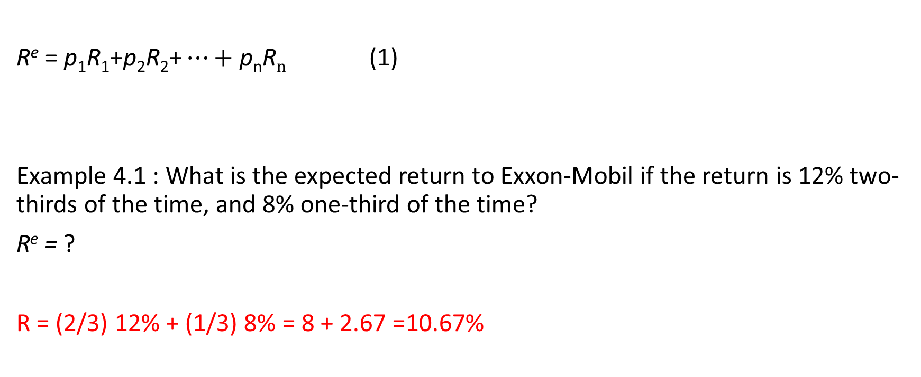
Expected Return
$\text{R}\text{e}\text{ = }\text{p}\text{1}\text{R}\text{1}\text{+}\text{p}\text{2}\text{R}\text{2}\text{+}…+\text{p}\text{n}\text{R}n$ (1)
Example 4.1 : What is the expected return to Exxon-Mobil if the return is 12% two-thirds of the time, and 8% one-third of the time?
R^{e} = ?
R = (2/3) 12% + (1/3) 8% = 8 + 2.67 =10.67%

Slide 5

Risk: Standard Deviation (1 of 4 )
$σ=\sqrt{\text{p}\text{1}\text{(}\text{R}\text{1}\text{−}\text{R}\text{e}\text{)}\text{2}\text{+}\text{p}\text{2}\text{(}\text{R}\text{2}\text{−}\text{R}\text{e}\text{)}\text{2}\text{+}…+\text{p}\text{n}\text{(}\text{R}\text{n}\text{−}\text{R}\text{e}\text{)}\text{2} }$ (2)
Example 4. 2: Consider the following two companies and their forecasted returns for the upcoming year:
What is the standard deviation of the returns on the Fly-by-Night Airlines and Feet-on-the-Ground Bus Company? Of these two stocks, which is riskier?
Blank | Blank | Fly-by-Night | Feet-on-the-Ground
Outcome 1 | Probability | 50% | 100%
Blank | Return | 15% | 10%
Outcome 2 | Probability | 50% | 0%
Blank | Return | 5% | n/a

Slide 6
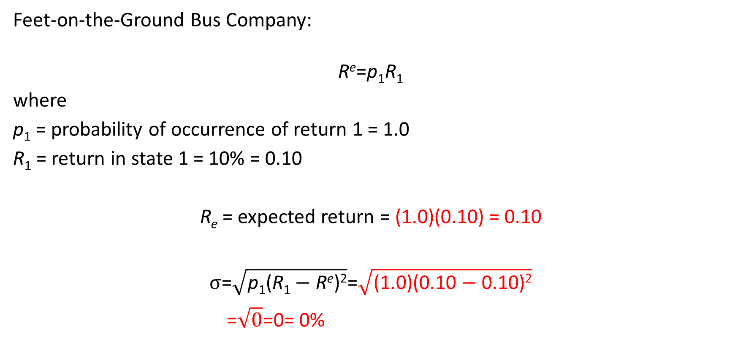
Risk: Standard Deviation (3 of 4)
Feet-on-the-Ground Bus Company:
$$\text{R}\text{e}\text{=}\text{p}\text{1}\text{R}\text{1}$$
where
p₁ = probability of occurrence of return 1 = 1.0
R₁ = return in state 1 = 10% = 0.10
R_{e} = expected return = (1.0)(0.10) = 0.10
$$σ\text{=}\sqrt{\text{p}\text{1}\text{(}\text{R}\text{1}−\text{R}\text{e}\text{)}\text{2}}\text{=}\sqrt{\text{(1.0)(0.10}−\text{0.10)}\text{2}}$$
$$\text{=}\sqrt{0}\text{=0= 0\%}$$

Slide 7
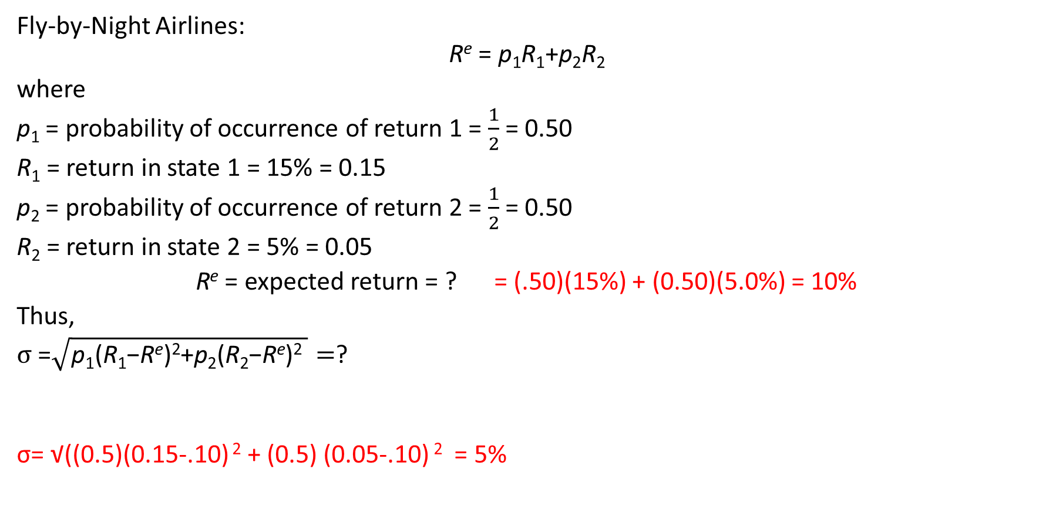
Risk: Standard Deviation (2 of 4)
Fly-by-Night Airlines:
$$\text{R}\text{e}\text{ = }\text{p}\text{1}\text{R}\text{1}\text{+}\text{p}\text{2}\text{R}\text{2}$$
where
p₁ = probability of occurrence of return 1 = $\frac{1}{2}$ = 0.50
R₁ = return in state 1 = 15% = 0.15
p₂ = probability of occurrence of return 2 = $\frac{1}{2}$ = 0.50
R₂ = return in state 2 = 5% = 0.05
R^{e} = expected return = ? = (.50)(15%) + (0.50)(5.0%) = 10%
Thus,
$σ \text{=}\sqrt{\text{p}\text{1}\text{(}\text{R}\text{1}\text{−}\text{R}\text{e}\text{)}\text{2}\text{+}\text{p}\text{2}\text{(}\text{R}\text{2}\text{−}\text{R}\text{e}\text{)}\text{2} }=$?
σ= √((0.5)(0.15-.10) $\text{2}$ + (0.5) (0.05-.10) $\text{2}$ = 5%

Slide 8
Risk: Standard Deviation (4 of 4)
Fly-by-Night Airlines has a standard deviation of returns of 5%; Feet-on-the-Ground Bus Company has a standard deviation of returns of 0%.
Clearly, Fly-by-Night Airlines is a riskier stock because its standard deviation of returns of 5% is higher than the zero standard deviation of returns for Feet-on-the-Ground Bus Company, which has a certain return.
A risk-averse person prefers stock in the Feet-on-the-Ground (the sure thing) to Fly-by-Night stock (the riskier asset), even though the stocks have the same expected return, 10%. By contrast, a person who prefers risk is a risk preferrer or risk lover. We assume people are risk-averse, especially in their financial decisions.

Slide 9
Measuring Return and Quantifying Risk
Scenario Analysis Method
STOCKS
BONDS

Slide 10
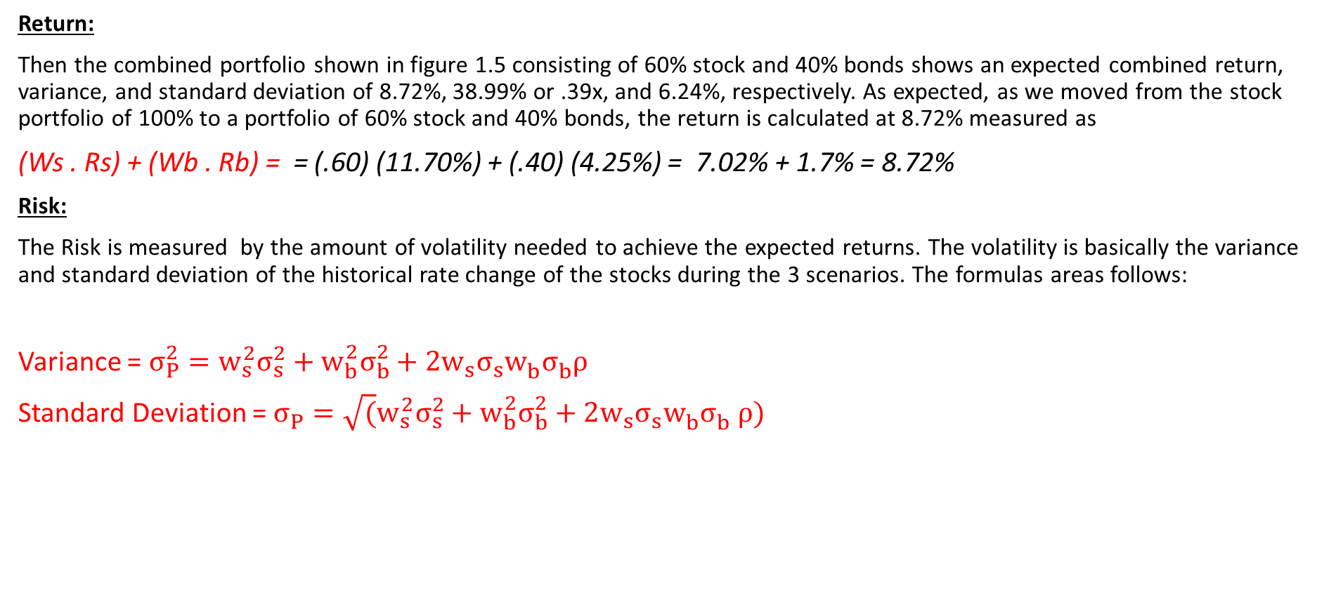
Return, Return Expectation, Risk and Allocation
Return:
Then the combined portfolio shown in figure 1.5 consisting of 60% stock and 40% bonds shows an expected combined return, variance, and standard deviation of 8.72%, 38.99% or .39x, and 6.24%, respectively. As expected, as we moved from the stock portfolio of 100% to a portfolio of 60% stock and 40% bonds, the return is calculated at 8.72% measured as
(Ws . Rs) + (Wb . Rb) = = (.60) (11.70%) + (.40) (4.25%) = 7.02% + 1.7% = 8.72%
Risk:
The Risk is measured by the amount of volatility needed to achieve the expected returns. The volatility is basically the variance and standard deviation of the historical rate change of the stocks during the 3 scenarios. The formulas areas follows:
Variance = $σ_{P}^{2}=w_{s}^{2}σ_{s}^{2}+w_{b}^{2}σ_{b}^{2}+2w_{s}^{ }σ_{s}^{ }w_{b}^{ }σ_{b}^{ }ρ$
Standard Deviation = $σ_{P}^{ }=\sqrt{(}w_{s}^{2}σ_{s}^{2}+w_{b}^{2}σ_{b}^{2}+2w_{s}^{ }σ_{s}^{ }w_{b}^{ }σ_{b }^{}ρ)$

Slide 11
Determinants of Asset Demand (2 of 2)
The quantity demanded of an asset differs by factor.
  Wealth: Holding everything else constant, an increase in wealth raises the quantity demanded of an asset
  Expected return: An increase in an asset’s expected return relative to that of an alternative asset, holding everything else unchanged, raises the quantity demanded of the asset
  Risk: Holding everything else constant, if an asset’s risk rises relative to that of alternative assets, its quantity demanded will fall
  Liquidity: The more liquid an asset is relative to alternative assets, holding everything else unchanged, the more desirable it is, and the greater will be the quantity demanded

Slide 12
Table 4.1 Summary Response of the Quantity of an Asset Demanded to Changes in Wealth, Expected Returns, Risk, and Liquidity
Variable | Change in Variable | Change in Quantity Demanded
Wealth | Increase | ?
Expected Return relative to other assets | Increase | ?
Risk relative to other assets | Increase | ?
Liquidity relative to other assets | Increase | ?

Slide 13
Table 4.1 Summary Response of the Quantity of an Asset Demanded to Changes in Wealth, Expected Returns, Risk, and Liquidity
Variable | Change in Variable | Change in Quantity Demanded
Wealth | Increase | Increase
Expected Return relative to other assets | Increase | Increase
Risk relative to other assets | Increase | Decrease
Liquidity relative to other assets | Increase | Increase

Slide 14
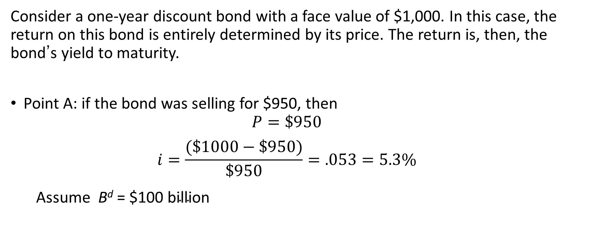
Supply & Demand in the Bond Market:
Derivation of Demand Curve (1 of 3)
Consider a one-year discount bond with a face value of $1,000. In this case, the return on this bond is entirely determined by its price. The return is, then, the bond’s yield to maturity.
Point A: if the bond was selling for $950, then
  $$P=\$950$$
  $$i=\frac{(\$1000−\$950)}{\$950}=.053=5.3\%$$
  Assume $\text{B}\text{d}\text{ = }\text{\$}\text{100} \text{billion}$

Slide 15
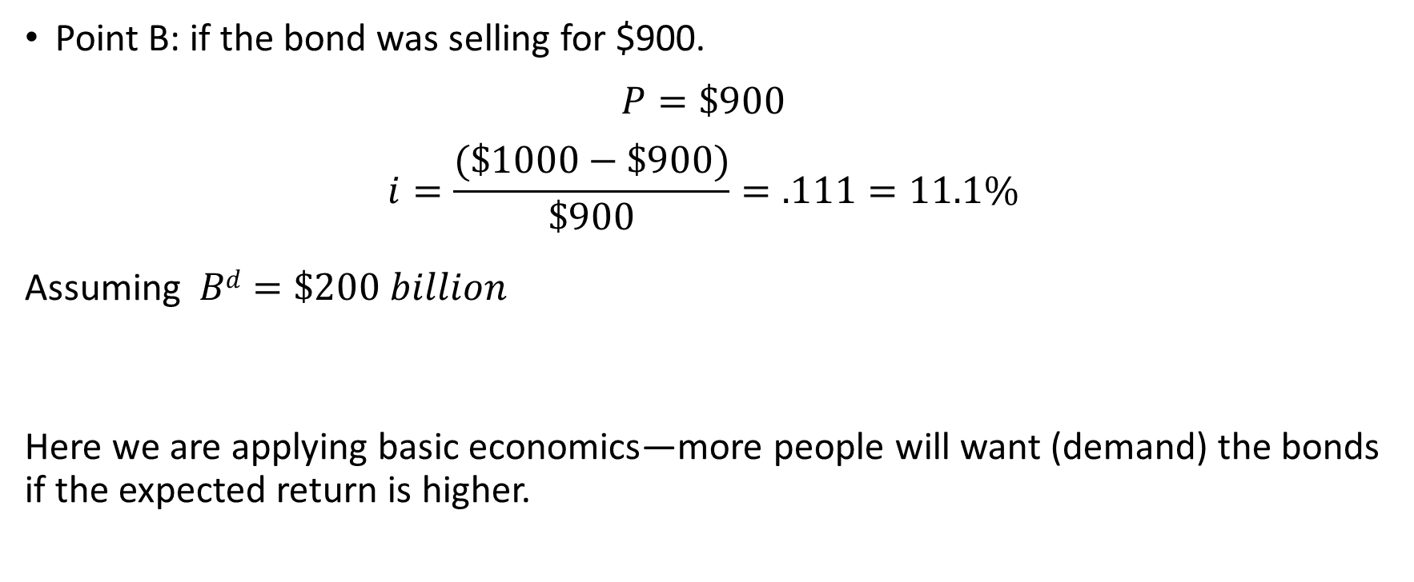
Derivation of Demand Curve (2 of 3)
Point B: if the bond was selling for $900.
$$P=\$900$$
$$i=\frac{(\$1000−\$900)}{\$900}=.111=11.1\%$$
Assuming $Bd=\$200 billion$
Here we are applying basic economics—more people will want (demand) the bonds if the expected return is higher.

Slide 16
Derivation of Demand Curve (3 of 3)
To continue …
Point C: P = $850 i = 17.6% B^{d} = 300
Point D: P = $800 i = 25.0% B^{d} = 400
Point E: P = $750 i = 33.0% B^{d} = 500
Demand Curve is B^{d} in Figure 4.1 (next slide) which connects points A, B, C, D, E.
  Has usual downward slope

Slide 17
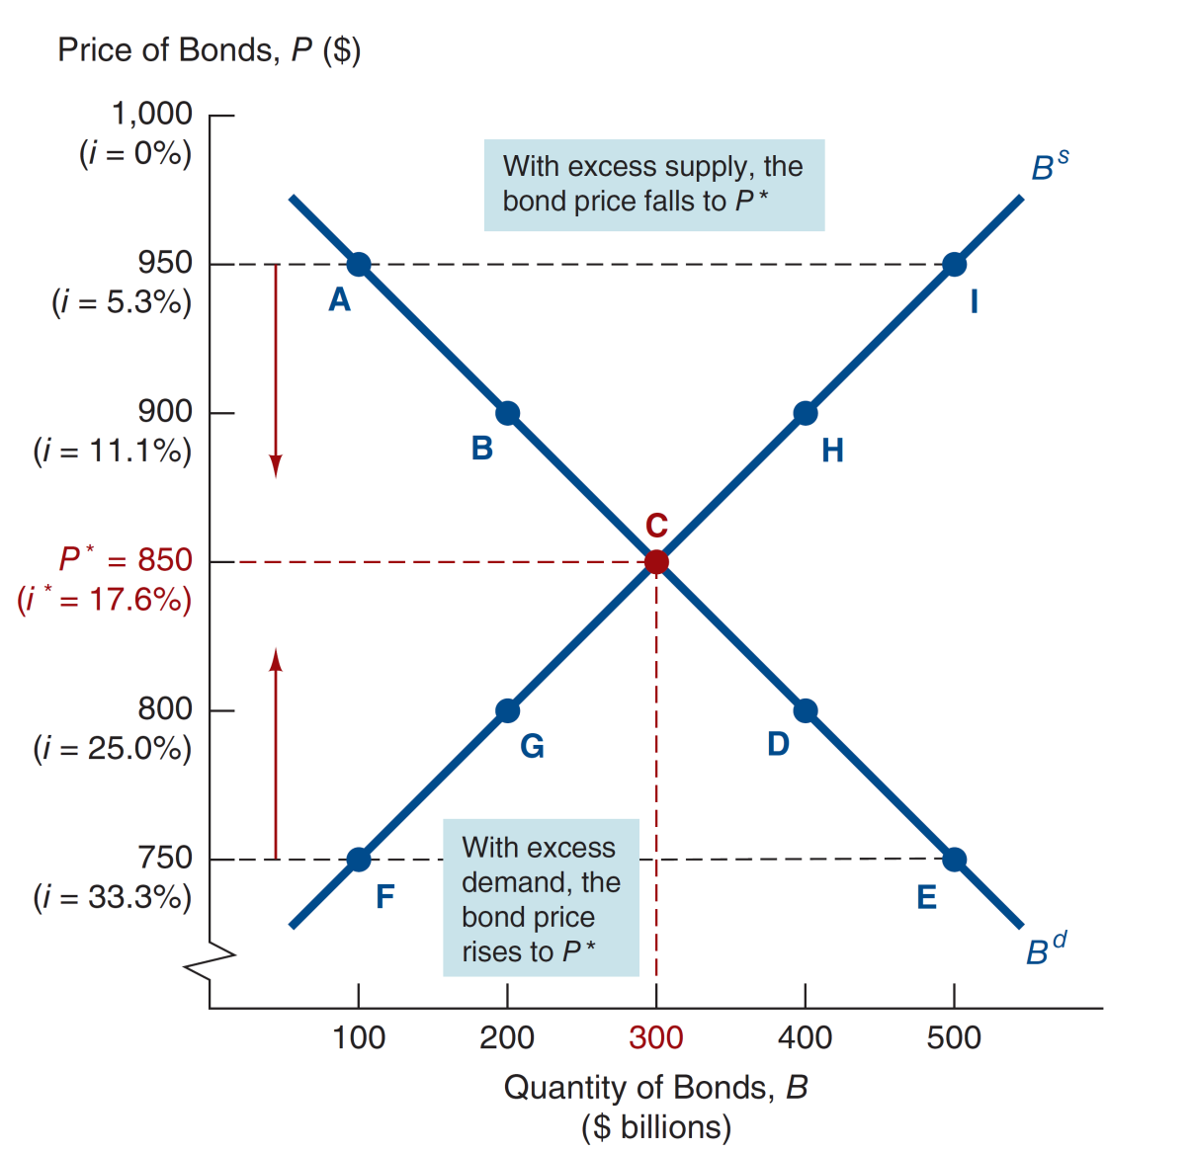
Figure 4.1 Supply and Demand for Bonds

Slide 18
Derivation of Supply Curve
In the last figure, we snuck the supply curve in—the line connecting points F, G, C, H, and I. The derivation follows the same idea as the demand curve.
Point F: P = $750 i = 33.0% B^{s} = 100
Point G: P = $800 i = 25.0% B^{s} = 200
Point C: P = $850 i = 17.6% B^{s} = 300
Point H: P = $900 i = 11.1% B^{s} = 400
Point I: P = $950 i = 5.3% B^{s} = 500
Supply Curve is B^{s} that connects points F, G, C, H, I, and has an upward slope
Again we are applying basic economics—more people will offer (supply) the bonds if the expected return (cost) is lower.

Slide 19
Market Equilibrium
The equilibrium follows what we know from supply-demand analysis:
Occurs when B^{d} = B^{s}, at P* = 850, i* = 17.6%
When P = $950, i = 5.3%, B^{s} > B^{d}
(excess supply): P ↓ to P*, i ↑ to i*
When P = $750, i = 33.0, B^{d} > B^{s}
(excess demand): P ↑ to P*, i ↓ to i*

Slide 20
Market Conditions
Market equilibrium occurs when the amount that people are willing to buy (demand) equals the amount that people are willing to sell (supply) at a given price
Trading level
Excess supply occurs when the amount that people are willing to sell (supply) is greater than the amount people are willing to buy (demand) at a given price
sell more than willing to buy
Excess demand occurs when the amount that people are willing to buy (demand) is greater than the amount that people are willing to sell (supply) at a given price
Buy more than willing to sell

Slide 21
Changes in Equilibrium Interest Rates: How Factors Shift the Demand Curve
(1 of 5)
Remember: movements along the curve will be due to price changes alone.
Wealth/saving
  Economy up, wealth up
  B^{d} higher, B^{d} shifts out to right
  OR
  Economy down, wealth down
  B^{d} lower, B^{d} shifts out to left

Slide 22
How Factors Shift the Demand Curve
(2 of 5)
Expected Returns on bonds
  i ↓ in future, R^{e} for long-term bonds ↑
  B^{d} shifts out to right
  OR
  π^{e} ↓, relative R^{e} ↑
  B^{d} shifts out to right

Slide 23
How Factors Shift the Demand Curve
(3 of 5)
…and Expected Returns on other assets
  ER on other asset (stock) ↑
  R^{e} for long-term bonds ↓
  B^{d} shifts out to left
These are closely tied to expected interest rate and expected inflation from Table 4.2

Slide 24
How Factors Shift the Demand Curve
(4 of 5)
Risk
  Risk of bonds ↓, B^{d} ↑
  B^{d} shifts out to right
  OR
  Risk of other assets ↑, B^{d} ↑
  B^{d} shifts out to right

Slide 25
How Factors Shift the Demand Curve
(5 of 5)
Liquidity
  Liquidity of bonds ↑, B^{d} ↑
  B^{d} shifts out to right
  OR
  Liquidity of other assets ↓, B^{d} ↑
  B^{d} shifts out to right

Slide 26
Summary of Shifts in the Demand for Bonds (1 of 2)
Wealth: in a business cycle expansion with growing wealth, the demand for bonds rises, conversely, in a recession, when income and wealth are falling, the demand for bonds falls
Expected returns: higher expected interest rates in the future decrease the demand for long-term bonds, conversely, lower expected interest rates in the future increase the demand for long-term bonds

Slide 27
Summary of Shifts in the Demand for Bonds (2 of 2)
Risk: an increase in the riskiness of bonds causes the demand for bonds to fall, conversely, an increase in the riskiness of alternative assets (like stocks) causes the demand for bonds to rise
Liquidity: increased liquidity of the bond market results in an increased demand for bonds, conversely, increased liquidity of alternative asset markets (like the stock market) lowers the demand for bonds

Slide 28
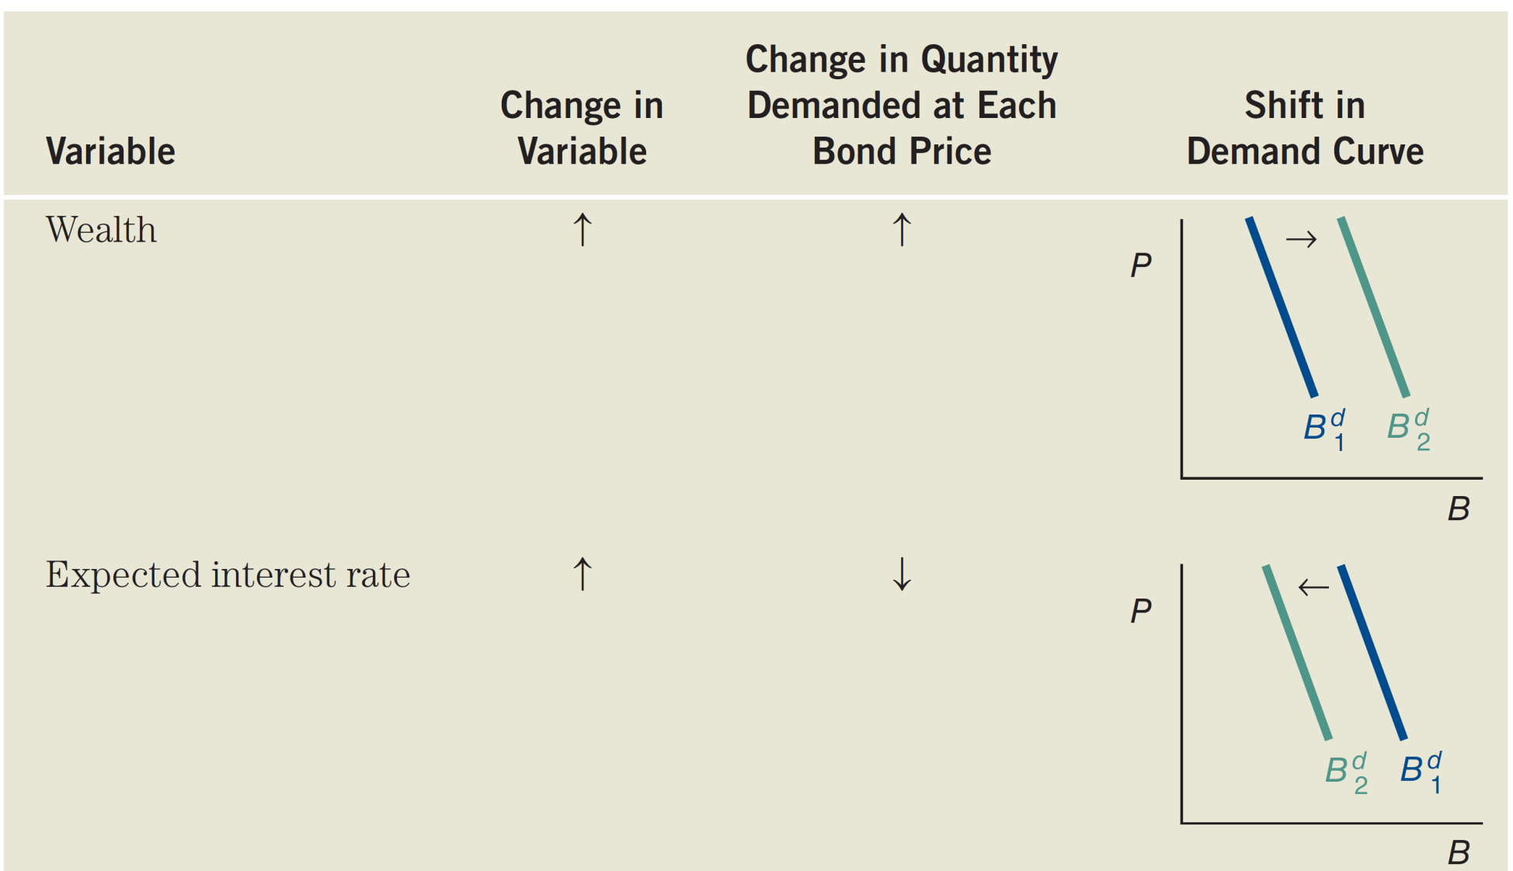
Table 4.2 Summary Factors That Shift the Demand Curve for Bonds (1 of 2)

Slide 29
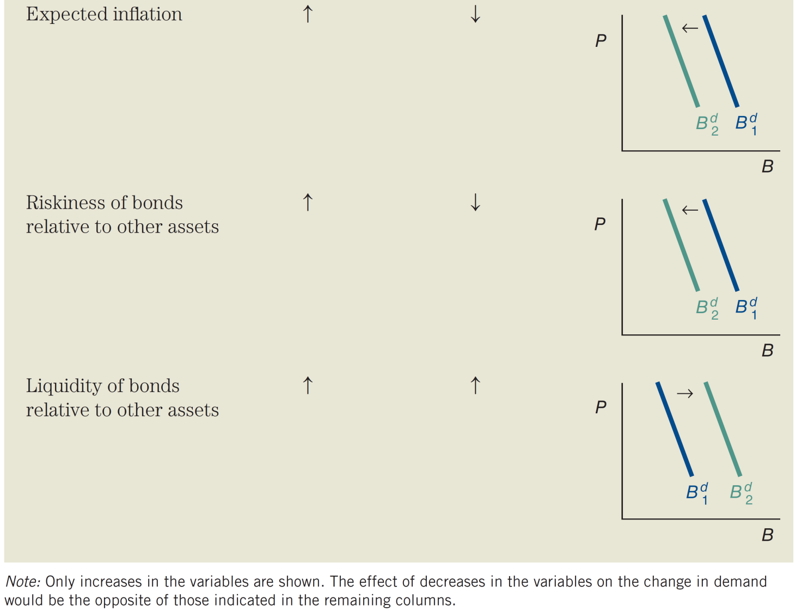
Table 4.2 Summary Factors That Shift the Demand Curve for Bonds (2 of 2)

Slide 30
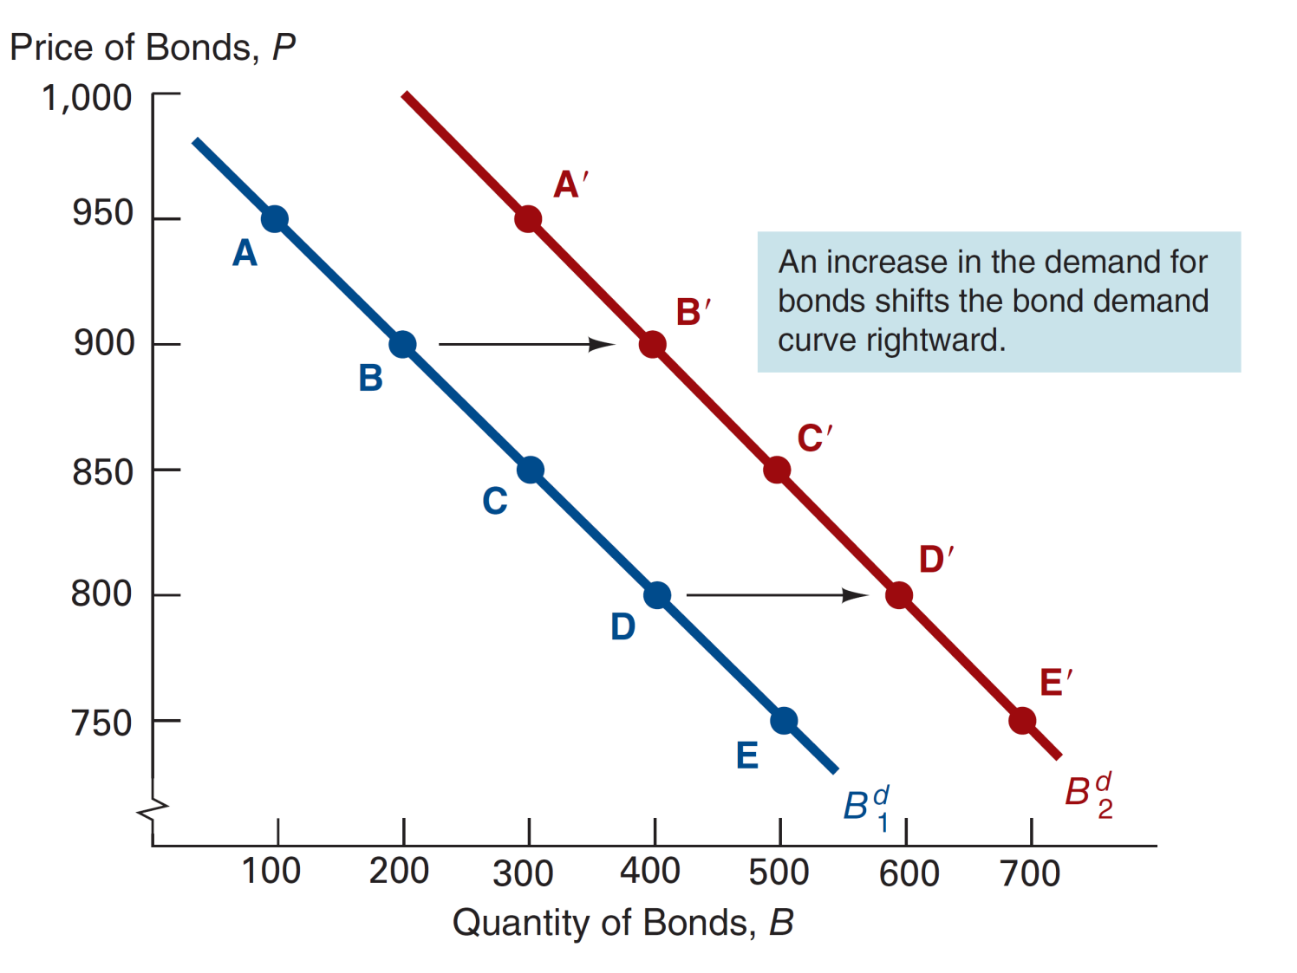
Figure 4.2 Shift in the Demand Curve for Bonds

Slide 31
Shifts in the Supply Curve
Profitability of Investment Opportunities
  Business cycle expansion,
  investment opportunities ↑, B^{s} ↑,
  B^{s} shifts out to right
Expected Inflation
  π^{e} ↑, B^{s} ↑
  B^{s} shifts out to right
Government Activities
  Deficits ↑, B^{s} ↑
  B^{s} shifts out to right

Slide 32
Summary of Shifts in the Supply of Bonds
Expected Profitability of Investment Opportunities: In a business cycle expansion, the supply of bonds increases. Conversely, in a recession, when there are far fewer expected profitable investment opportunities, the supply of bonds falls.
Expected Inflation: An increase in expected inflation causes the supply of bonds to increase.
Government Activities: Higher government deficits increase the supply of bonds. Conversely, government surpluses decrease the supply of bonds.

Slide 33
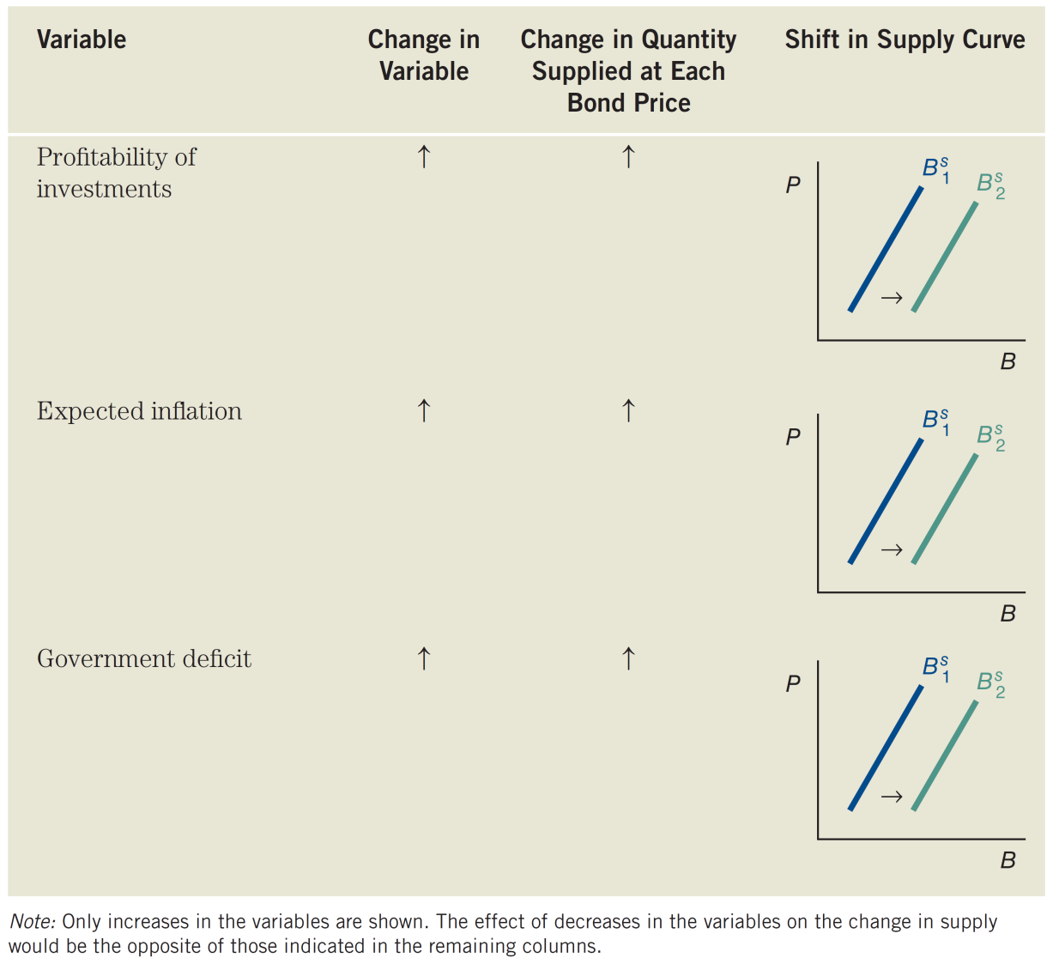
Table 4.3 Factors That Shift Supply Curve of Bonds

Slide 34
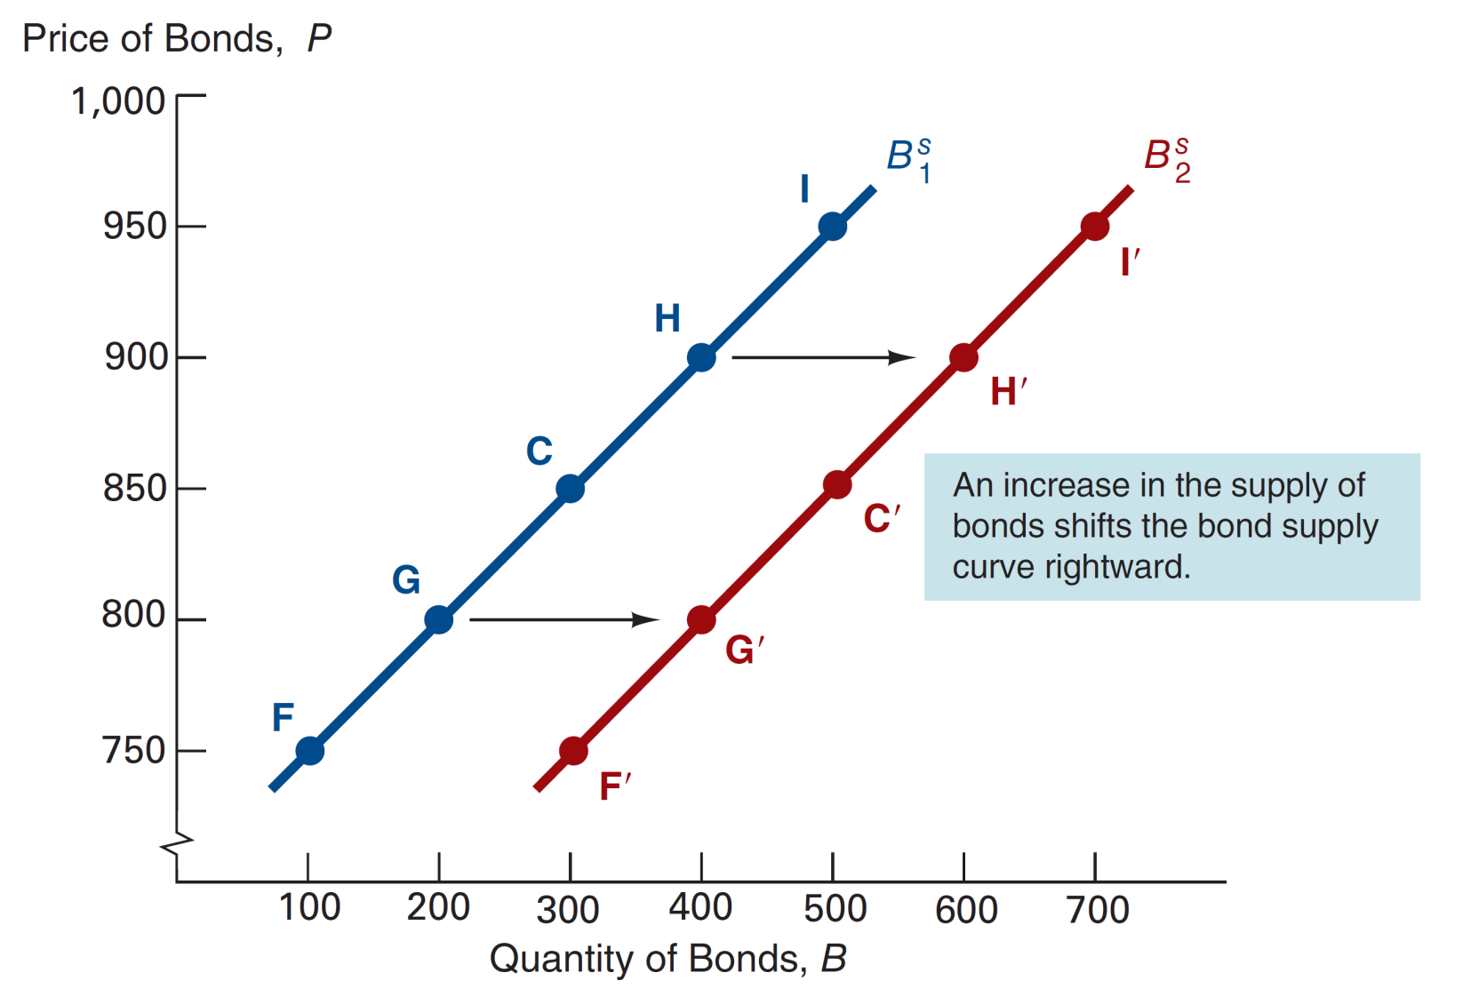
Figure 4.3 Shift in the Supply Curve for Bonds

Slide 35
Case: Changes in π^{e}: The Fisher Effect
WHEN EXPECTED INFLATION RISES, INTEREST RATES WILL RISE
What if there is a change in expected inflation?
As seen in the next slide, if π^{e} ↑
1. Relative R^{e} ↓, B^{d} shifts in to left
2. B^{s} ↑, B^{s} shifts out to right
3. P ↓, i ↑

Slide 36
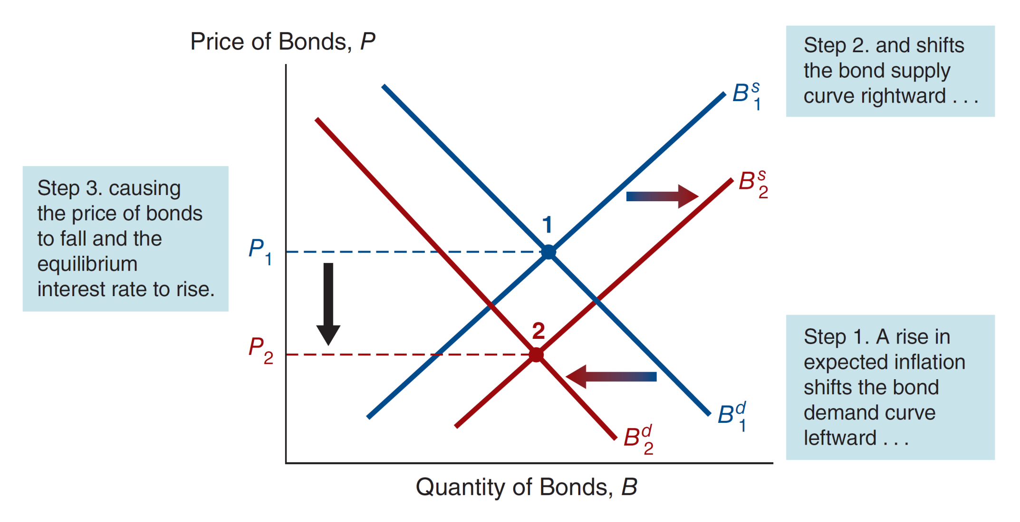
Figure 4.4 Response to a Change in Expected Inflation

Slide 37
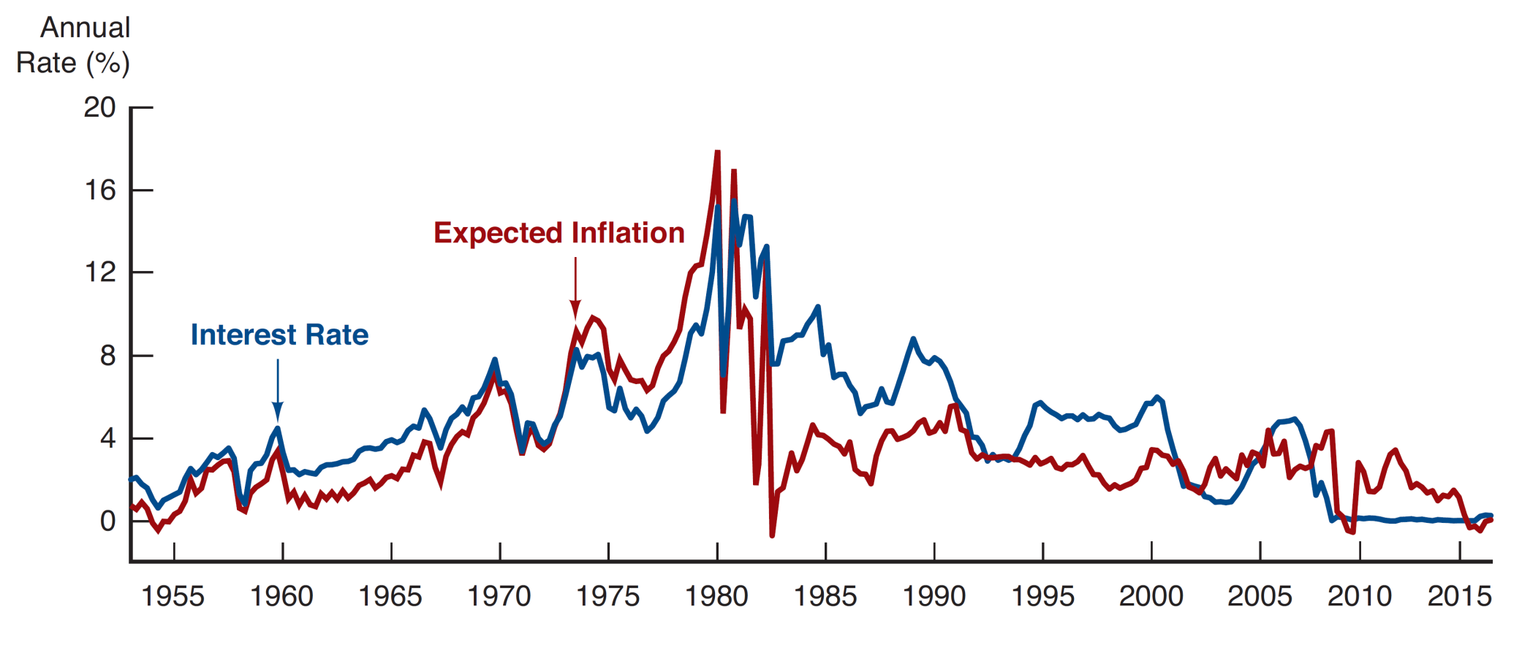
Figure 4.5 Expected Inflation and Interest Rates (Three-Month Treasury Bills), 1953–2016

Slide 38
Summary of the Fisher Effect
If expected inflation rises from 5% to 10%, the expected return on bonds relative to real assets falls and, as a result, the demand for bonds falls.
The rise in expected inflation also means that the real cost of borrowing has declined, causing the quantity of bonds supplied to increase.
When the demand for bonds falls and the quantity of bonds supplied increases, the equilibrium bond
price falls.
Since the bond price is negatively related to the interest rate, this means that the interest rate will rise.

Slide 39
Case: Business Cycle Expansion
As the next slide shows, in a Business Cycle Expansion,
Wealth ↑, B^{d} ↑, B^{d} shifts out to right
Investment ↑, B^{s} ↑, B^{s} shifts right
If B^{s} shifts more than B^{d} then P ↓, i ↑

Slide 40
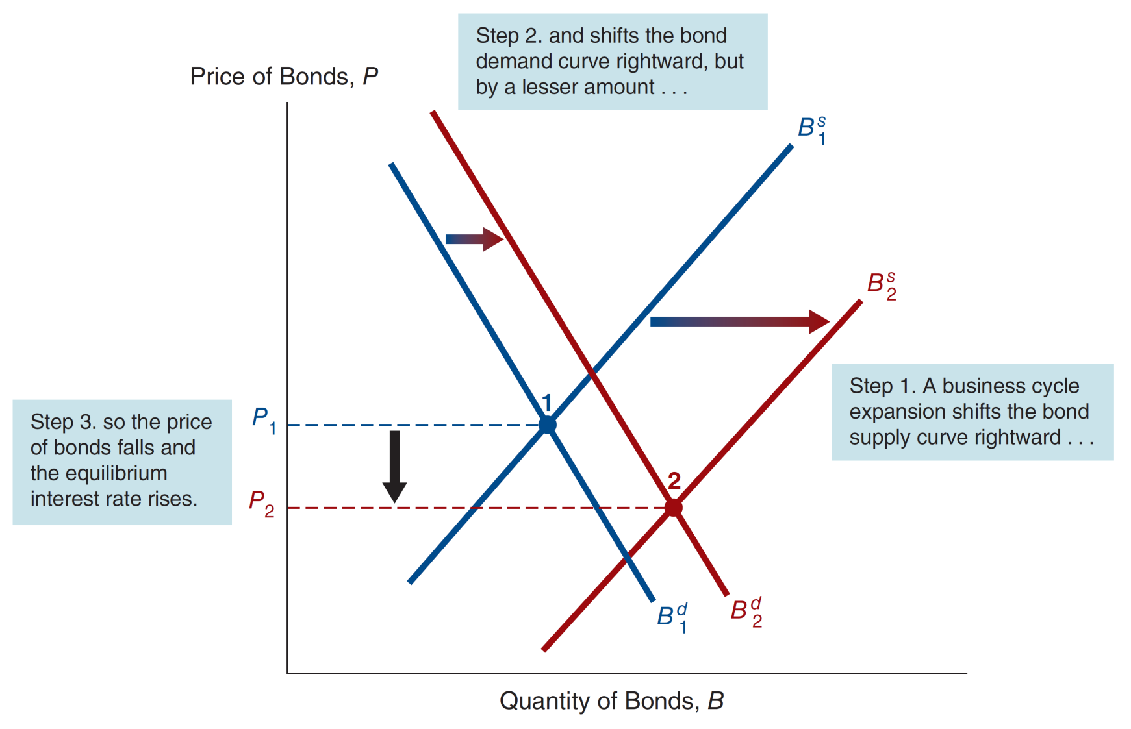
Figure 4.6 Response to a Business Cycle Expansion

Slide 41
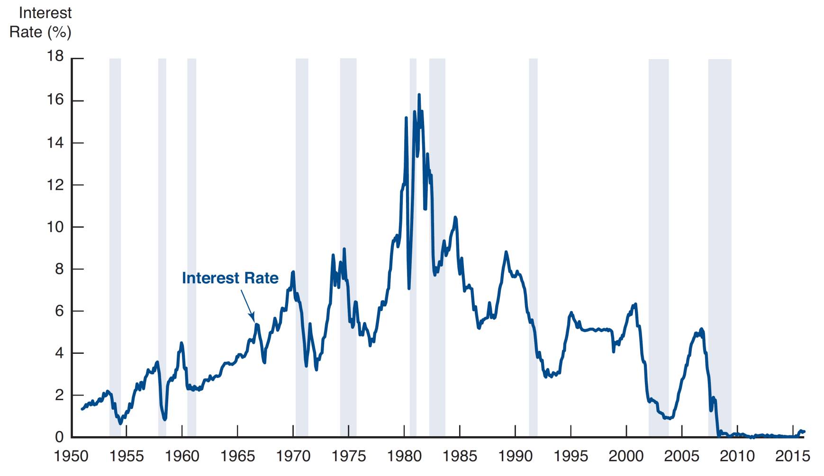
Figure 4.7 Business Cycle and Interest Rates (Three-Month Treasury Bills), 1951–2016

Slide 42
Case: Low Japanese Interest Rates (1 of 2)
Negative inflation lead to B^{d} ↑
  B^{d} shifts out to right
Negative inflation lead to ↑ in real rates
  B^{s} shifts out to left
Net effect was an increase in bond prices (falling interest rates).

Slide 43
Case: Low Japanese Interest Rates (2 of 2)
Business cycle contraction lead to ↓ in interest rates
  B^{s} shifts out to left
  B^{d} shifts out to left
But the shift in B^{d} is less significant than the shift in B^{s}, so the net effect was also an increase in bond prices.

Slide 44
Profiting from Interest-Rate Forecasts
Financial economists are hired (sometimes for high salaries) to forecast interest rates.
Methods for forecasting
  Supply and demand for bonds: use Flow of Funds Accounts and judgment
  Econometric Models: large in scale, use interlocking equations that assume past financial relationships will hold in the future
Make decisions about assets to hold
  Forecast i ↓, buy long bonds
  Forecast i ↑, buy short bonds
Make decisions about how to borrow
  Forecast i ↓, borrow short
  Forecast i ↑, borrow long

Slide 45
Chapter Summary
Determining Asset Demand: We examined the forces that affect the demand and supply of assets.
Supply and Demand in the Bond Market: We examine those forces in the context of bonds, and examined the impact on interest rates.
Changes in Equilibrium Interest Rates: We further examined the dynamics of changes in supply and demand in the bond market, and the corresponding effect on bond prices and interest rates.

