Slide 1
Topic 3: Understanding Interest Rate
Main Reading (Sources): Chap 3 Mishkin & Eakins, 8th

Slide 2
Chapter Preview
In this chapter, we will develop a better understanding of interest rates. We examine the terminology and calculation of various rates, and we show the importance of these rates in our lives and the general economy. Topics include:
  Measuring Interest Rates
  The Distinction Between Real and Nominal
  Interest Rates
  The Distinction Between Interest Rates and Returns

Slide 3
Concepts -Terms of Debt (Loans and Bonds
Money Terms
  Amount of Loan/Bond
  Interest Payment
  Maturity/Term
  Principal Payment (Original Loan/Bond Amount)

Slide 4
Concept- Time Value of Money
5 Variables
Present Value (money you invest today, the amount loan you pay)
Future Value (The expected money you will receive or pay in the future)
Interest Rate
  Growth of your money
  Discount Rate
  Holding Period Return (HPR)
  Internal Rate of Return (IRR) or Rate of Return (ROR)
Time
Payment (Even Monthly, Even Annual Payment received or pay)

Slide 5
Measuring Interest Rate:
Present Value
Different debt instruments have very different streams of cash payments to the holder (known as cash flows), with very different timing.
All else being equal, debt instruments are evaluated against one another based on the amount of each cash flow and the timing of each cash flow.
This evaluation, where the analysis of the amount and timing of a debt instrument’s cash flows lead to its yield to maturity or interest rate, is called present value analysis.
Yield to maturity = interest rate that equates today’s value with present value of all future payments

Slide 6
Present Value
The concept of present value (or present discounted value) is based on the commonsense notion that a dollar of cash flow paid to you one year from now is less valuable to you than a dollar paid to you today. This notion is true because you could invest the dollar in a savings account that earns interest and have more than a dollar in one year.
  MONEY GROWS
The term present value (PV) can be extended to mean the PV of a single cash flow or the sum of a sequence or group of cash flows.

Slide 7
Present Value
There are four basic types of credit instruments which incorporate present value concepts:
Simple Loan
Fixed Payment Loan
Coupon Bond
Discount Bond

Slide 8
Present Value
1. Simple Loan
Loan Principal: the amount of funds the lender provides to the borrower.
Maturity Date: the date the loan must be repaid; the Loan Term is from initiation to maturity date.
Interest Payment: the cash amount that the borrower must pay the lender for the use of the loan principal.
Simple Interest Rate: the interest payment divided by the loan principal; the percentage of principal that must be paid as interest to the lender. Convention is to express on an annual basis, irrespective of the loan term.

Slide 9
Present Value Concept: Simple Loan (1 of 2)
Simple loan of $100
Year: | 0 | 1 | 2 | 3 | n
 | $100 | $110 | $121 | 133 | 100×(1+i)^{n}
Future Value: F=P×(1+i)^{n}
Warren Buffett thought a haircut worth $300,000. Why?
His company Berkshire Hathaway generated about 20% annual return in the 55 year period since 1965 until 2020.
Suppose a fancy haircut cost $15, then future value of the hair-cut=15*(1+0.2)^55=?

Slide 10
Present Value Concept: Simple Loan (2 of 2)
The previous example reinforces the concept that $100 today is preferable to $100 a year from now since today’s $100 could be lent (or deposited) at 10% interest to be worth $110 one year from now, or $121 in two years or $133 in three years.
You are just as happy having $100 today as having $110 a year from now, or as having $121 two years from now, or as having $133 three years from now.

Slide 11
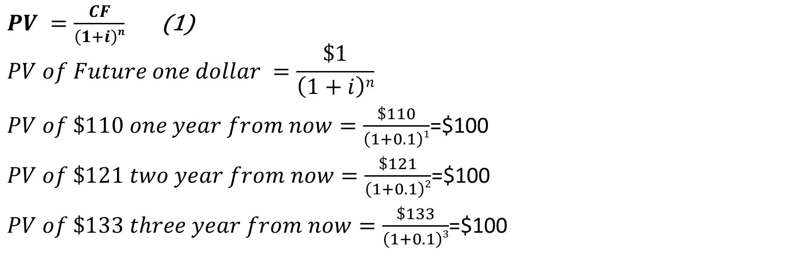
Present Value Formula
$PV =\frac{CF}{\left(1+i\right)n}$ (1)
$$PV of Future one dollar =\frac{\$1}{\left(1+i\right)n}$$
$PV of \$110 one year from now=\frac{\$110}{\left(1+0.1\right)1}$=$100
$PV of \$121 two year from now=\frac{\$121}{\left(1+0.1\right)2}$=$100
$PV of \$133 three year from now=\frac{\$133}{\left(1+0.1\right)3}$=$100

Slide 12

Present Value:
Example 3.1 Simple Present Value
What is the present value of $250 to be paid in two years if the interest rate is 15%?
CF=Cash flow in two years=$250
i=annual interest rate=0.15
n=number of years=2
$$PV =?$$

Slide 13
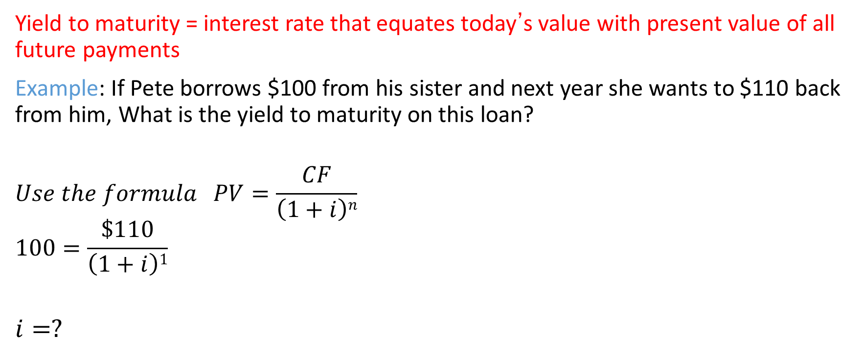
Yield to Maturity: Loans
Yield to maturity = interest rate that equates today’s value with present value of all future payments
  Example: If Pete borrows $100 from his sister and next year she wants to $110 back from him, What is the yield to maturity on this loan?
  $$Use the formula PV=\frac{CF}{\left(1+i\right)n}$$
  $$100=\frac{\$110}{\left(1+i\right)1}$$
  $$i=?$$

Slide 14
Present Value Concept: Fixed-Payment Loan Terms
Simple Loans require payment of one amount which equals the loan principal plus the interest.
Fixed-Payment Loans are loans where the loan principal and interest are repaid in several payments, often monthly, in equal dollar amounts over the loan term.
Installment Loans, such as auto loans and home mortgages are frequently of the fixed-payment type.

Slide 15
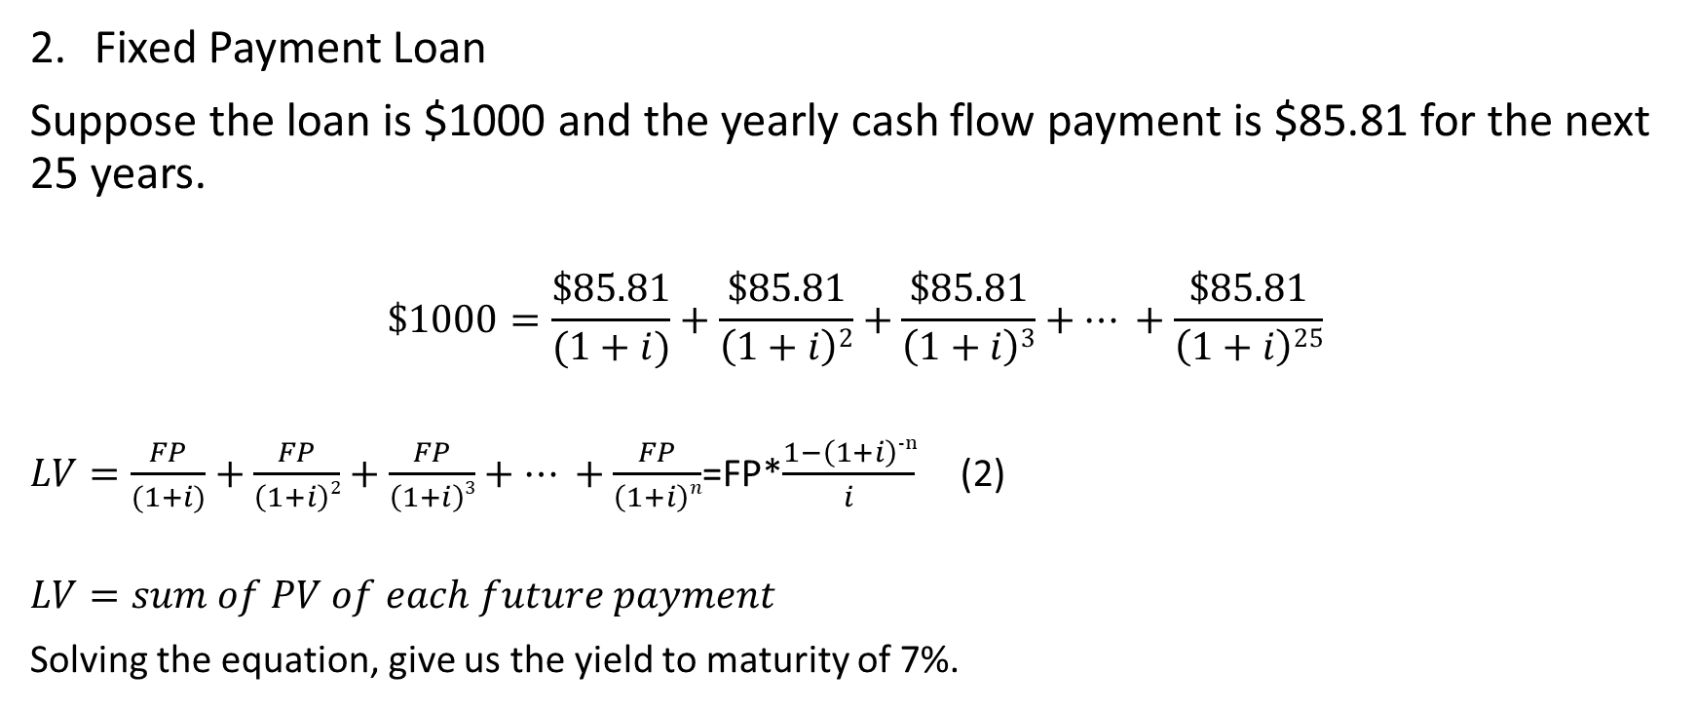
Present Value Concept: Fixed-Payment Loan Terms
Fixed Payment Loan
Suppose the loan is $1000 and the yearly cash flow payment is $85.81 for the next 25 years.
$$\$1000=\frac{\$85.81}{(1+i)}+\frac{\$85.81}{\left(1+i\right)2}+\frac{\$85.81}{\left(1+i\right)3}+… +\frac{\$85.81}{\left(1+i\right)25}$$
$LV=\frac{FP}{(1+i)}+\frac{FP}{\left(1+i\right)2}+\frac{FP}{\left(1+i\right)3}+… +\frac{FP}{\left(1+i\right)n}$=FP*$\frac{1−\left(1+i\right)−n}{i}$ (2)
$$LV=sum of PV of each future payment$$
Solving the equation, give us the yield to maturity of 7%.

Slide 16
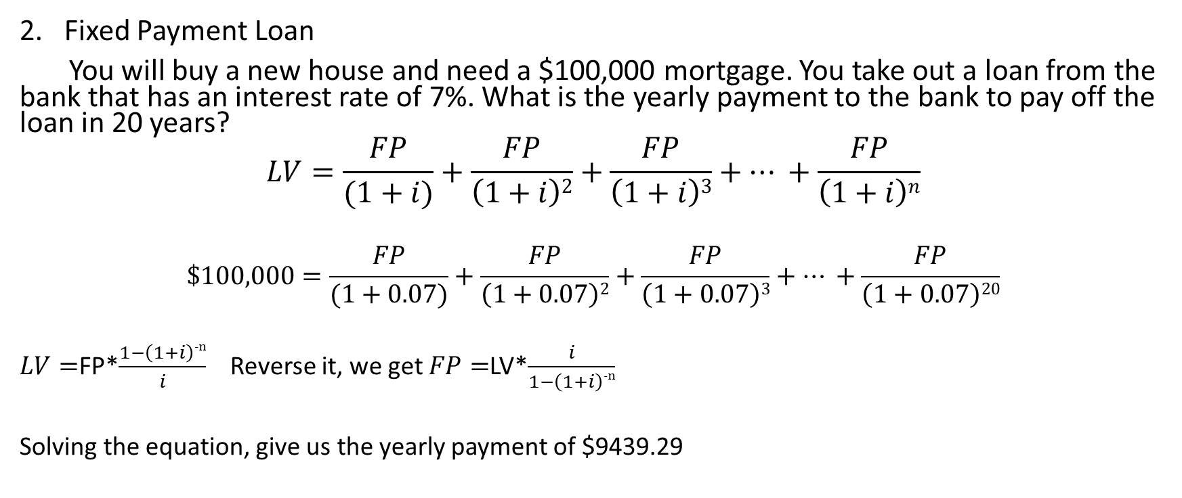
Present Value Concept: Fixed-Payment Loan Terms
Fixed Payment Loan
You will buy a new house and need a $100,000 mortgage. You take out a loan from the bank that has an interest rate of 7%. What is the yearly payment to the bank to pay off the loan in 20 years?
$$LV=\frac{FP}{(1+i)}+\frac{FP}{\left(1+i\right)2}+\frac{FP}{\left(1+i\right)3}+… +\frac{FP}{\left(1+i\right)n}$$
$$\$100,000=\frac{FP}{(1+0.07)}+\frac{FP}{\left(1+0.07\right)2}+\frac{FP}{\left(1+0.07\right)3}+… +\frac{FP}{\left(1+0.07\right)20}$$
$LV=$FP*$\frac{1−\left(1+i\right)−n}{i}$ Reverse it, we get $FP=$LV*$\frac{i}{1−\left(1+i\right)−n}$
Solving the equation, give us the yearly payment of $9439.29

Slide 17
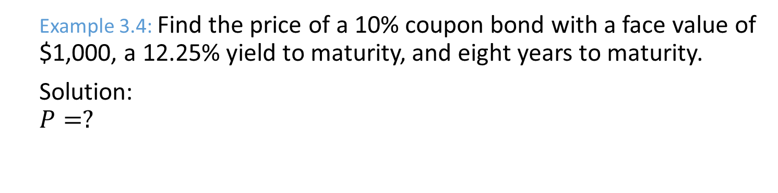
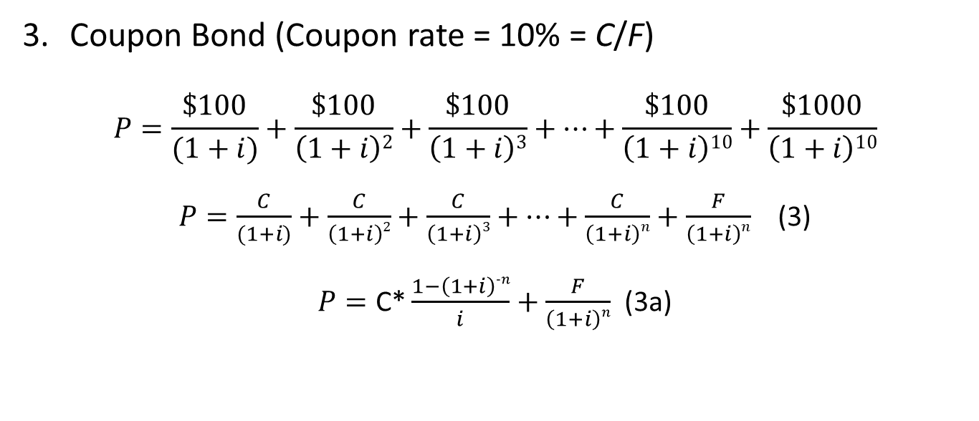
Present Value Concept: Coupon Bond
Coupon Bond (Coupon rate = 10% = C/F)
$$P=\frac{\$100}{(1+i)}+\frac{\$100}{\left(1+i\right)2}+\frac{\$100}{\left(1+i\right)3}+…+\frac{\$100}{\left(1+i\right)10}+\frac{\$1000}{\left(1+i\right)10}$$
$P=\frac{C}{(1+i)}+\frac{C}{\left(1+i\right)2}+\frac{C}{\left(1+i\right)3}+…+\frac{C}{\left(1+i\right)n}+\frac{F}{\left(1+i\right)n}$ (3)
$P=\text{C}\text{∗}\frac{1−\left(1+i\right)−n}{i}+\frac{F}{\left(1+i\right)n}$ (3a)
Example 3.4: Find the price of a 10% coupon bond with a face value of $1,000, a 12.25% yield to maturity, and eight years to maturity.
Solution:
$$P=?$$

Slide 18
Relationship Between Price and Yield to Maturity
It’s also straight-forward to show that the value of a bond (price) and yield to maturity (YTM) are negatively related. If the interest rate i increases (YTM increases), the PV of any given cash flow is lower; hence, the price of the bond must be lower.

Slide 19
Relationship Between Price and Yield to Maturity
Table 3.1 Yields to Maturity on a 10% Coupon Rate Bond Maturing in 10 Years (Face Value = $1,000)
Price of Bond($) | Yield to Maturity (%)
1,200 | 7.13
1,100 | 8.48
1,000 | 10.00
900 | 11.75
800 | 13.81
Three interesting facts in Table 3.1
  When bond is at par, yield equals coupon rate
  Price and yield are negatively related
  Yield greater than coupon rate when bond price is below par value

Slide 20
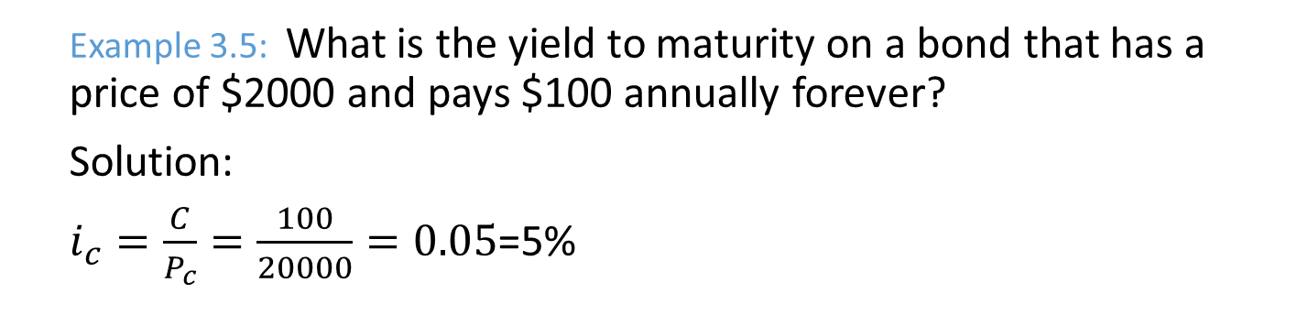

Present Value Concept: Coupon Bond
Coupon Bond
Perpetuity or Consol: Fixed coupon payments of $C forever
$P_{c}=\frac{C}{i_{c}}{\begin{aligned} \\ (4) i\end{aligned}}_{c}=\frac{C}{P_{c}}$ (5)
Example 3.5: What is the yield to maturity on a bond that has a price of $2000 and pays $100 annually forever?
Solution:
$i_{c}=\frac{C}{P_{c}}=\frac{100}{20000}=0.05$=5%

Slide 21
Current Yield
Current yield (CY) is just an approximation for YTM - easier to calculate. However, we should be aware of its properties:
  If a bond’s price is near par and has a long maturity, then CY is a good approximation.
  A change in the current yield always signals change in same direction as yield to maturity
  Formula: i_{c} = C / P

Slide 22
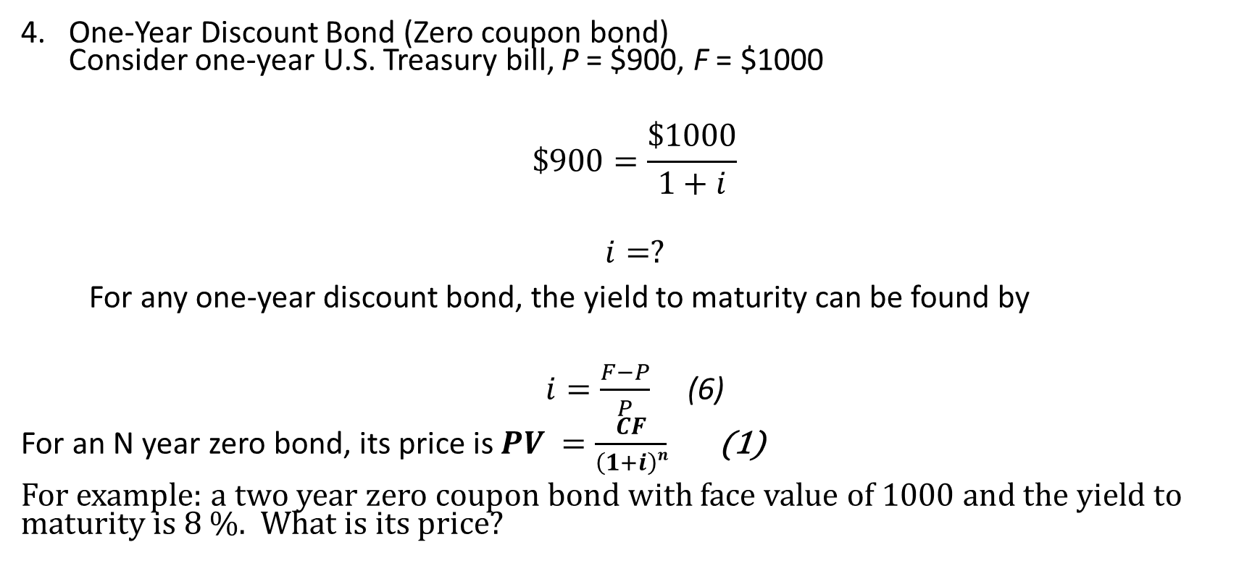
Present Value Concept: Discount Bond
One-Year Discount Bond (Zero coupon bond)
Consider one-year U.S. Treasury bill, P = $900, F = $1000
$$\$900=\frac{\$1000}{1+i}$$
$$i=?$$
For any one-year discount bond, the yield to maturity can be found by
$i=\frac{F−P}{P}$ (6)
For an N year zero bond, its price is $PV =\frac{CF}{\left(1+i\right)n}$ (1)
For example: a two year zero coupon bond with face value of 1000 and the yield to maturity is 8 %. What is its price?

Slide 23
Distinction Between Real and Nominal Interest Rates (1 of 2)
Nominal Interest Rate i =i_{r} + π^{e} (7)
Real interest rate
  Interest rate that is adjusted for expected changes in the price level
  i_{r} = i − π^{e} (8)
  Real interest rate more accurately reflects true cost of borrowing
  When the real rate is low, there are greater incentives to borrow and less to lend
  We usually refer to this rate as the ex ante real rate of interest because it is adjusted for the expected level of inflation. After the fact, we can calculate the ex post real rate based on the observed level of inflation.

Slide 24
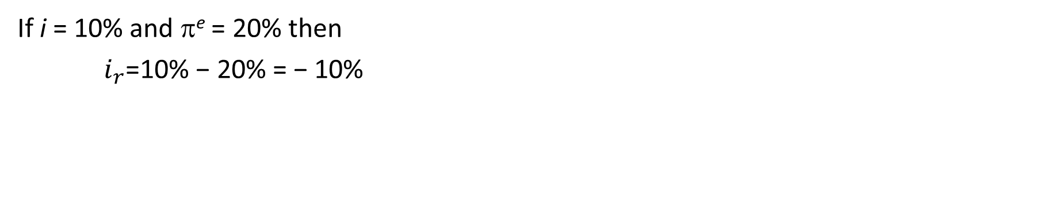
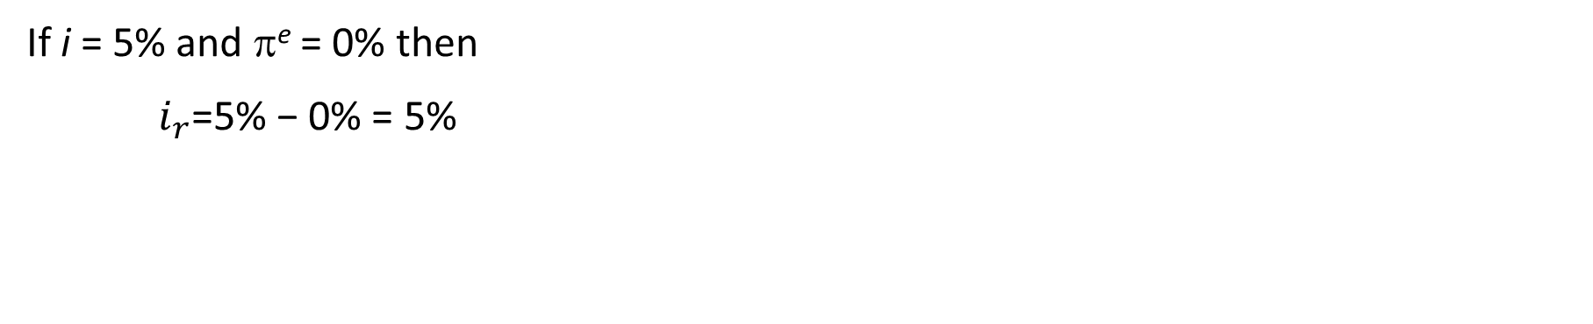
Distinction Between Real and Nominal Interest Rates (2 of 2)
If i = 5% and π^{e} = 0% then
$i_{r}$=5% − 0% = 5%
If i = 10% and π^{e} = 20% then
$i_{r}$=10% − 20% = − 10%

Slide 25
Global: Negative T-Bill Rates? It Can Happen
In November 1998, rates on Japanese
6-month government bonds were negative! Investors were willing to pay more than they would receive in the future.
Same thing happened in the U.S. in September of 2008, then Sweden (July 2009), Denmark (July 2012), the Eurozone (June 2014), Switzerland (December 2014), and Japan again in early 2016.
Best explanation is that investors found the convenience of the Treasury bills (in the U.S. case) worth something—more convenient than cash. But that can only go so far—the rate was only slightly negative.

Slide 26
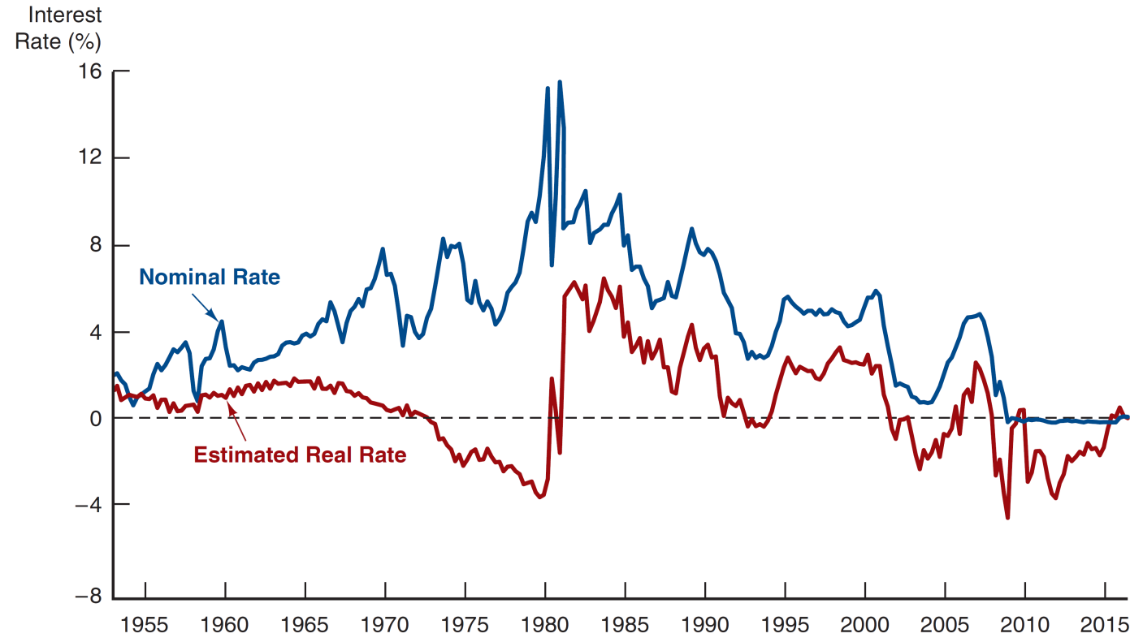
Figure 3.1 Real and Nominal Interest Rates (Three-Month Treasury Bill), 1953–2016
Sources: Federal Reserve Bank of St. Louis FRED database: https://fred.stlouisfed.org/series/TB3MS and https://fred.stlouisfed.org/series/CPIAUCSL. The real rate is constructed using the procedure outlined in Frederic S. Mishkin, “The Real Interest Rate: An Empirical Investigation,” Carnegie–Rochester Conference Series on Public Policy 15 (1981): 151–200. This involves estimating expected inflation as a function of past interest rates, inflation, and time trends and then subtracting the expected inflation measure from the nominal interest rate.

Slide 27
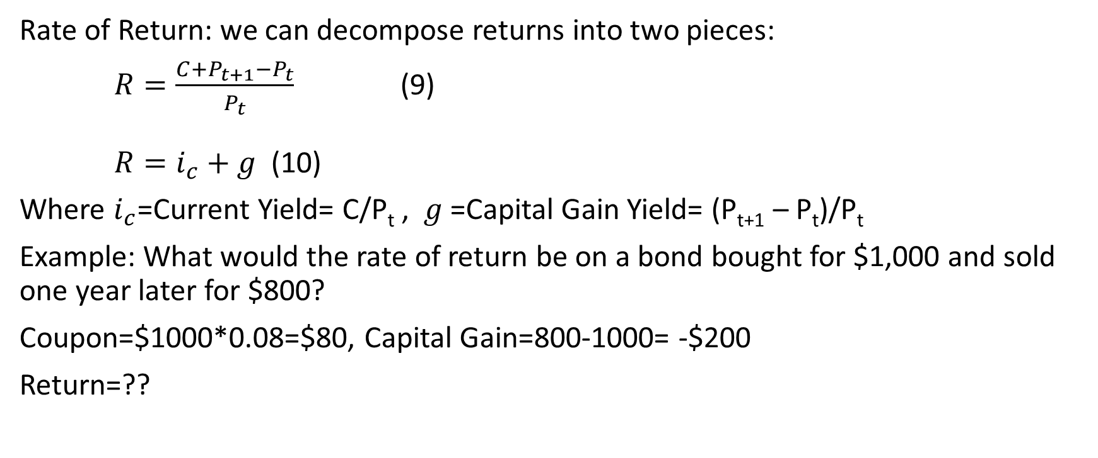
Distinction Between Interest Rates and Returns
Rate of Return: we can decompose returns into two pieces:
$R=\frac{C+P_{t+1}−P_{t}}{P_{t}}$ (9)
$R=i_{c}+g$(10)
Where $i_{c}$=Current Yield= C/P_{t} , $g$=Capital Gain Yield= (P_{t+1} – P_{t})/P_{t}
Example: What would the rate of return be on a bond bought for $1,000 and sold one year later for $800?
Coupon=$1000*0.08=$80, Capital Gain=800-1000= -$200
Return=??

Slide 28
Table 3.2 One-Year Returns on Different-Maturity 10% Coupon Rate Bonds When Interest Rates Rise from 10% to 20%
Original maturity | Initial Current Yield (%) | Initial Price ($) | Price Next Year ($) | Rate of Capital Gain (%) | Rate of Return (%)
30 | 10 | 1,000 | 503 | −49.7 | −39.7
20 | 10 | 1,000 | 516 | −48.4 | −38.4
10 | 10 | 1,000 | 597 | −40.3 | −30.3
5 | 10 | 1,000 | 741 | −25.9 | −15.9
2 | 10 | 1,000 | 917 | −8.3 | 1.7
1 | 10 | 1,000 | 1,000 | 0 | 10
Sample of current coupon rates and yields on government bonds
http://www.bloomberg.com/markets/iyc.html

Slide 29
Maturity and the Volatility of Bond Returns (1 of 3)
Key findings from Table 3.2 (1 of 2)
  Only bond whose return = yield is one with
  maturity = holding period
  For bonds with maturity > holding period,
  as rates increase, price falls, implying capital loss
  Longer is maturity, greater is price change associated with interest rate change

Slide 30
Maturity and the Volatility of Bond Returns (2 of 3)
Key findings from Table 3.2 (2 of 2)
  Longer is maturity, more return changes with change in interest rate
  Bond with high initial interest rate can still have negative return if i ↑

Slide 31
Maturity and the Volatility of Bond Returns (3 of 3)
Conclusion from Table 3.2 analysis
  Prices and returns more volatile for long-term bonds because they have higher interest-rate risk
  No interest-rate risk for any bond whose maturity equals holding period

Slide 32
Reinvestment Risk
Occurs if investor holds a series of short bonds over long holding period
i at which reinvest uncertain
Gain from i ↑, lose when i ↓

Slide 33
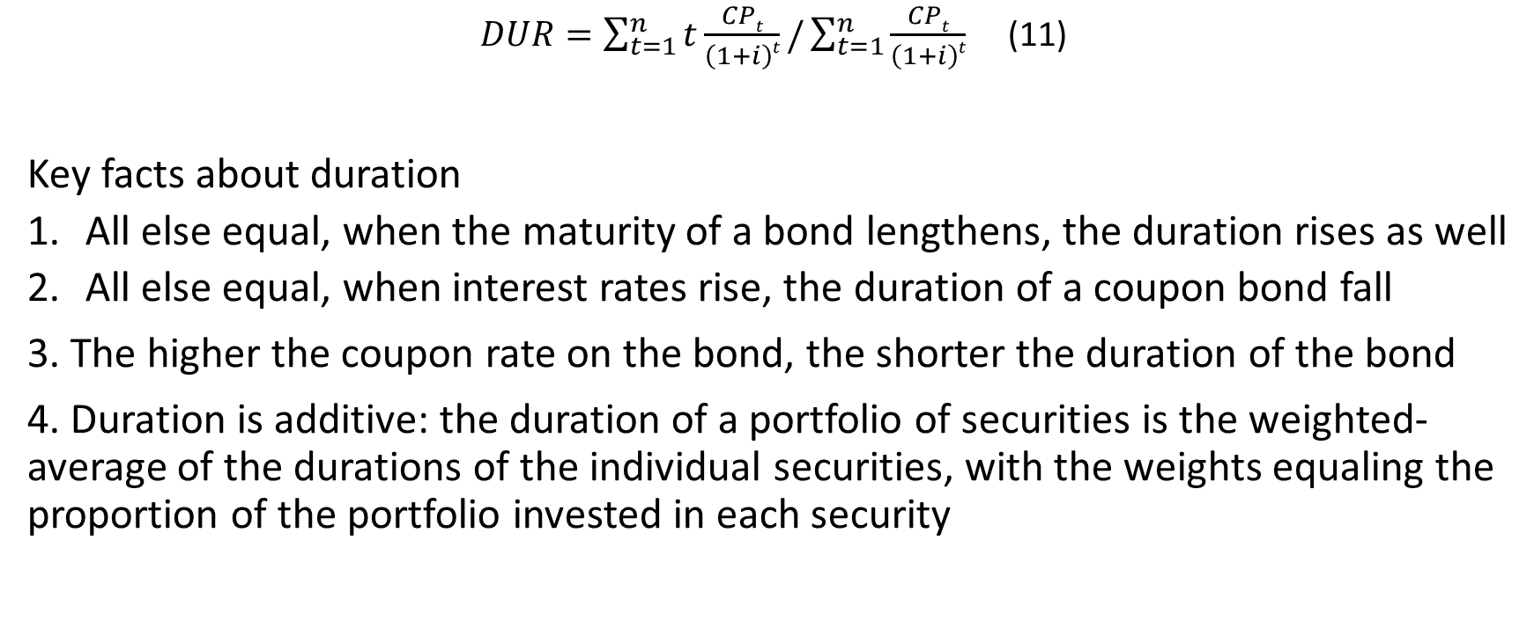
Formula for Duration
$DUR=\sum_{t=1}^{n}{t\frac{CPt}{\left(1+i\right)t}}/\sum_{t=1}^{n}{\frac{CPt}{\left(1+i\right)t}}$ (11)
Key facts about duration
  All else equal, when the maturity of a bond lengthens, the duration rises as well
  All else equal, when interest rates rise, the duration of a coupon bond fall
3. The higher the coupon rate on the bond, the shorter the duration of the bond
4. Duration is additive: the duration of a portfolio of securities is the weighted-average of the durations of the individual securities, with the weights equaling the proportion of the portfolio invested in each security

Slide 34
Table 3.3 Calculating Duration on a $1,000 Ten-Year 10% Coupon Bond When Its Interest Rate Is 10%
(1) | (2) | (3) | (4) | (5)
Year | Cash Payments (Zero-Coupon Bonds) ($) | Present Value (PV) of Cash Payments (i = 10%) ($) | Weights (% of total PV = PV/$1,000) (%) | Weighted Maturity (1 × 4)/100 (years)
1 | 100 | 90.91 | 9.091 | 0.09091
2 | 100 | 82.64 | 8.264 | 0.16528
3 | 100 | 75.13 | 7.513 | 0.22539
4 | 100 | 68.30 | 6.830 | 0.27320
5 | 100 | 62.09 | 6.209 | 0.31045
6 | 100 | 56.44 | 5.644 | 0.33864
7 | 100 | 51.32 | 5.132 | 0.35924
8 | 100 | 46.65 | 4.665 | 0.37320
9 | 100 | 42.41 | 4.241 | 0.38169
10 | 100 | 38.55 | 3.855 | 0.38550
10 | 1,000 | 385.54 | 38.554 | 3.85500
Total | Blank | 1,000.00 | 100.000 | 6.75850

Slide 35
Table 3.4 Calculating Duration on a $1,000 Ten-Year 10% Coupon Bond When Its Interest Rate Is 20%
(1) | (2) | (3) | (4) | (5)
Year | Cash Payments (Zero-Coupon Bonds) ($) | Present Value (PV) of Cash Payments (i = 20%) ($) | Weights (% of total PV = PV /$580.76) (%) | Weighted Maturity (1 × 4)/100 (years)
1 | 100 | 83.33 | 14.348 | 0.14348
2 | 100 | 69.44 | 11.957 | 0.23914
3 | 100 | 57.87 | 9.965 | 0.29895
4 | 100 | 48.23 | 8.305 | 0.33220
5 | 100 | 40.19 | 6.920 | 0.34600
6 | 100 | 33.49 | 5.767 | 0.34602
7 | 100 | 27.91 | 4.806 | 0.33642
8 | 100 | 23.26 | 4.005 | 0.32040
9 | 100 | 19.38 | 3.337 | 0.30033
10 | 100 | 16.15 | 2.781 | 0.27810
10 | 1,000 | 161.51 | 27.808 | 2.78100
Total | Blank | 580.76 | 100.000 | 5.72204

Slide 36
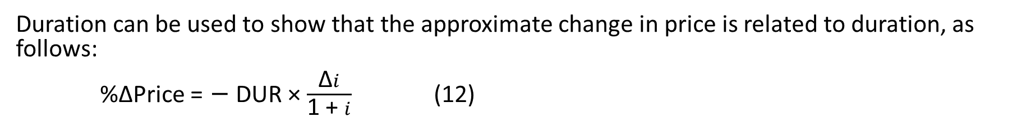
Duration and Interest-Rate Risk (1 of 2)
Duration can be used to show that the approximate change in price is related to duration, as follows:
%∆Price = − DUR × $\frac{\text{∆}i}{\text{1 + }i}$ (12)
i ↑ 10% to 11%:
  Table 3.4, −10% coupon bond
  %∆Price = −6.76 × (0.01 / 1.10) = −6.15%
i ↑ 10% to 11%:
  20% coupon bond, DUR = 5.72 years
  %∆Price = ????

Slide 37
Duration and Interest-Rate Risk (2 of 2)
The greater the duration of a security, the greater the percentage change in the market value of the security for a given change in interest rates
Therefore, the greater the duration of a security, the greater its interest-rate risk

Slide 38
Chapter Summary
Measuring Interest Rates: We examined several techniques for measuring the interest rate required on debt instruments.
The Distinction Between Real and Nominal Interest Rates: We examined the meaning of interest in the context of price inflation.
The Distinction Between Interest Rates and Returns: We examined what each means and how they should be viewed for asset valuation.

Slide 39
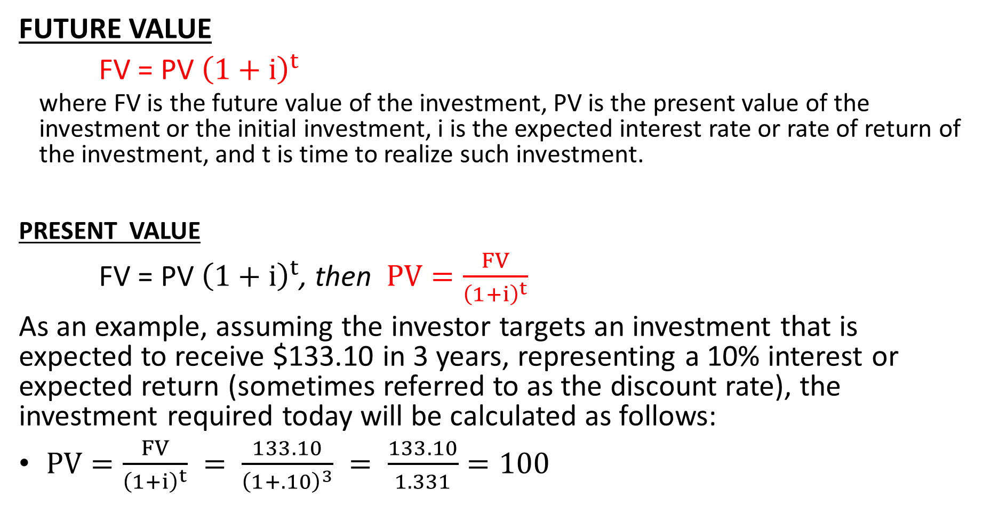
One-Time Investment
FUTURE VALUE
FV = PV ${\left(1+i\right)}^{t}$
  where FV is the future value of the investment, PV is the present value of the investment or the initial investment, i is the expected interest rate or rate of return of the investment, and t is time to realize such investment.
  PRESENT VALUE
FV = PV ${\left(1+i\right)}^{t}$, then $PV=\frac{FV}{{\left(1+i\right)}^{t}}$
As an example, assuming the investor targets an investment that is expected to receive $133.10 in 3 years, representing a 10% interest or expected return (sometimes referred to as the discount rate), the investment required today will be calculated as follows:
$PV=\frac{FV}{{\left(1+i\right)}^{t}} = \frac{133.10}{{\left(1+.10\right)}^{3}} = \frac{133.10}{1.331}=100$

Slide 40
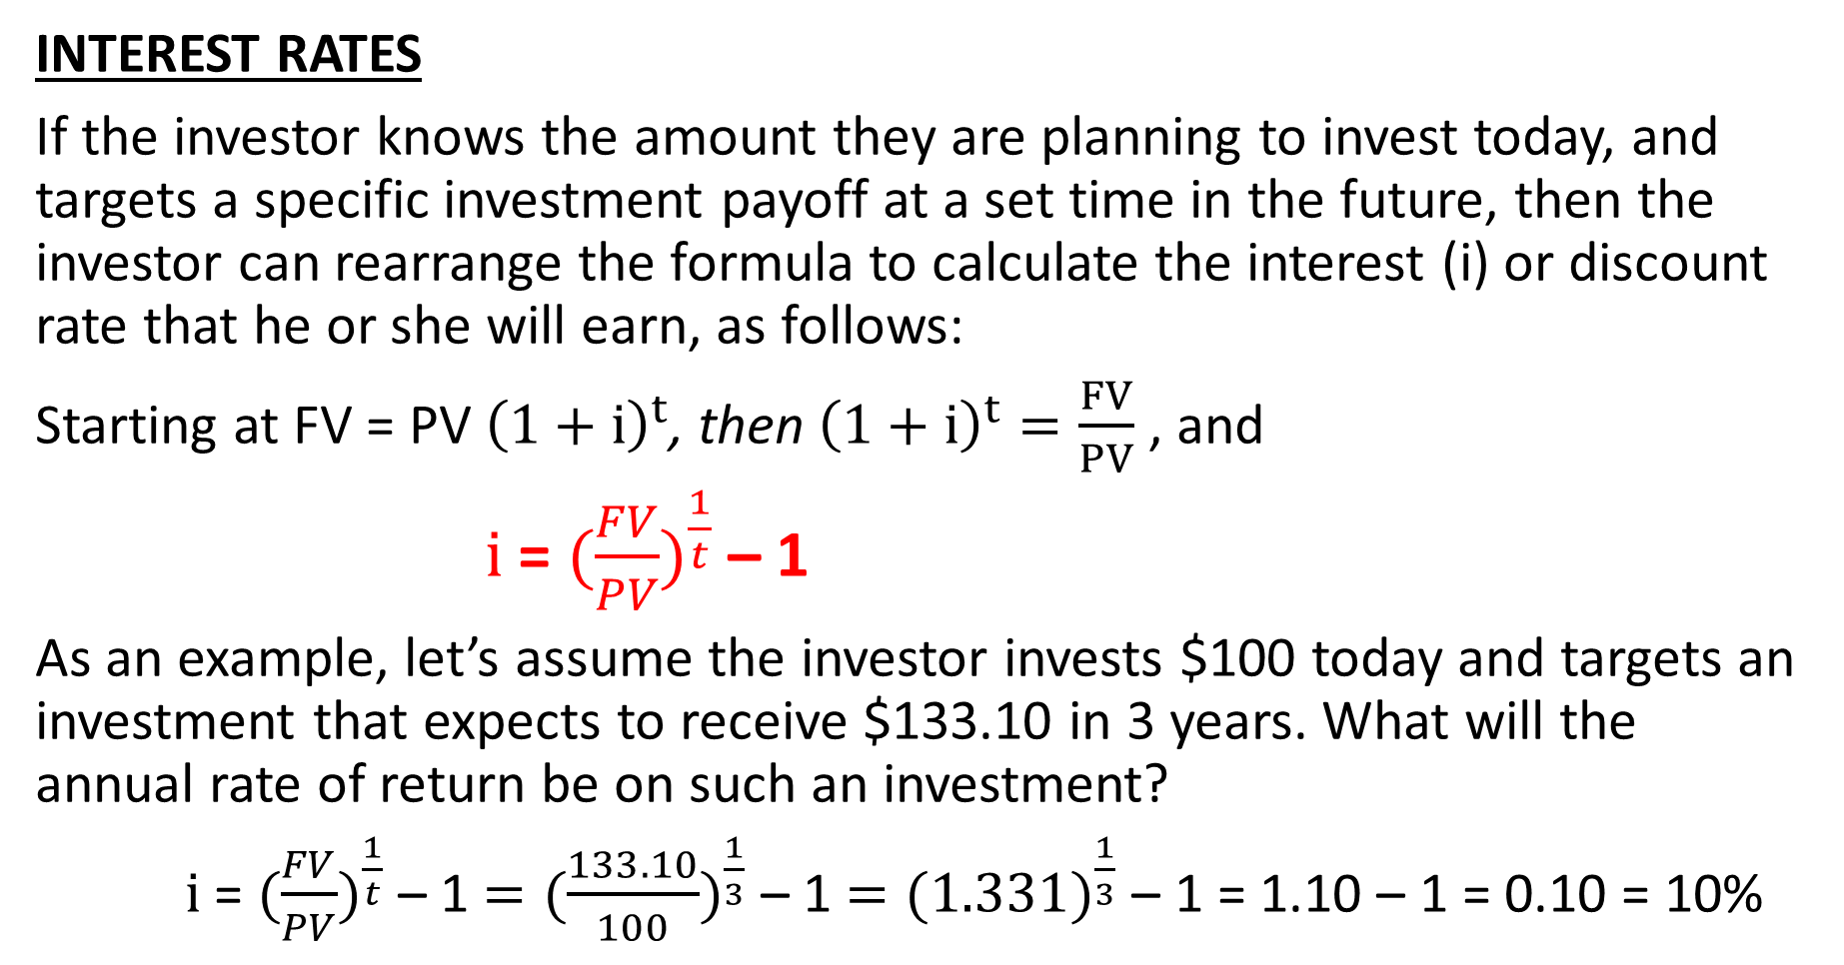
One-Time Investment
INTEREST RATES
If the investor knows the amount they are planning to invest today, and targets a specific investment payoff at a set time in the future, then the investor can rearrange the formula to calculate the interest (i) or discount rate that he or she will earn, as follows:
Starting at FV = PV ${\left(1+i\right)}^{t}$, then ${\left(1+i\right)}^{t}=\frac{FV}{PV}$ , and
$i$ = $({\frac{FV}{PV})}^{\frac{1}{t}}$ – 1
As an example, let’s assume the investor invests $100 today and targets an investment that expects to receive $133.10 in 3 years. What will the annual rate of return be on such an investment?
$i$ = $({\frac{FV}{PV})}^{\frac{1}{t}}$ – 1 $=({\frac{133.10}{100})}^{\frac{1}{3}}$ – 1 $=({1.331)}^{\frac{1}{3}}$ – 1 = 1.10 – 1 = 0.10 = 10%

Slide 41
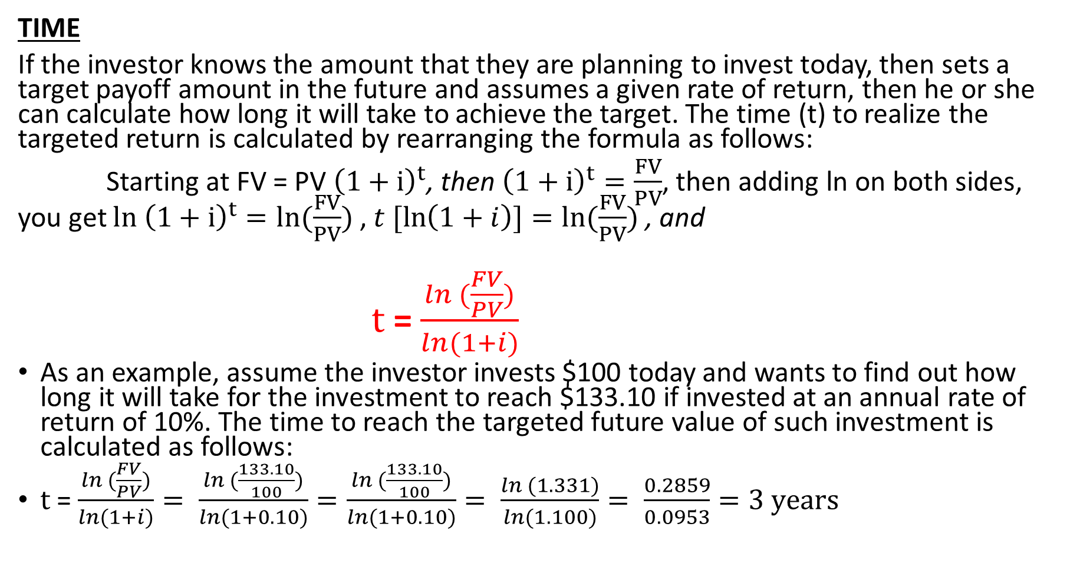
One-Time Investment
TIME
If the investor knows the amount that they are planning to invest today, then sets a target payoff amount in the future and assumes a given rate of return, then he or she can calculate how long it will take to achieve the target. The time (t) to realize the targeted return is calculated by rearranging the formula as follows:
Starting at FV = PV ${\left(1+i\right)}^{t}$, then ${\left(1+i\right)}^{t}=\frac{FV}{PV}$, then adding ln on both sides, you get ${ln \left(1+i\right)}^{t}=ln(\frac{FV}{PV})$ , $t [\ln\left(1+i\right)]=ln(\frac{FV}{PV})$ , and
$t$ = $\frac{ln (\frac{FV}{PV})}{ln⁡(1+i)}$
As an example, assume the investor invests $100 today and wants to find out how long it will take for the investment to reach $133.10 if invested at an annual rate of return of 10%. The time to reach the targeted future value of such investment is calculated as follows:
$t$ = $\frac{ln (\frac{FV}{PV})}{ln⁡(1+i)}= \frac{ln (\frac{133.10}{100})}{ln⁡(1+0.10)}=\frac{ln (\frac{133.10}{100})}{ln⁡(1+0.10)}= \frac{ln (1.331)}{ln⁡(1.100)}= \frac{0.2859}{0.0953}=3 years$

Slide 42
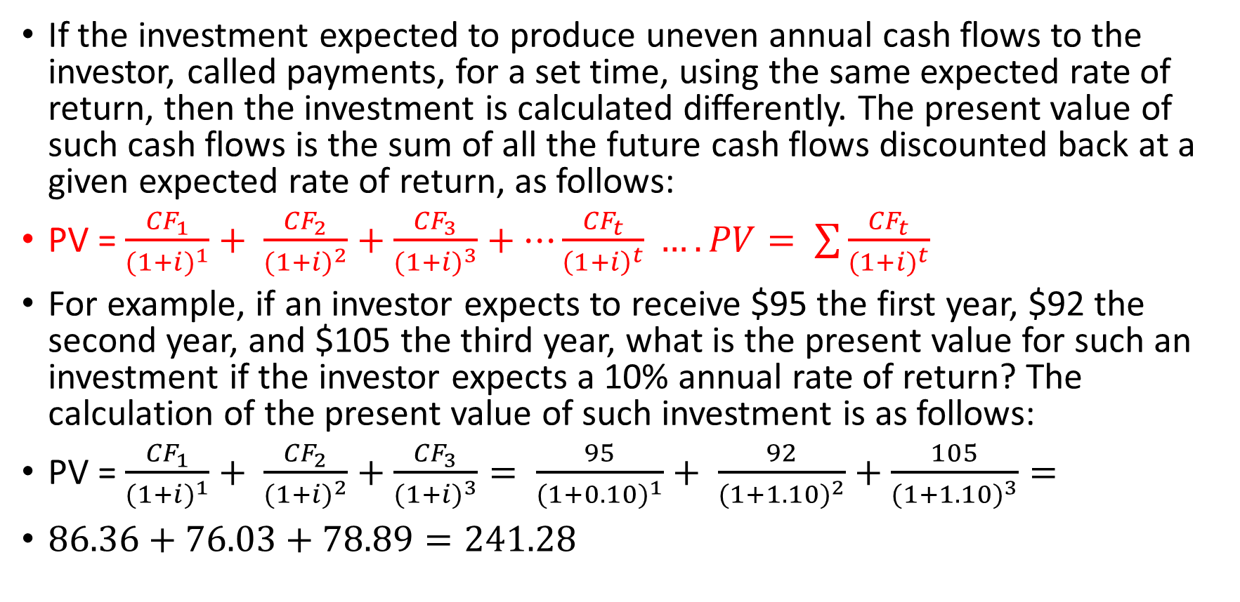
Uneven Annual Cash Flows
If the investment expected to produce uneven annual cash flows to the investor, called payments, for a set time, using the same expected rate of return, then the investment is calculated differently. The present value of such cash flows is the sum of all the future cash flows discounted back at a given expected rate of return, as follows:
PV = $\frac{{CF}_{1}}{{(1+i)}^{1}}+ \frac{{CF}_{2}}{{(1+i)}^{2}}+\frac{{CF}_{3}}{{(1+i)}^{3}}+…\frac{{CF}_{t}}{{\left(1+i\right)}^{t}} …. PV= \sum{\frac{{CF}_{t}}{{(1+i)}^{t}}}$
For example, if an investor expects to receive $95 the first year, $92 the second year, and $105 the third year, what is the present value for such an investment if the investor expects a 10% annual rate of return? The calculation of the present value of such investment is as follows:
PV = $\frac{{CF}_{1}}{{(1+i)}^{1}}+ \frac{{CF}_{2}}{{(1+i)}^{2}}+\frac{{CF}_{3}}{{(1+i)}^{3}}= \frac{95}{{(1+0.10)}^{1}}+ \frac{92}{{(1+1.10)}^{2}}+\frac{105}{{(1+1.10)}^{3}}=$
$86.36+76.03+78.89=241.28$

Slide 43
Excel based formulas:
Excel formulas for calculating all five variables including the present value, future value, rate of return, time and cash flows or payments (represent set additional payments received during the investment):
= PV (rate, years, payment, future value) or =pv(rate,nper,pmt,fv)
=FV (rate, years, payment, -present value) or =fv(rate,nper,pmt,pv)
=Rate (years, payment, - present value, future value) or =rate(nper,pmt,pv,fv)
=Nper (rate, payment, - present value, future value) or =nper(rate,pmt,pv,fv)
= Pmt (rate, years, -present value, future value) or =pmt(rate,nper,pv,fv)

