Slide 1
Topic 13: Central Banks and the Federal Reserve System
Main Reading (Sources): Chap 9 Mishkin & Eakins, 8th

Slide 2
Chapter Preview
We examine the role of government authorities over the money supply. We focus primarily on the role of the U.S. Federal Reserve System, but also examine similar organizations in other nations. Topics include:
Origins of the Federal Reserve System
Structure of the Federal Reserve System
How Independent is the Fed?
Should the Fed Be Independent?
Structure and Independence of the European Central Banks
Structure and Independence of other Foreign Central Banks
Notes:
Part 4 Central Banking and the Conduct of Monetary Policy

Slide 3
Origins of the Federal Reserve System
Fear of centralized power and distrust of moneyed interests guided central bank activities in the 19th century.
The First Bank of the U.S. was disbanded in 1811.
The Second Bank of the U.S. was disbanded in 1836 when President Andrew Jackson vetoed its renewal.
As a result, banking panics became regular events, absent a lender of last resort, culminating in the panic of 1907.
Widespread bank failures and depositor losses convinced the U.S. that a central bank was needed.

Slide 4
Federal Reserve Act of 1913
Fear of a “central authority” was rampant—people worried that powerful Wall Street interests would manipulate the system.
Questions arose as to whether such a monetary authority would be private or a government institution.
The Federal Reserve Act of 1913 was a compromise that created the Federal Reserve System, including elaborate checks and balances.

Slide 5
Inside the Fed: The Political Genius of the Founders of the FRS
The founders decided against concentrating the federal banking system in NYC or D.C. in order to maintain public support for the idea, increasing its effectiveness.
The 12 branches are spread across the country to make sure all regions of the country are represented in policy deliberations.
The banks are quasi-private institutions, promoting a concern with regional issues.

Slide 6
Structure of the Federal Reserve System
Design was intended to diffuse power along the following dimensions:
Regions of the U.S.
Government and private sector interests
Needs of bankers, businesses, and the public
The system as it exists now includes:
Twelve Federal Reserve Banks
Board of Governors (BOG) of the Federal Reserve System
Federal Open Market Committee (FOMC)
Federal Advisory Council
Member Banks (around 2,000)

Slide 7
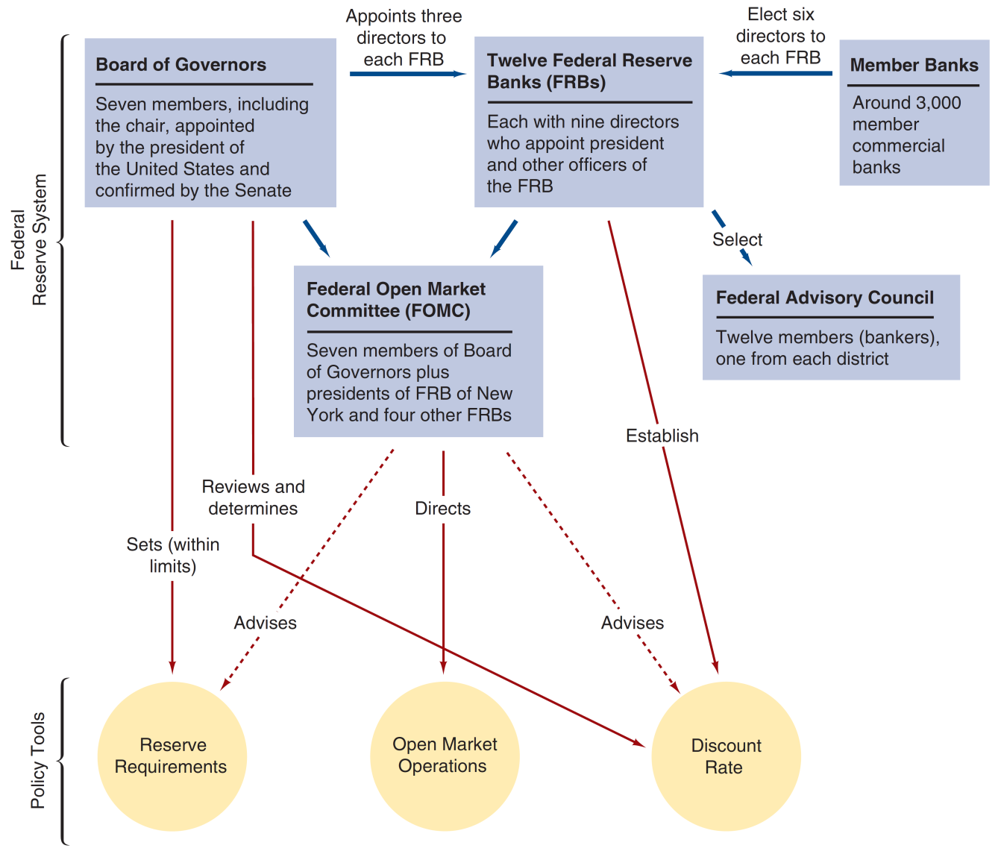
Figure 9.1 Structure and Responsibility for Policy Tools in the Federal Reserve System
Notes:
The slide outlines the relationships of these entities to one another and to the three policy tools of the Fed:
Open market operations
Discount rate
Reserve requirements

Slide 8
Twelve Federal Reserve Banks
Each of the twelve districts has a main Federal Reserve Bank and at least one branch office
The banks are “quasi-public”
Owned by member commercial banks in the district
Member banks elect six directors, while three directors are appointed by the Board of Governors
Directors represent professional bankers, prominent business leaders, and public interests (three from each group)

Slide 9
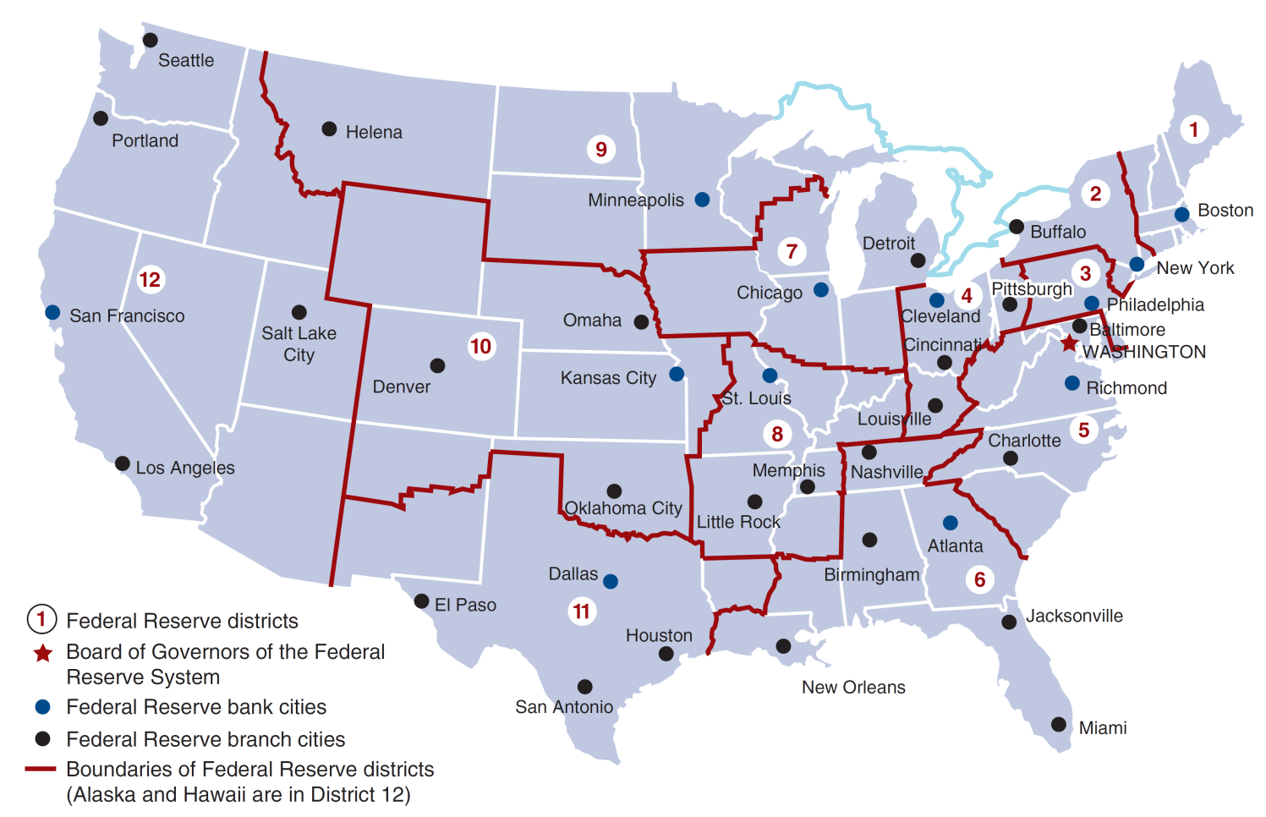
Figure 9.2 Federal Reserve System
Notes:
The next slide shows the location of the 12 main Federal Reserve Banks, and other prominent cities in the Federal Reserve System.
You are going to groups. Each group can act on behalf of one Federal Reserve Bank.

Slide 10
Federal Reserve Bank Functions: Monetary Policy
“Establish” the discount rate at which member banks may borrow from the Federal Reserve Bank (subject to BOG review)
Determine which bank receive loans
Elect one member to the Federal Advisory Council
Five of the 12 bank presidents vote in the Federal Open Market Committee
Notes:
Central banks are the government authorities in change of monetary policy. For example, in the U.S., the central bank is the Federal Reserve System. Although we typically hear about central banks in connection with interest rates, their actions also affect credit, the money supply, and inflation (just to name a few areas).

Slide 11
Federal Reserve Bank Functions: General
Clear checks
Issue new currency and remove damaged currency
Administer and make discount loans to banks in their districts
Evaluate bank mergers and expansions
Liaison between local community and the Federal Reserve System
Perform bank examinations
Collect and examine data on local business conditions
Conduct research related to monetary policy

Slide 12
The FRB of New York
The New York Fed is responsible for oversight of some of the largest financial institutions headquartered in Manhattan and the surrounding area.
The New York Fed houses the open market desk. All of the Feds open market operations are directed through this trading desk.
Finally, the chairman of New York Fed is the only permanent member of the FOMC, serving as the vice-chairman of the committee.
The New York Fed is the only member of the Bank for International Settlements, providing close contact with other foreign central bankers

Slide 13
Member Banks
National banks (banks chartered by the Office of the Comptroller of the Currency) are required to be members.
State commercials banks may elect to join. Currently, about 1/3 of the commercial banks in the U.S. are members of the system, down from 49% in 1947.
Prior to 1980, only member banks were required to maintain reserves. By 1987, all depository institutions were required to maintain reserves, eliminating this downside of membership.

Slide 14
Board of Governors (1 of 2)
The seven governors are appointed by the President, and confirmed by the Senate, for 14-year terms on a rotating schedule.
All Board members are members of the FOMC.
Sets reserve requirements and effectively set the discount rate.

Slide 15
Board of Governors (2 of 2)
Serve in an advisory capacity to the President of the United States, and represent the U.S. in foreign economic matters.
Other duties as established by legislation (e.g., Regulation Q, Credit Control Act of 1969).
Set margin requirements for stock purchases.
Sets the salary of the president and all officers of each Federal Reserve bank and reviews each bank’s budget.

Slide 16
Inside the Fed: The research staff
The Federal Reserve System employs over 500 research economists. What do all these researchers do?
Offer insight on incoming economic data and interpret where it suggests our economy is heading
Provide briefs for formal meetings on the economic outlook of the country
Provide support for supervisory staff in decisions about bank mergers, lending activities, and other technical advice
Produce reports on the developments in major foreign economies
Public education

Slide 17
Federal Open Market Committee
Make decisions regarding open market operations, to influence the monetary base.
The chairman of the BOG is also the chair of this committee
Open market operations are the most important tool that the Fed has for controlling the money supply (along with reserve requirements and the discount rate)
Decisions about tightening (contractionary) of monetary policy (a rise in the federal funds rate) or an easing (expansionary) of monetary policy (a lowering of the federal funds rate) or neutral.
All actions are directed the Federal Reserve Bank of New York, where securities are bough / sold as required.
Notes:
Now let’s talk about the most important function of Federal Reserve System.

Slide 18
Inside the Fed: FOMC Meeting
Meet eight times each year (about every six weeks)
Important agenda items include
Reports on open market operations (foreign and domestic)
National economic forecasts are presented
Discussion of monetary policy and directives, including views of each member
Formal policy directive made
Post-meeting announcements, as needed
Notes:
Show them the calendar.

Slide 19
Inside the Fed: The Books
Several research documents are by the Fed, and have been given official, colorful names:
Green book: national forecasts for the next two years
Blue book: projections of monetary aggregates
Beige book: districts’ “state of the economy”

Slide 20
Chairman of the Federal Reserve System
Spokesperson for the entire Federal Reserve System, and supervises the Board’s staff
Negotiates, as needed, with Congress and the President of the United States
With these, the chairman has effective control over the system, even though he doesn’t have legal authority to exercise control over the system and its member banks.
Notes:
The second most powerful figure, next to the President. Sometimes even more important in terms of economic policy.

Slide 21
Inside the Fed: How Bernanke and Yellen Differ from Greenspan
Greenspan | vs. | Bernanke / Yellen
Professional career running a consulting firm | Blank | Academics
Disciple of Ayn Rand, believer in laissez-faire capitalism | Blank | More theorists - involved in model design/analytics
Not a theorist—believed more in what the data showed him | Blank | More “informal” and “clear” FOMC meetings relative to Greenspan

Slide 22
How Independent is the Fed?
A broad question of policy for the Federal Reserve Systems is how free the Fed is from presidential and congressional pressure in pursuing its goals.
Instrument Independence: the ability of the central bank to set monetary policy instruments.
Goal Independence: the ability of the central bank to set the goals of monetary policy.
Evidence suggests that the Fed is free along both dimensions. Further, the 14-year terms (non-renewable) limit incentives to curry favor with either the President or Congress.

Slide 23
How Independent is the Fed? Other Evidence
The Fed usually generates revenue in excess of its expenses, so it is not typically under appropriations pressure.
However, Congress can enact legislation to gain control of the Fed, a threat wielded as needed. For example, the House Concurrent Resolution 133 requires the Fed to announce its objective growth rate for the money supply.
Presidential appointment clearly sets the direction of the Fed.

Slide 24
Should the Fed Be Independent?
Every few years, the question arises in Congress as to whether the independence of the Fed should be reduced in some fashion. This is usually motivated by politicians who disagree with current Fed policy.
Arguments can be made both ways, as we outline next.

Slide 25
Case for Independence (1 of 2)
The strongest argument for independence is the view that political pressure will tend to add an inflationary bias to monetary policy. This stems from short-sighted goals of politicians. For example, in the short-run, high money growth does lead to lower interest rates. In the long-run, however, this also leads to higher inflation.
The notion of the political business cycle stems from the above argument.
Expansionary monetary policy leads to lower unemployment and lower interest rates—a good idea just before elections.
Post-election, this policy leads to higher inflation, and therefore, higher interest rates—effects that hopefully disappear (or are forgotten) by the next election.

Slide 26
Case for Independence (2 of 2)
Other arguments include:
The Treasury may seek to finance the government through bonds purchased by the Fed. This may lead to an inflationary bias.
Politicians have repeatedly shown an inability to make hard choices for the good of the economy that may adversely affect their own well-being.
Its independence allows the Fed to pursue policies that are politically unpopular, yet in the best interest of the public.

Slide 27
Case Against Independence
Some view Fed independence as “undemocratic”—an elite group controlling an important aspect of the economy but accountable in few ways.
If this argument seems unfounded, then ask why we don’t let the other aspects of the country be controlled by an elite few. Are military issues, for example, any less complex?
Indeed, we hold the President and Congress accountable for the state of the economy, yet they have little control over one of the most important tools to direct the economy.
Further, the Fed has not always been successful in the past. It has made mistakes during the Great Depression and inflationary periods in the 1960s and 1970s.
Lastly, the Fed can succumb to political pressure regardless of any state of independence. This pressure may be worse with few checks and balances in place.

Slide 28
Explaining Central Bank Behavior
Two competing theories try to explain the observed behavior of central banks:
Public Interest View: the central bank serves the public interest.
Theory of Bureaucratic Behavior: the central bank will seek to maximize its own welfare.
The Fed often fights to maintain autonomy while avoiding conflict with Congressional power groups.
Notes:
These seem to favor the latter theory, but this view is probably too extreme.

Slide 29
Inside the Fed: Fed’ s Communication Strategy (1 of 2)
Has made changes toward more transparency over the years:
1994 – began to reveal the FOMC directives immediately after each FOMC meeting
1999 – began to announce the “bias” toward which direction monetary policy was likely to go
2002 – the Fed started to report the roll call for the FOMC meeting votes
2004 – moved up the release date of the minutes of FOMC meetings
Notes:
The Fed generally likes to keep its actions hidden—not transparent—to avoid conflicts with Congress and other politicians. For example, in the past, the Fed didn’t announce the results of the FOMC meetings. Now it does, but try to find out what bonds are being traded at the New York Fed – that is guarded closely.

Slide 30
Inside the Fed: Fed’ s Communication Strategy (2 of 2)
Each chairman, of course, adds changes to this view:
In 2007, Bernanke extended the forecast horizon for FOMC projections from 2 years to 3 years.
FOMC publishes these projects quarterly (instead of twice a year).
The Chairman now also gives a press conference after FOMC meetings in January, April, June, and November.
In 2011, provided guidance on target fed funds rates
In 2012, started adding projections for FOMC forecasts of the appropriate level of target fed funds rates.
Anchored inflation target to 2%.

Slide 31
Structure and Independence of the European Central Bank
Founded (as it currently exists) in 1999 by a treaty between the European Central Bank (ECB) and the European System of Central Banks (ESCB).
The ECB is housed in Frankfurt, Germany.
Executive board consists of the president, vice president, and four members, all serving eight-year terms.
The policy group consists of the executive board and governors from the 17 member countries central banks.

Slide 32
The European Central Bank (1 of 2)
Difference between the Fed and the ECB:
Budgets of the Fed are controlled by the BOG, while the National banks that make up the ECB control their own budgets (and the ECBs).
Monetary operations are conducted at the national level, not directly by the ECB.
The ECB is not involved in bank regulation or supervision.
Only the 17 members attend the monthly meetings of the ECB, with no staff.
No voting! All decisions are made by consensus.
The ECB holds a press conference following the monthly meeting, while the Fed typically doesn’t.
Finally, the ECB may actually expand in the future, while the Fed obviously won’t. Other countries which may eventually join include the U.K., Sweden, Denmark, and many others.

Slide 33
The European Central Bank (2 of 2)
The ECB is the most instrument and goal independent central bank in the world. It was given independence in the Maastricht Treaty, and that policy can only be changed by amending the treaty.
The treaty set the ECB’s long-term goal as price stability, so it’s not entirely free to pursue its own goals.

Slide 34
Structure and Independence of Other Foreign Central Banks
Unlike the United States, central banks of other industrial countries consist of one central bank that is owned by the government. Here, we examine the structure and independence of four important foreign central banks:
Bank of Canada
Bank of England
Bank of Japan

Slide 35
Bank of Canada
Founded in 1934
Directors are appointed by the government for three-year terms, and they appoint a governor for a seven-year term.
A governing council is the policy-making group comparable to the FOMC.
In 1967, ultimate monetary authority was given to the government. However, this authority has never been exercised to date.

Slide 36
Bank of England
Founded in 1694
The “Court” (like our BOG) consists of the governor, two deputy governors (five-year terms), and 16 nonexecutive directors (three-year terms).
The Monetary Policy committee compares with the U.S. FOMC, consisting of the governor, deputy governors, two other central bank officials, plus four outside economic experts.
The Bank was the least independent of the central banks, until 1997, when it was granted authority to set interest rates.
The government can step in under “extreme” circumstances, but has never done so yet.

Slide 37
Bank of Japan (Nippon Ginko)
Founded in 1882
The Policy Board sets monetary policy, and consists of the governor, two vice governors, and six outside members. All serve five-year terms.
The Bank of Japan Law (1998) gave the Bank considerable instrument and goal independence.
Japan’s Ministry of Japan can exert authority through its budgetary approval of the Bank’s non-monetary spending.
Recently, Ministry of Finance lost its authority to oversee many operations of the Bank of Japan.
In a recent episode, the new Abe government put pressure on the Bank of Japan to adopt a 2% inflation target against the wishes of its current Governor.
Governor resigned! May suggest that the Bank of Japan’s independence is limited.

Slide 38
Trend toward Independence
In recent years, we have seen a remarkable trend toward increasing independence. The Fed used to be substantially more independent than other central banks, but this has changed with the formation of the ECB and changes at other central banks. This trend should continue.

Slide 39
Chapter Summary
Origins of the Federal Reserve System: A brief history on central banking in the U.S. was discussed, including key dates leading to the formation of the Fed.
Structure of the Federal Reserve System: The checks and balances of power in the Federal Reserve System were outlined.
Structure of the Federal Reserve System: Further, the internal structure of the Fed and the important relationships were detailed.
How Independent is the Fed?: Both the instrument independence and goal independence of the Federal Reserve System was discussed.
Should the Fed Be Independent?: This “big picture” question was asked and examined from various perspectives.
Structure and Independence of the ECB and Other Foreign Central Banks: The instrument and goal independence of the foreign counterparts of the Federal Reserve System was discussed.

