Slide 1







Chapter 4: Credit Risk Management
Warehouse Financing
Private Credit CLOs, BDCs, BLFs
SWAPs
Chapter 4
“Credit Risk Management & Analysis”

Slide 2
Credit risk Management Overview
Lenders face two broad categories of risk: (1) Enterprise/Borrower Risk and (2) Portfolio Risk.
However, lenders also confront a range of additional risks (Systemic/Market):
Credit Risk – Risk of borrower default and associated loss given default (LGD).
Interest Rate Risk – Exposure to fluctuations in base rates (e.g., fixed vs. floating, SOFR).
Reinvestment Risk – Difficulty reinvesting returned principal at comparable rates and risk levels.
Credit Spread Risk – Impact of changing credit spreads or deterioration in borrower credit quality.
Liquidity Risk – Inability to syndicate or exit the loan efficiently.
Refinancing Risk – Risk that loan maturities cannot be refinanced if borrower cash flows are insufficient.
Collateral Value Risk – Decline in the value of collateral pledged against the loan.

Slide 3
Credit risk Management Overview
When addressing Credit Risk, the credit analyst must identify the specific risks an enterprise—and therefore the loan—may face, and work to mitigate those risks using the tools available.
The primary types of Credit Risk, which align closely with elements of the 5 Cs of Credit, include:
Reputation Risk (Character) – The borrower’s integrity, track record, and reputation in the market.
Liquidity Risk (Capital) – The borrower’s ability to meet short-term obligations with available resources.
Operational Risk (Capacity) – The enterprise’s ability to generate sufficient cash flow to service debt.
Legal Risk (Conditions) – Exposure to regulatory, contractual, or legal challenges that could impair repayment.
Market Risk (Customers & Constituents) – Vulnerability to shifts in demand, competition, or external market forces.

Slide 4
Capital Markets
Portfolio Credit Risk – Loan Structures

Slide 5
Portfolio Credit Risk – Warehouse Facility
EQUITY
DEBT
via a Warehouse
Facility
Establishing the SPV
Initial Equity Investment
  Equity investors provide the first-loss capital.
  This equity serves as a cushion for the warehouse lender, absorbing losses before debt holders.
Warehouse Facility Financing
  The SPV secures a short-term credit line (warehouse facility) from a bank.
  This allows the CLO manager to begin purchasing a pool of leveraged corporate loans (often from the secondary loan market).
Portfolio Accumulation & Diversification
  The CLO manager purchases and aggregates loans.
  The warehouse stage continues until the portfolio reaches sufficient size and diversification (by borrower, industry, and credit rating).
Financing
Special Purpose
Vehicle (SPV)
Buys
Primary and Secondary Loan Markets

Slide 6
Portfolio Credit Risk – Warehouse Facility
CLO portfolio aggregation under a warehouse facility seeks to maximize the available warehouse borrowing by ensuring the loans archive maximum borrowing base eligibility
Typical restrictive stipulations: (Borrowing Base Strips)
Maximum Maturity
Minimum Coverage Ratios – EBITDA / Interest and EBITDA / Debt Service
Maximum Leverage Ratios – Total Debt / EBITDA (or at least the Total Debt including the loan being considered in the portfolio)
Maximum participation amount
Maximum concentration in any single loan or borrower
During the aggregation of the pool of loans the manager must be concerned with market liquidity

Slide 7
Portfolio Credit Risk – Warehouse Facility
New CLO DEBT
Refinancing via Capital Markets
  Once diversified, the warehouse facility is refinanced with long-term permanent financing.
  The CLO issues debt securities structured into tranches (senior, mezzanine, subordinated).
Tranche Structuring & Credit Ratings
  Each tranche receives a credit rating (AAA down to BB/B) from agencies such as Moody’s, S&P, or Fitch.
  Senior tranches carry lower risk/lower return; junior tranches carry higher risk/higher return.
Ongoing Loan Purchases
  Proceeds from tranche issuance are used to repay the warehouse line and to continue acquiring loans.
  The CLO becomes self-sustaining, using loan repayments and interest income to service tranches and equity investors.
Refinancing the Warehouse Debt
Special Purpose
Vehicle (SPV)
Continiues to Buy
Primary and Secondary Loan Markets

Slide 8
Portfolio Credit Risk – Structuring CLOs
Credit portfolios on a financial institution operate like CLOs
CLO Formation
  100-250 homogeneous loans
  Funding from the institution and third-parties in Multiple tranches
  Tranches have different credit ratings, and rights to cash flows and pricing – AAA, AA - BB
Structuring the CLO Tranches
  Diversification across borrowers and industries, yet homogeneous in term
Warehouse Financing – Aggregating the CLO assets
  Manager / Originator: The sponsoring financial institution funds the loans on balance until the pool reaches sufficient scale to be securitized (CUSIP)
  E.g. Goldman Sachs / Bank of Montreal
  Non-bank originators, SPVs, use warehouse lines – credit facilities from banks

Slide 9
Metanext CLO Fund IV – Case Study
Metanext CLO Fund IV (MCLO) has raised $500 million to set up their fourth CLO.
$450 million debt - four tranches - weighted average cost of debt: SOFR + 2.5% (S+2.5%).
$50 million Equity
The loan portfolio returns on average SOFR + 5.0% (S+5.0%)
Management Fee: 0.5%
$11.5 million net income - 23% ROE ($11.5 mm/$50 mm) before any portfolio losses.

Slide 10
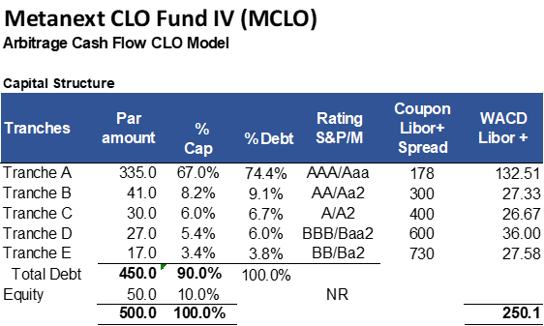
Metanext CLO Fund IV – Case Study
Metanext CLO Fund IV (MCLO) has raised $500 million to set up their fourth CLO.
$450 million debt - four tranches - weighted average cost of debt: SOFR + 2.5% (S+2.5%).
$50 million Equity
The loan portfolio returns on average SOFR + 5.0% (S+5.0%)
Management Fee: 0.5%
$11.5 million net income - 23% ROE ($11.5 mm/$50 mm) before any portfolio losses.

Slide 11
Metanext CLO Fund IV – Case Study
Metanext CLO Fund IV (MCLO) shows capitalization of of
  Tranche A - $335mm @ S+178
  Tranche B - $41mm @ S+300
  Tranche C – $30mm @ S+400
  Tranche D – $27mm @ S+600
  Tranche E - $17mm @ S+730

Slide 12
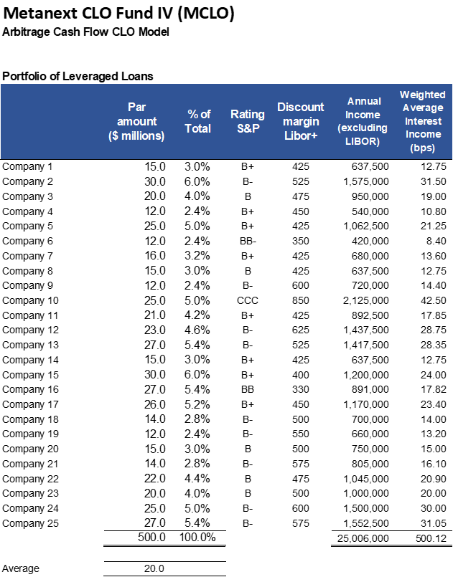
Metanext CLO Fund IV – Case Study
Metanext CLO Fund IV (MCLO) shows a purchase of
  25 loans at an average of
  $20 million per loan,
  generating 500 basis points or 5%
  $500-million portfolio.

Slide 13
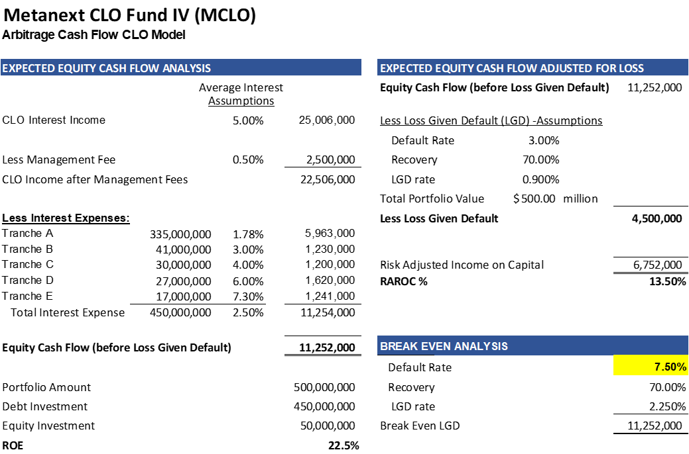
Metanext CLO Fund IV – Case Study
Metanext CLO Fund IV (MCLO)
  Net income generated form the Metanext CLO Fund IV of $11.2 million after interest payments and management fees - 22.5% (ROE)
  Default Assumption – 3%
  recovery rates of 70%, yielding a loss-given default (LGD) of 0.9% of $500 million - $4.5 million
  RAROC - $6,752,000 = 13.5%

Slide 14
Other Portfolio Structures – BDCs
Business Development Companies (BDCs):
A business development company (BDC) is a non-bank financial institution, that invests in a variety of loan types, such as asset-based loans (ABLs), commercial finance, and leveraged loans.
To qualify as a BDC, it must be registered in compliance with Section 54 of the Investment Company Act of 1940.
The BDC structure is a tax pass-through vehicle, similar to REITs (Real Estate Investment Trusts).
The first BDC was Allied Capital, based in Washington DC and now defunct.
Many financial institutions are set up to have both CLOs and BDC structures. A major difference between a BDC and a CLO fund is that BDCs allow smaller, non-accredited investors to invest in these funds.
The other difference is that BDCs have a maximum leverage of 1:1 equity and debt. Due to lower leverage than CLOs, many BDCs invest in junior debt that carries higher yields.
Closed-end funds that make investments in middle-market companies as distinct from the CLOs which invest in more broadly syndicated loans and primarily leveraged loans.
BDCs provide the investors with exposure to debt and equity investments in predominantly privately owned companies.
Because BDCs are regulated investment companies, they must distribute over 90% of their profits to shareholders, which results in above-average dividend yields.

Slide 15
Other Portfolio Structures:
Bank Loan Funds
Bank loan funds (BLFs) are closed-end funds that trade leveraged loans.
BLFs are sometimes called floating rate funds because the loans in these funds are SOFR or prime rate based on floating rate loans.
Trade based on the market value of the individual loans that create BLFs’ net asset value and are structured like CLOs except they provide daily information such as liquidity and diversification across borrowers and industries.
Market values may fluctuate based on individual loan and industry performance.
Loans in the BLFs may be repaid without penalty at any time, creating prepayment risk for investors, as the expected income stream can end before the stated maturity.
Prepayment may be caused by an upgrade of the rating of the borrower, a declining interest rate environment, and favorable market conditions.

Slide 16
Bank Loans Asset Class:
Why invest in Bank Loans
The leveraged loan asset class has been relatively attractive for many portfolio managers due to the following investment characteristics:
1. Insulation from interest rate risk: Both the revenues and cost of the CLO are based on floating rate interest (LIBOR based) that is reset at least every 90 days, so even if the interest rate rises for the CLO’s loan obligations, the rates will also rise at the same level for the individual portfolio of companies, enabling natural arbitrage for the CLO manager.
2. Low price volatility: In general, leverage loans experience reduced volatility resulting from a low correlation and covariance with other assets. The floating rate nature of leveraged loans contributes to its low correlation with other security types. Only short-term treasury bills (considered risk free) consistently exhibit lower volatility.
3. Defensive strategy: Senior loan funds have historically provided consistent, higher risk–adjusted returns compared to other asset classes, which may make them attractive to investors during volatile markets

Slide 17
The LSTA, in conjunction with Standard & Poor’s Leveraged Commentary & Data (LCD), has developed a LevFin index as a benchmark representing a weighted average of the 100 largest loan facilities. The index, S&P/LSTA Index is a total return index of the leverage loans.
Loan portfolio managers use this as a benchmark to compare the portfolio performance and other asset class to the market.

Slide 18
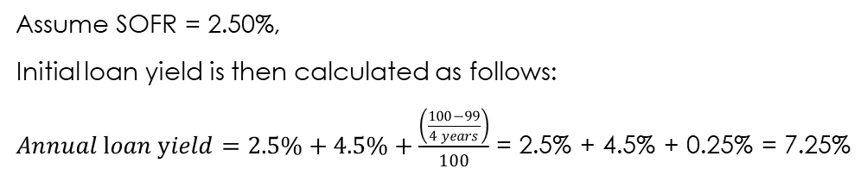
Portfolio Pricing and Valuation
“The term loan B price is set at SOFR + 4.5% at 99.0 OID and is now free to trade.”
LGD = Expected Portfolio Default Rates (Pd)* (1-Recovery Rate (r))
LGD = 3.0% x (1 – 0.70) = 0.9%.
Loan Sales and Trading Association (LSTA):
  Annual loan yield = LIBOR + spread + (((100-OID)/(4 years)))/100
convention based on 4 years’ average loan life
Assume SOFR = 2.50%,
Initial loan yield is then calculated as follows:
$Annual loan yield=2.5\%+4.5\%+\frac{\left(\frac{100−99}{4 years}\right)}{100}$ = 2.5% + 4.5% + 0.25% = 7.25%

Slide 19
Loan Portfolio Monitoring, CECL, FASB PCL and ACL
Unlike the CLO manager that manages its portfolio of loan loans guided by the credit rating, traditional banks that are regulated need to frequently monitor their portfolio of loans and report their status to the various authorities. In 2016, the Financial Accounting Standards Board (FASB) issued a new standard for banks to estimate current period allowances for credit losses in their portfolio (ACL, a balance sheet contra asset) as well as the methodology for establishing the current provision for credit losses (PCL, an income statement expense to accrue any expected changes in the balance sheet ACL of the overall credit portfolio). The new FASB standard is known as current expected credit loss (CECL) directive.
Two approaches to loan loss provisioning under CECL, PCL and ACL:
Weighted Average Remaining Maturity (WARM): WARM applies an historical experience of losses to a portfolio of similar loans, with similar characteristics. Often used for homogeneous large volume credit exposure, such as mortgages, auto receivables and credit card debt.
Loan-level Specific Reserves: Because the use of new technologies using artificial intelligence and machine learning can be applied efficiently, automatically, and inexpensively across a portfolio of individual loans, this textbook recommends incorporating the CECL requirements into the AMMR function of each borrower loan at the outset. CECL mandates that loans be evaluated based on:
(i) historical experience,
(ii) current conditions, and
(iii) reasonable and supportable forecasts.

Slide 20
Loan Level Credit Risk Management - AMMR
Asset Management Monitoring and Reporting – AMMR – “Inspect what you Expect”
AMMR Protocol Design – directly relates to financial forecast, structure and covenants of the loans
Forecasts
DSCR and Leverage Tests, along with other Compliance Covenants, along with testing frequency
Reporting Requirements:
Financial Statements – audit, quarterly, tax, unit level, etc
Borrowing Base Certificates
Bank reconciliations
Compliance certificates – financial and regulatory, environmental and human resources (OSHA, EPA, ESG, etc.), and all operational licensing and permitting, construction schedules, etc.
Plan v Budget variance analysis
Use of third-party experts – ABL (inventory and AR audits), construction and engineering monitoring, environmental

Slide 21
Structural Risk Mitigation – Ratio Analysis

Slide 22
Loan Level Credit Risk Management - Derivatives
Interest rate Swaps:
Reduces interest rate risk, by fixing a floating rate loan – banks generally lend floating rate, unless using term securitization for loans like mortgages, equipment loans and other structured products
First Interest Rate Swap – 1980s
International Swap Dealers Association (originally the Primary Dealer – of US Treasuries) – Solomon Bros, Citi, & BofA
Generally, investment grade (IG) counter parties
Often resulting from credit market arbitrage – e.g Xerox – first cross border money market swap
  Xerox, previously limited issues in Europe
  Investment grade credit, substantial European floating rate appetite from lenders
  Swapped into Yen, oil and back to USD – T-250bps
Borrower Initiated - agrees to pay another party a fixed rate in return for receiving an offsetting floating rate
  Only the base rate is remitted between parties (plus a swap spread)
  Based on the notional principal

Slide 23
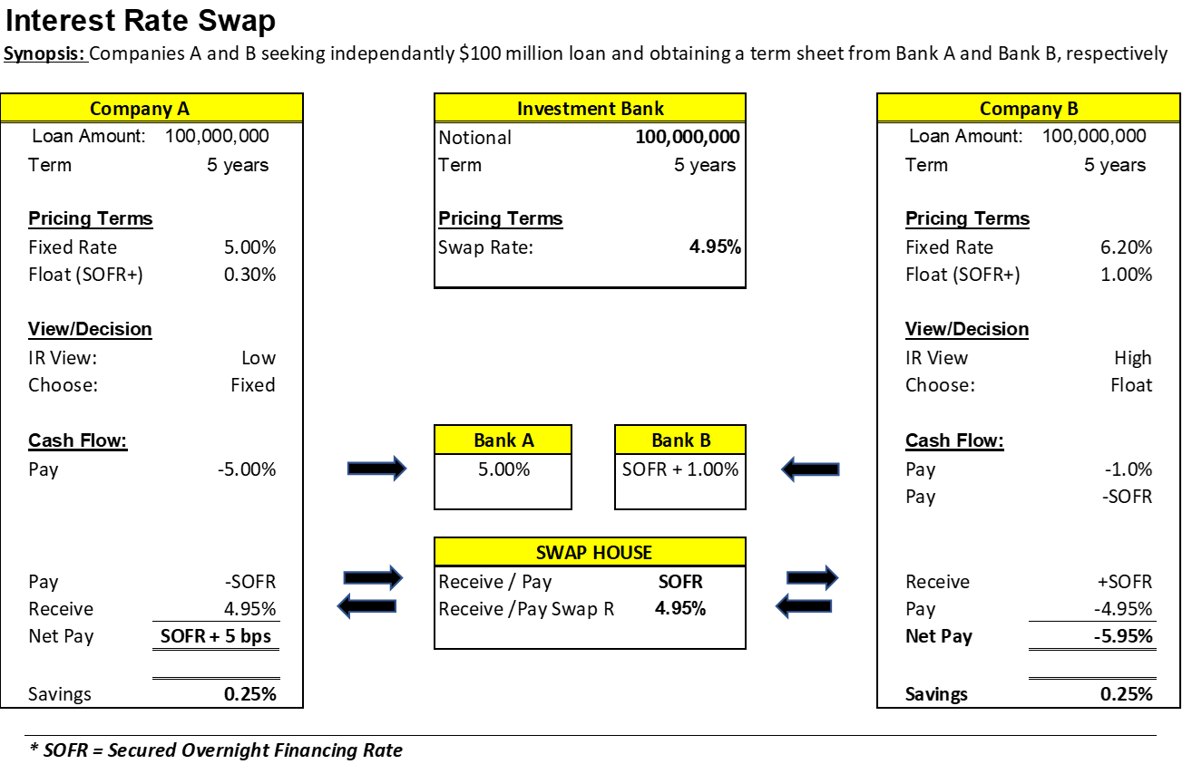
Structural Risk Mitigation – Interest Rate Swap

Slide 24
Loan Level Credit Risk Management - Derivatives
Credit Default Swaps:
An insurance product used to mitigate any loss resulting from default (LGD), regulated by ISDA
First CDS – JP Morgan, 1994 Exxon Valdez Disaster - $4.8B
Lender initiated – seeks default insurance, two types
  Change in credit quality
  Loss Given default
Insurance contract based on notional principal (say $100 million)
Annual premium is paid between lender and counter party (usually another investment grade lender) – similar cost to credit spread of borrower – can represent arbitrage opportunity, default can add risk (e.g. GFC)
  P = Premium per Payment Period = Risk Spread per annum / Payment Frequency
  N = Notional Principal = Face Value of the Loan subject to the Risk
  R = recovery rate (in percentage of Notional Principal) * Notional Principal = r * N

Slide 25
Loan Level Credit Risk Management - Derivatives

