Slide 1
Secondary Markets: Stock Investments and Valuation
Chapter 10
“An Analytical Approach to Investments, Finance and Credit”

Slide 2
Trading Stocks: An Overview
Buying and selling stock is probably the most common activity for an individual that started for the first time to invest. It is after all an investment that triggers anyone’s curiosity and excitement.
Buying a share of common stock in a firm represents getting ownership interest in that firm. Other class of ownership could be preferred stock. Preferred stock has priority over the claims of common stock.
The most common question of someone is looking to invest is “what company you think I should invest in”. Everyone has the basic understanding that if they buy the stock of a company today, they assume that the value of such stock will go up based on their success of business.
Investing in companies that have good business or a good product is expected but the most sophisticated investors add a few other criteria before they make such recommendation. These would include the risk I am taking or how long to hold such stock and how this stock is performing against a risk-free investment or how is this stock performing against the overall market. All these questions need to be addressed by the professionals when recommending a stock.

Slide 3
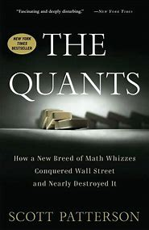
Author’s Notes
A great book to read is Scott Patterson’s (2010) The Quants: How a New Breed of Math Whizzes Conquered Wall Street and Nearly Destroyed It. It’s fun to read and it covers many of the investment concepts described here, such as the capital asset pricing model (CAPM), the formula that analysts use to set their return expectation on a stock while adjusting for the market beta. The book discusses, using a lot of humor, four math geniuses called the quants that set up quantitative funds aimed at taking advantage of inefficiencies in the equity markets: Peter Muller, a mathematician; Ken Griffin, the founder of Citadel investments; Cliff Asness, the founder of AQR Capital Management; and Boaz Weinstein, chess master and card counter who traded derivatives at Deutsche Bank.
The moral to this story is that even though many investors are seeking mathematical methods to take advantage of the stock market, we often find investors fall back to the Warren Buffet approach. Whatever your approach for picking the right stock, at the end of the day, after many lessons I learned for years as a banker, it’s easier to pick a stock of company that had good products and services. It’s much easier to defend your investment than trying to explain why your bitcoin investment did not do well.

Slide 4
Secondary Trading Markets: An Overview
Exchange markets: National exchanges serve a broad base of investors and require that the stock of traded companies meet certain standards called listing requirements:
  New York Stock Exchange (NYSE)
  NASDAQ
Electronic Communications Network (ECN) – Third Market: Thinly traded stocks with lower transaction costs and all of the unfilled orders are available for review.
Alternative Trading Systems (ATSs) and Dark Pools (Fourth Market)

Slide 5
Secondary Trading Markets: Mutual Funds/ETF
Mutual Funds: a pool of stocks – trade and settle once a day - higher management fees with no broker commissions.
Exchange Trade Funds: a pool of stocks – trade like stocks with lower management fees that mutual funds. Like stocks, the investor have to pay a broker commission each time they buy or sell shares
Alternative Trading Systems (ATSs) and Dark Pools (Fourth Market)

Slide 6

Indices and Tracking Market Performance
Indices and tracking market performance: A stock market index is a method of measuring the performance of a specific segment of the stock market or economy
  Price weighted - Dow Jones Industrial Average (DJIA)
  $DJIA_{t}=\sum_{i=1}^{30}{\frac{P_{it}}{D}}$
  Capitalization weighted - Standard & Poor’s 500 (S&P 500)
  $Index=\frac{ΣPt.Qt}{D}$

Slide 7
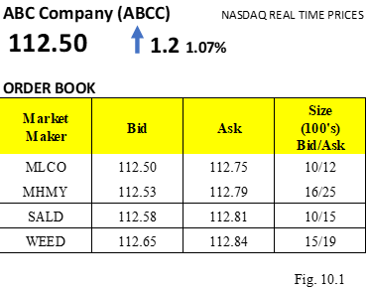
How to Trade Stocks
Types of Orders
  Market Orders: Market orders are BUY or SELL orders that need to be executed immediately at the current market price.
  Limit Orders: Investors may place an order with an instruction to buy or sell at a specific price regardless what the market prices are.
  Stop Order (Stop-Loss Orders or Stop-Buy Orders): A stop order is like a limit order with a condition to buy or sell at a certain price but differing on the mechanics

Slide 8
Types of Markets
Broker Markets
Dealer Markets
The difference between a broker and a dealer is that the dealer can hold his or her own inventory of stocks in addition to brokering the trades.

Slide 9
Trading Strategies
Buying on Margin Strategy:
Buying on margin is when an investor is leveraging the purchase of a company’s stock or borrowing part of the initial investment from a bank or broker

Slide 10
Trading Stock with Dividends and Return
Assume that you buy the stock at $100 and sell it at $120. While you were holding it you received $2 dividend per share. What is your profit and Holding Period Return (HPR%)
Gain on the stock = Sell Price – Purchase Price
Profit = Gain on the stock + Dividend
HPR% = Profit / Purchase Price
Gain on the stock = $120 - $100 = $20
Profit = $20 + $2 = $22
HPR% = $22 / $100 = 22%

Slide 11
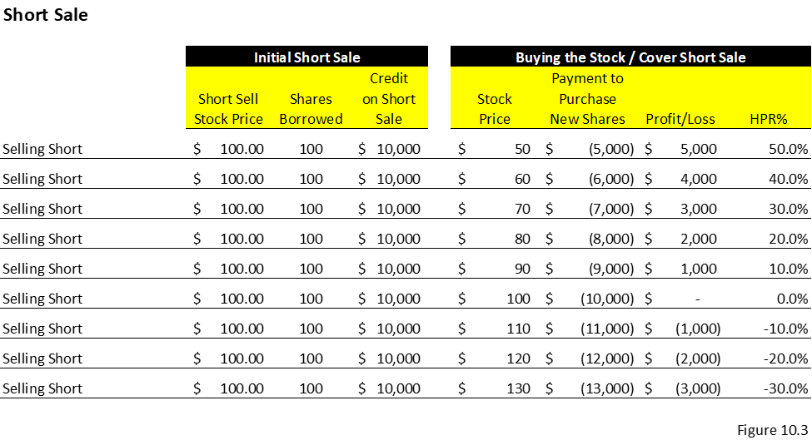
Trading Strategies
Short-Selling Strategy: Short selling is the process where an investor borrows the stock and then sells it immediately at the current price and will profit when the stock price declines
Short Interest Ratio (SIR)
Short Interest to Volume Ratio (Days to cover)

Slide 12
The stockholder is entitled to receive dividends
Dividend Payment Process
Declaration date: This is the date by which the board of directors declares dividends. In their announcement they mention two other dates including the record date and the payable date.
Record date: This is the date the shareholder must register on or before to receive the dividend.
Payable date: This is the date that the dividend is paid to the shareholder on record.
Ex-dividend date: This is the date 2 business days prior to the record date. Any regular way trades of the stock take 3 days to settle (T+3), which will give the official title of the stock

Slide 13
Program Trading Strategies
Algorithmic Trading: Algorithmic trading is based on complex mathematical formulas built on powerful computers. These algebraic formulas are built based on historical stock movements to predict the direction of a given stock.
High-Frequency Trading: High-frequency trading, a subset of algorithmic trading, is a type of trading done by state-of-the-art fast computers. A high-frequency trader makes profits on the bid-ask spread and cross-market arbitrage strategies, even at very small differentials
Dark Pools: Dark pools are trading programs that are set up by large broker-dealers for their clients or for its proprietary traders with the purpose of trading in private.

Slide 14
Stocks move up and down based on many factors
Fundamental (Company Specific) – stocks move up and down based on announced earnings. The stock price as a multiple of earnings per share called “Price Earnings Ratio” (PE). The higher the PE the higher the expectation that the stock will rise – leading indication.
Technical (Market - Systemic and non-systemic)
Behavioral

Slide 15
Stock Analysis
Fundamental Analysis
  Growth, Income, or Value Investing
  Growth Companies and Growth Stocks
  Value Companies and Value Stocks
  Income Companies and Income Stocks
  Defensive Companies and Stocks
  Cyclical Companies and Stocks
  Speculative Companies and Stocks

Slide 16
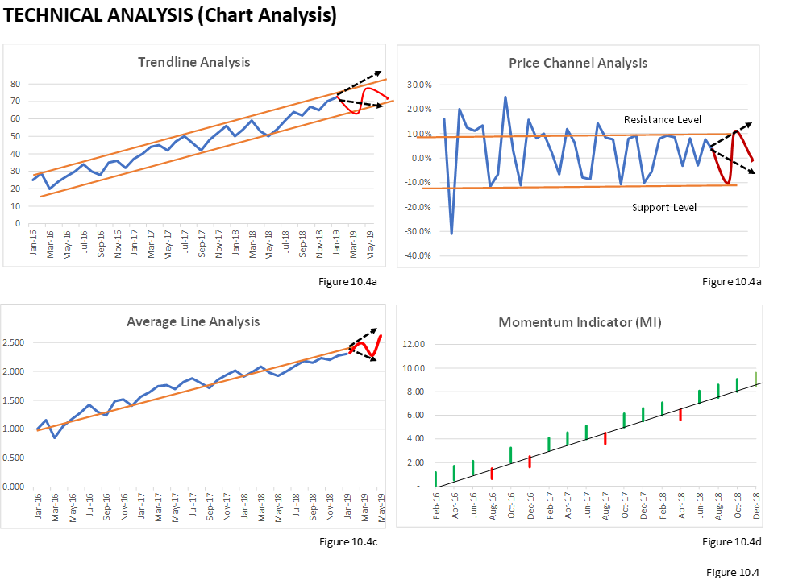

Stock Analysis
Technical Analysis
  Trendline Analysis
  Price Channel
  Average-Line Analysis
  Momentum Indicators Analysis (MI)
  MI= $\frac{close (i)}{close (i−n)} x 100$

Slide 17
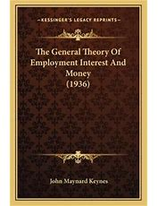
Stock Analysis
Behavioral Finance Analysis
The original passage by Keynes (1936) reads: Even apart from the instability due to speculation, there is the instability due to the characteristic of human nature that a large proportion of our positive activities depend on spontaneous optimism rather than mathematical expectations, whether moral or hedonistic or economic. Most, probably, of our decisions to do something positive, the full consequences of which will be drawn out over many days to come, can only be taken as the result of animal spirits—a spontaneous urge to action rather than inaction, and not as the outcome of a weighted average of quantitative benefits multiplied by quantitative probabilities. (pages161-162)
  Forecasting errors
  Overconfidence
  Conservatism
  Framing
  Mental accounting
  Regret avoidance

Slide 18
Valuation Analysis Overview
The chapter will introduce the following eight methods of valuating the company’s enterprise value:
Method 1: Using the current stock price as a basis of valuation
Method 2: Intrinsic value and capital asset pricing model (CAPM)
Method 3: Dividend discount model (DDM)
Method 4: Comparable method using trading EBITDA multiples
Method 5: Comparable method using acquisition EBITDA multiples
Method 6: Discount cash flow method (DCF)
Method 7: Leveraged buyout private equity expectation model (LBO)
Method 8: Black-Scholes option pricing model

Slide 19
Valuation of Publicly Traded Companies.
Testing the current Stock Price

Slide 20
Methods 1-6: Valuation of Public Traded Companies
Method 1: Using the Stock Price as the Basis of Valuation
  The formula to value the firm or the enterprise value (EV) is as follows:
EV = MVE + D – C
where EV is enterprise value, MVE is the market value of the equity, D is the total debt outstanding, and C is the cash and cash equivalents of the company.
  The stock price that represents the market value of each share when multiplied by the shares outstanding will give us the market value of the equity.
  MVE = (SP . SO)
where MVE is the market value of the equity, SP is the stock price and SO is the shares outstanding.
Bonds/Loans
Mezzanine / Loans
Series A, B, C

Slide 21
Methods 1-6: Valuation of Public Traded Companies
Method 1: Using the Stock Price as the Basis of Valuation
Series A, B, C

Slide 22

Methods 1-6: Valuation of Public Traded Companies
Method 2: Intrinsic Value and CAPM
The expected return is calculated by applying the capital asset pricing model (CAPM):
E_{r} = Rf_{r} + $β$ (M_{r} - Rf_{r})
where E_{r} is the expected return, Rf_{r} is the risk-free rate,$β$is the beta of the company that is analyzed, and M_{r} is market return.
The formula for today’s intrinsic value is
$$v_{0}=\frac{D_{1}+ρ_{1}}{1+k}$$
where D₁ is the dividend expected to receive within a year, P₁ is the expected stock price a year from now, and k is the discount rate or expected rate of return.

Slide 23
Methods 1-6: Valuation of Public Traded Companies
Method 2: Intrinsic Value and CAPM

Slide 24

Methods 1-6: Valuation of Public Traded Companies
Method 3: Dividend Discount Model (DDM) and Gordon Growth Model (GGM) or Perpetuity Valuation Method
To calculate such value using the DDM method, the analyst needs to estimate a growth rate for the company, the expected dividend per share paid for the year, and a discount rate, which derived using the capital asset pricing model (CAPM).
DDM: $V=\frac{D1}{k−g}$
$$GGM: V=\frac{D1 (1+g)}{k−g}$$
where D₁ is the expected dividend, k is the discount rate, and g is the expected growth rate.
Please note that according to the Gordon model, stock value is positively related to the dividend growth rate and negatively related to the required return

Slide 25
Methods 1-6: Valuation of Public Traded Companies
Method 3: Dividend Discount Model (DDM)

Slide 26
Methods 1-6: Valuation of Public Traded Companies
Method 4: Using Comparable Trading EBITDA Multiples

Slide 27
Methods 1-6: Valuation of Public Traded Companies
Method 4: Using Comparable Trading Price Earning (PE) Multiples
Suppose the average industry PE ratio for hotel stocks is 25x. What is the current price of Hyatt stock if the Hyatt per share earnings are projected to be $4.00
Stock Price = P/E x Earnings
Hyatt Stock Price = 25 x 4.00 = $100

Slide 28
Methods 1-6: Valuation of Public Traded Companies
Method 5: Using Comparable Acquisition EBITDA Multiples

Slide 29
Methods 1-6: Valuation of Public Traded Companies
Method 6: Using the Discount Cash Flow Method (DCF)
  To value the company using the DCF method the analyst needs to derive the following four items:
    Setting up a stream of cash flows
    Identifying an exit year
    Calculating the value at exit year (terminal value)
    Using the appropriate discount rate to value the present value of the firm

Slide 30
Methods 1-6: Valuation of Public Traded Companies

Slide 31
Method 7: Using the Leveraged Buyout Model (LBO) Method
While the DCF analysis is used for determining today’s value of the company based on future cash flows, the value of the company using this LBO method is determined based on investor expectation, which means return determines the acquisition price of the firm.
  Building the Transactions Sources and Uses
  Setting up the Debt Schedules
  Calculating the Expected Equity Return
  Running Projections
  Determining the Terminal Value
  Determining the Value of the Firm

Slide 32
Method 7: Using the Leveraged Buyout Model (LBO) Method

Slide 33
Method 7: Using the Leveraged Buyout Model (LBO) Method

Slide 34
Methods 1-7 - Summary:
  Putting All the Values Together

Slide 35
Method 6: Discount Cash Flow Method (DCF)
One of the most effective ways to value a private company is to dive into the company’s projections and change the assumptions based on the investor’s view of how the revenue will grow and at what cost.
Since there is no stock price that trades, which gives the investor a direct indication of what the company is worth (market value), an important method used by professionals is the discount cash flow (DCF) method, which measures the company’s intrinsic value.
The conduction of this method is to calculate the first the equity cash flows, identify the exit year, estimate the terminal value in the exit year, and use the expected equity return as the discount rate.

Slide 36
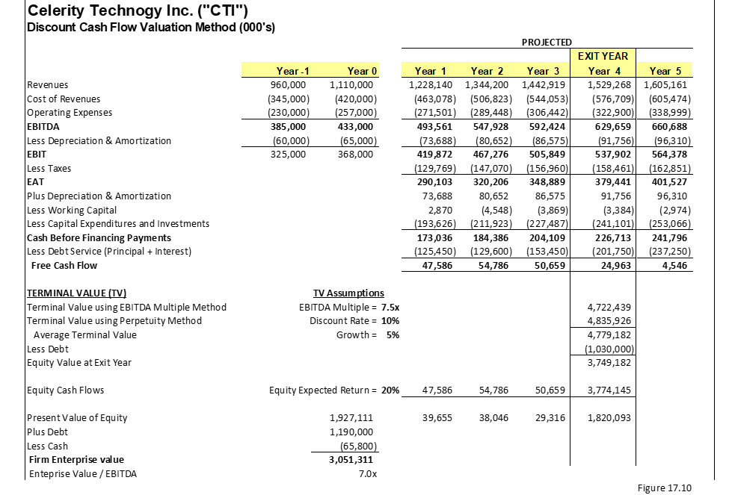
Valuation Analysis – Celerity Technology Inc

Slide 37
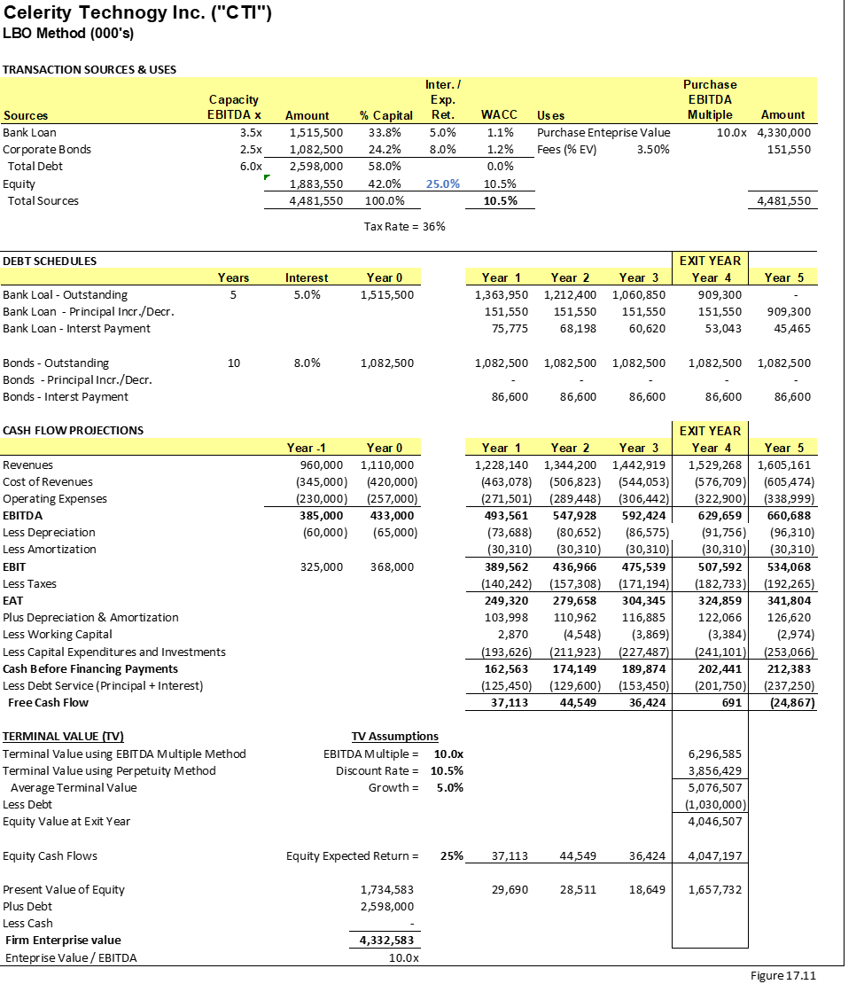
Method 7: Leveraged Buyout (LBO) Method for Private Companies

Slide 38
Method 8: Valuation of Distress Firms
Option Pricing Model Framework
  In option pricing and specifically in call options the payoff formula or intrinsic value of the option is
Option payoff = Max (0, S – X)
where S is the stock price and X is the exercise price.
  To calculate the enterprise value
EV = E + D – C or EV = E + net D
where EV is the enterprise value of the firm, E is the equity value, D is the debt and C is cash. The net D is referred to as debt minus cash implied that the current debt could be paid with cash on hand.
  Solving for equity:
E = EV – net D
where E is the equity, EV is the enterprise value and net D is the net debt.

Slide 39

Method 8: Valuation of Distress Firms
Option Pricing Model Framework
  The Black-Scholes formula is
    $$C option payoff=Se^{−δ.t} .N \left(d1\right)−Xe^{−i.t}.N (d2)$$
  where S is the stock price, δ is the dividend yield, t is time until expiration, X is the option exercise price, i is the risk-free interest rate, and N is the normal distribution.
$d1=\frac{\left[\ln\left(\frac{S}{X}\right)+\left( i−δ+\frac{σ^{2}}{2}\right).t\right]}{σ√t}$ and $d2=d1− σ√t$
where S is the current stock price, X is the contractual exercise price, i is the risk-free interest rate, δ is the dividend yield, σ is the standard deviation, and t is time to expiration.

Slide 40
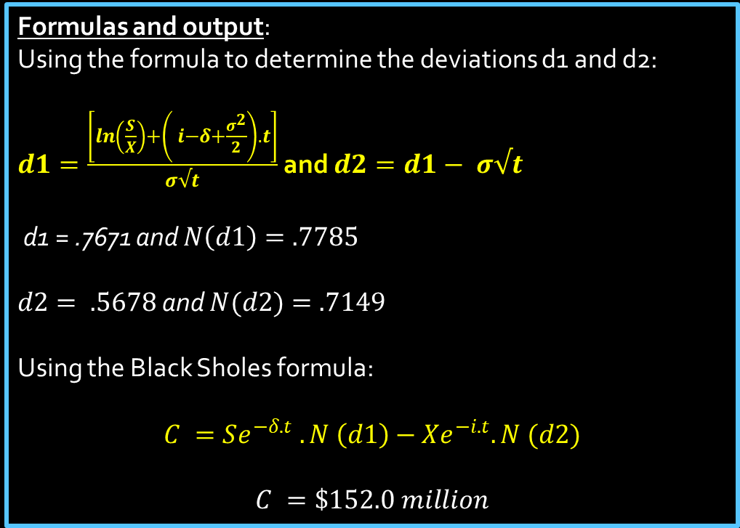
Method 8: Valuation of Distress Firms
  Input:
    S = Value of the firm = $1 billion
    X = Exercise price = debt value = $1,200 million
    σ = Standard deviation of the asset = 20%
    t = Time = term of the bond = 5 years
    i = Risk-free rate = 3%
    δ = Dividends = cash flow paying the equity = $0
    C = Equity value = E =?
Formulas and output:
Using the formula to determine the deviations d1 and d2:
$d1=\frac{\left[\ln\left(\frac{S}{X}\right)+\left( i−δ+\frac{σ^{2}}{2}\right).t\right]}{σ√t}$ and $d2=d1− σ√t$
d1 = .7671 and $N\left(d1\right)=.7785$
$d2= .5678$ and $N(d2)=.7149$
Using the Black Sholes formula:
$$C =Se^{−δ.t} .N \left(d1\right)−Xe^{−i.t}.N (d2)$$
$$C =\$152.0 million$$

Slide 41
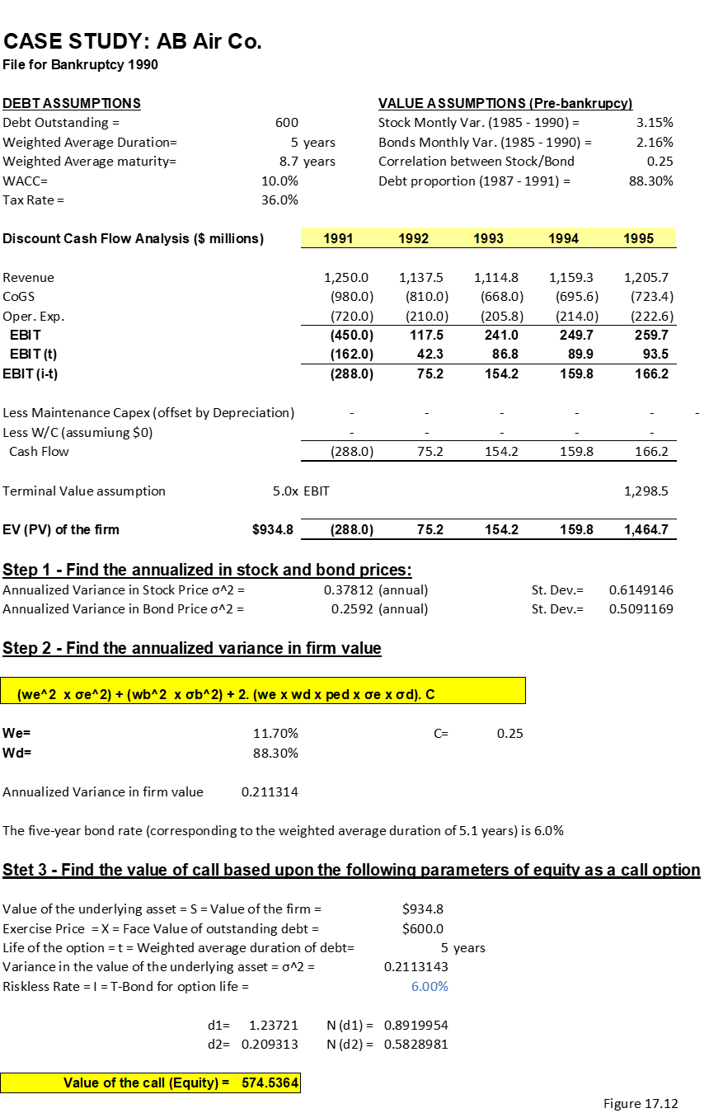
Valuation Analysis of Distress Company – AB Air Co.

