Slide 1
Chapter 17
Macroeconomic and Industry Analysis
INVESTMENTS | BODIE, KANE, MARCUS
© McGraw-Hill Education. All rights reserved. Authorized only for instructor use in the classroom. No reproduction or further distribution permitted without the prior written consent of McGraw-Hill Education.

Slide 2
Fundamental Analysis
Intrinsic value comes from its earnings prospects determined by:
The global economic environment
Economic factors affecting the firm’s industry
The position of the firm within its industry

Slide 3
The Global Economy (1 of 2)
International economy affects firm prospects
Performance in countries and regions can be highly variable
Harder for businesses to succeed in contracting economies than in expanding ones

Slide 4
The Global Economy (2 of 2)
Political risk:
Greek and Spanish economies
U.S. fiscal cliff
Exchange rate risk:
Changes the prices of imports and exports
Honda manufacturing in North America

Slide 5
Economic Performance (1 of 2)
Table 17.1 Economic Performance
 | Stock Market Return, 2015 (%) In Local Currency | Stock Market Return, 2015 (%) In U.S. Dollars | Forecasted Growth in GDP, 2016 (%)
Brazil | -12.7 | -40.0 | -1.9
Britain | -3.8 | -8.8 | 2.2
Canada | -9.5 | -24.3 | 1.9
China | 10.1 | 5.3 | 6.4
France | 10.0 | -0.8 | 1.3
Germany | 10.8 | -0.2 | 1.7
Greece | -25.3 | -32.6 | 2.2
Hong Kong | -6.8 | -6.7 | 2.1
India | -5.2 | -9.9 | 7.6
Italy | 13.0 | 2.7 | 1.3
Japan | 8.8 | 8.2 | 1.2

Slide 6
Economic Performance (2 of 2)
 | Stock Market Return, 2015 (%) In Local Currency | Stock Market Return, 2015 (%) In U.S. Dollars | Forecasted Growth in GDP, 2016 (%)
Mexico | 0.6 | -13.9 | 2.8
Russia | 17.0 | -2.7 | -0.3
Singapore | -14.2 | -19.6 | 3.0
South Korea | 2.6 | -3.5 | 2.7
Spain | -6.2 | -15.4 | 2.7
Thailand | -14.3 | -21.9 | 4.0
U.S | -0.6 | -0.6 | 2.5
Source: The Economist, January 2, 2016.

Slide 7
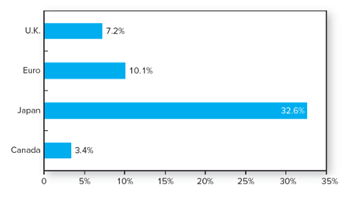
Exchange Rate Changes
Figure 17.1 Change in real exchange rate: U.S. dollar versus major currencies, 2003-2015
Source: Author’s calculations using data from OECD.

Slide 8
The Domestic Macro economy
Stock prices rise with earnings
P/E ratios are normal range: 12-25
Forecasting the performance of the broad market begins with an assessment of the economy as a whole

Slide 9
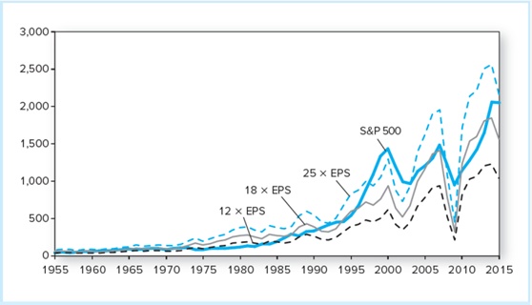
S&P 500 Index versus Earnings Per Share
Figure 17.2 S&P 500 index versus earnings per share
Source: Author’s calculations using data from The Economic Report of the President.

Slide 10
The Domestic Macro economy: Key Variables
Gross domestic product
Unemployment rates
Inflation
Interest rates
Budget deficit
Sentiment

Slide 11
Demand and Supply Shocks
Demand shock | Supply shock
An event that affects demand for goods and services in the economy | An event that influences production capacity or production costs

Slide 12
Demand-side Policy
Fiscal policy —
Monetary policy —
Notes:
Fiscal policy – the government’s spending and taxing actions
Monetary policy – manipulation of the money supply

Slide 13
Fiscal Policy (1 of 2)
Most direct way to stimulate or slow the economy
Formulation of fiscal policy is often a slow, cumbersome political process

Slide 14
Fiscal Policy (2 of 2)
The net effect of fiscal policy:
Budget surplus or deficit
Deficit stimulates the economy because:
Spending increases demand for goods > increased taxes reduces the demand for goods

Slide 15
Monetary Policy (1 of 2)
Money supply manipulation → to influence economic activity
Increasing the money supply lowers interest rates → stimulates the economy
Less immediate effect than fiscal policy

Slide 16
Monetary Policy (2 of 2)
Tools of monetary policy:
Open market operations
Discount rate
Reserve requirements

Slide 17
Supply-Side Policies
Creates an environment in which workers and owners of capital have the maximum incentive and means to produce and develop goods
Supply-siders focus on how tax policy can improve incentives to work and invest

Slide 18
Business Cycles
The transition points across cycles are called peaks and troughs
Peak:
Trough:
Notes:
Peak: the transition from the end of an expansion to the start of a contraction.
Trough: occurs at the bottom of a recession just as the economy enters a recovery.

Slide 19
The Business Cycle
Cyclical Industries | Defensive Industries
Above-average sensitivity to the state of the economy | Little sensitivity to the business cycle
Examples: Consumer durables Capital goods | Examples: Food producers and processors Pharmaceutical firms, Public utilities
High betas | Low betas

Slide 20
Economic Indicators (1 of 4)
Leading indicators:
Coincident indicators:
Lagging indicators:
Notes:
Leading indicators: tend to rise and fall in advance of the economy.
Coincident indicators: move with the market.
Lagging indicators: change subsequent to market movements.

Slide 21
Economic Indicators (2 of 4)
Table 17.2 Indexes of Economic Indicators
Leading Indicators
Average weekly hours of production workers (manufacturing)
Initial claims for unemployment insurance
Manufacturers' new orders (consumer goods and materials industries)
Institute of Supply Management's "Index of New Orders"
New orders for nondefense capital goods
New private housing units authorized by local building permits

Slide 22
Economic Indicators (3 of 4)
Yield curve slope: 10-year Treasury minus federal funds rate
Stock prices, 500 common stocks
Leading index of credit market conditions
Index of consumer expectations for business conditions
Coincident Indicators
Employees on nonagricultural payrolls
Personal income less transfer payments
Industrial production
Manufacturing and trade sales

Slide 23
Economic Indicators (4 of 4)
Lagging Indicators
Average duration of unemployment
Ratio of trade inventories to sales
Change in index of labor cost per unit of output
Average prime rate charged by banks
Commercial and industrial loans outstanding
Ratio of consumer installment credit outstanding to personal income
Change in consumer price index for services
Source: The Conference Board, Business Cycle Indicators, June 2016.

Slide 24
Indexes of Leading, Coincident, and Lagging Indicators (1 of 3)
Index of Leading Indicators

Slide 25
Indexes of Leading, Coincident, and Lagging Indicators (2 of 3)
Index of Coincident Indicators

Slide 26
Indexes of Leading, Coincident, and Lagging Indicators (3 of 3)
Index of Lagging Indicators

Slide 27
Economic Calendar (1 of 2)
Many sources, such as The Wall Street Journal and Yahoo! Finance, publish the public announcement dates of various economic statistics
Date | Time (ET) | Statistic | For | Actual | Briefing Forecast | Market Expects | Prior | Revised From
June 14 | 8:30 AM | Export prices | May | 1.0% | NA | NA | 0.4% | 0.5%
June 14 | 8:30 AM | Retail sales | May | 0.5% | 0.4% | 0.3% | 1.3% | ─
June 14 | 10:00 AM | Business inventories | Apr | 0.1% | 0.3% | 0.2% | 0.3% | 0.4%
June 15 | 8:30 AM | PPI | May | 0.4% | 0.4% | 0.3% | 0.2% | ─
June 15 | 8:30 AM | Empire manufacturing | June | 6.0 | -4.0 | -1.6 | -9.0 | ─
June 15 | 9:15 AM | Industrial production | May | -0.4% | -0.4% | -0.1% | 0.6% | 0.7%
June 15 | 9:15 AM | Capacity utilization | May | 74.9% | 75.1% | 75.2% | 75.3% | 75.4%
June 16 | 8:30 AM | CPI | May | 0.2% | 0.3% | 0.3% | 0.4% | ─

Slide 28
Economic Calendar (2 of 2)
Date | Time (ET) | Statistic | For | Actual | Briefing Forecast | Market Expects | Prior | Revised From
June 16 | 8:30 AM | Continuing claims | 06/04 | 2157K | NA | NA | 2112K | 2095K
June 16 | 8:30 AM | Current account balance | Q1 | -$124.8B | -$124.8B | -$125.4B | -$113.4B | -$125.3B
June 17 | 8:30 AM | Housing starts | May | 1164K | 1150K | 1150K | 1167K | 1172K
June 17 | 8:30 AM | Building permits | May | 1138K | 1144K | 1150K | 1130K | 1116K
Figure 17.4 Economic Calendar at yahoo!, week of June 14, 2016
Source: yahoo!, Finance, Earnings Calendar, biz.yahoo.com, June 20, 2016.

Slide 29
Industry Analysis
Similar to an ailing macro economy, it is unusual for a firm in a troubled industry to perform well
Economic performance can vary widely across industries

Slide 30
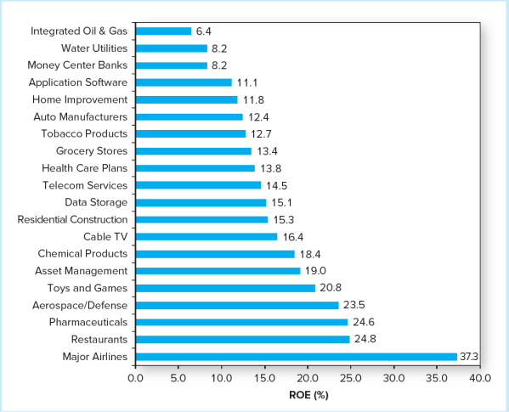
Return on Equity, 2015-2016

Slide 31
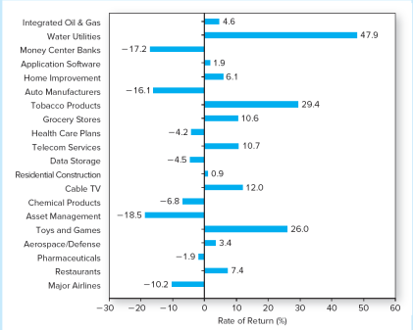
Industry Stock Price Performance, 2012 vs. 2016

Slide 32
Defining an Industry
North American Industry Classification System, or NAICS codes
Firms with the same four-digit NAICS codes are commonly taken to be in the same industry

Slide 33
Table 17.5 Examples of NAICS Industry Codes
NAICS Code | NAICS Title
23 | Construction
236 | Construction of Buildings
2361 | Residential Building Construction
23611 | Residential Building Construction
236115 | New Single-Family Housing Construction
236116 | New Multifamily Housing Construction
236118 | Residential Remodelers
2362 | Nonresidential Building Construction
23621 | Industrial Building Construction
23622 | Commercial and Institutional Building Construction

Slide 34
Sensitivity to the Business Cycle (1 of 3)
Three factors determine a firm’s sensitivity to the business cycle:
Sensitivity of sales
Necessities vs. discretionary goods
Items that are not sensitive to income levels (such as tobacco and movies) vs. items that are, (such as machine tools, steel, autos)

Slide 35
Sensitivity to the Business Cycle (2 of 3)
Operating leverage
Firms with low operating leverage (less fixed assets) are less sensitive to business conditions
Firms with high operating leverage (more fixed assets) are more sensitive to the business cycle
Notes:
Operating leverage : the split between fixed and variable costs

Slide 36
Sensitivity to the Business Cycle (3 of 3)
Financial leverage
Interest is a fixed cost that increases the sensitivity of profits to the business cycle
Notes:
Financial leverage: the use of borrowing

Slide 37
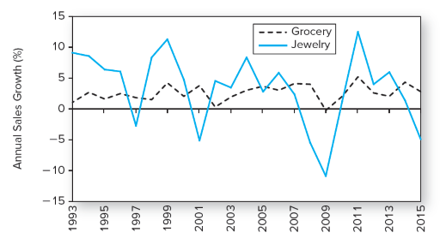
Industry Cyclicality
Figure 17.8 Industry cyclicality: Growth of sales, year over year, in two industries; sales of jewelry show much greater variation than sales of groceries

Slide 38
Operating Leverage of Firms A and B Throughout the Business Cycle
Firm A: Low Fixed Costs
Firm B: High Fixed Costs
 | (Recession) A | (Recession) B | (Normal) A | (Normal) B | (Expansion) A | (Expansion) B
Sales (million units) | 5 | 5 | 6 | 6 | 7 | 7
Price per units | $ 2 | $ 2 | $ 2 | $ 2 | $ 2 | $ 2
Revenue ($ million) | 10 | 10 | 12 | 12 | 14 | 14
Fixed costs ($ million) | 5 | 8 | 5 | 8 | 5 | 8
Variable costs (($ million) | 5 | 2.5 | 6 | 3 | 7 | 3.5
Total costs ($ million) | $10 | $10.5 | $11 | $11 | $12 | $11.5
Profits | $ 0 | $ (0.5) | $ 1 | $ 1 | $ 2 | $ 2.5

Slide 39
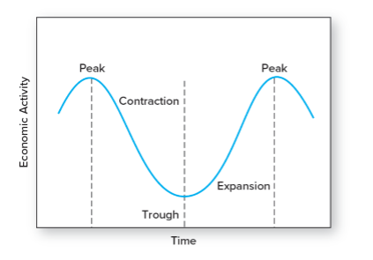
A Stylized Depiction of the Business Cycle

Slide 40
Sector Rotation (1 of 3)
Portfolio is shifted into industries or sectors that should outperform, according to the stage of the business cycle

Slide 41
Sector Rotation (2 of 3)
Peaks — natural resource extraction firms
Contraction — defensive industries such as pharmaceuticals and food
Trough — capital goods industries
Expansion — cyclical industries such as consumer durables

Slide 42
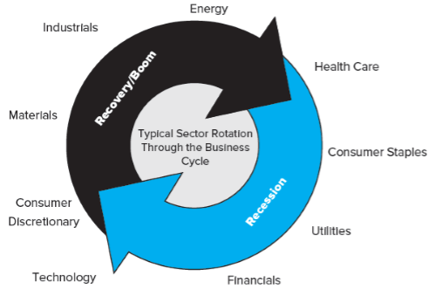
Sector Rotation (3 of 3)
Figure 17.10 Sector rotation
Source: Sam Stovall, BusinessWeek online, “A Cyclical Take on Performance.”

Slide 43
Industry Life Cycles (1 of 2)
Stage
Start-up
Consolidation
Maturity
Relative Decline
Sales Growth
Rapid and increasing
Stable
Slowing
Minimal or negative

Slide 44
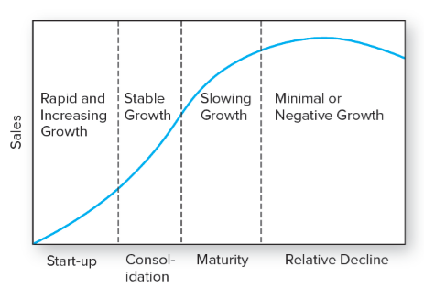
The Industry Life Cycle

Slide 45
Industry Structure and Performance: Five Determinants of Competition
Threat of entry
Rivalry between existing competitors
Pressure from substitute products
Bargaining power of buyers
Bargaining power of suppliers

Slide 46
End of Presentation

